Slide 1
CPO Training for IQA staff
UL de ARGENTINA
Argentina Energy Efficiency Scheme
July 2016

Slide 2
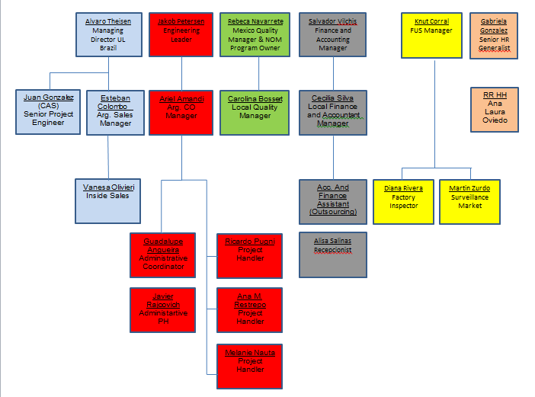
UL de Argentina SRL
Av. Alicia Moreau de Justo 550 – 1st Floor, Office 24 – Buenos Aires, Argentina

Slide 3
Scope
Argentina Energy Efficiency Scheme (Resolution 319/99)
Regulator from Government: Secretary of Commerce
Resolution 508/2015 - Mandatory certification for Safety in Electrical Products.
Resolution 896/99 - Mandatory certification for Personal Protective Equipment.
Resolution 319/99 - Mandatory certification for Energy Efficiency and labelling for specific Electrical Products.
Certification bodies that take part in this mandatory system must be OAA Accredited according to ISO/IEC 17065, and Recognized by the National Government.
Resolution 319/99 and annexes:
Electrical equipment for domestic use in the scope of this Resolution can only be marketed within the national Argentinean territory with a label showing the energy efficiency, noise level and the rest of related characteristics, along with user manual, according to the corresponding IRAM standard.
Scope:
-Refrigerators and freezers -Air Conditioners
-Washing machines/Dryers -Televisions & Monitors
-Lamps -Ballasts

Slide 4

Resolution 319/99
Local manufacturers and importers shall certify the compliance with the corresponding IRAM standard by means of a Certification under Mark of Comformity-System 5 (ISO 17067).
EE UL-AR Scheme
Type testing + Factory Inspection + Periodical control on products
The certification covers the series production of the product.
Annual factory inspection required.
The Argentina Safety mark (S Mark) IS NOT PLACED on products. Only the proprietary logo of the accredited certification organization can be shown:.
Products are subject to periodical surveillance testing.
-Products requiring EE certification shall obtain previously Safety certification (S Mark)-

Slide 5
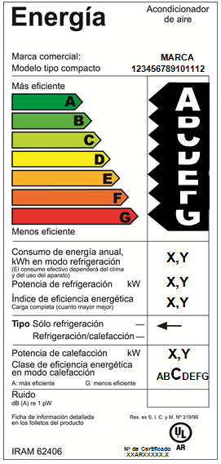
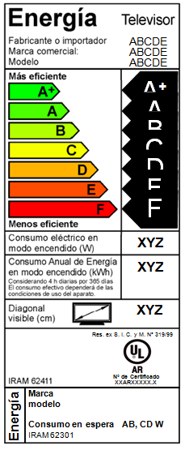
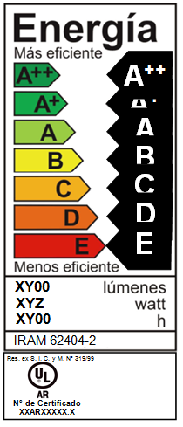
Label examples:

Slide 6
Surveillance:
Regulation specifies a Surveillance procedure per kind of product.
All of them require to complete a new full-testing evaluation every year, on the samples required in each case.

Slide 7
Inclusion of Energy Efficiency in UL de Argentina Quality System
According to ISO/IEC 17065 – In Spanish
Most of documents and SOPs are shared with S Mark Scheme.
-Certification Agreement Annex to 700 Agreement, covering only ULAR Mark.
-Non-discriminatory conditions, Publicly available information, Directory of certified products 40-CA-C0851
-Application EE Certification Procedure 40-CA-S0851; Application form 40-IC-F0029
-Application review EE Certification Procedure 40-CA-S0851;
-Evaluation EE Certification Procedure 40-CA-S0851; Amendments procedure 40-CA-
S0042; Factory Inspections procedure 40-GI-S0027.

Slide 8
Inclusion of Energy Efficiency in UL de Argentina Quality System
-Review EE Certification Procedure 40-CA-S0851; Amendments procedure 40-CA-
S0042
-Certification decision EE Certification Procedure 40-CA-S0851; Amendments procedure 40-CA-S0042
-Certification documentation Certificate Template 40-CA-E0025 + EE Label image,
Certificate Contents: EE Certification Procedure
40-CA-S0851
-Surveillance EE Certification Procedure 40-CA-S0851; Factory Inspections procedure 40-GI-S0027

