Slide 1
Internal Compliance Audit – Closing Meeting
UL International Polska S.P Z O.O.
September 16th 2022

Slide 2
Agenda:
Audit Scope
Technical Audits in Compliance Audit Process
Objectives and Focus Areas
Executive Summary
Risks and Raised Concerns
Recommended Improvement Roadmap and Next Steps
Assessment Team:
Lead Auditor: Michelle Howell
Auditors: Grainne Cheevers,
Przemyslaw Zaleski.

Slide 3
Audit Scope
The scope of the audit was reviewing the implementation of the UL INTERNATIONAL POLSKA SP. Z O.O.
ISO/IEC 17025:2017 management system for accredited test services:
CMIT
Energy and Industrial Automation
CBTL
ISO/IEC 17065:2012
Conformity assessment — Requirements for bodies certifying products, processes and services (applicable requirements only)
IAS/TL/009 - AC89 - Accreditation Criteria for testing Laboratory
Areas sampled and assessed against relevant requirements:
Organization and Leadership; Competency management, Handling of samples, Reporting of results, Evaluation procedures, Records management, Complaints and Non conforming Work, Management System Documentation.

Slide 4
Objectives and Focus Areas
Confirming activities and scope reflects on ATLAS records
Merging ICA and technical audit to cover CAB regional schedule of accreditation within accreditation cycle
Assessing implemented management system on all stages of project delivery including evaluation, testing and reporting.
Verifying conformance with Standards, Accreditation and Scheme as well as UL requirements.
Focus on expectations, issues and objectives identified by local, regional and global Leadership Team.
Provide feedback to Partners to reassure the capability, efficiency and consistency of implemented business processes.
New ICA Report - Europe
Additional ICA deliverables in Europe are:
Maturity level,
One UL Integration level
Governance level
Associated Potential Risk linked the findings,
Voluntary Suspension of Operations
Impartiality
Share Knowledge and best practices for improvements.
Audit Result
Executive Summary
Strengths & OFIs
Findings and Associated Risks
Governance, Management System Maturity Level and One UL Integration Indicators
Annual Improvement Roadmap

Slide 5
Throughout the year
Remote Test
Witness (SME)
Remote Project
Review (SME)
Technical
Interview (SME)
Competency Monitoring / PTP
UL Safety ITA
Local Test Witness
Local Project Review
Organised and / or completed by AMS-R
Technical Audits per service
ISO / IEC 17065:2012
ISO / IEC 17025:2017
Accreditation Requirements
Regional Requirements
Completed by Regional ICA Team
Conformity Process implementation per COU
One UL Integration
Maturity Level
TAT
H&S incidents
Utilization
Completed by Regional IQA Team with input from COU
Additional Business Requirements
Single Source of Data per CAB / COU
Complete Business Overview

Slide 6
Storage and accessibility
CAB Capabilities:
https://ul.sharepoint.com/sites/GRPEMEALAEMEALAQualityTeam/Lists/CAB%20Capabilities/AllItems.aspx
CAB Standards / Schemes:
https://ul.sharepoint.com/sites/GRPEMEALAEMEALAQualityTeam/Lists/CAB%20Activities/AllItems.aspx

Slide 7
Summary
Based on review of testing and evaluation methods, and interviews with the staff including test witnessing for CBTL, the assessment team concluded that the quality system of UL INTERNATIONAL POLSKA SP. Z O.O. meets the requirements of ISO 17025:2017 and 17065:2012 where applicable. Findings, observations and opportunities for improvement have been raised to further strengthen the system and ensure continued compliance.
Overall compliance issues were raised, none of which are significant enough in nature to provide a high risk to the business.
Two findings and two observations have been raised regarding the quality management system and technical activities.
Strengths
Laboratory management have good knowledge of the QMS, processes and systems
Good technical resource
Complaints and negative feedback
Weaknesses
Training and competence records
Approved supplier approval and review and associated records
Identification of non conforming work and the process of logging in the system

Slide 8
Risks and Raised Concerns
ISO 17025:2017 | Description of Finding | Expected outcome | Risk Level | CAR #
6.2.5 | Competence monitoring is not consistently performed in accordance with ULID-000687 | Defined and standardized competence management process | Medium | 2022-35-01
8.3.1 | Duplicate documents are held in ULDC and sharepoint for the regional transaction centre, and the document control information was not consistent between the two. Documents are not being adequately controlled using the ULDC system. | All documents to be controlled using ULDC with no uncontrolled copies available. | Medium | 2022-35-02
7.6.3 | There was evidence of UoM’s that had not been reviewed. | Review of affected uncertainty budgets. | Medium | 2022-35-03
8.2.1 | There was evidence of deviations were authorized by PDE,but were not recorded as required by ULID-000686 Cl. 6.5.1A | Perform root cause analysis and implement appropriate corrective action. | Medium | 2022-35-04

Slide 9
UL INTERNATIONAL POLSKA SP. – Laboratory Management System Maturity Level
10
BEST KNOWN METHOD
(BKM)/WORLD CLASS
8
CUSTOMER SATISFACTION
6
IMPROVEMENT
4
Accreditation & Scheme COMPLIANCE
0
Basic QMS IMPLEMENTATION
The assessment result of performance of implemented Quality Management System for UL INTERNATIONAL POLSKA SP. Z O.O. shows no significant deficiencies.
There are no high risk areas that need urgent attention but some improvement is required for training / competence management and document control.

Slide 10
Laboratory Process Improvement and Maturity
Step 1
Step 2
OBJECTIVE
5-10 Year
Vision
3-5 Year
Plan
Pn
,
In
Dn
I
P
Step 6
Step 3
Cn
P
D
P
D
Annual
Review
Annual Plan
I
C
I
C
P2
P
D
CSA
P
D
Technology
C
D
I
C
I
C
D2
Lab
CSE
Step 6
I2
Progress
Control
Step 5
Step 4
P1
C2
Implementation
Development of
Initiatives (plan)
I1
D1
Improve
Plan
Continuous Improvement
C1
Check
Do
Improve
Plan
Standard
Check
Do
Improvement
Consolidation through Standardization
Laboratory services
Processes
Process Maturity
Standard
Time
Y1
Y2
Y3
Y4

Slide 11
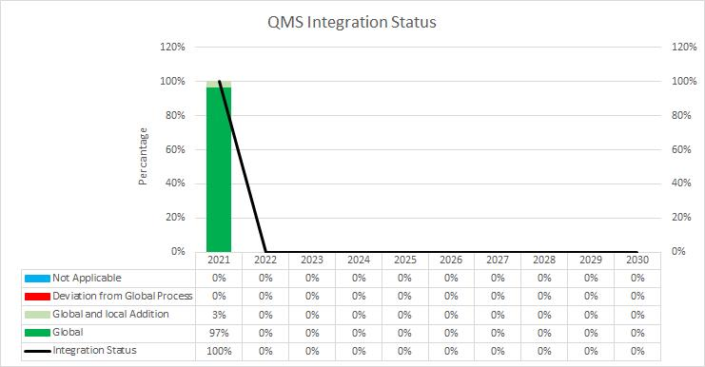
UL INTERNATIONAL POLSKA SP. - Integration towards One UL

Slide 12
Next Steps
Finalize and agree upon a transition plan to the UL Solutions Compliance Manual
Investigate the findings raised to address the weaknesses identified

Slide 13
Opening and Closing Meeting Attendance
Opening Meeting
Howell, Michelle
Baran, Katarzyna
Zaleski, Przemyslaw
Cheevers, Grainne
Barszczak, Michal
Lukaszuk, Michal
Kwiatkowski, Łukasz
Wiacek, Karolina
Zmijewski, Bartlomiej
Natzke-Kruszynski, Rafal
Cyran, Jan
Wagner, Marcin
Closing Meeting
Baran, Katarzyna
Wasilewski, Krzysztof
Zmijewski, Bartlomiej
Zaleski, Przemyslaw
Kwiatkowski, Łukasz
Barszczak, Michal
Wagner, Marcin
Howell, Michelle
Cheevers, Grainne

Slide 14
Thank you!

