Slide 1
Internal Compliance Audit – Closing Meeting -
UL International Demko A/S

Slide 2
Agenda:
Assessment Team:
Lead Auditor: Grainne Cheevers
Auditors: Michelle Howell Przemyk Zaleski
Audit Scope
Technical Audits in Compliance Audit Process
Objectives and Focus Areas
Executive Summary
Risks and Raised Concerns
Recommended Improvement Roadmap and Next Steps

Slide 3
Attendees
Opening Meeting Attendees – 9th November
Closing Meeting Attendees – 13th December
Peter Mortensen as Business Manager
Thomas Wilson as CAB Manager
Claus Madsen as Operations Manager
Jan-Erik Storgaard as Senior Quality Engineer
Grainne Cheevers as Lead Auditor
Przemyslaw Zaleski as Auditor
Michelle Howell as Auditor
Peter Mortensen as Business Manager
Thomas Wilson as CAB Manager
Flemming Hegner as Lab Leader
Claus Madsen as Operations Manager
Jan-Erik Storgaard as Senior Quality Engineer
Grainne Cheevers as Lead Auditor
Michelle Howell as Auditor
Przemyslaw Zaleski as Auditor
Paola Pesconi as Program Owner
Moath Awwad as Program Owner
Mark Vlanich as Program Owner

Slide 4
Audit Scope
The scope of the audit was reviewing the implementation of the UL International Demko A/S for multiple schemes under
ISO/IEC 17065:2012 Activities as issued by UL International Demko A/S as a Certification Body with Multiple Scheme Activity
See Table below for Schemes Under Review
Areas sampled and assessed against relevant requirements:
Organization and Leadership; Competency management, Handling of samples, Reporting of results, Evaluation procedures, Records management, Complaints, Management System Documentation.

Slide 5
Audit Scope
Schemes | Associated Audit | Findings | Observations | Owner
IECEE CBTL (Lab and Processes) | 2022-60-IQA | 0 | 4
IECEE NCB (CB Scheme) | 2022-760-IQA | 2 | 2
UL International Demko A/S Notified Body (ATEX) | 2022-741-IQA | 0 | 0
IECEX (Processes) | 2022-881-IQA | 0 | 0
GS Mark Scheme Evaluation | 2022-110-IQA | 0 | 0
Project for Mandatory Energy Efficiency Labelling Scheme | 2022-69-IQA | N/A | N/A
NORDIC CERTIFICATION SERVICE NOTIFICATION Evaluation | 2022-114-IQA | 0 | 0
Project for ENEC LICENSE Evaluation | 2022-111-IQA | 0 | 0
Project for Measuring Instruments Directive Scheme Evaluation | 2022-741-IQA | 0 | 0
Project for D-MARK Evaluation | 2022-114-IQA | 0 | 0
Project for Gulf Type Examination Certification Scheme Evaluation | 2022-153-IQA | 0 | 0
Project for SASO Conformity Assessment Program (SALEEM) Evaluation | 2022-69-IQA (See Pathnotes) | N/A | N/A
Project for Bahrain Conformity Assessment Program Evaluation | 2022-69-IQA (See Pathnotes) | 1 | 0
Project for OMAN Conformity Assessment Program Evaluation | 2022-69-IQA (See Pathnotes) | 1 | 0
Project for US / CAN Safety Scheme Evaluation | 2022-69-IQA (See Pathnotes) | 2 + 1 | 1
Project for UL Type Examination Certificate Evaluation | 2022-69-IQA International Certification (IC) Form-ULID-004110 | 1 | 0
Project for UL-EU Mark Safety Scheme Evaluation | 2022-69-IQA International Certification (IC) Form-ULID-004110 | 0 | 0

Slide 6
Objectives and Focus Areas
Confirming activities and scope reflects on ATLAS records
Merging ICA and technical audit to cover CAB regional schedule of accreditation within accreditation cycle
Assessing implemented management system on all stages of project delivery including evaluation, testing and reporting.
Verifying conformance with Standards, Accreditation and Scheme as well as UL requirements.
Focus on expectations, issues and objectives identified by local, regional and global Leadership Team.
Provide feedback to Partners to reassure the capability, efficiency and consistency of implemented business processes.
New ICA Report - Europe
Additional ICA deliverables in Europe are:
Maturity level,
One UL Integration level
Governance level
Associated Potential Risk linked the findings,
Voluntary Suspension of Operations
Impartiality
Share Knowledge and best practices for improvements.
Audit Result
Executive Summary
Strengths & OFIs
Findings and Associated Risks
Governance, Management System Maturity Level and One UL Integration Indicators
Annual Improvement Roadmap

Slide 7
Throughout the year
Remote Test
Witness (SME)
Remote Project
Review (SME)
Technical
Interview (SME)
Competency Monitoring / PTP
UL Safety ITA
Local Test Witness
Local Project Review
Organised and / or completed by AMS-R
Technical Audits per service
ISO / IEC 17065:2012
ISO / IEC 17025:2017
Accreditation Requirements
Regional Requirements
Completed by Regional ICA Team
Conformity Process implementation per COU
One UL Integration
Maturity Level
TAT
H&S incidents
Utilization
Completed by Regional IQA Team with input from COU
Additional Business Requirements
Single Source of Data per CAB / COU
Complete Business Overview

Slide 8
Storage and accessibility
CAB Capabilities:
https://ul.sharepoint.com/sites/GRPEMEALAEMEALAQualityTeam/Lists/CAB%20Capabilities/AllItems.aspx
CAB Standards / Schemes:
https://ul.sharepoint.com/sites/GRPEMEALAEMEALAQualityTeam/Lists/CAB%20Activities/AllItems.aspx

Slide 9
Risks and Raised Concerns
ISO 17065:2012 | Description of Finding | Expected outcome | Risk Level | CAR #
7.11.3 | Missing communication relating to changed in certification – termination / suspension. The process between FI and CO is not clear. Inconsistencies in management and record traceability for a number of certificates as listed in report. | Review process for managing changes to certification, specify how and where records shall be completed and stored. | Medium | 2022-69-CAR-GC-01
7.5.1 (Test) | The dates of tests performed were not recorded properly in Labware | Better oversight of detail and records | Low | 2022-69-P01
7.5.1 (Test) 7.12.1 (Cert) | The list of tests performed in Test record 3 of 00-E504280-A6001-TestRecordUL includes tests that were not actually performed as they were not applicable. | Better oversight of detail and records | Low | 2022-69-P02
7.4.3 | Test record 36 of 00-E48539-19920124-TestRecord for project 4789996917 does not include all the test data (original observations) that were performed in the evaluation. | Better oversight of detail and records | Low | 2022-69-P03
7.7.1 | The formal certification documentation (Test report and Certificates) was not created for project 4790176790. | Better oversight of detail and records | Medium | 2022-69-P04
7.4 | In the application process the customer was not informed in about the applicable Scheme Service Terms as required by ULID-000393 Cl. 7.4a). | Better oversight of detail and records | Low | 2022-69-P05
7.8.1.2 (Test) | Testing was completed by UL Germany with test report compiled by UL India. Report stated UL India as the CB Test Laboratory. After speaking with the project handler, it appears this is a systemic issue. | Better oversight of detail and records | Medium | MH-FIN-01

Slide 10
Certification Body Process Improvement and Maturity
Step 1
Step 2
OBJECTIVE
5-10 Year
Vision
3-5 Year
Plan
Pn
,
In
Dn
I
P
Step 6
Step 3
Cn
P
D
P
D
Annual
Review
Annual Plan
I
C
I
C
P2
P
D
CSA
P
D
Technology
C
D
I
C
I
C
D2
Lab
CSE
Step 6
I2
Progress
Control
Step 5
Step 4
P1
C2
Implementation
Development of
Initiatives (plan)
I1
D1
Improve
Plan
Continuous Improvement
C1
Check
Do
Improve
Plan
Standard
Check
Do
Improvement
Consolidation through Standardization
Laboratory services
Processes
Process Maturity
Standard
Time
Y1
Y2
Y3
Y4

Slide 11
UL INTERNATIONAL Demko A/S – Certification Body Management System Maturity Level
10
BEST KNOWN METHOD
(BKM)/WORLD CLASS
8
CUSTOMER SATISFACTION
6
IMPROVEMENT
Requirements categories | 2022 | 2021
General | 6.3 | 6.3
Structural | 7.0 | 6.1
Resources | 6.2 | 6.0
Process | 6.4 | 6.6
Management system | 7.0 | 7.0
4
Accreditation & Scheme COMPLIANCE
0
Basic QMS IMPLEMENTATION
The assessment result of performance of implemented Quality Management System for UL International Demko A/S shows some improvement in Resources and Structural requirements. There has been no improvements in the processes which may require greater oversight. This will occur as part of the increased overview of completed projects as discussed
There are no high-risk areas that need urgent attention but/and some improvement is required for records and processes overall

Slide 12
UL International Demko A/S Integration towards One UL – Certification
At the time of the audit there had been no changes made to integrate with the UL Solution Certification compliance policy, however the gap analysis and project planning had been reviewed and appeared appropriate. UL Demko has many additions, which appear to be required to ensure all Accreditation requirements are met, these may be reduced due to the updated Policy.

Slide 13
Executive Summary
Based on review of completed Certification Projects and interviews with the staff and management the assessment team concluded that the quality system of UL International Demko A/S meets the requirements of ISO / IEC 17065:2012. Findings, observations and opportunities for improvement have been raised to further strengthen the system and ensure continued compliance.
Overall, for the scope of audit 2022-69-IQA 6 Findings & 1 Observations for compliance issues were raised, there were none significant enough in nature to provide a high risk to the business.
Strengths
Cooperation with the audit team
Understanding of compliance and willing to address Non-compliances and continually improve
Weaknesses
Oversight of complex organizational output
Traceability and Record keeping
Opportunities for Improvement
Establishment of audit planning, with continued ongoing review of completed projects
Consistent record keeping for Certification – establishment of where and how ALL records should be stored.

Slide 14
Next Steps
Plan 2023 Audit
Breakdown of audit profiles and Dates for 2023 Audits
Agreement if audits will involve planned review of global resource of Schemes under responsibility of UL Demko – audit planning / Scheme Specific Templates! Questionnaire to follow.
Expectation: Certification Body and Testing Management System Assessment only 2023, with focus on internal calibration and integration status.

Slide 16
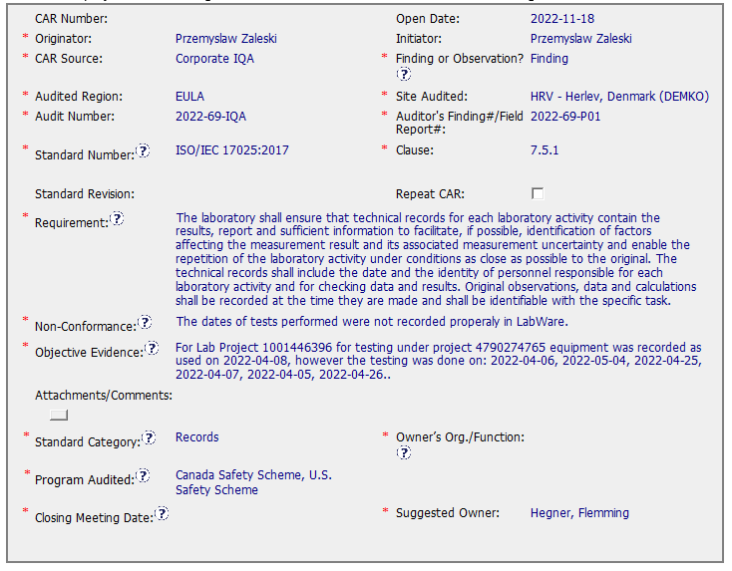
Non Conformances – US & CAN Safety Scheme

Slide 17
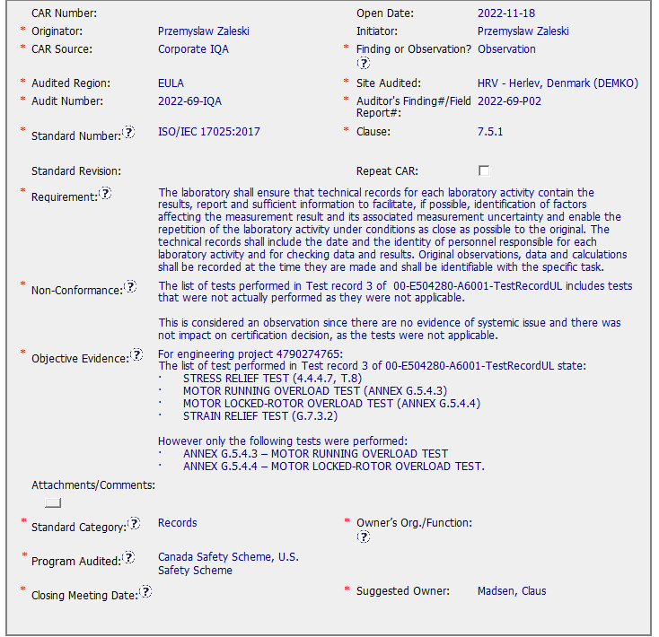
Non Conformances – US & CAN Safety Scheme

Slide 18
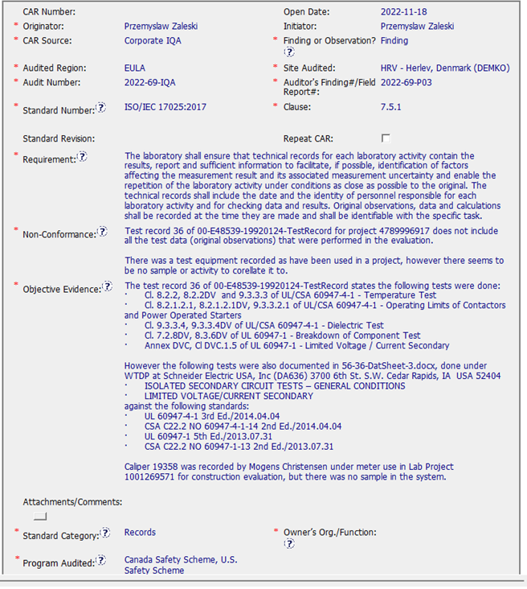
Non Conformances – US & CAN Safety Scheme
Jens Weise

Slide 19
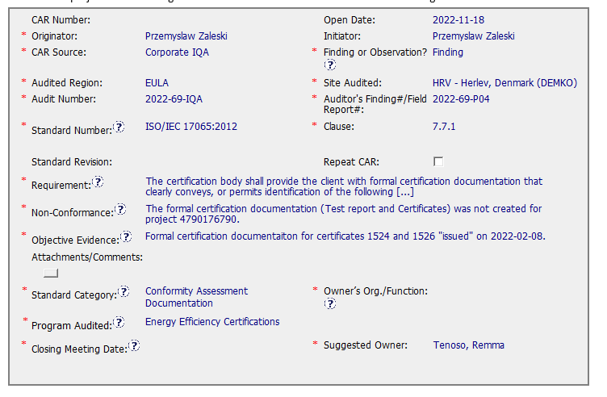
Non Conformances – Energy Efficiency

Slide 20
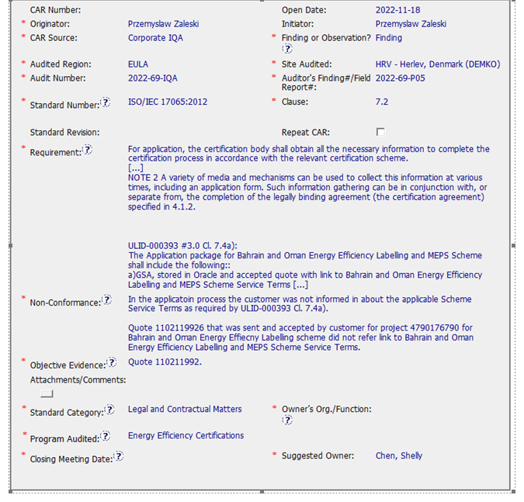
Non Conformances – Energy Efficiency

Slide 21
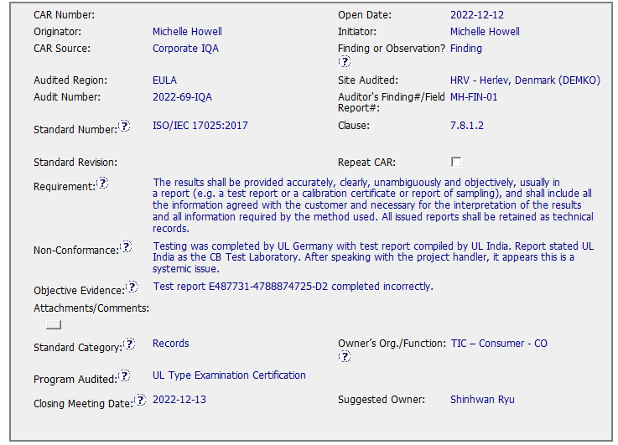
Non Conformances – UL Type Examination

Slide 22
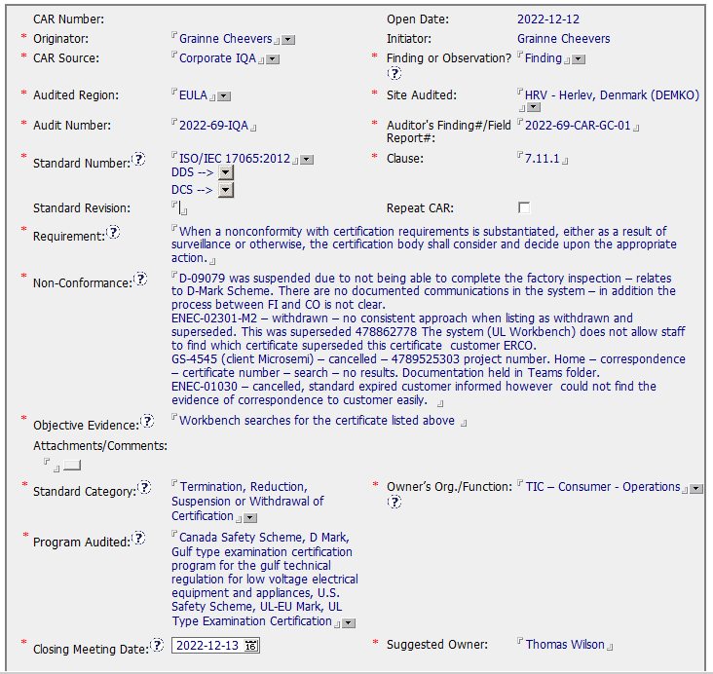
Non Conformances – Certification Body

