Slide 1
Internal Compliance Audit – Closing Meeting -
2023-12-IQA
Underwriters Laboratories Iberica S.L. - Processes

Slide 2
Agenda:
Assessment Team:
Lead Auditor: Grainne Cheevers
Auditors: Michelle Howell
Przemyk Zaleski
Audit Scope
Risks and Raised Concerns
Executive Summary
Recommended Improvement Roadmap and Next Steps

Slide 3
Attendees
Opening Meeting Attendees – 6th February
Closing Meeting Attendees – 17th February *
Cheevers, Grainne
Gonzalez, Jonathan
Malysa, Thomas
Rocco, Davide
Gravalos, Alberto
Friggi, Neil
Vidal, Jose
Andreola, Nadia – Did not attend
Martinez Moreno, Marc – Did not attend
Cheevers, Grainne
Gonzalez, Jonathan
Malysa, Thomas
Rocco, Davide
Gravalos, Alberto
Friggi, Neil
Vidal, Jose
Andreola, Nadia
Martinez Moreno, Marc
* Delayed due to Lead Absence (Illness)

Slide 4
Audit Scope
The scope of the audit was reviewing the implementation of the UL LLC requirement for the US and CAN Safety Scheme Project Reviews
COU
Appliances, HVAC & Lighting
Built Environment
Consumer, Medical & Information Technologies
Energy & Industrial Automation
UL Solutions Legal Entity | UL LLC
Accreditor | ANAB | OSHA | SCC
Spain - Barcelona | ACTIVE | SNAP | ACTIVE

Slide 5
Audit Scope
The scope of the audit was reviewing the implementation of the UL LLC requirement for the US and CAN Safety Scheme Project Reviews
 | Staff | Projects to audit | Project | Project Handler
AHL | 3 | 2 | 4790302153 4790111537 | Serrano, Jesus Serrano, Jesus
BE | 2 | 2 | 4790115314 4789569038 | Barrera, Leandro Sabbione, Juan Pablo
CMIT* | 3 | 2 | 4790010233* 4790613642* | Altamirano, Sabrina Altamirano, Sabrina
E&IA | 2 | 2 | 4790167376 4790502097 | Martinez Moreno, Marc Martinez Moreno, Marc
* Projects for CMIT were not completed during the audit as they were preliminary investigations which did not result in Certification. It was confirmed by CMIT Senior Regional Operations Manager that no CMIT US CAN projects were issued by location Barcelona.

Slide 6
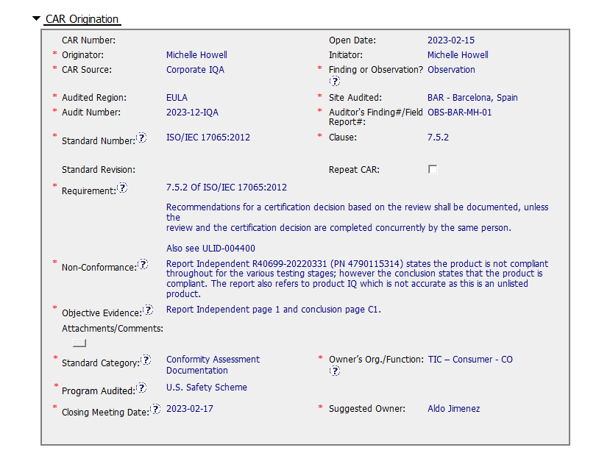
Non Conformances

Slide 7
Risks and Raised Concerns
ISO 17065:2012 | Description of Finding | Expected outcome | Risk Level | CAR #
7.5.2 | Report Independent R40699-20220331 (PN 4790115314) states the product is not compliant throughout for the various testing stages; however, the conclusion states that the product is compliant. The report also refers to product IQ which is not accurate as this is an unlisted product. | Conduct a review to verify if this is a systemic issue | Low | OBS-BAR-MH-01

Slide 8
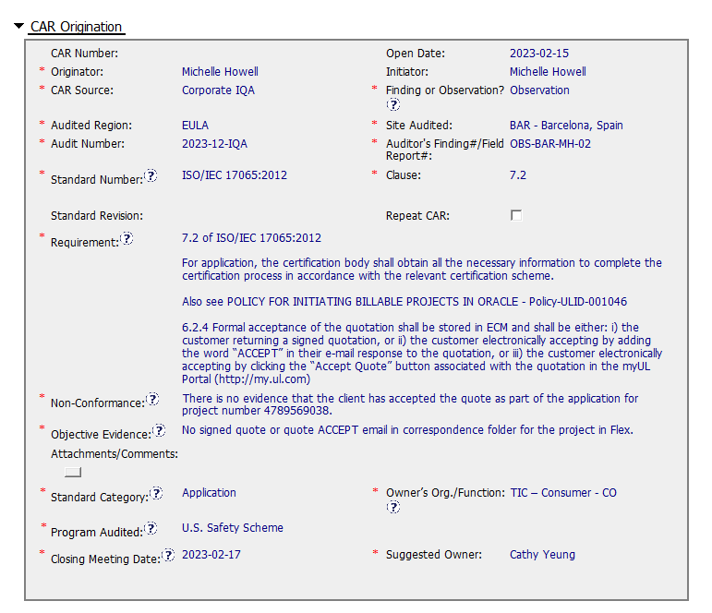
Non Conformances

Slide 9
Risks and Raised Concerns
ISO 17065:2012 | Description of Finding | Expected outcome | Risk Level | CAR #
7.5.2 | Report Independent R40699-20220331 (PN 4790115314) states the product is not compliant throughout for the various testing stages; however, the conclusion states that the product is compliant. The report also refers to product IQ which is not accurate as this is an unlisted product. | Conduct a review to verify if this is a systemic issue | Medium | OBS-BAR-MH-01
7.2 | There is no evidence that the client has accepted the quote as part of the application for project number 4789569038. | CAR FORCED CLOSED - project initiated in 2020 previous CAR addressed issue. 223925425 |  | OBS-BAR-MH-02

Slide 10
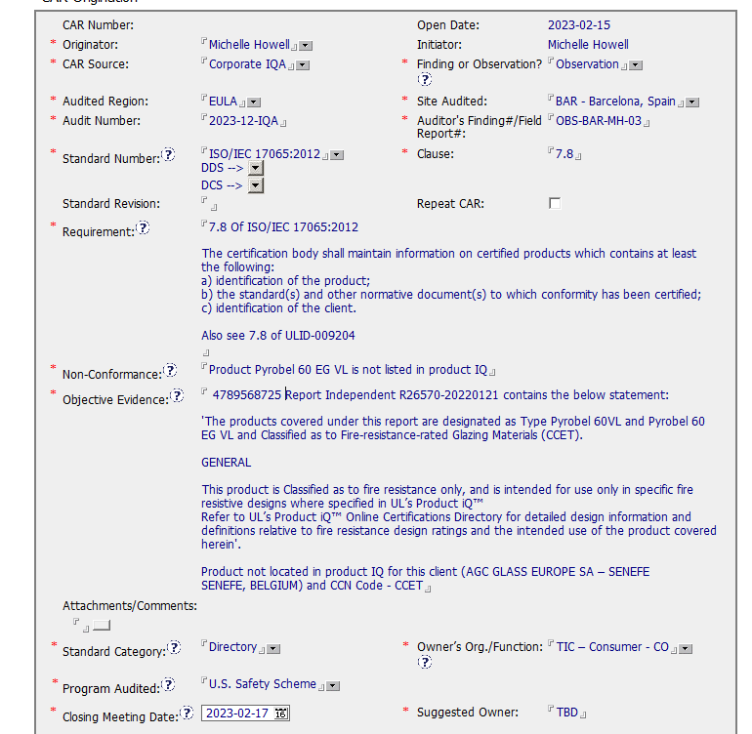
Non Conformances

Slide 11
Risks and Raised Concerns
ISO 17065:2012 | Description of Finding | Expected outcome | Risk Level | CAR #
7.5.2 | Report Independent R40699-20220331 (PN 4790115314) states the product is not compliant throughout for the various testing stages; however, the conclusion states that the product is compliant. The report also refers to product IQ which is not accurate as this is an unlisted product. | Conduct a review to verify if this is a systemic issue | Medium | OBS-BAR-MH-01
7.2 | There is no evidence that the client has accepted the quote as part of the application for project number 4789569038. | CAR FORCED CLOSED - project initiated in 2020 previous CAR addressed issue. 223925425 |  | OBS-BAR-MH-02
7.8 | Product Pyrobel 60 EG VL is not listed in product IQ | Conduct an investigation to understand why product is not listed, is it product type / transaction Centre / IT issue? Once determined sample a number of other projects to determine if issue is systemic | Low | OBS-BAR-MH-03
 | 4790111537 1-1-DataSheet-CR2 of E363621-20220128-TestRecord states TBD for Clause 8 Assembly and Packaging (Cell D56) and Pass in Comments/Measurements, which seems an obvious typo. | Service Request | Low

Slide 12
Underwriters Laboratories Iberica S.L – Integration Status
Integration records show compliance with approved UL SOLUTIONS CERTIFICATION BODY COMPLIANCE POLICY.
There is a one-year period for transition to this new enterprise policy. UL Solutions certification bodies that currently reference the Global Certification Compliance Manual (Policy-ULID-004123 (DCS:00-CB-P0854)) will need to update those references to this new policy during this one-year transition. UL Solutions certification bodies that do not currently utilize the compliance described herein will need to adopt this new policy during this one-year transition.

Slide 13
Summary
Based on the evaluation of the projects the Certification Body of UL LLC (Underwriters Laboratories Iberica S.L.) complied with the certification process through the records reviewed.
The Scope of the assessment was to review US an CAN Safety Scheme for CMIT, however no projects were handled from the Barcelona office.
Overall 3 Observations and 1 Service Request were raised, there were none significant enough in nature to provide a high risk to the business.
The Audit Team would like to thank all the staff management who assisted with record review and answered any queries which were raised. We appreciate the support.

Slide 14
Next Steps
Plan 2024 Audit
Dates: Week Commencing 12th February 2024
Expectation: As SNAP is being phased out with all locations becoming Recognized sites, the audit next year will focus on the full Credential Audit.

