Slide 1
Internal Compliance Audit – Closing Meeting –
UL International Netherlands B.V.
2022-157-IQA

Slide 2
Agenda:
Assessment Team:
Lead Auditor:
Auditors:
Audit Scope
Executive Summary
Risks and Raised Concerns
Recommended Improvement Roadmap and Next Steps

Slide 3
Attendees
Opening Meeting Attendees – January 16th
Closing Meeting Attendees – February 6th
Cheevers, Grainne
Friggi, Neil
Van Der Waal, Danny
Schilleman, Koen A.
Thelen, Horst W.
Kirkland, Michael
Riss-bourienne, Stephanie
Malysa, Thomas
Teubler, Erik
Johnson, Chris
Hoogerdijk, Peter
Cheevers, Grainne
Friggi, Neil
Van Der Waal, Danny
Schilleman, Koen A.
Thelen, Horst W.
Kirkland, Michael
Riss-bourienne, Stephanie
Malysa, Thomas
Teubler, Erik
Johnson, Chris

Slide 4
Objectives and Focus Areas
Confirming activities and scope reflects on ATLAS records
Merging ICA and technical audit to cover CAB regional schedule of accreditation within accreditation cycle
Assessing implemented management system on all stages of project delivery including evaluation, testing and reporting.
Verifying conformance with Standards, Accreditation and Scheme as well as UL requirements.
Focus on expectations, issues and objectives identified by local, regional and global Leadership Team.
Provide feedback to Partners to reassure the capability, efficiency and consistency of implemented business processes.
New ICA Report - Europe
Additional ICA deliverables in Europe are:
Maturity level,
One UL Integration level
Governance level
Associated Potential Risk linked the findings,
Voluntary Suspension of Operations
Impartiality
Share Knowledge and best practices for improvements.
Audit Result
Executive Summary
Strengths & OFIs
Findings and Associated Risks
Governance, Management System Maturity Level and One UL Integration Indicators
Annual Improvement Roadmap

Slide 5
Throughout the year
Remote Test
Witness (SME)
Remote Project
Review (SME)
Technical
Interview (SME)
Competency Monitoring / PTP
UL Safety ITA
Local Test Witness
Local Project Review
Organised and / or completed by AMS-R
Technical Audits per service
ISO / IEC 17065:2012
ISO / IEC 17025:2017
Accreditation Requirements
Regional Requirements
Completed by Regional ICA Team
Conformity Process implementation per COU
One UL Integration
Maturity Level
TAT
H&S incidents
Utilization
Completed by Regional IQA Team with input from COU
Additional Business Requirements
Single Source of Data per CAB / COU
Complete Business Overview

Slide 6
Audit
The Objective of the assessment was to verify compliance of notified body activities to international standards and other requirements listed below, as well as to assess level of integration to UL Solutions Certification Compliance Manual
The Scope of the assessment was ISO/IEC 17065:2012 Notified body activities under C 648 accreditation by RvA performed locally at UL Netherlands.
Schemes reviewed were:
Directive 2014/90/EU Marine equipment
Directive 2006/42/EC Machinery
Regulation 2016/425/EU Personal Protective Equipment
Regulation 305/2011/EU Construction Products: PAC 10, 31, 35
Areas sampled and assessed against relevant requirements:
Organization and Leadership; Competency management, Handling of samples, Reporting of results, Evaluation procedures, Records management, Complaints, Management System Documentation.

Slide 7
Opportunities for Improvement
Focus should be on UL Solutions Integration – as discussed, in order to prevent findings raised in the future UL International Netherlands B.V. should aim to move to UL approved tools and processes, or obtain approval from the Certification Committee for approved deviations. Evidence of approval will be required.

Slide 8
Non Conformances
Non-Conformity Reports
2023-157-GC-CAR01 Non-Conformity Report Originator: Grainne Cheevers Suggested owner: Chris Johnson Severity: Finding Standard Nº: ISO / IEC 17065:2012 Clause Nº: 7.9.3 Requirement: When continuing use of a certification mark is authorized for placement on a product (or its packaging, or information accompanying it) (for process or service, see 7.9.4) of a type which has been certified, surveillance shall be established and shall include periodic surveillance of marked products to ensure ongoing validity of the demonstration of fulfilment of product requirements. Non-Conformance: There was no review of the use of the CE Mark during the factory inspection, This was not picked up at Review or Decision Objective evidence: Factory_Inspection_Report_DBI_UL_NL_UKCA_and_UL-EU_-_Signed.pdf UL Project Number 4790454008, Inspection performed: 2021-11-03 By: Krzysztof Matuszyk

Slide 9
Risks and Raised Concerns
ISO 17065:2012 | Description of Finding | Expected outcome | Risk Level | CAR #
 | There was no review of the use of the CE Mark during the factory inspection, This was not picked up at Review or Decision | Review of projects which involved Surveillance to ensure Logo was effectively checked | Low | 2023-157-GC-CAR01

Slide 10
CAB Process Improvement and Maturity
Step 1
Step 2
OBJECTIVE
5-10 Year
Vision
3-5 Year
Plan
Pn
,
In
Dn
I
P
Step 6
Step 3
Cn
P
D
P
D
Annual
Review
Annual Plan
I
C
I
C
P2
P
D
CSA
P
D
Technology
C
D
I
C
I
C
D2
Lab
CSE
Step 6
I2
Progress
Control
Step 5
Step 4
P1
C2
Implementation
Development of
Initiatives (plan)
I1
D1
Improve
Plan
Continuous Improvement
C1
Check
Do
Improve
Plan
Standard
Check
Do
Improvement
Consolidation through Standardization
CAB services
Processes
Process Maturity
Standard
Time
Y1
Y2
Y3
Y4

Slide 11
UL Internation Netherlands B.V.– CAB Management System Maturity Level
10
BEST KNOWN METHOD
(BKM)/WORLD CLASS
8
CUSTOMER SATISFACTION
6
IMPROVEMENT
Accreditation & Scheme COMPLIANCE
4
Basic QMS IMPLEMENTATION
The assessment result of performance of implemented Quality Management System for UL International Netherlands BV shows some improvement in resource records.
There are no high-risk areas that need urgent attention but/and some improvement is required for detail overall.
The main strength are the system checks and records already in place.

Slide 12
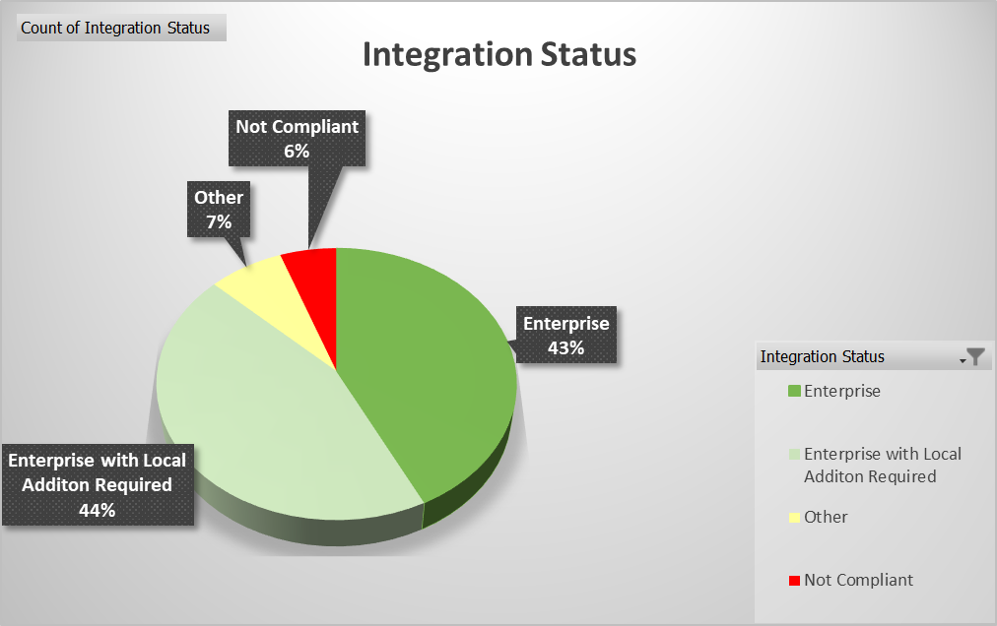
UL International Netherlands B.V.Integration towards One UL -
There is a one-year period for transition to this new enterprise policy. UL Solutions certification bodies that currently reference the Global Certification Compliance Manual (Policy-ULID-004123 (DCS:00-CB-P0854)) will need to update those references to this new policy during this one-year transition. UL Solutions certification bodies that do not currently utilize the compliance described herein will need to adopt this new policy during this one-year transition.

Slide 13
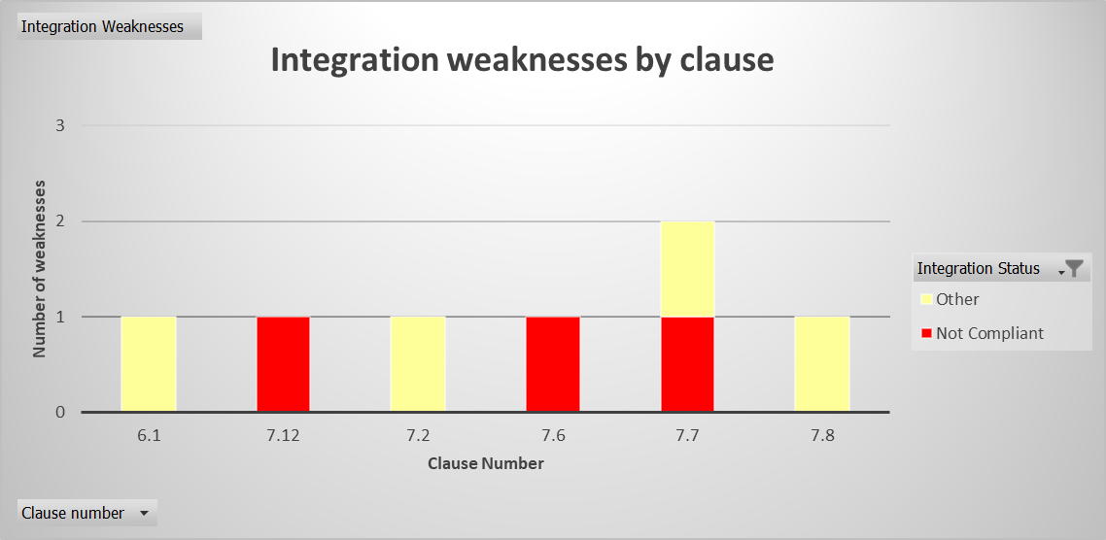
UL International Netherlands B.V. Integration towards One U
Integration records show some deviations from the approved UL SOLUTIONS CERTIFICATION BODY COMPLIANCE POLICY.

Slide 14
Summary
Based on sampled review of Certification and interviews with the staff, the assessment team concluded that the management system of UL International Netherlands B.V. meets the requirements of ISO / IEC 17065:2012 and EA2-17M2020. Any comments which have been raised are to further strengthen the system and ensure continued compliance. Ongoing review of certification are required to fully cover accredited aspects over the 4 year cycle.
In terms of process, there were no listed opportunities for improvement, however improvements were noted in Risk and Impartiality Management, value of stakeholder committee meeting, and competency management which were raised as issues in 2022.
The main strength are the system checks and records already in place. Although these may be repetition, or additional to other Schemes and services provided by UL, they are a logical and systematic flow through the certification process which allows internal and external assessors to quickly retrieve the required information.
This not only provides assurance that certifications are correctly issued but provides assurance to recognition bosies that UL are in control of their systems.
UL Solutions Integration – as discussed, in order to prevent findings raised in the future UL International Netherlands B.V. should aim to move to UL approved tools and processes or obtain approval from the Certification Committee for approved deviations. Evidence of approval will be required.
Overall 1 Finding for compliance issues was raised, there were none significant enough in nature to provide a high risk to the business.

Slide 15
Next Steps
Remaining Audits and those in support of other Credentials:
Reference | Lead | In Support of | Scope | Dates
2023-221-IQA | Grainne Cheevers | UL International Netherlands BV | Wire and Cable (CPR System 3) | Monday 20th Feb – Wednesday 22nd
2023-223-IQA | Grainne Cheevers | UL Demko NCB | IECEE CB Scheme | Mon 27th Feb – Mon 6th March
2023-224-IQA | Grainne Cheevers | UL Demko CB | UL EU Scheme | Mon 27th Feb – Mon 6th March
2023-225-IQA | Grainne Cheevers | UL LLC | US CAN Scheme | Mon 27th Feb – Mon 6th March
2023-22-IQA | Grainne Cheevers | UL International Netherlands BV | CBTL Lab closure Audit | MAY
TBC | Grainne Cheevers | Dutch Ministry | Technical Assessment Body | TBC
Dates for 2024 Internal Assessment – Notified Body:
Week Commencing January 15th 2024

