Slide 1
Internal Compliance Audit – Closing Meeting -
22 March 2022
2023-296-IQA

Slide 2
Agenda:
Assessment Team:
Lead Auditor: Przemyslaw Zaleski
Lead Auditor in training: Andrew Strachan
Audit Scope
Compliance Audit Process
Objectives and Focus Areas
Executive Summary
Risks and Raised Concerns
Recommended Improvement Roadmap and Next Steps

Slide 3
Attendees
Opening Meeting Attendees – Monday 6th March
Closing Meeting Attendees – Wednesday 22nd March
Przemyk Zalewski
Andrew Strachan (Lead Auditor in Training)
Primary Contact: Velu, Gnanaskandan
Neil Friggi
Soeker, Holger
Ham, SungGyu
Tentzerakis, Sokratis
Mellinghoff, Harald
Rimpl, Danny
Beier, Kathrin
Przemyk Zalewski
Andrew Strachan (Lead Auditor in Training)
Primary Contact: Velu, Gnanaskandan
Neil Friggi
Soeker, Holger
Ham, SungGyu
Tentzerakis, Sokratis
Mellinghoff, Harald
Rimpl, Danny
Beier, Kathrin

Slide 4
Audit Scope
The scope of the audit was reviewing the implementation of the UL Oldenburg.
ISO/IEC 17025:2017 testing laboratory activities under accreditation by DAkkS
Approach taken –
Remote assessment of relevant requirements: Application, Evaluation, Review and Decision, conformity assessment documentation and Management system.
Accessing and reviewing records available on ECM and other databases.
Staff Interviews
Personnel Records (HR)

Slide 5
Objectives and Focus Areas
Confirming activities and scope reflects on ATLAS records
ICA audit to cover CAB regional schedule of accreditation within accreditation cycle
Assessing implemented management system on all stages of project delivery including evaluation, testing and reporting (remotely).
Verifying conformance with Standards, Accreditation and Scheme as well as UL requirements.
Focus on expectations, issues and objectives identified by local, regional and global Leadership Team.
Provide feedback to Partners to reassure the capability, efficiency and consistency of implemented business processes.
New ICA Report - Europe
Additional ICA deliverables in Europe are:
One UL Integration level
Governance level
Associated Potential Risk linked the findings,
Voluntary Suspension of Operations
Impartiality
Share Knowledge and best practices for improvements.
Audit Result
Executive Summary
Strengths & OFIs
Findings and Associated Risks
Governance, Management System and One UL Integration Indicators
Annual Improvement Roadmap
NOTE: Integration assessed to UL Enterprise Testing and Calibration Laboratory Compliance Policy Policy-ULID-009203 only and not UL Solutions Testing Organization and Calibration Organization Policy Policy-ULID-014435

Slide 6
Throughout the year
Remote Test
Witness (SME)
Remote Project
Review (SME)
Technical
Interview (SME)
Competency Monitoring / PTP
UL Safety ITA
Local Test Witness
Local Project Review
Organised and / or completed by AMS-R
Technical Audits per service
ISO / IEC 17065:2012
ISO / IEC 17025:2017
Accreditation Requirements
Regional Requirements
Completed by Regional ICA Team
Conformity Process implementation per COU
One UL Integration
Maturity Level
TAT
H&S incidents
Utilization
Completed by Regional IQA Team with input from COU
Additional Business Requirements
Single Source of Data per CAB / COU
Complete Business Overview

Slide 7
Opportunities for Improvement
[OFI 01] There is an OFI to consider updating GTC with clear statement that confidential information might be released when required by law. See Cl. 4.2.2 of ISO/IEC 17025:2017.
[OFI 02] There is an OFI to better align naming conventions/terminology between what is in ATLAS and ULID-006421 Cl. 5.
It shall be also considered how to define the activities outside of scope of 17025 like Research and Studies in Atlas.
It could be also considered if political reviews and expert opinions shall remain in scope, as reporting opinions has some specific requirements for reporting in ISO/IEC 17025.
[OFI 03] There are some guidance/work instruction type of the documents that are controlled under the local procedure which are technical instructions, often dedicated to some specific projects, and as such there was a decision made to keep them controlled under local process, outside of ULDC as the local process is simpler to process revisions.
There is an OFI to consider if those guidance/work instructions need to be processed as controlled documents at all, since the examples shown during this audit were just instructional in nature, supporting to the testing methods, it seems they potentially do not need to be strictly controlled.
[OFI 04] There is an OFI to better describe the means how it is verified that risks which have been defined as to be “Avoided” (risk 12 and 16) are actually avoided, and if its effective.
[OFI 05] Local procedure ULID-006459 “Purchase” as referenced in the Quality Manual has been obsoleted. The correct reference should be ULID-006458. Apparently, the document was duplicated when it was transferred to ULDC. There is an OFI to get those references corrected.

Slide 8
Opportunities for Improvement
[OFI 06] There is an OFI to consider updating some document templates.
Explicit identification of the end of report could be added to templates.
Clear statement can added to the test reports stating when the information is supplied by the customer and can affect the validity of results. Currently the disclaimer states “The test results documented in this report relate only to the items, site & scenarios tested UL does not guarantee the calculated wind conditions or the calculated energy yield.
Letters of assignment can could be updated with wording to indicate that they cover not only accredited work, and update the address information with current location.
[OFI 07] W-EC-0114 “Job description” Issue 1 2021-01-07 is a locally held procedure and not referenced within the Quality manual. There is an OFI to better link this document with the QMS.
[OFI 08] There is an OFI to define the storage location of records for competency authorization/monitoring in the relevant document (ULID-006416). Consider CAR 2023-206-P03.
[OFI ML01] There is an OFI to implement monitoring of validity of results other than interlaboratory comparisons (PTPs)
[OFI WP 01] There is an OFI to consider simplifying the level of detailed tasks in the QMatrix (Q-Martix_WP_Rev06.1.xlsx) as part of transitioning to the TCD database (verify if all are needed) in order to make determining of competencies simpler.
[OFI WP02] There is an OFI to consider more detailed formal definition of a process for periodic review of staff authorizations in order to better manage refresher trainings for competencies held.

Slide 9
Non Conformances
CAR 2023-296-P01: As required by ULID-009203 UL Oldenburg defines its structure in two documents: ULID-006334 Org chart which shows detailed teams and reporting lines, and ULID-006421 Organization and Services document which focuses more on showing the areas of laboratory operations, and technical supervision responsible for those areas. Both those documents are outdated and do not accurately reflect current set-up of operations.
CAR 2023-296-P02: The procedure local procedure ULID-006420 for document control is currently still on #1.0 in ULDC, and it still refers to obsoleted UL DCS system. There are some guidance/work instruction type of the documents that are controlled under this local procedure. The procedure is outdated.
CAR 2023-296-P03: The SOP for storage and archiving of information is outdated.
CAR 2023-269-A01: ML - 6.4.9, 7.9.1, 7.10.1- Calibration certificate- 0884489 from imc. Not accredited and calibrated by the manufacturer. The item arrived for calibration as out-of-calibration. Skandan was not notified as part of the local process requirements. The non-conforming work procedure was not followed or trace-back initiated.
WP- The non-conforming work process was not followed. It was good that internal complaints were raised (observed in SharePoint) and that action was taken but the process was not followed and the AMS rep was not notified.
CAR 2023-269-A02: WP 7.7- There was no complete intralaboratory / interlaboratory activities undertaken to ensure the validity of results. FGW Round Robin was not completed during the last round. Sophie Jankowski was working on the Round Robin but left UL in October 2022 and it was not completed. No intralaboratory activities completed.

Slide 10
Risks and Raised Concerns
ISO 17025:2017 | Description of Finding | Expected outcome | Risk Level | CAR #
5.2 | As required by ULID-009203 UL Oldenburg defines its structure in two documents: ULID-006334 Org chart which shows detailed teams and reporting lines, and ULID-006421 Organization and Services document which focuses more on showing the areas of laboratory operations, and technical supervision responsible for those areas. Both those documents are outdated and do not accurately reflect current set-up of operations. |  | LOW | 2023-296-P01
8.3.1 | The procedure local procedure ULID-006420 for document control is currently still on #1.0 in ULDC, and it still refers to obsoleted UL DCS system. |  | MED | 2023-296-P02
8.4.2 | The SOP for storage and archiving of information is outdated. |  | MED | 2023-296-P03
6.4.9, 7.9.1, 7.10.1 | ML- Calibration certificate- 0884489 from imc. Not accredited and calibrated by the manufacturer. The item arrived for calibration as out-of-calibration. Skandan was not notified as part of the local process requirements. The non-conforming work procedure was not followed or trace-back initiated. WP- The non-conforming work process was not followed. It was good that internal complaints were raised (observed in SharePoint) and that action was taken but the process was not followed and the AMS rep was not notified. |  | MED | 2023-296-A01
7.7 | There was no complete intralaboratory / interlaboratory activities undertaken to ensure the validity of results. |  | MED | 2023-296-A02

Slide 11
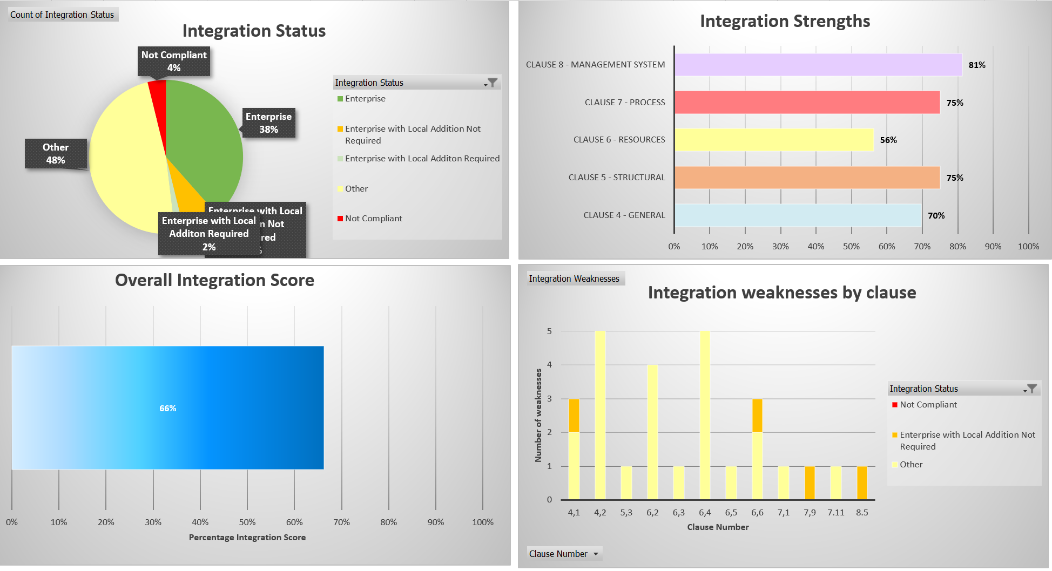
UL International Gmbh Oldenburg Branch Integration towards One UL - Laboratory

Slide 12
Summary
Based on review of testing and evaluation methods, and interviews with the staff, the assessment team concluded that the quality system of UL International Gmbh Oldenburg Branch meets the requirements of ISO / IECE 17025:2017. Findings and opportunities for improvement have been raised to further strengthen the system and ensure continued compliance.
Overall 5 Findings & 11 Opportunities for improvement for compliance issues were raised, there were none significant enough in nature to provide a high risk to the business.
Strengths
Able to manage transition from major internal structural changes with Wilhelmshaven location closure last year, which influenced the number of staff and composition of teams.
Weaknesses
Transition to Global processes which coincided with re-structure and will take additional time to roll out (e.g., process manual revision, Technical Competency Database, MET TEAM).

Slide 13
Next Steps
Plan 2024 Audit (to be confirmed via IQA)
Dates: March 2024
Expectation: Full transition to UL Enterprise Policy requirements and UL Global tools.

