Slide 1
Internal Compliance Audit
Spain - Barcelona
Opening Meeting
2024-12-IQA
DATE: 12th February 2024

Slide 2
Opening Agenda:
Assessment Team:
Lead Auditor: Grainne Cheevers
Auditors Danny Van Der Waal Michelle Howell
Manuela Scalisi
Andrew Strachan
Jan-Erik Storgaard
Thanks to all for attending.
• Introductions
• Confirmation of audit objectives and criteria
• Confirmation of audit scopes/changes
• Confirm any changes since last audit
• Confirm detail of plan (logistics, facilities, breaks, escorts etc.)
Any Health and Safety concerns - NA
• Date and time of closing meeting
• Questions

Slide 3
Attendees – Introductions as needed
Opening Meeting Attendees – 12th February
Cheevers, Grainne
Garcia, Jose Vicente
Malysa, Thomas
Vidal, Jose
Rocco, Davide
Friggi, Neil
Martinez Moreno, Marc
Machmur, Bashier
Riss-bourienne, Stephanie
Bagheri, Iman
Urkidi, Amaia

Slide 4
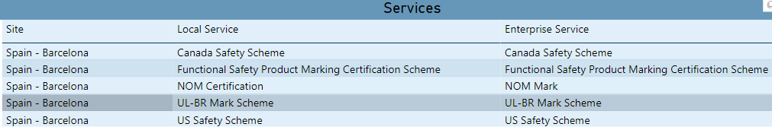
Confirmation of ATLAS
Sampled projects based on the above Enterprise Services
US/CAN Safety scheme Projects extracted based on sampling criteria
Sample Functional Safety and UL Brazil Mark projects extracted
Confirmation from Alberto there are NO NOM projects handled from Barcelona.

Slide 5
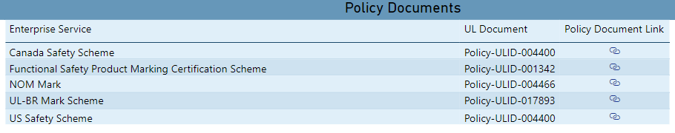
Confirmation of audit objectives and criteria
The scope of the assessment is reviewing the implementation of the UL Solutions Management System (in complaince with ISO 17065:2012), with focus on UL LLC and UL Canada Certification Body Management System in support of US and Canada Safety Scheme (Policies listed).
Product evaluation records;
Certification Review and Decision
Areas sampled and assessed against relevant requirements:
Competency management, Handling of samples, Reporting of results, Evaluation, Records management, Complaints, Management System Documentation.

Slide 6
Projects, Handlers and Auditors
Row Labels | Appliances/HVAC & Lighting | Building & Life Safety Technologies | CTECH | Energy & Power Technologies | Life & Health Sciences | Audit Team
Gravalos, Alberto | 4790367371 |  |  |  |  | Andrew
DAP Project | 4790847106 |  |  |  |  | Michelle
Barrera, Leandro |  | 4789946597 |  |  |  | Michelle
Barrera, Leandro |  | 4790875940 3.1 |  |  |  | Michelle
Altamirano, Sabrina |  |  | all cancelled |  | all cancelled | NA
Martinez Moreno, Marc |  |  |  | 4789818683 |  | Jan-Erik
Martinez Moreno, Marc |  |  |  | 4790700402 |  | Manuela
DAP Project |  |  |  | 4790507768 |  | Manuela
Urkidi, Amaia (FSCO) |  |  |  | 4790758578 |  | Grainne
Garcia, Jose Vicente (BRB) |  |  |  | 4790613443 |  | Grainne

Slide 7
Sample and Equipment Management
Interview with | Date: 13th February
Alberto Gravalos | Sample Handling Samples over 60 days without disposition executed. Quarantine samples not properly Dispositioned Samples Cancelled
 | Equipment Management Review of equipment used for Construction Review

Slide 8
Date and time of closing meeting
Summary of audit provided during Closing meeting – Friday 16th February (12noon)
Review of any OFI / Noncompliance’s
Improvement Plan if required
Agree Ownership if applicable
Agree Dates for 2025

Slide 9
Questions

Slide 11
Confirmation of audit scopes/changes
Refer to completed Pre-Audit Questionnaire – not implemented at time of planning.

Slide 12
Internal Compliance Audit
UL Barcelona Office
Closing Meeting
2024-12-IQA
DATE: 16th February 2024

Slide 13
Closing Agenda:
Assessment Team:
Lead Auditor: Grainne Cheevers
Auditors: Manuela Scalisi
Andrew Strachan
Jan-Erik Storgaard (In Training)
Michelle Howell
Thanks to all participants
Reminder that this is a sampling exercise
Defer questions until after non-compliances have been agreed
Confirmation of audit objectives and criteria
Individual auditor Summary of report, highlights & concerns
OFIs / Noncompliance
CARs and Owners agreed
Post Audit Risk Assessment Results
Timescales for issuing Report
Agree date for following year
Request Feedback – reminder of importance of the feedback survey
Close Meeting

Slide 14
Attendees –
Opening Meeting Attendees – 12th February
Closing Meeting Attendees – 16th February
Cheevers, Grainne
Garcia, Jose Vicente
Malysa, Thomas
Vidal, Jose
Rocco, Davide
Friggi, Neil
Martinez Moreno, Marc
Machmur, Bashier
Riss-bourienne, Stephanie
Bagheri, Iman
Urkidi, Amaia Harris, Stephen
Cheevers, Grainne
Malysa, Thomas
Vidal, Jose
Rocco, Davide
Friggi, Neil
Martinez Moreno, Marc
Machmur, Bashier
Riss-bourienne, Stephanie
Bagheri, Iman
Harris, Stephen Will update after meeting

Slide 15
Confirmation of ATLAS
Sampled projects based on the above Enterprise Services
US/CAN Safety scheme Projects extracted based on sampling criteria
Sample Functional Safety and UL Brazil Mark projects extracted – confirmation these were not required to be sampled at the BAR office.
Confirmation from Alberto there are NO NOM projects handled from Barcelona.

Slide 16
Confirmation of audit objectives and criteria
The scope of the assessment is reviewing the implementation of the UL Solutions Management System (in complaince with ISO 17065:2012), with focus on UL LLC and UL Canada Certification Body Management System in support of US and Canada Safety Scheme (Policies listed).
Product evaluation records;
Certification Review and Decision
Areas sampled and assessed against relevant requirements:
Competency management, Handling of samples, Reporting of results, Evaluation, Records management, Complaints, Management System Documentation.

Slide 17
Projects, Handlers and Auditors
Row Labels | Appliances/HVAC & Lighting | Building & Life Safety Technologies | CTECH | Energy & Power Technologies | Life & Health Sciences | Audit Team
Gravalos, Alberto | 4790367371 |  |  |  |  | Andrew
DAP Project | 4790847106 |  |  |  |  | Michelle
Barrera, Leandro |  | 4789946597 |  |  |  | Michelle
Barrera, Leandro |  | 4790875940 3.1 |  |  |  | Michelle
Altamirano, Sabrina |  |  | all cancelled |  | all cancelled | NA
Martinez Moreno, Marc |  |  |  | 4789818683 |  | Jan-Erik
Martinez Moreno, Marc |  |  |  | 4790700402 |  | Manuela
DAP Project |  |  |  | 4790507768 |  | Manuela
Urkidi, Amaia (FSCO) |  |  |  | 4790758578 |  | Grainne
Garcia, Jose Vicente (BRB) |  |  |  | 4790613443 |  | Grainne
Functional safety and UL BR are audited during the service and Certification Body audit, which samples globally

Slide 18
Sample and Equipment Management
Interview with | Date: 13th February
Alberto Gravalos | Sample Handling Samples over 60 days without disposition executed. Quarantine samples not properly Dispositioned Samples Cancelled
 | Equipment Management Review of equipment used for Construction Review
Conclusion
Sample Handling: OFI – Alberto to contact customer of aging sampled to reconfirm and authorise storage.
Equipment: Agreement between UL Barcelona and Carugate for equipment management. Records were reviewed and found to be in order. Davide is monitoring equipment on behalf of BAR office.

Slide 19
CAR awaiting verification of effectiveness
Link | Next Action Date | CAR Number | CAR Source | Verification Complete | Program Affected | Total
 |  | 223925585 | Technical Audit | N | U.S. Safety Scheme
Between the Agenda creation and the audit week, the CAR and actions were verified as effective.
No follow up required.

Slide 20
Improvement Plan
GENERAL
Nothing specific for Barcelona Office with the exception of :
Sample Handling: OFI – Alberto to contact customer of aging sampled to reconfirm and authorise storage.

Slide 21
Risks and Raised Concerns
ISO 17065:2012 | Description of Finding | Expected outcome | Risk Level | CAR #
 | NO Risks other than those idenitifed

Slide 22
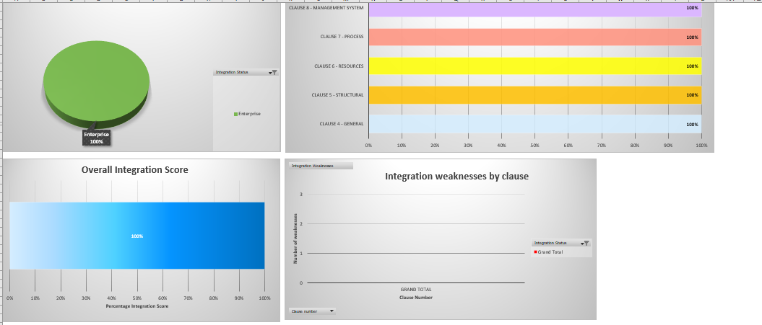
Integration with UL Solutions Certification Requirements
All UL Solutions requirements are followed. No change since 2023

Slide 23
Process Improvement and Maturity
Step 1
Step 2
OBJECTIVE
5-10 Year
Vision
3-5 Year
Plan
Pn
,
In
Dn
I
P
Step 6
Step 3
Cn
P
D
P
D
Annual
Review
Annual Plan
I
C
I
C
P2
P
D
CSA
P
D
Technology
C
D
I
C
I
C
D2
Lab
CSE
Step 6
I2
Progress
Control
Step 5
Step 4
P1
C2
Implementation
Development of
Initiatives (plan)
I1
D1
Improve
Plan
Continuous Improvement
C1
Check
Do
Improve
Plan
Standard
Check
Do
Improvement
Consolidation through Standardization
Enterprise services
Processes
Process Maturity
Standard
Time
Y1
Y2
Y3
Y4

Slide 24
Integration with UL Solutions Maturity Rating
2023 a number of observations were raised, in 2024 there were no observations or non- compliances, suggesting that the processes are being followed by the BAR team.
Year | 2023 | 2024
Certification body personnel | 7 | 7
Resources for evaluation | 7 | 7
General | 6 | 7
Application | 7 | 7
Application review | 7 | 7
Evaluation | 6 | 7
Review | 7 | 7
Certification decision | 7 | 7
Certification documentation | 6 | 7
Directory of certified products | 7 | 7
Surveillance | 7 | 7

Slide 25
FINAL Summary
Based on review of evaluation methods, and interviews with the staff the assessment team concluded that the quality system of UL Barcelona meets the requirements of UL LLC Certification Body Compliance Manual and ISO / IECE 17065:2012 where applicable. No Observations / Nonconformance’s were raised, and opportunities for improvement (Improvement Plan) have been raised to further strengthen the system and ensure continued compliance.
Overall with the issues raised, there were none significant enough in nature to provide a high risk to the business.
Strengths
Cooperation of the engineers and mangers.
Weaknesses
None.

Slide 26
Next Steps
IQA Tool will be updated Monday
Plan Nest Year Audit
Dates:
Expectation:

Slide 27
Questions

Slide 28
Request Feedback – reminder of importance of the feedback survey
Thanks to everyone who participated.

