Slide 1
Annual Internal Quality Audit - Closing Meeting
Lead Auditors : Simy Li, Paul Ip
Auditor : Shannon Tsui, Brian Wong, Ringo Yu, Kelvin Tsoi
Auditor Trainees : Else Man, Cammy Hung
Date : Jan 18-19, 2016

Slide 2
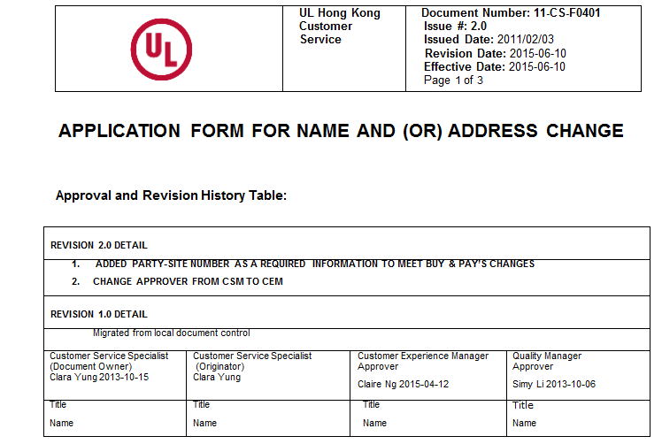
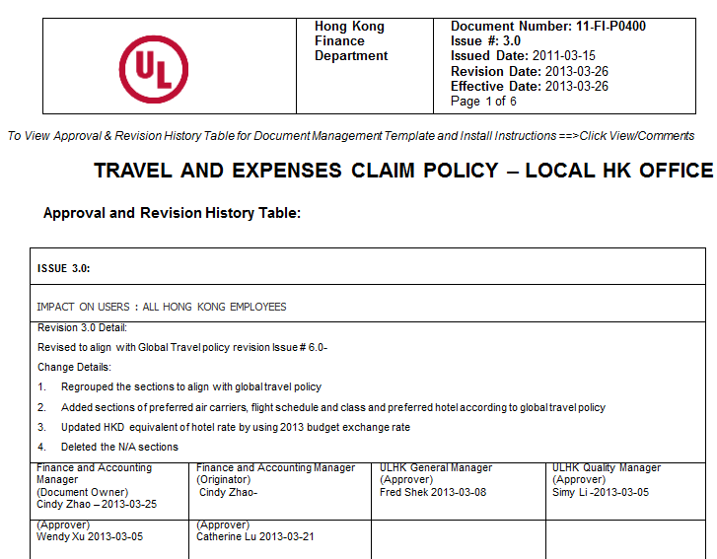
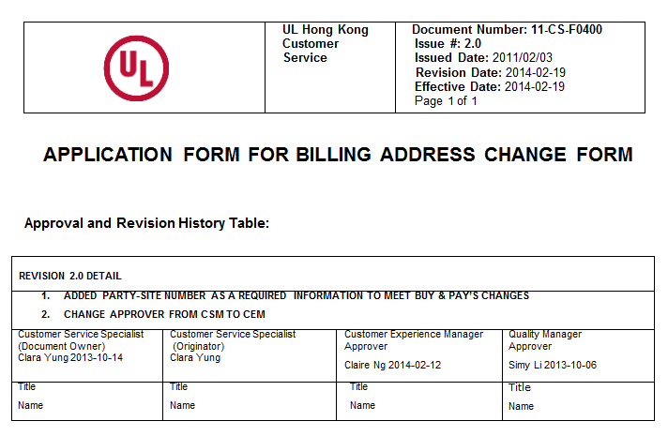
Observation 1 – from Ringo Yu
Requirement: 00-QAS0003
Clarified & Fixed
Non-Compliance:
No 2 Years Review / Review Date by Approver not matched
Responsible Person: Clara Yung / Simy Li
Evidence:
1) 11-CS-F0400, Application Form for Billing Form Address Change
2) 11-CS-F0401, Application for Name and (or) Address Change
3) 11-FI-P0400 Travel and Expenses Claim Policy – Local HK Office
From Simy : This is not an issue. Clarified with Rebecca Sarlo, evidence #1, 2 & 3 are updated forms and policy.

Slide 3
Observation 2 – from Brian Wong
Requirement : 00-OP-S0416, Issue 11, Clause 7.4, 9.2, 9.3 Table 1
For adding model name with physical change to product, Job Type should be considered as NT-Simple and L3 should be involved.
Non-compliance : Job type is selected as “Add or change model” and then no L3 is involved.
Evidence : 4786844279
Responsible Person : Else Man (CAR# 163915679)

Slide 4
Observation 3 – from Else Man
Requirement : There are two TRACEBACK control document in DCS
00-OP-F0404
00-OP-S0405
Non-compliance : There are non-compliance on 00-OP-S0405.
From 00-OP-S0404 - In order to reduce the number of SOP's we have moved the requirements out of 00-OP-S0405 into the Traceback Form 00-OP-F0404 and next 00-OP-S0405 will obsoleted. Added Steve Margis (Approver)
Evidence :
SR were created after 15 business days
ECD of SR = TAT 6 weeks, but 00-OP-S0405 → 20 business days
Responsible Person : German Cheung
Clarified & Fixed
From Simy : This is not an issue. Counter checked the corporate DCS email and confirmed that 00-OP-S0405 had been obsoleted. The existing 00-OP-F0404 didn’t lay down the TAT, when to create a SR to address traceback equipment.

Slide 5
Observation 4 – from Else Man
Requirement : Traceback for equipment with issue
Non-compliance : 4 equipment (PA048, SET001, AL012, OP001) were randomly selected, one equipment (OP001) wasn’t seen traceback has been taken, or approval to waive traceback was in evidence.
The Alert Form (11-LO-F0401) didn’t clearly indicate whether or not traceback has been taken or waiving traceback has been approved. Recommend to modify the Alert Form.
Evidence : OP001 (issue: Output reading is not accurate)
Responsible Person : German Cheung (CAR# 163915680)

Slide 6
Quick Fix 1 – from Else Man
Issue:
Models are affected by IFR (effective date: 2016-9-20)
Status Letter was sent to customer
IFR Tracking form is CLOSED in IFR DB (Lotus Notes)
Solution:
Contact IFR DB adm to RE-ACTIVE IFR Tracking Form
Responsible engineer follows up with customer on decision of affected models
Responsible Person : Jacky Yip/Kenneth Mak
Fixed

Slide 7
Quick Fix 2 – from Shannon Tsui
Requirement : 00-OP-W0038
9.3.1 Complete the Sample Identification and Measurement Instrument tables as necessary.
A. When more than one model is included in a CRD, the Sample Identification table shall identify the differences in construction. The following statement may be included in the CRD if appropriate.
“Indications of compliance apply to all samples identified with specific indications of compliance included for construction differences of the different samples.”
Non-compliance : E479533, issued 2015-10-30, Test Record No. 1 and 2, CRD:
Missing the statement “Indications of compliance apply to all samples identified with specific indications of compliance included for construction differences of the different samples.”
Quick Fix : SR3072482.829337 created
Evidence : Project 4787109187
Responsible Person : 3009FNWT
Fixed

Slide 8
Quick Fix 3 – from Shannon Tsui
Requirement : 00-OP-W0038
9.1.5 For each section or clause identified,
B. Indicate if the product construction complies, does not comply or the section or clause is not applicable.
Non-compliance : E479533, issued 2015-10-30, Test Record No. 1 and 2, CRD, Cl. SD4.4:
YES column was selected and “RATED MIN. V-1” was recorded. However, with reference to Description, components, LED package, did not employ with any V-1 material
Quick Fix : SR3072558.829416 created
Evidence : Project 4787109187
Responsible Person : 3009FNWT
Fixed

Slide 9
Quick Fix 4 – from Shannon Tsui
Requirement : 00-OP-S0416, 3.0 Definition Evaluator – Minimum L2 staff in Technical Competency db
Non-compliance :
Evaluator: Ming Tam (03515) - No XJYW TC level, No task assignment
Quick Fix: Ming was qualified as L2 by L3 with confirmation letter on 2015-05-08 and it was updated in Oracle.
Due to system error, this record was missed; a ticket will be opened to IT to solve this issue.
Evidence : Project 4787186695
Responsible Person : 3009ANWT
Fixed

Slide 10
Quick Fix 5 – from Shannon Tsui
Requirement : 00-OP-S0067, 165.4.2 Test Record Summary statement as illustrated below:
The results of this investigation indicate that the products evaluated comply with the applicable requirements and, therefore, such products are judged eligible to bear the special identification marking described on the Conclusion Page of this Report.
Non-compliance :
File E256053, Issued: 2015-12-09 and 2015-12-10, Test Record No. 1, Test Record Summary:
“... and, therefore, such products are judged eligible to bear UL’s Mark as described on the Conclusion Page of this Report…”
Quick Fix: SR created
Evidence : Project 4787186695
Responsible Person : 3009ANWT
Fixed

Slide 11
Quick Fix 6 – from Shannon Tsui
Requirement : 00-OP-S0067, 165.3.1 All Reports under the New Unlisted Component Program shall include the statement “For use only in (or with) Applicant's complete equipment where the acceptability is determined by UL LLC”
Exception: The statement may reference Underwriters Laboratories Inc. for Reports issued prior to July 1, 2012
Non-compliance :
File E256053, Vol. 10 Sec. 49 Page 2, Issued: 2015-12-10:
“Use – For use only in Applicant’s PORTABLE ELECTRIC TOOLS where the acceptability of the combination is determined by Underwriter’s Laboratories Inc.”
Quick Fix: SR created
Evidence : Project 4787186695
Responsible Person : 3009ANWT
Fixed

Slide 12
Quick Fix 7 – from Brian Wong
Project 4786959991 (3015ANWT): Missing statement “End of datasheet package” at the end of datasheet page. SR no. 3072436.829296
Project 4786660767 (3014ANWT): NOA is not profiled in eComm.
Fixed

Slide 13
Area for Improvement 1 – from Brian Wong
1. No training plan designed to Kwany Lam (46114) for L2 qualification for CCN FKSZ
Fixed. Briefed to all EM/EL

Slide 14
Area for Improvement 2 – from Paul Ip
Requirement : 00-IT-P0829, Clause 10.4 - Media Life Cycle: The media shall be disposed when it has passed the vendor recommended life cycle for that particular type of media. For any magnetic media, this type of media must be disposed after 5 years.
Non-compliance : No procedure was found to monitor the life cycle
Evidence : No record was found to keep track the life cycle
Responsible Person : Steve Wong (UL Taiwan) / Ivan Lai
(Fm Simy : Discussed with Ivan, he said he could check the purchase date of those newly purchased media by purchase description, then identify the media’s life cycle. But he won’t have the alert when the media will be overdue for 5 years. Ken Chi replied us the improvement plan and follow-up action. See attached.)
Fixed
Ken Chi’s reply
Ken Chi’s
FU action
Tape update

