Slide 1
Annual Internal Quality Audit - Closing Meeting
Lead Auditors : Simy Li, Paul Ip
Auditor : Shannon Tsui, Brian Wong, Kelvin Tsoi
Auditor Trainees : Cammy Hung, Else Man, Ringo Yu
Date : March 17-18, 2014

Slide 2
Observation 1 – from Paul Ip
Requirement : CTL 251B, the limit of leakage current was +/- 3.6% at 50/60Hz.
Non-compliance :
OS003 (Voltmeter) and TCM008 (Measuring device) were calibrated individually. However, the accuracy of completed circuit was undetermined and non-documented to be complied with CTL 251 C accuracy requirement.
Responsible Person : Wangkei Tsang
(Clarifying the requirement with corporate IQA and other affiliates. ) <Reply from Kyle : There is no problem to calibrate the Network and measurement device separately. However, the acceptance criteria of Network and measurement device should comply with 251 C and CTL-OP113( attached). Please be aware that CTL-OP -113 was published before 251C. Confirmed with Kei, we do comply with 251C and CTL-OP113. This issue is withdrawn.>

Slide 3
Observation 2 – from Paul Ip
Requirement :
00-OP-W0038, Clause 9.2.4 - identify the applicable clause in CRD
Non-compliance : identify the applicable clause in CRD
Responsible Person : Kam Chan 7407X - Project 4786179776 (Quick Fixed)

Slide 4
Observation 3 – from Paul Ip
Requirement :
00-OP-S0067 Clause 150.6.5 item K - 1. Identify the standard(s) upon which the overall product is certified in test summary
Non-compliance : Not found CSA Standard name in test summary.
Responsible Person : MICHAEL WETHERINGTON 3020X - Project 4786113354 (Quick Fixed)

Slide 5
Observation 4 – Brian Wong
Requirement : 00-LO-S0409, Issue 2.0, Clause 7.1.1
All materials will be used or disposed of by or before the supplier provided expiration date.
Non-compliance : Kerosene (ID: CC1756) with expiration date 2013/11/23 still be found in cabinet 2. (Quick Fixed)
Requirement : 00-LO-S0409, Issue 2.0, Clause 7.4.1
Stored materials shall be marked with expiration date. When an expiration date has been assigned to a critical consumable by the manufacturer, that critical consumable shall be labeled with that expiration date.
Non-compliance : Isopropyl Alcohol (ID: CC3284) with no expiration date labeled. (Quick Fixed)

Slide 6
Observation 5 – Simy Li
Requirement : 00-OP-S0417
1) Clause 9.3.1 : The candidate’s mentor evaluates the candidate’s knowledge, experience and skills against the requirements of competence requirements for High Speed Team L0 staff.
2) Clause 9.4.1 : The candidate’s mentor determines whether the Candidate is qualified to be granted a High Speed Team L0 Technical Competency.
Non-compliance : 1) No documented evidence to evaluate the candidate’s knowledge, experience and skills against the competence requirements for HST L0 staff.
2) HST L0 staff haven’t been granted Technical Competency.
Evidence : 1) LMS record is not complete. No evaluation on competency requirements of HST staff and 2) No TC for HST L0
(Remarks : HST L0 staff were qualified by grandfathered rule. Therefore they don’t go through all the qualification process.)
Responsible Person : Else Man (Else documented back all her HST staff’s TC and training records before Simy created the CAR. This observation has been resolved and will not be entered into the CAR DB.)
Qualification of HST L0
Training record of HST L0 staff_AmyWong

Slide 7
Observation 6 – Simy Li
Requirement : High Speed Team members work closely with Review staff to ensure that appropriate and accurate Technical Judgment is being applied.
Non-compliance : No documented communication was recorded between the Review staff and L0 for the revised temperature rating.
Evidence : Same as above
Responsible Person : Flora Heung (Quick Fixed)

Slide 8
Observation 7 – from Simy Li
Requirement : 11-QA-P0400
Clause 9.7.7 : Disaster recovery drill shall be conducted annually
Non-compliance : Last disaster recovery drill was done in 2010.
Evidence : No disaster recovery (DR) drill was conducted in 2013 and 2014 DR plan is being developed.
Responsible Person : Winson Chau
(Remarks : Winson will update HKMT why there was no DR drill for 2013 and the current status of DR plan for 2014.)
IT DR Drill

Slide 9
Observation 8 – from Shannon Tsui
Requirement : 00-OP-C0032
Each calibration certificate is to include a valid accreditation body endorsement for the calibrations performed in the form of an accreditation body logo.
Non-compliance :
No accreditation body logo (CNAS) in Calibration Certificates for a WTDP customer.
Clock UL120401 (Page 4)
Temp./R.H. Recorder UL101 (Page 28)
Crushed UL200 (Page 62)
Printing Friction YCCT-350 (Page 73)
Caliper JH1602 (Page 76)??
Evidence : 13CA54789
Responsible Person : Pan Sze (Resolved. Issued a SR to upload all the 5 calibration certificates to DMS)
Email
E-prod / SR

Slide 10
Observation 9 – from Shannon Tsui
Requirement : 00-LO-S0829, Cl. 6.1.1
All records shall be provided in English.
Non-compliance :
With reference to File E315696, Issued 2009-05-16, Test Record No. 3, DS1, Page 7, some records were provided in Chinese, not English
Evidence : 13CA54789
Responsible Person : 3014ANWT
Quick Fixed: A SR is created to make revisions

Slide 11
Observation 10 – from Shannon Tsui
Requirement : 00-LO-S0829, Cl. 6.1.3G
When recording dates on all testing related records the yyyy-mm-dd format shall be used.
Non-compliance :
With reference to File E315696, Issued 2009-05-16, Test Record No. 3, DS1, Page 6, the yyyy-mm-dd format were not be used, when recording dates on Test Equipment Information (Last Cal. Date & Next Cal Date).
Evidence : 13CA54789
Responsible Person : 3014ANWT
Quick Fixed: A SR is created to make revisions

Slide 12
Observation 11 – from Shannon Tsui
Requirement : UL 60950-1, Cl. 5.3.1, 5.3.4, 5.3.7
If the circuit was interrupted by the opening of a component of unknown reliability, the test shall be repeated twice (three times total) using new components as necessary.
Non-compliance :
With reference to File E333437, Issued date 2013-08-08, Test Record No. 4, DS1, Page 74, Component Failure Test was not repeated twice (three times total), when the circuit was interrupted by the opening of a component of unknown reliability (U20)
Evidence : 13CA42856
Responsible Person : 3009FNWT
Quick Fixed: Project Handler confirmed with lab, U20 and other components were damaged during test. Revision has been made under SR325562.111391.

Slide 13
Observation 12 – from Shannon Tsui
Requirement : 00-OP-W0038 , Cl. 9.1.3B
When the CRD is completed at a UL facility, measurement equipment information shall be recorded electronically in the Meter Use tool in UL's Laboratory Project Management (LPM) database. On the Test Equipment Information Sheet, check the checkbox adjacent to the following statement.
[ ] UL measurement equipment information is recorded on Meter Use in UL’s Laboratory Project Management (LPM) database.
Non-compliance :
With reference to E32247-20100312-TestRec10-CR, Page 1, the checkbox adjacent to the following statement was not checked:
[ ] UL measurement equipment information is recorded on Meter Use in UL’s Laboratory Project Management (LPM) database.
Evidence : Project 4786177929
Responsible Person : 7407XNWT
Quick Fixed: Revision was made under SR.

Slide 14
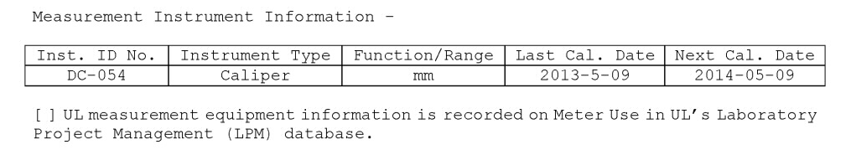
Observation 13 – from Cammy Hung
Requirement : 00-LO-S0829 6.1.3G
When recording dates on all testing related records the yyyy-mm-dd format shall be used.
Non-compliance :
The last cal. Date in CRD in yyyy-m-dd format
Evidence : 4786186597
Responsible Person : 3011BNWT (Quick Fixed)

Slide 15
Observation 14 – from Cammy Hung
Requirement : 00-OP-S0044 9.15
Stop/Follow-Up Dates/Revised Estimated Completion Dates (ECDs) Guide
Non-compliance :
ECD: 2014-02-12
NoA: 2014-02-15
Evidence : 4786186597
Responsible Person : 3011BNWT (Quick Fixed)

Slide 16
Observation 15 – from Cammy Hung
Requirement : 00-IC-S0036 9.6.8
Calibration certificates for each piece of test equipment used is collected during the Witness Test program and retained with the data sheet package.
Non-compliance :
The cal cert record in DMS is incomplete (just have first 2 pages)
Evidence : 4786186597
Responsible Person : Angel Siu (CAR #143913086)

Slide 17
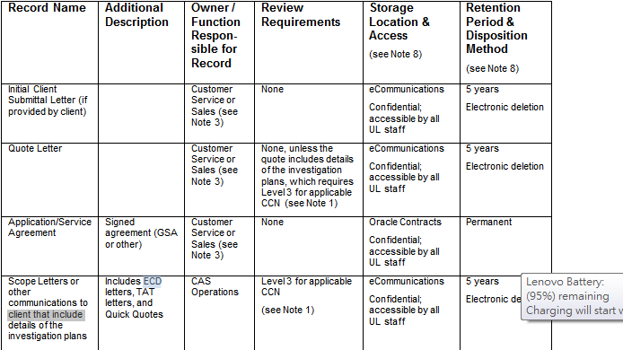
Observation 16 – from Cammy Hung
Requirement : 00-CE-S0030 Table 7.1
Non-compliance :
No ECD/TAT letter are found in eComm
Evidence : 13CA56451
Responsible Person : 3014ANWT
(Comment from Simy : This is a possible finding. Further random sampling on the PH for any missing ECD / TAT letter to be filed to e-Comm.)

Slide 18
Global Issue: Missing ECD/TAT/PP Letters - last update 07/08/2013
Issue Summary: ECD letters, TAT letters, and Quick Quotes communicating to client details of the investigation plans are not found in eComm
As a result, if a nonconformance is discovered pertaining to an ECD or TAT letter or quick quote missing or not sent to a client, and the project was opened on or after July 1, 2013 for any Product Safety Project and on or after August 1, 2013 for Verification Services Small Appliance Projects, CAR 123911191 cannot be used to support the corrective action response.
If a CAR is generated by an accreditor as an observation, CAR Administrators are instructed to turn the CAR into a finding in the GCAR Database. Any issues discovered by Internal Audits are to be issued as a finding. For any finding generated, please add Gunsimar Paintal as an optional recipient.
CAR Responses that include any form of the below should only be accepted with the written concurrence of Denise Echols or Joe Taylor.
- Staff did not understand requirements - Staff need training - Human error - Isolated issue

Slide 19
Further Checking
Proj Ref | ECD/TAT
13CA53986 | Y (TAT)
4786198450 | Y (ECD)
12ME08280 | Y (TAT)
13CA25100 | Y (TAT)
13CA36482 | Y (TAT)
13CA37993 | Y (TAT)
4786186492 | Y (ECD)
11CA61897 | Y (TAT)
4786126179 | Y (TAT)
12CA62731 | Y (TAT)
12CA46807 | Y (TAT)
12CA17529 | Y (TAT)
4786175726 | Y (ECD)
4786099468 | Y (ECD)
Conclusion : 1/15 was found without ECD. Corrective action:To e-comm back the ECD.

Slide 20
Recommendation 1 – from Paul Ip
Issue : Gage R&R for 3027C, Construction Review Test was repeated on 2012 and 2013.
Recommendation: Suggest selecting other tests in 2014.
Responsible Person : Violet Pau

Slide 21
Recommendation 2 – from Paul Ip
Issue : In-House Calibration Document
Recommendation:
Traceability Chart was not found. - The traceability is not documented and the documentation cannot be reproduced if requested. (5.6.2.1.1 Note 2)
Recommendation: There is no equipment recall system SOP (to identify calibration equipment requiring re-calibration).
Responsible Person : German Cheung

Slide 22
Recommendation 3 – from Simy Li
Issue : New Staff Training Program
The raw data of the training quiz, evaluation or projects handled can be uploaded to LMS but cannot be retrieved. When retrieval is required, the individual staff needs to go to her personal folder to find the raw records.
Recommendation : As it is a system bug in LMS that the attachment cannot be read, it is recommended to retain the raw records centrally in KMS or shared folder or filing area.
Responsible Person : Else Man (Else will create a sharepoint and EM/EL will upload the training raw data to the sharepoint. To be followed out of the CAR DB.)

Slide 23
Recommendation 4 – from Simy Li
Issue : Document Control
Most of the interviewed staff mentioned that they will read the standard from website except one staff who mentioned that she would read the standard from her hardcopy standards placed in the box file.
No subscription of DDS for the frequently used standards.
Non-compliance : Interviewed Staff
Responsible Person : Angel Siu (Done. The staff subscribe DDS.)
DDS_Email
Training Record_HST staff

Slide 24
Recommendation 5 – from Shannon Tsui
Observation :
Quote letter was issued under “old” Quote No. 1001674824, not Quote 1001681845. A comment was added in eProd “Pls. refer the application detail under previous Quote #1001674824 and Order #7736015”.
Evidence : Project 13CA54789 (Quote 1001681845, Order 7779442)
Responsible Person : 3024TGCR
Recommendation: To add reason why the quote no. was changed.

Slide 25
Recommendation 6 – from Else Man
Requirement : ISO/IEC 17025, Clause 4.4.5
If a contract needs to be amended after work has commenced, the same contract review process shall be repeated and any amendments shall be communicated to all affected personnel
Evidence :
Project File: E161964
Revised page: E77849
File E161964 (original applicant) was transferred to File E77849 after project was opened.

Slide 27
THANK YOU

