Slide 1
CAR Database Updates
October 2009

Slide 2
GCAR Database Updates
Fields removed from CARs
Fields renamed – keeping same functionality
Fields moved to a different location within the CAR
Newly added fields
Owner’s Assistant processing
Extension request processing (greater than 30 days or more than 3 requests)

Slide 3
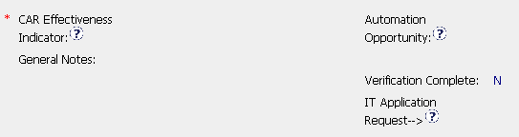
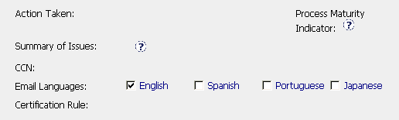
Fields Removed
CAR Owner area:
CAR Admin Review area:

Slide 4



Name Changes – Same Functionality
CAR Origination area:
Old Name
New Name
Old Name
Old Name
New Name
New Name

Slide 5


Name Changes – Same Functionality
CAR Owner area:
Old Name
New Name

Slide 6


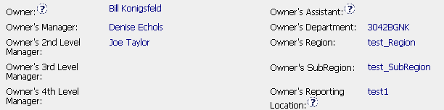
Fields Relocated
Moved from CAR Origination area:
(1)
(2)
(3)
NOTE: CAR Admin is now responsible for completing these 3 fields.
To CAR Admin Review area:
(1)
(2)
(3)

Slide 7
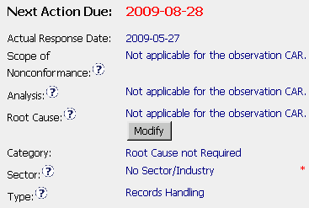
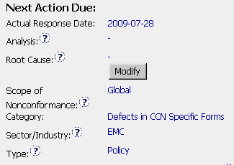
Fields Relocated
Within CAR Owner area:
Old
Location
New
Location

Slide 8
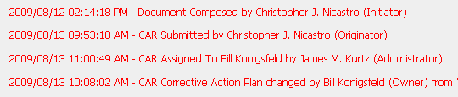
New Fields Added
Comments area and Milestones:
The Comments area and Milestones now indicate the role of the the person who made changes to the CAR.

Slide 9
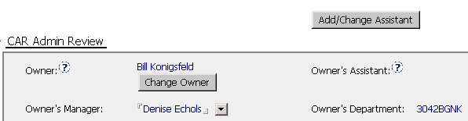
New Fields Added
CAR Admin Review area:
Owner’s Assistant
Person who will input information into the CAR for the owner
Add/Change Assistant
Allows CAR Owner to select someone to edit the CAR for him/her
CAR Owner remains responsible for CAR through CAR closure

Slide 10


Extensions
The CAR database will send extension requests to the CAR Process Owner for approval when:
  There are more than 3 extensions for the response
  There are more than 3 extensions for a milestone
  The extension is for more than 30 days beyond the Next Action Due date
If greater
than 30 days
4
If greater
than 3
4
NOTE: The CAR Administrator no longer forwards these requests to the CAR Process Owner.

Slide 11
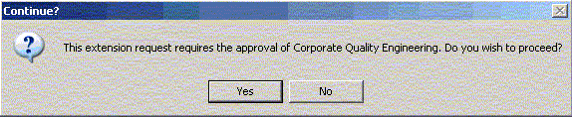
Extensions
Extensions for greater than 30 days or more than 3 requests:
  Notification that approval is required for the extension request is provided.
  Option to not proceed with the request is provided.

Slide 12
Questions?

