Slide 1
CAR Database Updates
October 2009
October 28, 2009, Rev. 2
For questions or comments on the content, please contact Cheryl Allison

Slide 2
GCAR Database Updates
Fields removed from CARs
Fields renamed – keeping same functionality
Fields moved to a different location within the CAR
Newly added fields
Owner’s Assistant processing
Extension request processing (greater than 30 days or more than 3 requests)

Slide 3
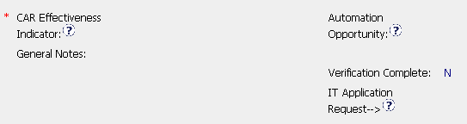
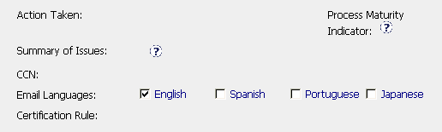
Fields Removed
CAR Owner area:
CAR Admin Review area:

Slide 4



Name Changes – Same Functionality
CAR Origination area:
Old Name
New Name
Old Name
Old Name
New Name
New Name

Slide 5


Name Changes – Same Functionality
CAR Owner area:
Old Name
New Name

Slide 6


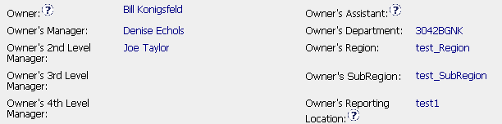
Fields Relocated
Moved from CAR Origination area:
(1)
(2)
(3)
NOTE: CAR Originator is responsible for completing these 3 fields.
To CAR Admin Review area:
(1)
(2)
(3)

Slide 7
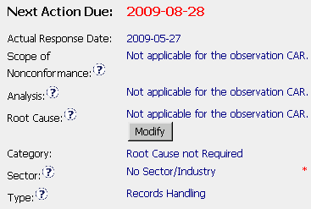
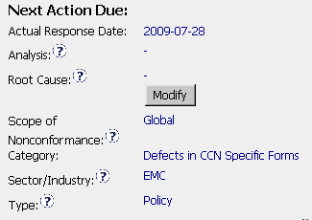
Fields Relocated
Within CAR Owner area:
Old
Location
New
Location

Slide 8
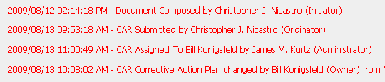
New Fields Added
Comments area and Milestones:
The Comments area and Milestones now indicate the role of the the person who made changes to the CAR.

Slide 9
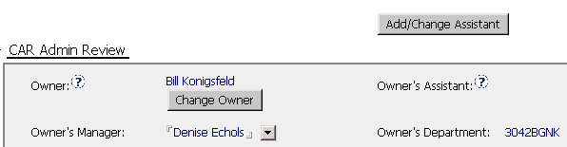
New Fields Added
CAR Admin Review area:
Owner’s Assistant
Person who will input information into the CAR for the owner
Add/Change Assistant
Allows CAR Owner to select someone to edit the CAR for him/her
CAR Owner remains responsible for CAR through CAR closure

Slide 10


Extensions
The CAR database will send extension requests to the CAR Process Owner for approval when:
  There are more than 3 extensions for the response
  There are more than 3 extensions for all milestones
  The extension is for more than 30 days beyond the Next Action Due date
If greater
than 30 days
4
If greater
than 3
4
NOTE: The CAR Administrator no longer forwards these requests to the CAR Process Owner.

Slide 11
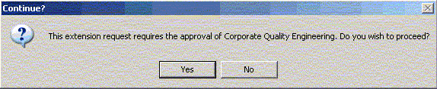
Extensions
Extensions for greater than 30 days or more than 3 requests:
  Notification that approval is required for the extension request is provided.
  Option to not proceed with the request is provided.

Slide 12
Revisions
Revision 1 – October 19, 2009, Original release
Revision 2 – October 28, 2009
  Owner’s Region, Owner’s SubRegion and Owner’s Reporting location are now editable by the CAR Originator. These fields are to be completed by the CAR Originator and not the CAR Administrator.
  Extensions - The CAR database will send extension requests to the CAR Process Owner for approval when there are more than 3 total extensions for all milestones.

