Slide 1
CAR Administrator Training
April 20, 2009, Rev. 3
For questions or comments on the content, please contact Cheryl Allison or Kathy Lindstrom
Notes:
Training consists of this module and three workshops:
Root Cause Analysis workshop
Corrective Action Plan workshop
CAR Database workshop
This training can be used for both current CAR Admins as well as new CAR Admins.
NOTE: New CAR Admins must be familiar with the 00-QA-S0006 Corrective Action Request Process SOP prior to attending this training.

Slide 2
Agenda
Purpose
CAR Categories
CAR Process (00-QA-S0006)
  CAR Administrator Responsibilities
  CAR Owner Responsibilities
Root Cause Analysis Workshop
Corrective Action Plan Workshop
Other CAR Admin Responsibilities
CAR Database Workshop

Slide 3
Purpose
Provide for consistency among CAR Admins
Training for new CAR Admins
Notes:
Current CAR Admins will benefit from this training as a refresher of CAR Admin responsibilities.
This training will help to ensure consistency among all CAR Admins at UL.
New CAR Admins will begin learning CAR Admin duties from this training.
New CAR Admins must be familiar with the 00-QA-S0006 Corrective Action Request Process SOP prior to attending this training.

Slide 4
CAR Categories
There are two CAR categories
Finding: A nonconformance to a requirement or procedure that is at least one of the following:
  Systemic
  Recurring
  Severe
Notes:
The two CAR categories are Findings and Observations.
This slide and the next one provides a definition for each of these.
Provide examples of Findings.

Slide 5
CAR Categories
Observation: A nonconformance that does not appear to be systemic, recurring or severe. An observation may also be an opportunity for improvement.
  One time occurrence
    No analysis or root cause statement necessary
    Need to fix the occurrence
  Opportunity for improvement
    Owner determines if they will act on the opportunity
Notes:
Provide examples of Observations.
Point out the differences between the examples of Observations and the examples given for Findings.
Give examples to illustrate the difference between a general observation CAR and an opportunity for improvement observation CAR.

Slide 6
CAR Process
Notes:
Transition slide to start the discussion of the CAR process. The specific topics are listed on the next slide.

Slide 7
CAR Process
Topics
  CAR Administrator Responsibilities
    Reviewing a CAR
    Assigning a CAR Owner
    Coaching CAR Owners
  CAR Owner Responsibilities

Slide 8
CAR Administrator Responsibilities
Reviews CAR
Should it be a CAR?
Why would it not be a CAR?
  No linkage to a requirement
  Existing CAR
  Did the initiator try to resolve this through normal channels?
    Customer Complaint process,
    Certification Requirement Decision (CRD) process,
    Contact those involved with the problem, etc.
Notes:
Explain that CARs can be forced close if they should not be CARs.
Emphasize that a CAR may still be needed even if it does go through the Customer Complaint process, CRD, etc.

Slide 9
CAR Administrator Responsibilities
Reviews CAR, cont.
Checks the corrective action plan to ensure that it does not conflict with:
  ISO/IEC Standards such as 17025, 17020 and Guide 65
  UL policies or procedures
  Accreditor requirements such as OSHA regulations and CTL decisions

Slide 10
CAR Administrator Responsibilities
Reviews CAR, cont.
Is it a Repeat CAR?
CAR (findings only) meeting the following:
  CAR written against the exact same department/program/function/site/sector for the same issue.
  CAR written as the exact issue and level (local, regional or global) or as the exact issue at a lower level than previous CAR, i.e.,
    previous and current CAR are both local
    previous and current CAR are both global
    previous CAR was global the current CAR is local
  In all cases, the previous CAR was closed as “verified effective”
Notes:
CAR Admins must determine if a CAR is a “Repeat CAR”. If so, they must select the “Repeat CAR” box on the first page of the CAR database screen.

Slide 11
CAR Administrator Responsibilities
Assigns Owner
  Assigns it at the appropriate level (e.g., process owner) and to the appropriate group (e.g., within CAS) that can actually make the changes necessary
  Process or policy issue: assign to policy or process owner (See 00-QA-P0031, Global Policy and Process Owners Matrix)
  See 00-QA-S0006
Notes:
The SOP 00-QA-S0006 provides a table to assist with assigning CAR owners.

Slide 12
CAR Administrator Responsibilities
Coaches CAR Owners
  How much help do you give?
  Explaining the scope of the CAR
  Training on Root Cause
  Guidance on Corrective Action Plan
Notes:
How much help – Emphasize that CAR Admins assist but are not responsible for doing the work.

Slide 13
CAR Owner Responsibilities
Accepts responsibility for the CAR
Determines scope of problem
Responsible for containment
Determines root cause and corrective action plan (CAP)
Implements the CAP
Notes:
Discuss facilitating discussions with the potential CAR owner/s regarding ownership. Discuss resistance to accept ownership and how to resolve those concerns.
Scope – Remind that scope is determined after at least part of the root cause analysis is complete.
Containment – Define it and emphasize the importance. More is included in the Corrective Action Plan workshop.

Slide 14
CAR Owner Responsibilities
Provides description of how they will determine effectiveness
Establishes and submits milestones
Requests extensions through the database
Notes:
Determine effectiveness - Emphasize that the CAR owner must plan for how they will determine that the corrective actions were effective. Stress that this is the owner’s responsibility prior to closing a CAR.

Slide 15
Workshop on Root Cause

Slide 16
Corrective Action Plans

Slide 17
Elements of a Corrective Action Plan
Containment
Addresses the objective evidence
Addresses the root cause to prevent recurrence
All the milestones fully address what the nonconformance describes and covers all steps of CAP
Statement of how owner will verify effectiveness
Notes:
Provide high-level descriptions for these. They are discussed in detail in the Corrective Action Plan workshop.

Slide 18
Workshop on Developing Corrective Action Plans

Slide 19
Other CAR Admin Responsibilities

Slide 20
Other CAR Admin Responsibilities
Acts on CARs within 14 calendar days of response, implementation submission, request for extension, etc.

Slide 21
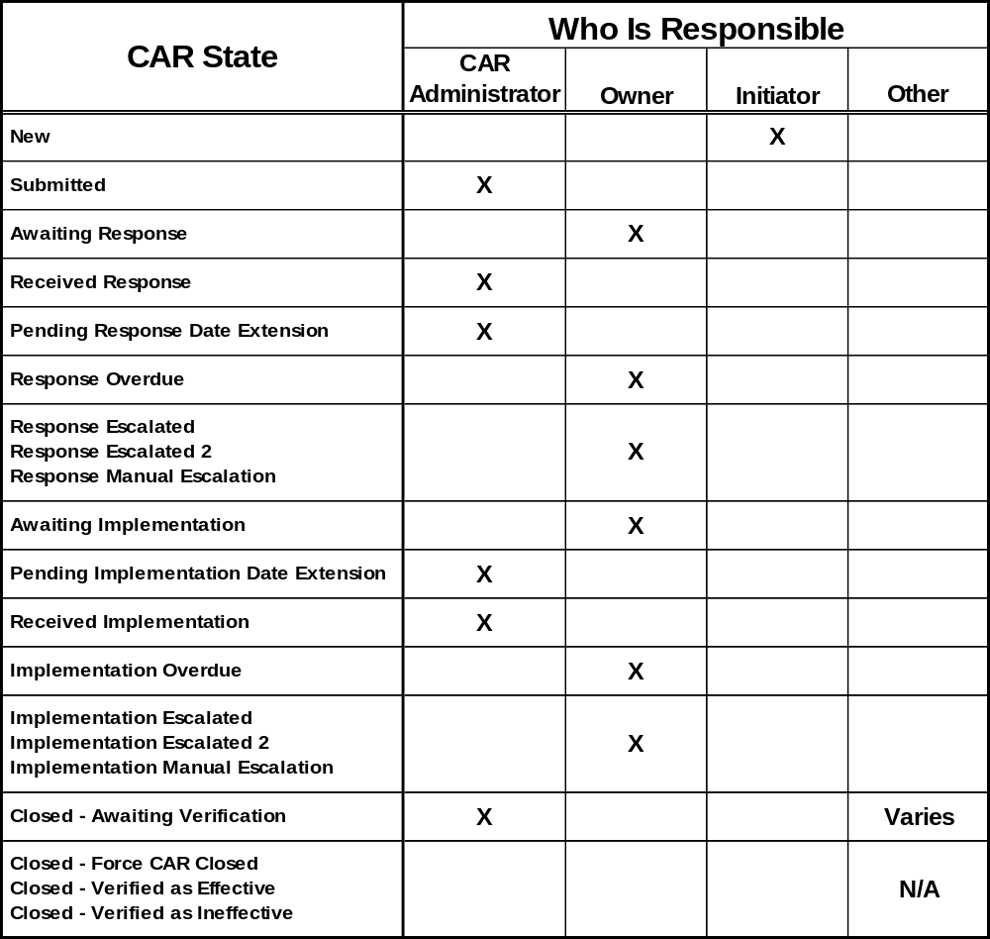

Slide 22
Other CAR Admin Responsibilities
Reviewing Implementation
  Is the response complete?
  Documents are revised and published in doc control
  Revised records are published in DMS, etc.
    Links should be to the official record (i.e., DMS, not to ePro)
  Were all steps of CAP covered?
Notes:
Emphasize the importance of each item.
Emphasize that it is important to ensure that updated documents do not conflict with higher level documents, accreditor requirements and standards.

Slide 23
Other CAR Admin Responsibilities
Reviewing Implementation, cont.
  Training records – actual evidence such as a sign-in sheet, not just owner saying it was done. Note: E-mails are usually not an effective means of training.
  If CAP changed, ensure that it still fully addresses the nonconformance.
Notes:
Emphasize the importance of each item.

Slide 24
Other CAR Admin Responsibilities
CAR Extensions
  Is it a legitimate reason for extension?
  If more than 30 days, or more than the 3rd extension, needs approval of the CAR Process Owner
  CAR owner should request an extension through the CAR database, and not send the CAR Admin an e-mail with the request
Notes:
Stress that the CAR Admin should challenge questionable requests.
It may help to get the owner’s manager involved.
Emphasize the requirement for granting extensions 30 days or more, or more than the 3rd request. These must be approved by the CAR Process Owner.

Slide 25
Other CAR Admin Responsibilities
CAR Extensions, cont.
  If CAR is overdue, owner can’t request an extension via the database, but you can change the state and the date if you feel it’s a valid request (unless more than 30 days, or more than 3rd extension).

Slide 26
Other CAR Admin Responsibilities
Closing CARs and Verifying Effectiveness
  For both Findings and Observations:
    Verifies the objective evidence has been addressed
    Verifies all milestones are complete
    Closes the CAR (Closed – Awaiting Verification)
    Verifies effectiveness for certain Finding CARs (see CAR website) and for all Observation CARs
Notes:
Remind them that Observations are no longer forced close.

Slide 27
CAR Database Workshop

