Slide 1
CAR Owner Training
March 28, 2011, Initial Release
For questions or comments on the content, please contact Cheryl Allison

Slide 2
Topics
Purpose
CAR Categories
CAR Owner Responsibilities
CAR Database
Familiarization
Assigning Owner’s Assistant
CAR Owner Resources

Slide 3
Purpose

Slide 4
Purpose
Explain CAR Owner responsibilities and expectations
Familiarize CAR Owners with the parts of a CAR they must complete
Introduce CAR website and FAQs
Explain other parts of a CAR via training on how to create a CAR
Become familiar with the CAR Database
Provide resources for help

Slide 5
CAR Categories

Slide 6
CAR Categories
There are two CAR categories: Findings and Observations
Finding
A nonconformance to a requirement or procedure that is at least one of the following:
Systemic
Recurring
Severe

Slide 7
CAR Categories, cont.
Observation
A nonconformance that does not appear to be systemic, recurring or severe. An observation may also be an opportunity for improvement.
One time occurrence
No analysis or root cause statement necessary
Need only to fix the occurrence
Opportunity for improvement
A nonconformance is not present
Owner decides if they will act on the opportunity

Slide 8
CAR Owner Responsibilities

Slide 9
CAR Owner Responsibilities
Accepts responsibility for the CAR
*Performs an analysis of the nonconformance
*Determines root cause
*Determines scope of problem
Develops a corrective action plan (CAP)
Creates milestones
Acts on CARs by due dates
* For Finding CARs only – does not apply to Observation CARs

Slide 10
1. Accepts Responsibility for CAR
CARs are assigned to the individual with the authority to resolve the issue and obtain the best result in preventing recurrence of the issue.
If you think that someone other than you should be the owner of a CAR, discuss this with the CAR Administrator.

Slide 11
1. Accepts Responsibility, cont.
CAR owners often work with other UL departments to resolve CAR concerns.
As CAR owner, you enlist the support and approval of other UL departments for their completion of any necessary actions.
Examples:
IT for system updates
Document owners to make updates for policy or process exceptions

Slide 12
1. Accepts Responsibility, cont.
CAR owners may assign an Owner’s Assistant
A person designated by the CAR Owner to act on a CAR on the CAR Owner’s behalf.
The Owner’s Assistant is given the same edit abilities for the CAR as the CAR Owner (able to input analysis, create milestones, submit implementation, request extensions, etc.).
The CAR Owner continues to remain responsible for the CAR through closure even if an Owner’s Assistant has been designated.

Slide 13
1. Accepts Responsibility, cont.
Review FAQ #4 on the CAR website: “What should I consider when I Assign CARs to owners?”

Slide 14
2. Performs Analysis*
A thorough analysis is key to resolving the nonconformance
Analysis determines the cause of the nonconformance and why the problem was not previously detected
Stakeholders are consulted
Records and other documents are reviewed
* For Finding CARs only – does not apply to Observation CARs

Slide 15
2. Performs Analysis, cont.
Key Components to the Analysis:
Review the nonconformance
Choose a method to analyze the problem
Get the right people involved
Determine the bottom line reason for the problem (root cause)
Determine the scope of the problem

Slide 16
2. Performs Analysis, cont.
Review the nonconformance
Understand the requirement that was not adhered to
Review the objective evidence
Understand the problem – the nonconformance

Slide 17
2. Performs Analysis, cont.
Methods to Analyze the Problem
This is a partial list of methods that you may want to investigate further:
The 5 Whys
Keep asking “Why” – it may be more or less than 5.
Be reasonable – know how deep to go and when to stop.
If you think you are done, ask one more “Why?” to be certain.

Slide 18
2. Performs Analysis, cont.
Methods to Analyze the Problem, cont.
Fishbone Diagrams
Visual method to organize ideas and see relationships
Pareto Diagram
Used for analyzing data
Brainstorming
Used to generate lots of ideas from stakeholders

Slide 19
2. Performs Analysis, cont.
Get the Right People Involved
Who was there when the problem occurred?
Who understands the system or process involved? May require the involvement of the process or policy owner.
Who has the skills to help?
Requires someone with the appropriate authority, especially if it is a widespread problem.

Slide 20
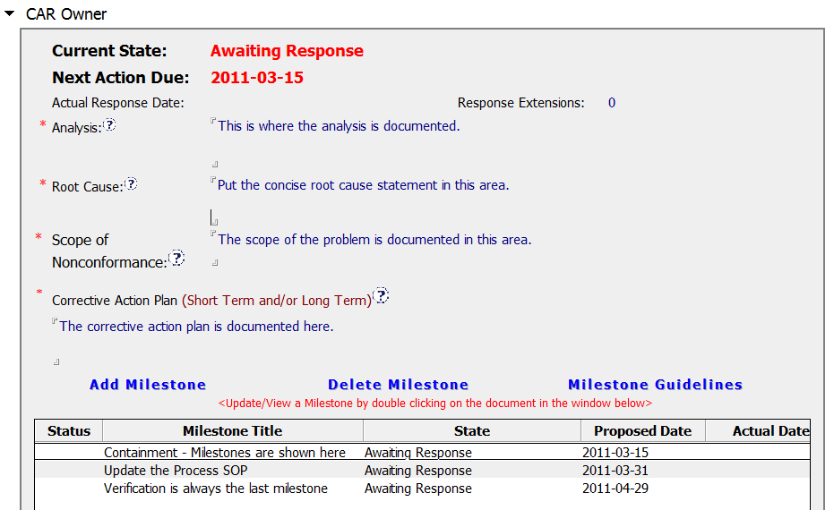
2. Performs Analysis, cont.
Analysis
Section

Slide 21
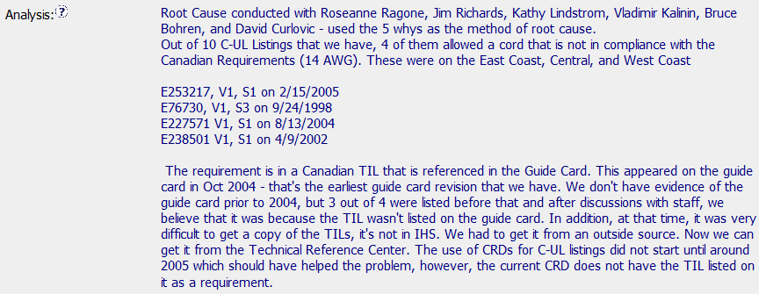
2. Performs Analysis, cont.
Analysis Example
Stakeholders Involved
Scope
Determined
Records
Reviewed
Analysis
Method
Used
Cause
Determined

Slide 22
2. Performs Analysis, cont.
Review FAQ #18 on the CAR website: “What should be included in the Analysis section of a CAR?”

Slide 23
3. Determines the Root Cause*
What is a Root Cause?
Root cause is the bottom line reason why a problem exists
You want to find the root cause so that by addressing it, you prevent the problem from happening again
* For Finding CARs only – does not apply to Observation CARs

Slide 24
3. Determines the Root Cause, cont.
Analysis vs. Root Cause Statement
Analysis:
Shows your thought process: How did you get to the root cause?
Root Cause Statement:
One or two sentences summarizing the bottom line reason the problem occurred

Slide 25
3. Determines the Root Cause, cont.
The Root Cause:
Naturally flows from the analysis
Has linkage to the nonconformance statement
Explains the cause and does not restate the nonconformance

Slide 26
3. Determines the Root Cause, cont.
Root Causes to Further Explore
Human Error
Root cause investigation BEGINS with an operator error. What in the process allowed such an error to occur?
Training
What failed in regards to training? Does the initial training need to be more comprehensive? Would recurrent training be of help?

Slide 27
3. Determines the Root Cause, cont.
Root Causes to Further Explore
Knew the requirement but chose not to follow it
Why did someone choose to not follow the process? Are SOPs and work instructions accessible? Is the process too cumbersome?
This shouldn’t be a CAR
See the CAR Administrator for guidance on resolving this.
A restatement of the problem
A statement of a symptom

Slide 28
3. Determines the Root Cause, cont.
Avoid including inappropriate statements in the root cause and elsewhere in the CAR. This includes, but is not limited to:
Employee discipline
Personal complaints
Disparaging remarks about UL, employees, or others

Slide 29
3. Determines the Root Cause, cont.
Root
Cause
Section

Slide 30
3. Determines the Root Cause, cont.
Root Cause Example
Concise… Addresses the nonconformance completely…
…Flows naturally from the Analysis… Bottom line reason for the nonconformance

Slide 31
3. Determines the Root Cause, cont.
Review FAQ #19 on the CAR website: “What should be included in the Root Cause section of a CAR?”

Slide 32
4. Determines Scope*
The objective evidence provided with the nonconformance does not describe the entire scope of the problem.
Based upon the analysis, determine how widespread the problem is.
Is the problem local? Regional? Global?
* For Finding CARs only – does not apply to Observation CARs

Slide 33
4. Determines Scope, cont.
Scope of
Nonconformance
Section

Slide 34
4. Determines Scope, cont.
Scope of Nonconformance Example
How widespread is the problem… Global? Regional? Local?

Slide 35
4. Determines Scope, cont.
Review FAQ #17 on the CAR website: “What should be included in the Scope of Nonconformance section of a CAR?”

Slide 36
5. Develops a Corrective Action Plan
Elements of a Corrective Action Plan
Containment
Stops “the bleeding”
Immediate, short-term action
If containment is not required, explain rationale
Containment usually is the first milestone
Addresses the objective evidence

Slide 37
5. Develops a CAP, cont.
Elements of a Corrective Action Plan, cont.
Addresses items that were not specifically identified in the objective evidence
Addresses the root cause to prevent recurrence

Slide 38
5. Develops a CAP, cont.
Elements of a Corrective Action Plan, cont.
Statement of how owner will verify effectiveness of actions completed
Addressed in the last milestone
Owners must verify effectiveness before CAR is closed
Ensures that the corrective action worked to prevent the problem from happening again
Ensures that new problems have not been created

Slide 39
5. Develops a CAP, cont.
Corrective
Action Plan
Section

Slide 40
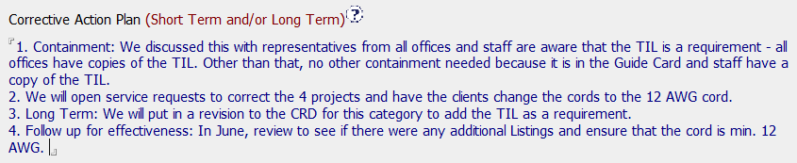
5. Develops a CAP, cont.
Corrective Action Plan Example
Addresses the
Objective Evidence and
Other Items Found
Containment
Owner’s Verification
of Effectiveness
Addresses the
Root Cause

Slide 41
5. Develops a CAP, cont.
Elements of a Corrective Action Plan, cont.
Review FAQ #20 on the CAR website: “What should be included in the Corrective Action section of a CAR?”

Slide 42
6. Creates Milestones
Milestones
Fully address the nonconformance and all steps of CAP
Appropriate steps with appropriate timeline
Can combine pieces of the corrective action plan into one milestone
It is often effective to group related actions into one milestone.
Example: For a document update, (1) the draft along with (2) stakeholder comments and (3) evidence of submission to KMS can all be in one milestone instead of three separate milestones.

Slide 43
6. Creates Milestones, cont.
Milestone
Section

Slide 44
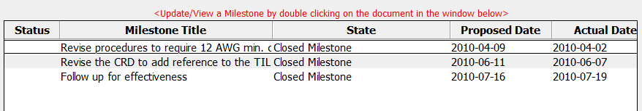
6. Creates Milestones, cont.
Milestones Example
Fully Addresses the Corrective Action Plan… Reasonable timeframes…
…Verification of Effectiveness is last milestone … (Note: Containment would be
the first milestone – in this case, containment has already been completed.)

Slide 45
6. Creates Milestones, cont.
You may attach records, documents, links, etc. within each milestone.
Supporting evidence is required to demonstrate the completion of the milestone
Paste links in the “Attachments” area
Use the “Attachments” button to select documents to attach

Slide 46
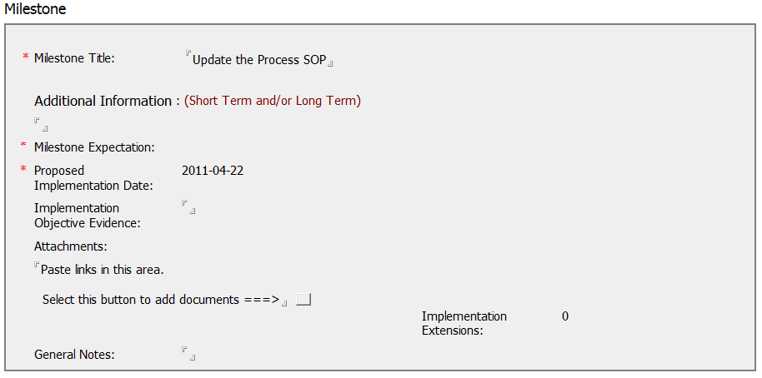
6. Creates Milestones, cont.

Slide 47
6. Creates Milestones, cont.
Review FAQ #15 on the CAR website: “Is there a Checklist for CAR Owner help?”

Slide 48
7. Acts on CARs by Due Dates
CARs will escalate to successively higher levels of CAR owner management if not addressed by due dates
Extensions are requested through the database when due dates cannot be met
CAR Administrators review extension requests
Requests may be denied for business reasons, to meet Accreditor deadlines, if sufficient CAR progress is not being made, etc.

Slide 49
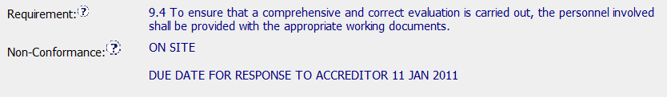
7. Acts on CARs by Due Dates, cont.
Accreditors may require specific response timeframes. CAR responses must meet these dates.

Slide 50
CAR Database

Slide 51
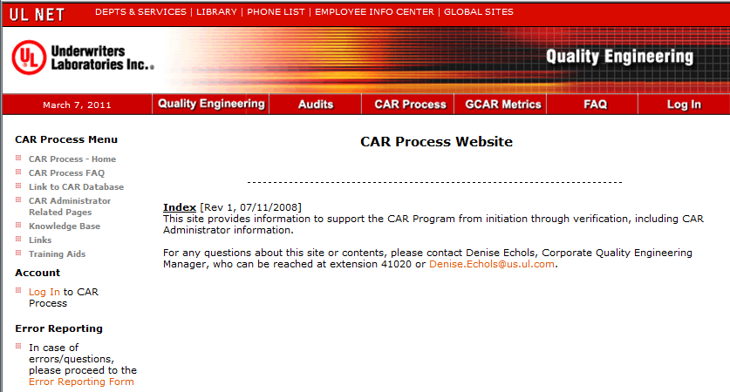
CAR Database
Access the CAR Database via the CAR Process Website:

Slide 52
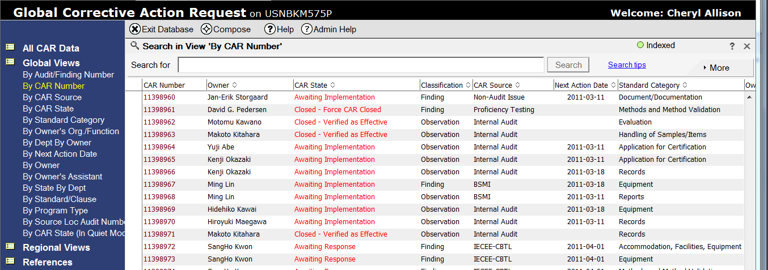
CAR Database, cont.
View: By CAR Number

Slide 53
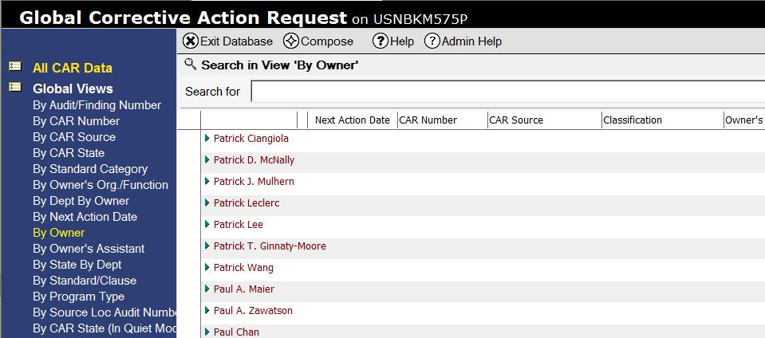
CAR Database, cont.
View: By CAR Owner

Slide 54
Creating CARs
The presentation on creating CARs helps a CAR owner to better understand:
The meaning of the fields on “CAR Origination” page
Why a nonconformance exists
The requirements of the CAR database, such as identifying the fields required to be completed
Review FAQ #29 on the CAR website: “How Do I Create a New CAR?”

Slide 55
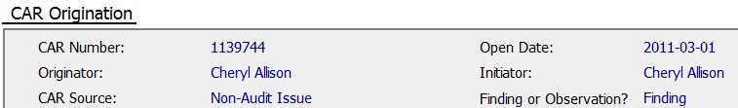

Attaching Documents
Attach documents that support the analysis in the “Attachments/Comments” area of the CAR.
Remember: Milestone related information is attached within the milestone
.
.
.

Slide 56
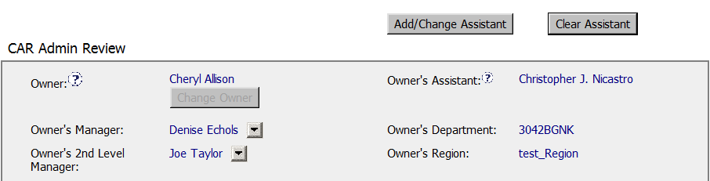
Assign Owner’s Assistant
To Assign/Remove an Owner’s Assistant:
Remove
Owner’s
Assistant
Add
Owner’s
Assistant

Slide 57
CAR Owner Resources

Slide 58
CAR Owner Resources
CAR Administrator
Administers the CAR
Primary point of assistance for CAR Owner
CAR ownership questions
CAR validity concerns
Root Cause Analysis guidance
Corrective Action Plan assistance
Reviews Extension Requests
Either approves CAR Owner responses or requests additional information

Slide 59
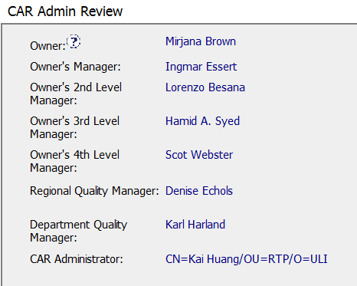
CAR Owner Resources, cont.
CAR Administrator

Slide 60
CAR Owner Resources, cont.
CAR Process SOP 00-QA-S0006
CAR Website
Supplements the CAR Process SOP
Frequently Asked Questions
Link to CAR Database
CAR Website link:
http://corporate.ul.com/departments/snk5212/QE/

Slide 61
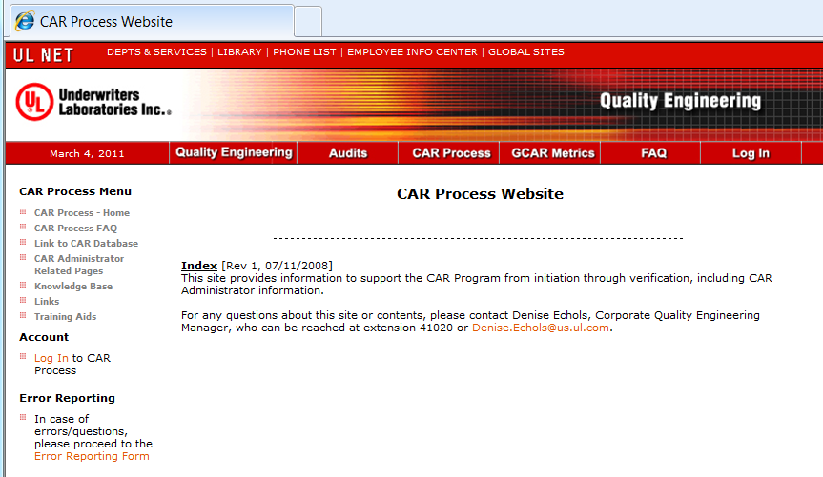
CAR Owner Resources, cont.

Slide 62
End

Slide 63
Revision History
Revision A: Initial Release

