Slide 1
CAR Database Training:
How to Create a CAR
March 10, 2011, Revision 2

Slide 2
How To Create A CAR
Open the GCAR Database
“Compose” a “New CAR”
Complete the fields. Required fields are generally indicated by a red asterisk “*”
“Submit CAR”
Locate CARs You Initiated

Slide 3
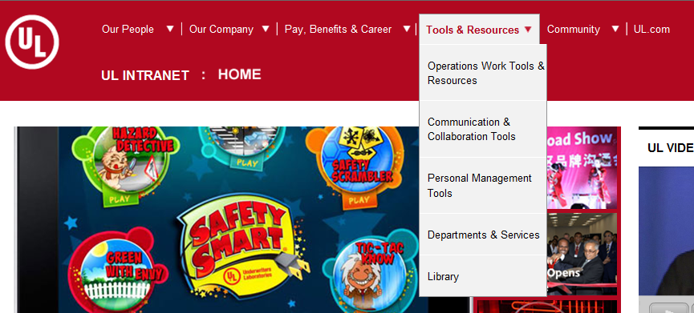
1. Open the GCAR Database
From UL Net, Tools & Resources, select
“Department & Services”.

Slide 4
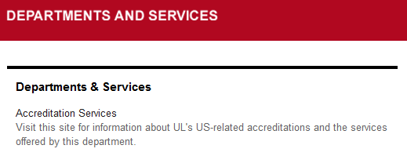
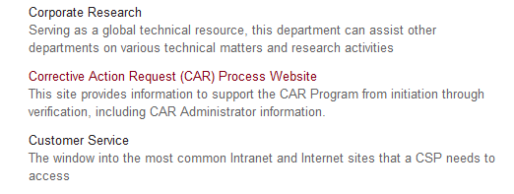
1. Open the GCAR Database, cont.
2. From Department & Services, select “Corrective Action Request (CAR) Process Website”.
…

Slide 5
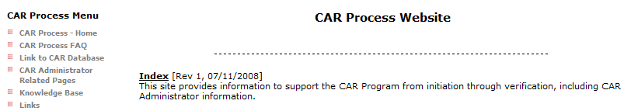
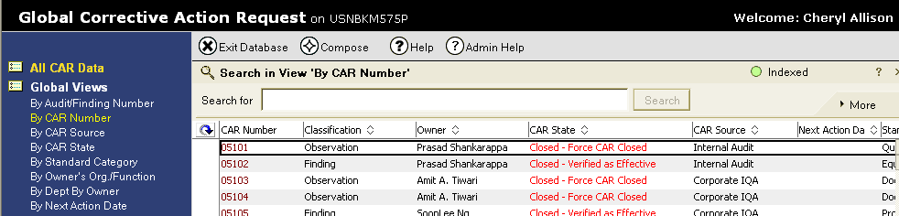
1. Open the GCAR Database, cont.
3. From the Corrective Action Request (CAR) Process Website, select “Link to CAR Database”.
The CAR Database displays:

Slide 6
2. Compose a New CAR
1. To create a new CAR, select “Compose”.
2. Select “New CAR” from the drop down list.
New CAR
Region Profile
Sub Region Profile
CAR Type Profile
Email Document
Admin Doc

Slide 7
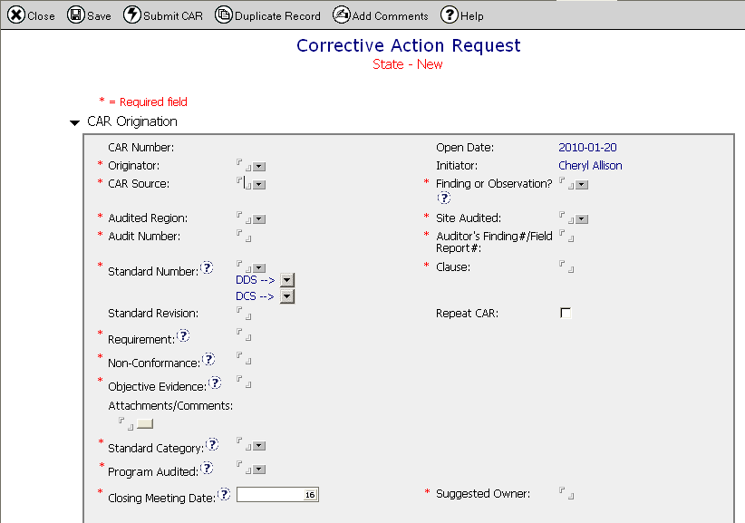
2. Compose a New CAR, cont.
A new CAR displays:

Slide 8
3. Complete Fields
Fields that must be completed are indicated by a red asterisk *. Other fields should be completed as applicable.

Slide 9
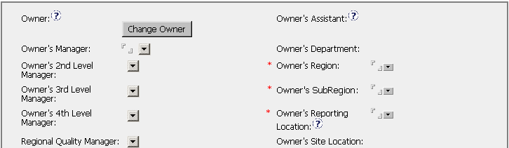
3. Complete Fields, cont.
Page down to the third screen for the final required fields.

Slide 10
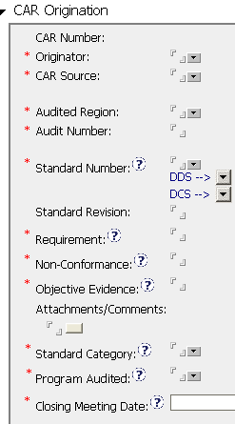
3. Complete Fields, cont.
Originator – The UL employee who was directly responsible for identifying the issue that resulted in the CAR.
CAR Source – From the drop down list, select the source of the CAR, e.g., internal audit, customer complaint.
Audited Region – From the drop down list, select the region where the issue was found.
Audit Number – Enter the audit number. If no audit number, enter “None”.

Slide 11
3. Complete Fields, cont.
Standard Number – Select the standard that contains the requirement from one of the drop down lists. If the standard is not on one of the lists, type in the standard number. DDS = Document Distribution System; DCS = Document Control System.
Standard Revision – Enter the standard revision, if applicable.
Requirement – Enter the text of the specific requirement that was violated.

Slide 12
3. Complete Fields, cont.
Non-Conformance – Describe the issue that was found.
Objective Evidence – Provide the project numbers, file numbers, or other evidence of the non-conformance.
Attachments/Comments – Attach any specific notes or additional information pertinent to the CAR.

Slide 13
3. Complete Fields, cont.
Standard Category – Select the standard category from the drop down list. FAQ#14 on the CAR website provides guidance for selecting the standard category.
Program Audited – From the drop down list, select the program(s) for which there is objective evidence that a nonconformance exists.
Closing Meeting Date – Enter the date of the closing meeting. If there was no meeting, enter the date the CAR was created.

Slide 14
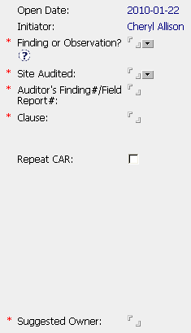
3. Complete Fields, cont.
Finding or Observation? – Select the type of CAR from the drop down list. Findings are systemic, recurring, and/or severe non-conformances. Observations are neither of these, and may also be suggestions for improvement.
Site Audited – Select the site audited or where the non-conformance occurred.
Auditor’s Finding#/Field Report # - Enter the auditor’s finding #, the field report #, or “None” if neither applies.

Slide 15
3. Complete Fields, cont.
Clause – Enter the specific clause number from the standard or requirement that was violated.
Repeat CAR – Select this box if this is a repeat finding. See 00-QA-S0006 CAR Process document for the definition of a repeat finding. A CAR Administrator can also help with this.
Suggested Owner – Enter the name of the appropriate potential owner for the CAR. See FAQ #4 On the CAR website for guidance on determining the CAR owner.

Slide 16
3. Complete Fields, cont.
*** Page down to the third screen for the final required fields.
Owner’s Region – Select the region for the suggested owner from the drop down list.
Owner’s SubRegion – Select the subregion.
Owner’s Reporting Location – Select the reporting location.

Slide 17
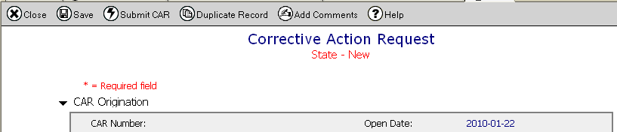
4. Submit CAR
Once you have completed the required fields and other applicable fields:
1. Select “Submit CAR” from the toolbar.
2. Congratulations! You have just created a new CAR.
3. A CAR Administrator will assign the CAR to the CAR owner, and may contact you with questions if needed.

Slide 18
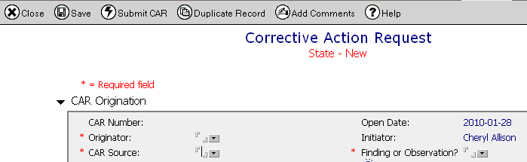
5. Locate CARs You Initiated
The person who composes a new CAR becomes the “Initiator” of that CAR.
Perform the following query to retrieve a list of CARs for which you are the initiator.

Slide 19
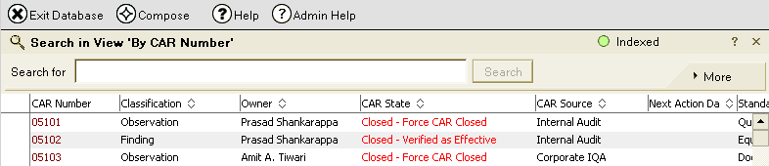
5. Locate CARs You Initiated, cont.
1. Select “More” from the search area:

Slide 20
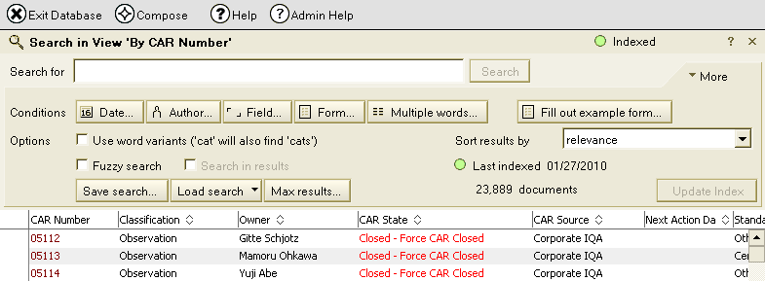
5. Locate CARs You Initiated, cont.
2. Select “Field” from the search area:

Slide 21
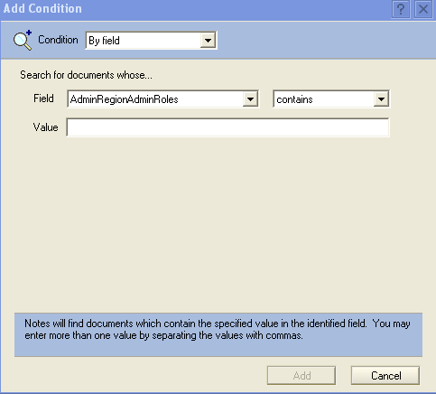
5. Locate CARs You Initiated, cont.
3. The following box appears. Select “CARInitiator” from the drop down list in the “Field” area:
CARImplementationExtens
CARImplementationObjEvid
CARInitiator
CARNextActionDate
CARNonConformance
CARNumber

Slide 22
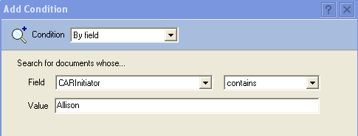

5. Locate CARs You Initiated, cont.
4. The “Add Condition” screen appears. Type your last name in the “Value” area. In this example, the last name entered is “Allison”.
5. Select “Add”.

Slide 23
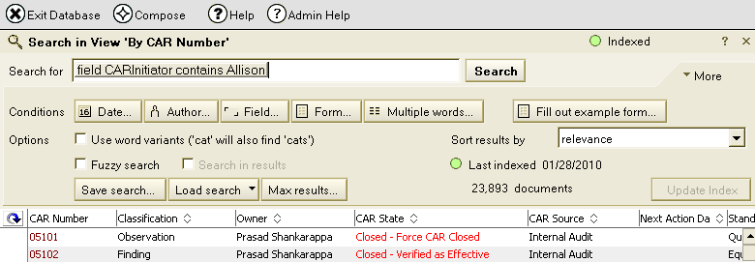
5. Locate CARs You Initiated, cont.
6. Notice that “Search for” area is populated with your search criteria. Select “Search”.

Slide 24
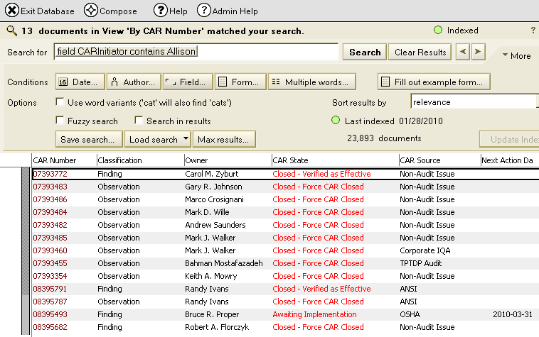
5. Locate CARs You Initiated, cont.
A list of CARs that you initiated displays.

Slide 25
Questions?
For questions or comments, please contact Cheryl Allison, Northbrook, x43246

Slide 26
Revision History
Initial Release, February 2, 2010
Revision 2 - March 10, 2011
  Updated slides 3, 4 and 5 with screen shots of the current versions of the Corporate and CAR websites

