Slide 1
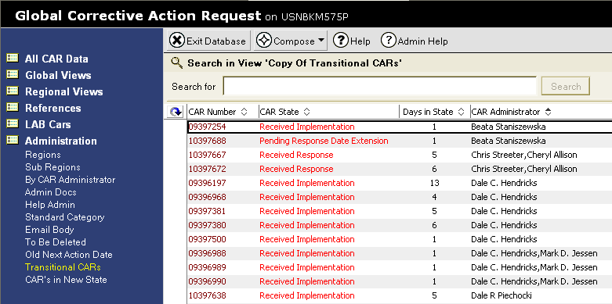
Viewing Transitional CARs
The Transitional CARs view lists all CARs awaiting the attention of the CAR Administrators.
  To access the Transitional CAR view, under “Administration”, select
  “Transitional CARs”.
  To group your CARs together, sort by clicking “CAR Administrator”.
  Note that the “Days in State” is listed for each CAR. The “Days in State” goal as of April 1, 2010 is 9 days or less.

