Slide 1
DAP Lead Auditor Training
Day 2
May 23, 2016 –Revision 5
For questions or comments, please contact DAP Performance Enhancement Team

Slide 2
Learning Objectives – Day 2
You will be able to:
Explain DAP technical requirements
Describe UL’s audit process
Plan for the audit
Conduct the opening meeting
Slide <number>
Notes:
We will review ISO/IEC 17025 technical requirements,
We will learn about the role of an auditor and steps in the UL auditing process,
We will all complete the tools necessary to plan for the audit,
And finally, practice conducting an opening meeting.

Slide 3
DAP Technical Requirements
(ISO/IEC 17025 - Section 5)
Module 5

Slide 4
Learning Objectives
Identify applicable ISO/IEC 17025 technical clauses to DAP’s various programs.
Explain all ISO/IEC 17025 based technical requirements.
Slide <number>

Slide 5
Applicable ISO/IEC 17025 Clauses
Section 5: Technical Requirements
Clauses to be assessed based on GALO | With Active ISO/IEC 17025 Accreditation | With No Active ISO/IEC 17025 Accreditation
Clause 5.2 Personnel |  | X
Clause 5.3 Accommodation and Environmental Condition | X | X
Clause 5.4 Test and Calibration Items | X | X
Clause 5.5 Equipment | X | X
Clause 5.6 Measurement Traceability |  | X
Clause 5.8 Handling of Test and Calibration Items |  | X
Clause 5.10 Reporting the Results | X | X
In-House Calibration (if applicable) | X | X
CTDP, TCP, TPTDP and PPP - Scope of Assessment
(00-IC-P0026, Table 9.1)
CTDP, TCP, TPTDP, PPP – All clauses apply
Slide <number>
Notes:
There are more clauses that apply to CTDP clients in Section 4: Management Requirements.
We will learn about each applicable clause next and identify which clauses apply to CTDP participants as they are the majority of our DAP clients.

Slide 6

Section 5 – Technical Requirements
5.2 Personnel*
  5.2.5 – Management shall authorize personnel to perform test and/or calibration.
  Lab shall maintain records of training of all technical staff.
  Records shall be accessible and include the date competence is confirmed.
    “Can I please see Linda’s training record?”
*not required for those with Active ISO17025 accreditation
Slide <number>
Notes:
Ask: 5.2 - why is personnel competence critical?
Ensure tests are conducted according to methods in standard.
Ensures reliable and consistent test data.
Since UL no longer conducts visits to evaluate lab techs are newly qualified, Lab is responsible for fully qualifying staff for tests in their current scope.
DAP no longer keeps track of qualified lab technicians so client lab must maintain qualified technician list.

Slide 7
Section 5 – Technical Requirements
5.2 Personnel*
    Real-Life Findings:
    No list of authorized tests for individual technicians.
    No date of authorization on training records or only standards listed, not all tests in Scope of Participation.
*not required for those with Active ISO17025 accreditation
Slide <number>

Slide 8
Section 5 – Technical Requirements
5.3 Accommodation/environmental conditions
  5.3.1 – The lab must have environmental conditions to run tests correctly.
  Conditions include:
    Ambient temperature, relative humidity and barometric pressure
    Lighting and air circulation
    Power sources (Power Quality Analysis, 00-OP-C0036) – determining the need for PQA and requirements are covered on last day.
  “Did your Power Quality Analysis for the lab meet required limits?”
  “Can we review your Power Quality Analysis for the lab?”
Slide <number>
Notes:
Power Quality Analysis required every 3 years, or as needed (i.e. lab location change).
We will discuss how to determine when PQA is needed and the requirements for acceptability.
This LA training will not cover how to conduct a PQA.

Slide 9
Section 5 – Technical Requirements
5.3 Accommodation/environmental conditions
  5.3.2– Monitor, control, record all conditions required by test methods.
  Tests shall be stopped if conditions could invalidate test results.
“How do you monitor the temperature/humidity/pressure in the lab?”
      “Can we see the chart recordings?”
  CLASS REVIEW: 00-OP-C0035, Environment-Laboratory Ambient Conditions
Slide <number>
Notes:
DAP provides guidance (recommendations) on environmental conditions in 00-OP-C0035.
Review client guide document with class.

Slide 10
Section 5 – Technical Requirements
5.3 Accommodation/environmental conditions
  5.3.3 – There should be effective separation between lab and areas nearby with different activities.
  5.3.4 – Access to the lab shall be controlled.
  “How do you control access to the test lab?”
  Check to see if other areas near the lab would affect results.
Slide <number>

Slide 11
Section 5 – Technical Requirements
5.3 Accommodation/environmental conditions
    Real-Life Findings:
    Lab did not monitor the humidity of the lab as specified in the Standard.
    Lab did not continuously monitor or record temperature in Mold Stress Test chamber.
    Access to the lab was not controlled and many pieces of equipment would go “missing” with staff knowing.
    Lab was next to shipping/receiving so the lab’s temperature would change significantly when the doors would open and close.
Slide <number>

Slide 12

Module 5 - Activity 1, Case Study Scenarios
Directions:
Review scenario 6
Determine if there are any potential non-conformities.
If so, what clauses would you cite?
Time: 10 minutes – in Teams
10 minutes – Class Discussion
Slide <number>
Notes:
Instructor Answer Key:
Scenario 6: Yes, possible NCR. Is access to the lab controlled and how does the lab ensure quality of test work? 5.3.4.

Slide 13
Section 5 – Technical Requirements
5.4 Test and Calibration Methods and Method Validation
5.4.1 – All requirements in this paragraph are emphasized elsewhere in the standard and any resulting NCR’s should be documented there instead.
  Lab shall use appropriate test methods (5.4.2)
  Lab shall have instructions for all equipment (5.5.5) and on the handling and preparation of items for testing (5.8), where the absence of such instructions could jeopardize the results of tests.
  Lab shall have procedures for handling of test items (5.8.1)
  All instructions and standards shall be kept up to date (5.4.2)
  All standards shall be accessible to staff (4.3.2.2)
  Deviations from methods must be documented, justified and accepted by the customer (5.10.3.1)
Slide <number>
Notes:
UL is the “customer” for DAP labs. They submit data that meets our UL DAP requirements.

Slide 14
Section 5 – Technical Requirements
5.4 Test and Calibration Methods and Method Validation
  5.4.2 – Lab must use test methods that meet the needs of the customer.
  Lab must use most valid edition of the standard.
  If standard test method changes, confirmation of the lab’s ability to conduct test must be repeated.
  “Can I see the standard you are referencing for testing?”
      “How do you ensure the lab uses the latest valid edition of the standard (i.e. UL, CSA, ASTM)?”
Slide <number>
Notes:
UL is the “customer” for DAP labs. They submit data that meets our UL DAP requirements.
Be aware there are industries that use older editions/revisions of standards. When in doubt, ask L3/PDE.

Slide 15
Section 5 – Technical Requirements
5.4 Test and Calibration Methods and Method Validation
  5.4.7 – Concerns data calculation, data transfer, and use of custom software to handle data.
  5.4.7.1 – Calculations and data transfers shall be checked by someone other than the person that collected the data.
  “Is this data directly measured or calculated (change of resistance)?”
  “Is this electronic data the original data or was it written out prior to this?”
  “How did you check this data transfer for accuracy?”
Slide <number>

Slide 16
Section 5 – Technical Requirements
5.4 Test and Calibration Methods and Method Validation
  5.4.7.2 - Software developed by lab (Excel, LabView) must be validated and documented.
  Procedure required to process and protect data.
  If code or calculation changes, validation process must be repeated.
  Ensure proper functioning of computers and automated equipment.
    “Does the lab manipulate any original data before placing in the datasheet?
  “Do you use Excel to perform any automatic calculations?”
Slide <number>
Notes:
Excel validation example: Record the automated calculation result and the hand-written calculation result. If the same, calculation is validated. Maintain record.
The lab does not need to validate if they only use calculation functions that Excel provides. But, if the lab created a program script we need to see a validation record.

Slide 17
Section 5 – Technical Requirements
5.4 Test and Calibration Methods and Method Validation
  Real-Life Findings:
    Out-of-date standards used in the lab.
    Non-standard testing conducted without prior approval from UL.
    Automatic excel calculations not documented or validated.
    Transferred data not checked by someone else; original data thrown away before check can be made.
Slide <number>

Slide 18
Module 5 - Activity 2, Case Study Scenarios
Directions:
Review scenario 7.
Determine if there are any potential non-conformities.
If so, what clause would you cite?
Time: 5 minutes - in Teams
10 minutes - Class Discussion
Slide <number>
Notes:
Instructor Answer Key:
Scenario 7: Yes, NCR. Not following the standard, 5.4.2.

Slide 19
Section 5 – Technical Requirements
5.5 Equipment
  Concerns use, accuracy, calibration, operation, identification, records, transportation, storage, maintenance, repair, and safeguarding of equipment used for testing.
  5.5.1 – Lab must have all equipment needed for test.
    If rented, requirements of this standard must still be met.
  “How does your lab maintain all equipment necessary for testing?”
  “Does your lab need to use other department’s equipment for testing?”
  “How does the lab ensure the requirements are met for other area’s equipment?”
Slide <number>

Slide 20
Section 5 – Technical Requirements
5.5 Equipment
  5.5.2 – Equipment must meet accuracy required by the standard.
  Equipment must be calibrated for key values to be used during test.
  Lab must check that equipment meets requirements before use.
  “Was your equipment calibrated?”
    “How did you verify equipment meets accuracy requirements prior to use?”
CLASS REVIEW: 00-OP-C0034, Equipment Accuracy
Slide <number>
Notes:
The client lab must check that equipment meets accuracy requirements.
This is a check that shall be done after calibration has been conducted and before test use.
Review client guide with class.
Hierarchy of accuracy requirements:
Standard
00-OP-C0034 – emphasize this was not created by UL but taken from CTL provisional decision sheet (PDSH) 251B.
Nearest UL lab with same test equipment.
Manufacturer’s specifications.
MAKE SURE TO CHECK THE DAP SOPs REGULARLY FOR THE LATEST REQUIREMENTS. We are constantly working to meet accreditation requirements and use customer feedback while simplifying the system.

Slide 21
Section 5 – Technical Requirements
5.5 Equipment
  5.5.3 – Equipment must be operated by authorized personnel.
  Equipment manuals and instructions must be available.
  5.5.4 – All equipment must be uniquely identified.
  Check to make sure each piece of equipment is uniquely identified.
  “Who is authorized to use the lab’s equipment?”
  “Can I see the instruction manual for this meter?”
Slide <number>

Slide 22
Section 5 – Technical Requirements
5.5 Equipment
5.5.5 – Records required for all equipment and shall include:
    Identity of equipment and software
    Manufacturer name, type, and serial number of equipment
    Checks that equipment meets accuracy (5.5.2)
    Location (if appropriate)
    Manufacturer’s instructions or reference to location
    Calibration certificates
    Maintenance plan (if appropriate) and results
    Damage, malfunction, repair to equipment
  “Can I see all records for this dielectric tester?”
  “Have you had any equipment damaged or repaired recently?”
Slide <number>

Slide 23
Section 5 – Technical Requirements
5.5 Equipment
  5.5.6 – Lab must have a procedure for safe handling, transportation, storage, use and maintenance of equipment.
  “Where does your procedure show a process for transporting equipment?”
  “What are your requirements for their proper storage?”
  “Do you have other maintenance requirements besides periodic calibrations?”
Slide <number>

Slide 24
Section 5 – Technical Requirements
5.5 Equipment
  5.5.7 – Equipment is taken out of service when found defective, damaged or gives suspect results.
  Must be isolated or clearly labeled to prevent use until repaired and recalibrated.
  Lab must initiate 4.9 (Nonconforming Work) to examine how previous data was affected.
  “What do you do if a piece of equipment is damaged?”
  “How do you ensure that defective equipment is not used?”
  “Please describe your trace-back procedures?”
Slide <number>

Slide 25
Section 5 – Technical Requirements
5.5 Equipment
  5.5.8 – All calibrated equipment must have sticker including:
    Calibration status
    Last calibration date
    Next calibration date
  5.5.9 – When equipment goes out of lab’s control, lab must ensure equipment function and calibration are checked before use.
  Review random pieces of equipment in the lab for calibration stickers.
  “What methods do you use to ensure equipment works properly if it were used outside the lab?”
Slide <number>

Slide 26
Section 5 – Technical Requirements
5.5 Equipment
  5.5.10 – Procedure is required if lab conducts intermediate checks
  5.5.11 – Procedure is required to update software if equipment requires a correction factor due to calibration
  5.5.12 – Equipment shall be safeguarded from adjustments that would invalidate results.
  Review random pieces of equipment for tamper seal stickers.
  “Does any equipment require intermediate checks?”
  “Has any equipment require a correction factor due to its last calibration?”
Slide <number>

Slide 27
Section 5 – Technical Requirements
5.5 Equipment
  Real-Life Findings:
    No recorded check that equipment met accuracy requirements when returned from calibration.
    No procedures for safe handling, storage, or transportation of equipment.
    Lab technician was using defective equipment since it was not isolated or marked as out of service.
    No records maintained by the lab when equipment was repaired.
Slide <number>

Slide 28
Module 5 - Activity 3, Case Study Scenarios
Directions:
Review scenarios 8 & 9.
Determine if there are any potential non-conformities.
If so, what clauses would you cite?
Time: 10 minutes – in Teams
10 minutes – Class Discussion
Slide <number>
Notes:
Instructor Answer Key:
Scenario 8: Yes, possible NCR. The lab needs to know the equipment accuracy requirements as specified in order of a) the standard, b) 00-OP-C0034, c) closest UL lab that performs the test, d) manufacturer’s specifications, 5.5.2. Also need to see recorded checks of accuracy for all equipment used in client’s scope, 5.5.5c.
Scenario 9: Yes, possible NCR. Need to run test according to standard, 5.4.2. Status of calibration, cal date and due date required, 5.5.8. Equipment must be safeguarded from adjustments (i.e. tamper seal style cal sticker was torn), 5.5.12.

Slide 29
Section 5 – Technical Requirements
5.6 Measurement Traceability*
  Concerns equipment calibration program, traceability to SI units, and calibration certificates.
  5.6.1* – Lab must have a procedure for equipment calibration.
  Equipment must be calibrated before use.
  “Please describe how your calibration program works.”
  “How often is your equipment calibrated?”
  “How do you ensure that all the equipment is calibrated on time?”
*not required for those with Active ISO17025 accreditation
Slide <number>

Slide 30
Section 5 – Technical Requirements
5.6 Measurement Traceability
  5.6.2 applies to:
    Test labs that seek external calibration
    Test labs that conduct calibration of its own equipment
  5.6.2.1.1:
    External calibration provider has proper accreditation
    External calibrations conducted are within the provider’s scope
    External calibration certificates received meet 00-OP-C0032 requirements
  “How do you ensure the calibration provider is accredited?”
  “How do you check calibration certificates against 00-OP-C0032?”
Slide <number>
Notes:
NCRs related to external calibration certificates and providers are written against 5.6.2.1.1.

Slide 31
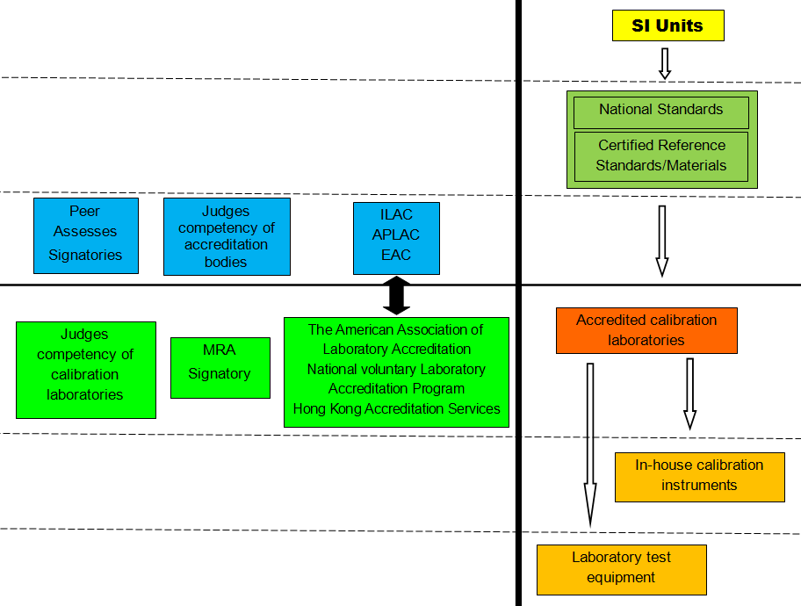
Measurement Traceability, Unbroken Chain
00-OP-C0032, Calibration Certificate Analysis
Slide <number>
Notes:
Ask: What is the measurement traceability?
Answer: An unbroken chain of calibrations traceable back to national/international standards. It is accomplished through competent calibration sources defined by ISO/IEC 17025. It includes the calculation and reporting of measurement uncertainty with each transfer of calibration.
It is the link between the SI standards and national standards which is then transferred to secondary standards.
NIST is the national standards institute where US secondary standards are traceable to.
Accreditation bodies accredit calibration laboratories to conduct calibrations.
Accreditation bodies that accredit calibration laboratories are deemed traceable. Accreditor are deemed competent via participation in MRA.
The calibration bodies own secondary standards which are in turn used to calibrate laboratory equipment.
Some equipment can only be calibrated through use of reference materials that must be traceable as well. (5.6.3.2)
Some equipment/materials are not able to be calibrated through traceable sources such as the OEM.
If time permits, show an accreditation body’s website (i.e. A2LA), choose calibration lab, and show scope.

Slide 32
Section 5 – Technical Requirements
5.6 Measurement Traceability
  5.6.2.2.2#* – If equipment cannot be calibrated to SI unit, lab must consult with client to ensure calibration provided meets their needs.
  # Typically n/a since most measurements are traceable to SI units
  “Do you have any equipment that is not able to be calibrated to SI units?”
  “If so, how is it calibrated and who performed the calibration?”
*not required for those with Active ISO17025 accreditation
Slide <number>
Notes:
Client = UL

Slide 33
Section 5 – Technical Requirements
5.6 Measurement Traceability
  5.6.3* - Reference standards & reference materials
  5.6.3** – “Standard” is equipment used to calibrate other equipment.
  5.6.3.1** – Procedure is required for calibration of its reference standards.
  Reference standards shall be used for calibration only.
  Reference standards shall be calibrated before & after any adjustment.
  ** Clause 5.6.3 only applies to test labs with in-house calibration.
  “What purposes are the reference standards used for?”
*not required for those with Active ISO17025 accreditation
Slide <number>
Notes:
“Standard” in this sense, does not mean a test method, but rather, equipment used to calibrate other equipment.
External calibration of reference standards also requires compliance with 00-OP-C0032.
In-house calibration makes up about 10% of DAP clients in NA and more in AP and EULA.
Reference standard is a general term. It can be primary, secondary, transfer or working standard.
To conduct immediate checks on reference standards means that you are verifying one reference standard with another reference standard. For example, verifying a reference gauge block with a reference caliper.
Ask: What is a transfer standard?
Often looked at as secondary reference standard. For example, for in-house calibration, the calibrated gauge block set can be looked at as “transfer standard” which is calibrated by a primary standard laboratory different from the lab maintaining it.
Ask: What is a working standard?
Working standard is a standard that you use to perform calibrations on equipment of lesser uncertainty. For example, you use the optical mic (transfer/secondary standard) to calibrate the gauge block (working standard) that is used to calibrate the caliper used for test.

Slide 34
Section 5 – Technical Requirements
5.6 Measurement Traceability
  5.6.3.2** – Reference materials shall be traceable to SI units.
  Internal reference materials shall be checked like consumables (4.6)
  5.6.3.4** – Procedure is required for safe handling, transport, storage, and use of reference standards and materials.
  ** Clause 5.6.3 only applies to test labs with in-house calibration.
  CLASS REVIEW: 00-OP-C0038, In-House Calibration Requirements (and Non-accredited calibration suppliers)
Slide <number>
Notes:
Certified reference material (CRM) is used to calibrate analytical instrument. Reference material can be certified plastic (polyethylene), aluminum casting
alloy, etc. They will come with a certificate (from NIST, or equivalent) and can be checked like the CoC for consumables.
Ask: What other examples of reference materials can you think of?
00-OP-C0038 is a guide for non-accredited calibration labs and client labs that choose to perform in-house calibration of equipment used for UL tests.

Slide 35
Section 5 – Technical Requirements
5.7 Sampling#
  Procedure is required for sampling.
  Procedure deviations required by customer shall be recorded in test results and communicated to personnel.
  Procedure used, sampler ID, environmental conditions, sampling location, and if appropriate, statistics the procedure is based on must be recorded.
  # NOT applicable to DAP since limited UL standards require sampling.
Slide <number>
Notes:
Briefly review slide and move on.

Slide 36
Section 5 – Technical Requirements
5.8 Handling of Test and Calibration Items*
  5.8.1 – Procedure required for transportation, receipt, handling, protection, storage, retention and disposal of test items.
  5.8.2 – Lab must have system for identifying test samples (not calibration items unless they are also an in-house cal lab)
  Identification shall:
    Be retained through life of the sample
    Allow subdivision of groups of items
    Be such as to avoid physical confusion or when referenced in records
*not required for those with Active ISO17025 accreditation
  “How do you identify samples to be tested?”
  “If you had to separate a group of samples, how would the IDs change?”
Slide <number>
Notes:
Point out that this applies to test samples, and equipment ONLY IF the lab is also an in-house cal lab.

Slide 37
Section 5 – Technical Requirements
5.8 Handling of Test and Calibration Items*
  5.8.3 – Must record abnormalities or damage to samples.
  If test sample is not suitable, lab must obtain and record instructions from the customer on how to proceed.
  5.8.4 – Procedure is required to avoid loss or damage during storage and sample handling.
  Conditions must be maintained, monitored and recorded, when sample is stored or conditioned under standard requirements.
  “If you received a damaged sample, what would you do?”
  “Where do you store samples prior to & after testing?”
*not required for those with Active ISO17025 accreditation
Slide <number>

Slide 38
Section 5 – Technical Requirements
5.8 Handling of Test and Calibration Items
  Real-Life Findings:
    No procedure for handling of test items.
    No system for identification of test items or some had same identification to confuse samples.
    Sample storage area was not protected from other areas (in close proximity to the manufacturing areas) which routinely caused damage to samples.
    Samples with abnormalities tested and data submitted without consulting customer (UL) for further instructions.
Slide <number>

Slide 39
Section 5 – Technical Requirements
5.10 Reporting the Results
  Concerns reporting test results for customers
  Also applies to external and in-house calibrations (reviewed in 5.6)
  5.10.1 – Test results must be reported accurately, clearly, and according to test method requirements
  Results must be reported and contain all information requested by customer (reviewed in 5.10.2)
  Results for internal customers may be reported in a simpler manner.
Slide <number>
Notes:
Remind the class the UL is the “customer”.

Slide 40
Section 5 – Technical Requirements
  5.10.2 – All test reports must include:
    Title
    Test lab name & address and where tests were conducted
    Unique identification of test report (Internal or UL project number)
    Identifier on each page indicating it is part of report, clear end of report
    Customer (UL Applicant) name & address
    Test method - Clear identification of item tested
    Date of receipt and date which testing was conducted
    Sampling plan (if applicable) - Test results with units
    Name & signature of person authorizing test report
    Statement that results relate only to items tested (where relevant)
Slide <number>
Notes:
You might notice these are the same requirements as those required on calibration certificates, 00-OP-C0032.
DAP policy NCRs against calibration certificates are written against 5.6
DAP requires NCRs against datasheets are written against 5.10

Slide 41
Section 5 – Technical Requirements
  5.10.3.1 – Test reports shall, where necessary, include:
    Test method deviation
    Environmental conditions
    Statement of compliance/non-compliance, if required
    Interpretations, if required
    Information requested by method or customer (00-OP-C0025)
Slide <number>
Notes:
Requirements in 5.10.3.1 are used to aid in interpretation of test results.

Slide 42


Main Components of 00-OP-C0025, Data Recording, Reporting and Related Requirements
Cover pages
Test data sheet pages
Test date (start/end, in/out of conditioning chamber)
Test title
Test staff signature
Sample identification
Equipment used for test
Test method
Environmental conditions (whether or not there is a designated location on the data sheet)
Test parameters
Results, with units
Measurement uncertainty, if applicable
Hand-written calculations made (including units conversions)
Deviations (justified and approved by L3)
Project number (or correlated tracking number) & page number on every page
End of Record
  Note – data sheets are not standardized. Clients need to become familiar with DAP requirements to ensure the datasheet packages submitted are complete.
Slide <number>
Notes:
Indicate these are the key items required in a datasheet but let’s review 00-OP-C0025 in detail.
Review 00-OP-C0025 with class instead of reading off bullet points.

Slide 43
Key Errors to Look for on Data Sheet
Submitting data for tests or standards not in their scope!
  Okay if the test is referenced in a test within their scope
Data Sheets missing statement “Unless specified otherwise in the individual Methods, the tests shall be conducted under the following environmental conditions” OR if no general conditions specified in Standard, this is indicated in place of list of conditions.
Environmental conditions not recorded.
Page # or project # not on every page.
Pages #s not sequential with correct total # of pages on cover page.
Intermediate data not correctly labeled.
Equipment not listed.
Test date not within equipment calibration dates
Error in date format
Slide <number>
Notes:
Look for blank spaces. This is often a trigger for our external auditors.
If datasheet has a selection for test method (check that a selection was made)
Add any other information you feel is important.

Slide 44
Key Errors to Look for on Data Sheet – cont.
Changes not crossed out, initialed & dated
Areas not used not lined out or marked “N/A”, initialed & dated
Technician not identified or clearly correlated to task
Samples not clearly described or correlated to test data. Not all test results fields completed
Use of the term “well-heated” instead of values
Missing units
Section of method not tested does not have a line or “X” across it, initialed & dated
Repeat testing is not correctly documented
      No signature of authorized signatory
Slide <number>

Slide 45
Module 5 – Activity 4, NTL Data Sheets
Directions:
In teams, review a sample NTL datasheet assigned to you.
Use any of the supporting materials you have for NTL and UL client guides to answer:
  Are these data sheets in compliance? Why or why not?
  Is anything missing or incorrectly filled out?
  How would you approach writing an internal CAR? What would you include in it?
Time: 20 minutes Teams
15 minutes Class Discussion
Slide <number>
Notes:
NOTE: Assign each team one of the data sheets
Instructor Answer Key:
Are these data sheets in compliance? Why or why not? No. Not in compliance with 00-OP-C0025.
Is anything missing or incorrectly filled out? Yes!!! See below.
NOTE: Answers below are not all-inclusive. Get class to find more errors.
Package #1 errors:
No project number on each page or “unique identifier” that correlates to a UL project number.
page numbering incomplete/off
No total # of pages on cover page
No standard revision date
Date format incorrect
No environmental conditions statement on cover page
No last calibration date (only due date)
Package #2 errors:
No project number on each page or “unique identifier” that correlates to a UL project number.
Date format incorrect
No standard info on cover page
No environmental conditions statement on cover page
Ambient temperature missing on page 8.
How would you approach writing an internal CAR? What would you include in it? First verify whether the errors were noted and addressed by CAS; if not, contact project handler and manager & issue a CAR. The CAR must identify the requirements and all missing or incorrect information.

Slide 46
Datasheet Nonconformities missed by CAS (Engineering)
If datasheet review discloses nonconformities missed by engineering,
DAP Lead Auditor notifies project handler’s Engineering Lead.
Documents the issues in a CAR in the Global CAR Database.
Assigns to the department that accepted the test data.
Slide <number>
Notes:
As the auditor, you may run into situations where data was accepted by CAS but not accepted by you because of errors you found.
Discuss the need to issue an internal CAR in these situations.
See Bruce Eng for assistance with issuing internal CARs.

Slide 47
Module Summary
ISO/IEC 17025 addresses testing and calibration lab services.
UL developed client guides to ensure consistent application of requirements across our variety of products.
UL’s adoption of applicable ISO/IEC 17025 requirements into DAP is required to meet accreditation criteria.
Slide <number>
Notes:
As you can see from what we’ve covered, 17025 applies to labs who test and calibrate.
UL is required to adopt 17025 criteria as part of DAP as a ‘chain of custody’ application of the control for data.
This adoption of ISO/IEC 17025 requirements affects both UL and its client labs alike.

Slide 48

Questions?

Slide 49
Audit Overview and Client Deliverables
Module 6
Notes:
Ask: Why do we do audits?
Responses: ISO/IEC Guide 17065 requires it, provides feedback to lab, to correct non-conformities, tool to improve lab
Ask: Do you think clients welcome/want audits? Why or why not?
Get several responses from the class for both why the client would welcome it and why they would not.
This module will help you understand the role and key concepts in auditing.

Slide 50
Learning Objectives
Describe basic auditing concepts
Describe roles and responsibilities of key personnel in the audit process
Describe the UL DAP auditing process
Explain DAP client deliverables at project close
Identify DAP document storage in UL
Slide <number>
Notes:
Transition – We want to look at a definition of “auditing” to get a better understanding of the purpose of it.

Slide 51
Definition of Auditing
  Systematic, independent & documented process for obtaining audit evidence (3.3) & evaluating it objectively to determine the extent to which the audit criteria (3.2) are fulfilled.
---- ISO19011:2011, guidelines for auditing
Slide <number>
Notes:
Indicate that auditing is a tool used to evaluate and confirm activities related to ISO/IEC 17025.
It should be seen as part of a continuous improvement effort by the client & UL because it provides data for improving the client’s systems.

Slide 52
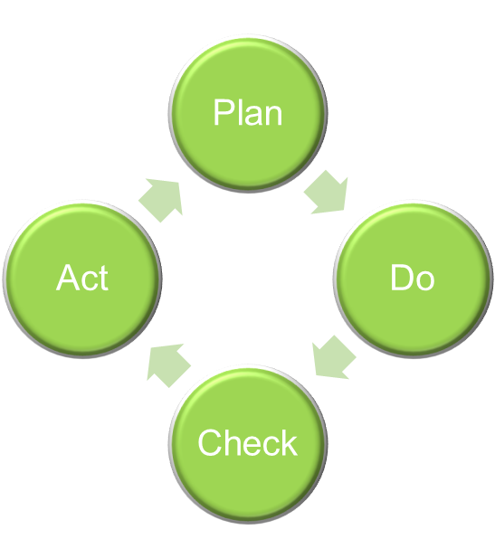
Benefits of an Audit
Provides objective evidence
  Reviews procedures, policies/processes, records
  Shows conformity to standard requirements
Management tool
  Evaluates adequacy of existing program
  Opportunity to correct and improve
  Increase consistency
Slide <number>
Notes:
Ask: What is objective evidence?
Responses: hard facts, not influenced by outside factors, can be verified, can be observed, is quantifiable and not strictly qualitative
Ask: In auditing, is discussion with lab staff objective evidence?
Yes. Although it is not a record, it is a hard fact that someone said something. Be sure statements are accurate and consistent with required procedures, records, and requirements.
Touch upon PDCA cycle:
Plan – determine the audit approach
Do – carry out the audit plan
Check – review objective evidence, analyze results, and identify opportunities for improvement and consistency
Act – take actions to make improvements

Slide 53
Roles in an Audit
Reviewer
Client
Audit Team (Lead Auditor & Technical Auditors)
Responsibility is to answer the following questions:
  Do client policies and procedures comply with the standard?
  Is the client lab following these policies and procedures?
  Are the end results consistent with the standard?
Slide <number>
Notes:
Ask: What are the responsibilities of the client in the audit?
Responses: be prepared, provide audit team with the information they request, be open to improvements.
Ask: What are the responsibilities of the auditor and team?
Responses: schedule the audit, communicate requirements before the visit, conduct meetings, verify effectiveness of compliance to the standard, write reports, following up and work with the client.
Ask: What are the responsibilities of the reviewer?
Responses: acts as a control to ensure the audit has met all requirements. Provides feedback to Audit Team and Management for training and process improvement.

Slide 54
Audit Fulfillment Procedure
DAP Assessment & Nonconformity Procedure 00-OP-S0056
Governs Audit fulfilment
  Describes the planning,
  - preparation,
  - performance,
  - reporting
  - and management of Data Acceptance Program audits for UL Mark Product Safety Certification & Certificated Agency Program (CAP) Schemes within the UL Family of Companies.

Slide 55
UL DAP Audit Process - Main Phases
Quoting/
Opening
Assessing
Closing
Customer Service:
Handle requests
Use Oracle, e-Pro
Develop/send quote
Contact client
DTO process also used
Delegate audit project to Lead Auditor
Sent client project acknowledgement
Audit Team:
Confirm test scope
Test representation
Obtain Technical Auditor as needed
Prepare agenda
Review past datasheets and NCRs
Conduct opening meeting
Conduct audit
Complete audit report
Conduct closing meeting
Update databases
Work with client to achieve acceptable corrective action plan.
DAP Reviewers,
Customer Service:
Preliminary/Final review
Review corrective action plans
Use e-Pro
Add to DAP database
Send certificate and scope
Slide <number>
Notes:
Discuss at a high level only.
Specific steps will be discussed as we progress through the course.
AUDIT ASSIGNMENTS BY REGION: eProduction audit profile delegated to LA.
NA: Direct-to-Order Process assigned on a monthly basis. Typically, LAs will be assigned audit projects in ePro 5 months prior to annivesary date.
AP/EULA:
In Q4 of each year:
AP/EULA Audit Manager pulls AP/EULA DTO list containing all DAP participants
Pulls list of EULA DAP Lead Auditors from TC dB (CCN: “DAPA”)
Pre-assigns Lead Auditors to DAP participants ensuring compliance with DAP LA rotation guidelines & ensuring that each LA has minimum 3 audits pre-assigned to meet LA qualification requirements.
Lead Auditor pre-assignment is collaborative effort that involves LA’s, DAP Site/Industry coordinators (AP only) and BU&DAP QE management
Once DAP Audit project has been opened, it will be delegated to LA based on pre-assignment arrangement.

Slide 56

Client Deliverables: DAP Plaque

Slide 57
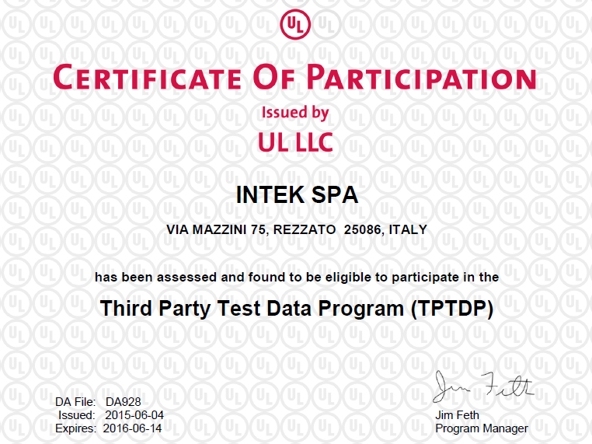
DAP Certificate of Participation
Lead Auditor’s responsibility to work with all parties to progress and complete audit project by this date.
Notes:
Participation expires on the client’s anniversary date (AVD).
Continued participation relies on the completion of the entire audit project by the AVD.
If not, the client will be inactivated until the audit project is completed.
Client may not test or submit data during this period.
It is the Lead Auditor’s responsibility to work with all parties to progress and complete the audit by the AVD.
Certificates can be searched on DMS by DA File number.

Slide 58
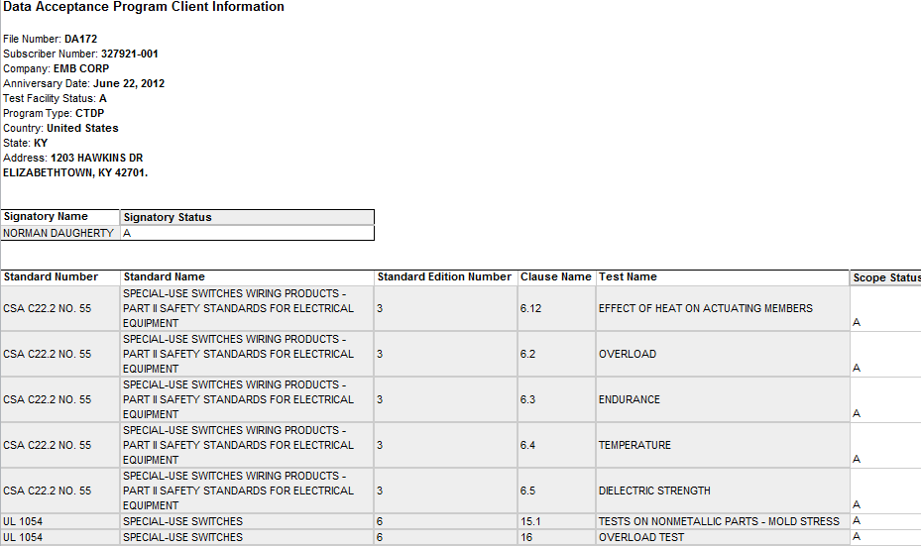
DAP Scope of Participation
DAP Client Information
Notes:
The scope of participation is confirmed and given to the client after a successful audit.
This is a snapshot of an output from internal database.
Indicate the subscriber number is the lab location. It may be the same or different from the applicant’s.
It is possible to have the same DA file # for several locations IF all are under the same corporate entity (same QMS system oversees all locations). Each situation must be evaluated.

Slide 59
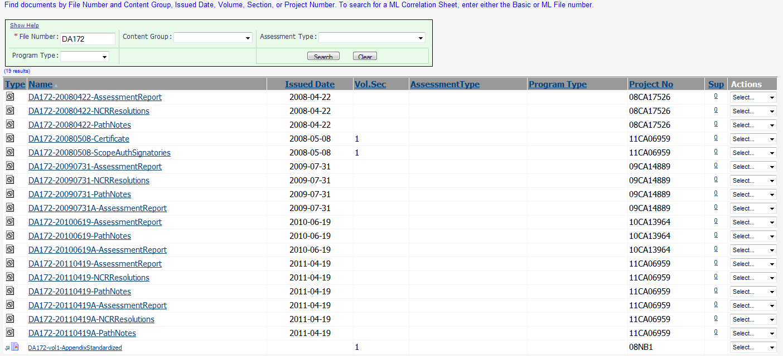
DAP Documents in DMS under “DA” File Number
Notes:
All audit documents, internal and those given to the DAP client, are stored in DMS under the DA file.

Slide 60

Module Summary
Definition of auditing
Audit benefits
Role and responsibilities
UL DAP Audit process
Client Deliverables at project close
DAP document storage in UL
Slide <number>

Slide 61
Questions?

Slide 62
Planning for the DAP Audit
Module 7

Slide 63
Learning Objectives
Follow the audit project timeline to prevent Inactivation
Why planning is important
Communicate technical auditor expectations
Generate UL OBI scope reports
Use DAP Assessment Tool to create the Audit Agenda
Update ePro and eComm
Datasheet & NCR Review Before the Audit
Slide <number>

Slide 64
Why Planning is Important to an Audit
Helps set time frames and expectations for all parties
Ensures availability and maximizes utilization of all personnel
Better prepared for an efficient on-site visit
Creates a better chance to complete audit project by AVD
Ask: Who’s responsibility is it to plan and monitor activities in the entire audit project?
Ask: Otherwise, what can happen?
Slide <number>
Notes:
Ask: Who’s responsibility is it to plan and monitor activities in the entire audit project? YOURS!
Ask: Otherwise, what can happen? The project is open past the expiration date/anniversary date (AVD), client is Inactivated and cannot conduct or submit data until the audit project closes.

Slide 65
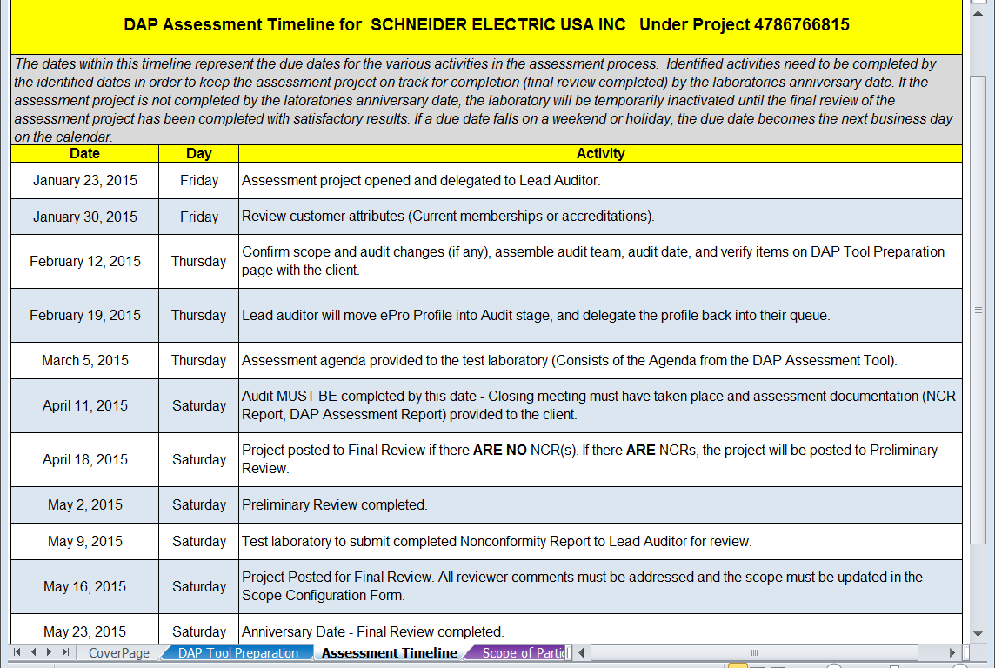
Audit Timeline – PREVENT INACTIVATION!
00-OP-S0056, Appendix D
Notes:
This is the timeline in DAP pathnotes tool – automatically generated
A quote is typically sent out 150 days before AVD giving the client 30 days to accept.
It is important to complete the audit project by the AVD to prevent inactivation.

Slide 66
Reminder Emails to Prevent Inactivation
Customer Service sends email only when project status in ePro does not meet Assessment Timeline and reminds us Inactivation will occur:
      Lead Auditor: 90 and 45 days before AVD
      Client, Lead Auditor, Reviewer: 30, 15 and 5 days before AVD
  Lead Auditor Responsibilities:
Set target dates with client so that audit project is complete by AVD.
Create ePro comment outlining the plan for completion.
RESPOND immediately to customer service with status and agreed upon plan between audit team and client.
Inactivation email typically does not get sent to client IF customer service sees progress in ePro and understands there is a plan to complete by AVD!
00-OP-S0056
Slide <number>

Slide 67
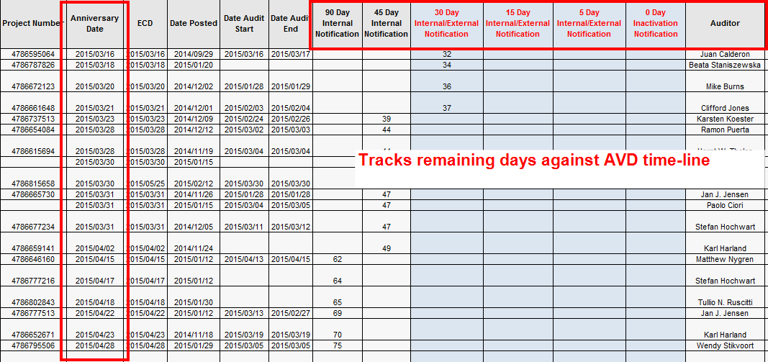
Audit Project Tracking
Client Project Management Report
Notes:
Example of a report generated from the DAP Dashboard in Oracle Business Intelligence (OBI).

Slide 68
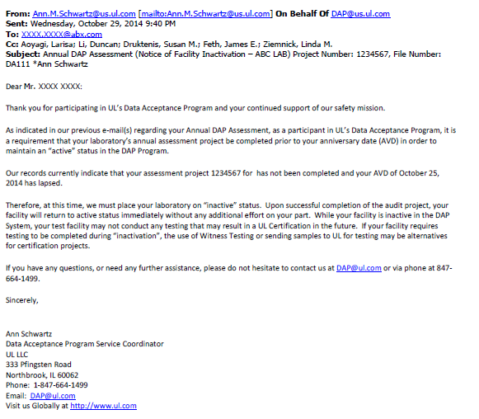
Inactivation Email Example

Slide 69
Communicating Technical Auditor Expectations
TA selection process
LA’s responsibility to confirm TA is at least L2 for tests selected to assess at audit.
Ask TA, “Do you feel comfortable evaluating the scope of tests to DAP requirements?” to gauge confidence.
Verify difference between Witness Test and DAP Technical Audit.
Indicate pre-audit, on-site, and post audit expectations.
By email, ePro comment, phone call, physical meeting before audit.
Discuss your roles at the audit. The LA is the leader.
Notes:
Discuss the TA assignment or selection process based on region.
As of 2015, it is the LA’s responsibility to ensure the TA is at least L2 for the tests to be assessed. Can be confirmed by discussion with TA, TA’s manager, TC database (by CCN).
Ask: When should you communicate with TA to plan for the audit? How far in advance of the audit?
Be sure to communicate expectations in the beginning of the audit planning stage. It will help meet the audit project timeline!
If the TA delays completing a task, you will fall behind.
LA chooses how to communicate expectations depending on the technical auditor’s experience, language, and past experience working with the TA.
Ask: Why is it important to meet in person before the audit?
To see how the TA is prepared, understands your expectations, your roles, and how you will communicate with the client on and off site.

Slide 70
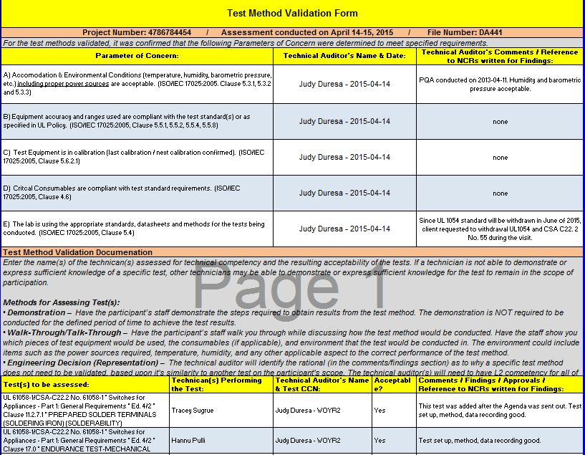
Communicating Technical Auditor Expectations
TA completes Test Method Validation in 00-OP-F0031
Slide <number>
Notes:
TA is required to complete the “Test Method Validation” worksheet in the DAP Assessment Tool.
TA needs to complete and send to LA by audit completion.
See TMV checklist for instructions on Demonstration, Walk-through & Engineering Decision (Representation)
Methods used to get the worksheet to TA are:
LA may direct TA to the updated DAP Assessment Tool in ePro.
LA emails the worksheet to TA.
Print and give at the beginning of the audit.

Slide 71
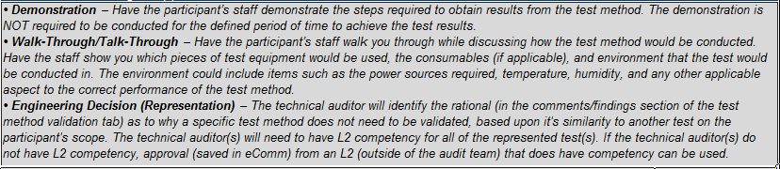
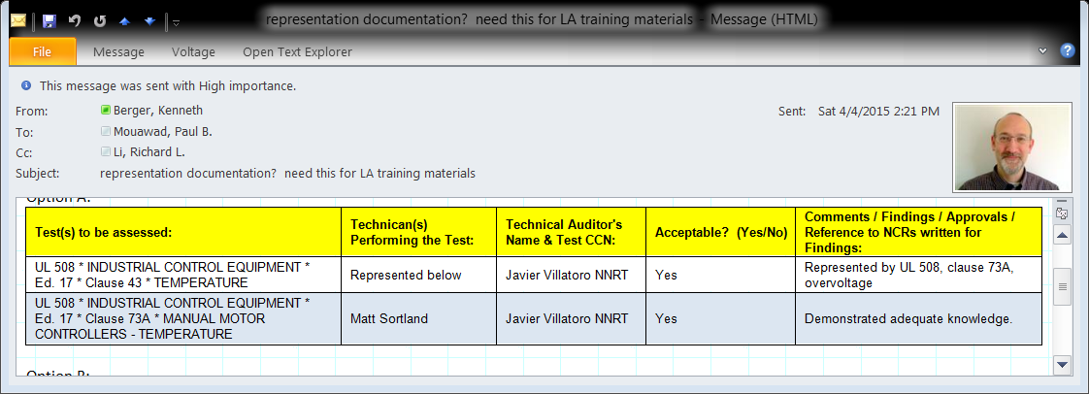
Recording Test Representation
DAP Assessment Tool (00-OP-F0031), same Test Method Validation tab.
TA identifies rationale based on similarity to another test in Scope.
TA needs to have L2 competency for all represented tests.
If not L2, save approval (eComm) from an L2 outside the audit team.
n/a
Slide <number>

Slide 72
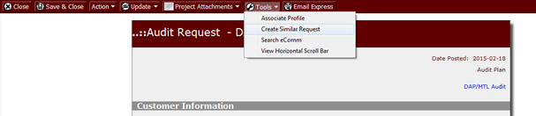
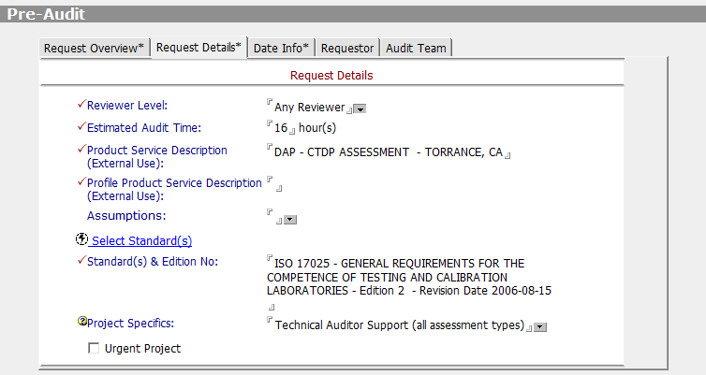
Create Similar Request for Technical Auditor(s)
  OPTIONAL – NOT REQUIRED
  Create in ePro, select “Technical Auditor Support” and delegate to staff.
Notes:
If needed, walk students through the process of creating a similar request in ePro.

Slide 73
Communicating Technical Auditor Expectations
TA and LA should audit at the same time.
    If not, be at each closing meeting by phone.
Both TA and LA may:
    Ask same questions since quality and technical requirements overlap.
    Be in test lab to conduct audit.
TA notifies LA of potential NCRs as they arise (or schedule breaks).
TA provides Test Method Validation to LA by end of audit.
Communicate importance of following timeline to prevent Inactivation!
TA delegates Final Review to their Manager or designee to close similar request, if one was created.
    Must attach blank document in “DAP Assessment Information” section and associate to DAP facility to close. See 00-OP-W0400, WORK INSTRUCTIONS FOR DAP/MTL USE OF THE EPRODUCTION AUDIT PROFILE
Notes:
Describe situations where audit cannot be conducted at the same time:
Staff availability
Client availability
TA and LA have different lengths of audit (one ends earlier)
Ask: If you have a situation where you and the TA do not audit at the same time? How would you handle it? (facilitate discussion)
Communicate audit structure/timing to the client lab so there are no surprises. (Personal story: TA got into car accident morning he was to fly out)
Have the TA discuss NCRs with you before his/her closing meeting with the client.
Try to be at the TA’s closing meeting by phone so you can still lead the end of the audit and discuss action items and target dates to close the project by the AVD.
Do a thorough job reviewing DAP requirements even if the TA may ask the same questions. Your requirements overlap and that is ok.
It is important for the TA to discuss potential NCRs with you as they arise. You must be on the same page when discussing NCRs at the daily wrap ups or closing meeting. When applicable, the LA should answer the client and tie the questions back to ISO/IEC 17025 and DAP requirements.
Check in with the TA to monitor audit progress and be there for support. It shows TA and client that you are the leader!
Personal Story about late TMV submission: I had to follow up with TAs several times to get the TMV. I passed the deadline to submit to PR by 2 weeks! What do you do in this case?
If you know you will not make the 1 week deadline to submit to PR, reach out to a reviewer or Review Lead, Paul Mouawad, to indicate your work is complete but you are waiting on the TA. We will determine a plan for each case. Especially if the TA has to conduct their audit at a later time, create an ePro comment and be sure to respond to the Inactivation emails. It helps staff to know your current status and determine to send or not send the Inactivation emails to the client.
Ask: What could I have done better? Communicate PRE-AUDIT, the project timeline and deadlines needed to complete the project by the AVD.
Associating a blank doc to the DAP facility is just like CAS does with DAP client datasheets. Save it in DAP/MTL Information then associate.
Ask: When can they close their profile?
After you have reviewed their TMV and NCR information and submit to PR.
Ask: If you need them to review a client’s CAR, should they keep their project open? You can, but be sure it is closed before you submit to FR.

Slide 74
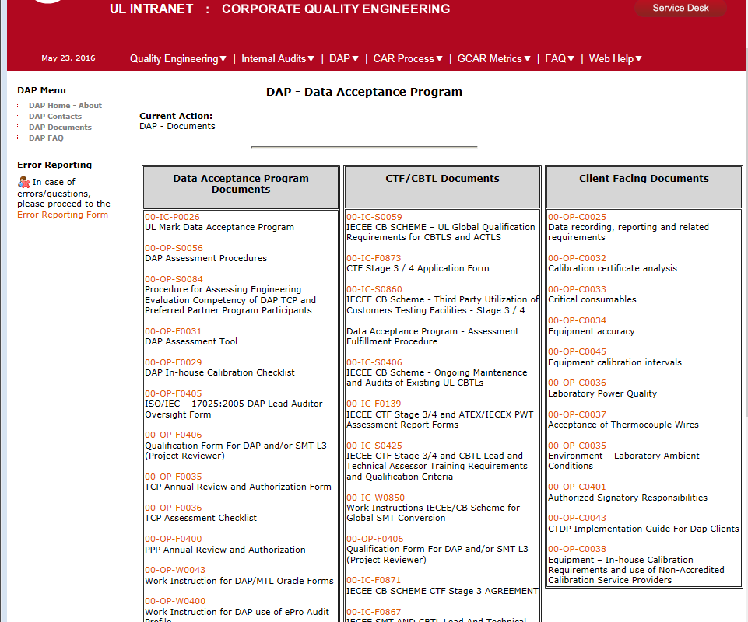
Download DAP Assessment Tool (00-OP-F0031)
Activity – Class follows with instructor demo to download.
Slide <number>
Notes:
Obtain the DAP Assessment Tool on QE site: http://corporate.ul.com/departments/snk5212/DAP/DAP_Documents.cfm
on DCS: http://dcs.ul.com/search/Pages/dcsresults.aspx
Encourage class to follow along with their laptops.
Save DAP Assessment Tool in a convenient location on their laptop.
Walk students through download of DAP assessment tool.
Have DAP Tool saved on your computer (email or have thumb drive if students are having trouble downloading).

Slide 75
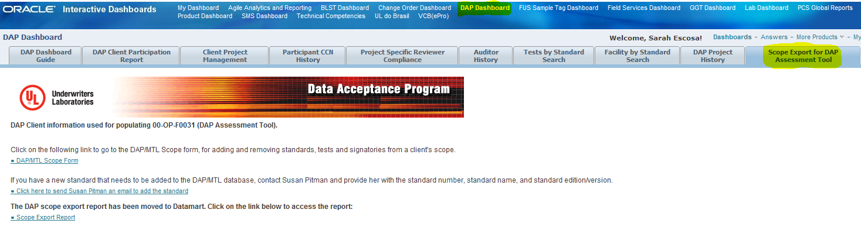
Scope Export - Oracle Business Intelligence (OBI)
Access OBI through UL Intranet Tools and Resources, click on “DAP Dashboard”, then “Scope Export Report”.
Global Quality: More Quality Related Links: Quality Dashboard: Applications: DAP Dashboard: Scope Export for DAP Assessment Tool: Scope Export Report!
Slide <number>
Notes:
Follow these steps to demonstrate for the class:
Select DA file number from drop down menu.
Click on “View Report” (to the right).
Select ‘Excel’ from the drop down menu for “Select a format”, click on “Export”.
SAVE the scope report in a convenient location on your computer. File name is your choice.
Make sure it is saved in .xls format.
Have an example of a scope export if class needs one (email or use external drive).

Slide 76
Items to verify with the client:
Scope of Participation
Client address
Client contact information (contact DAP@ul.com if different from ePro)
Need for protective equipment (i.e. steel toed shoes, safety glasses)
Suggest on-site audit dates per timeline and confirm client’s availability
Communicate number of auditors who will be onsite (based on tests selected for evaluation – will discuss in this module)
Slide <number>
Notes:
Client may request to add or remove tests.
Getting an accurate scope at this time will make things easier for you when creating reports throughout the audit project.
Client may still request to add to scope at the audit. This is acceptable but may require rework and recreation of client documents.
Scope is typically verified by Lead Auditor but may be verified by Technical Auditor (beneficial if they have a current working relationship with client).
Inform DAP@ul.com if client address and contact information is different from ePro. Behind the scenes work needs to be done to ensure records are consistent (i.e. agreements, Oracle, NAFT).
Test representation is discussed on the next slide.

Slide 77
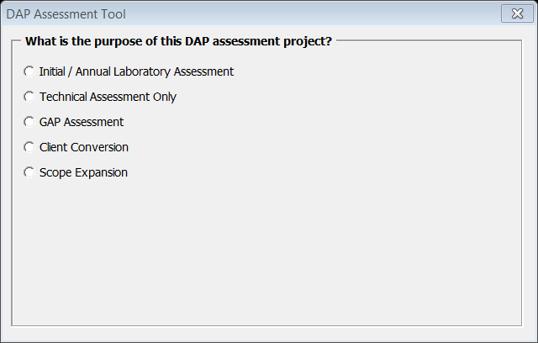
DAP Audit Agenda Preparation
  Open DAP Assessment Tool (00-OP-F0031)
  Select “Initial / Annual Laboratory Assessment”
  Activity – Class follows with instructor demo.
Slide <number>
Notes:
Follow these steps to demonstrate for the class:
Open DAP Assessment Tool, 00-OP-F0031.
Describe selections for class awareness.
Select “Annual Laboratory Assessment”.

Slide 78
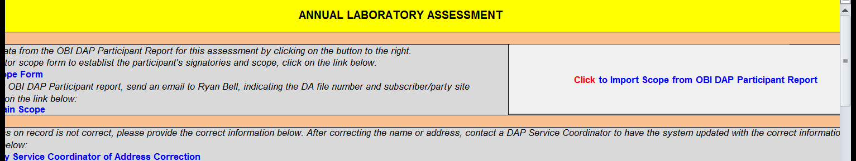
Import Scope into DAP Assessment Tool
  Go to “DAP Tool Preparation” tab.
  “Click to Import Scope from OBI DAP Participant Report”
  Activity – Class follows with instructor demo.
Slide <number>
Notes:
Follow these steps to demonstrate for the class:
Import scope.
Enter AVD found in ePro as “Certificate Renewal Date”.
Show “Assessment Timeline” page. (also on next slide)
Indicate the AVD establishes target dates throughout the audit project.
Enter dates the audit team is available to conduct the audit, paying attention to target dates within the timeline.
Review “Tests to Assess” page.
Discuss fill-out (date, project number, “Satisfactorily Completed”) when client participates in 3-year cycle.
Click to create Pre-Assessment Checklist.
It will output as a separate Excel document and automatically save to your desktop.
Send to client for fill-out. If client prefers, lead auditor can complete with client information.

Slide 79
Create the Audit Agenda
  Verify information and fill-out subsequent worksheets to create Agenda.
  Activity – Class follows with instructor demo.
  Worksheets:
  Complete “DAP Tool Preparation”.
  Review “Assessment Timeline”.
  Verify “Scope of Participation”.
  Add example tests to “Scope Additions”.
  Discuss thought process to select “Tests to Assess”.
  Verify “Agenda Review” information.
  Create PDF and save Agenda.
Slide <number>
Notes:
Follow steps above to demonstrate and discuss with class.
Review “Agenda Review”.
Agenda (Annex A) has no user input since the technical scope is imported.
Agenda (Annex B) has no user input since the tests to be demonstrated are established based on other inputs into the tool.
Daily Agenda page may be completed (not required) to help organize the audit.
Demonstrate creating .pdf documents.
Have example of completed Agenda for class.

Slide 80
Create the Audit Agenda
  Send audit agenda documents to the client 5 weeks before audit:
    Agenda, includes Annex A (scope) & B (tests to assess)
    Daily Agenda (optional)
  Profile email with attachment in eComm
  “Delegate Audit” in ePro to yourself (Lead Auditor)
What tells us the agenda should be sent 5 weeks before the audit?
Slide <number>
Notes:
Red colored tabs in the DAP Assessment Tool remind auditors they are the documents to send to the client.
Inform client you sent the agenda in advance so they can review in detail and bring up any concerns/changes.
Profiling the agenda in eComm is required to pass through final review.

Slide 81
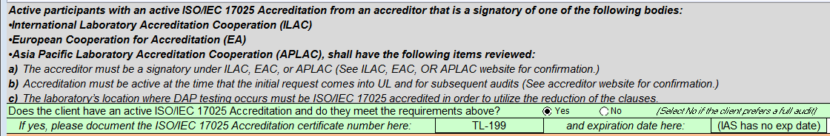
What if Participant is ISO/IEC 17025 Accredited?
Accreditor must be signatory under ILAC, EAC, or APLAC
Lead Auditor: See websites to verify
Accreditation must be active at the time of initial request & audit
Lead Auditor: See certificate expiration date (typically on website). Note: IAS does not use (http://www.iasonline.org/) so put “No exp date”)
The accredited scope may not identify location. Acceptable if the test lab is also clearly covered by the QMS of accredited lab.
The accredited scope may not specifically cover DAP Scope. Acceptable since the agenda covers the lab’s competency in the DAP Scope.
Lead Auditor completes DAP Assessment Tool accordingly and clause selection will automatically be reduced (00-IC-P0026)
Slide <number>
Notes:
Note: ISA does not issue expiration dates – see their website for their rationale - http://www.iasonline.org/.
The accredited scope may not specifically identify the test lab location. Acceptable as long as the test lab is also clearly covered by the Quality Management System of the accredited lab.
The accredited scope may not specifically cover the DAP Scope of Participation. Acceptable since the agenda covers the lab’s competency in the DAP Scope.

Slide 82
DAP Assessment Timeline
Final review must be completed by the Anniversary Date (AVD) to continue participation and prevent Inactivation.
Slide <number>
Notes:
Again, indicate the AVD establishes target dates throughout the audit project.
Work with audit team and client throughout the project to establish deadlines and expectations.
Our accreditors found audit projects staying open much longer than the AVD and wrote us up.
UL cannot continue the DAP program unless we meet these project completion dates.
Over 50% of data comes from DAP clients in NA and EULA, and more for AP.
Let’s do our part to prevent Inactivations and keep certification projects coming through!

Slide 83
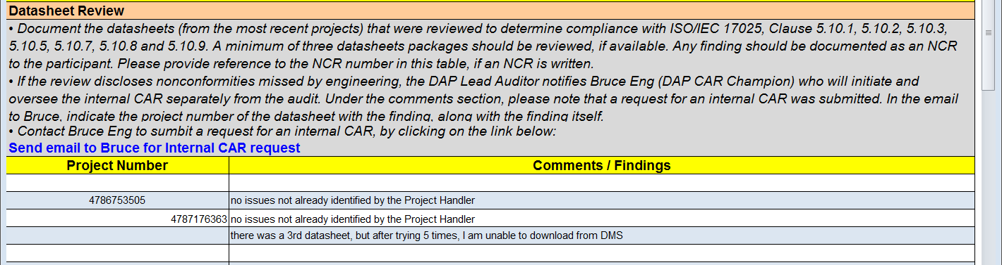
Datasheet Review
Datasheet review was covered in Clause 5.10
Select minimum 3 datasheets from OBI and/or DMS, submitted to UL since last DAP audit.
Activity – Class follows with instructor demo.
Record the following in “Datasheet (5.10) & NCR Review” tab.
    Comments
    Findings
    CAS notification and date, Internal CAR # (if applicable)
Slide <number>
Notes:
Repeat from 5.10:
If datasheet review discloses nonconformities missed by engineering,
DAP Lead Auditor notifies project handler’s Engineering Lead.
Bruce Eng documents the issues in a CAR in the Global CAR Database.
Assigns to the department that accepted the test data.
Document steps taken including date, CAS dept, internal CAR# in DAP Assessment Tool “Datasheet & NCR Review” tab.

Slide 84
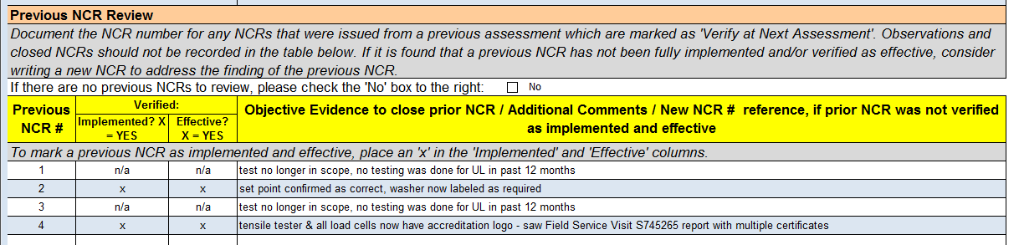
NCR Review Before the Audit
Obtain last audit’s NCRs in DMS
Record open NCRs in “Datasheet (5.10) & NCR Review” tab.
If actions to correct NCR were not done or attempted, create repeat NCR, record new NCR#, and notify DAP Audit Manager.
Slide <number>
Notes:
Use the DA file or subscriber number to get last year’s NCRs in DMS.
Determining the open NCRs and recording comments before the audit will assist you during the visit.
We will review NCR writing later.
**Ignore the note “Observations…should not be recorded…” SOP change coming.

Slide 85
Final Pre-Audit Steps
Attach the following to “DAP Assessment Information” in ePro:
    DAP Assessment Tool (Pathnotes)
Profile in eComm, Agenda and all correspondence associated with audit project.
        Per 00-OP-S0044: Project Handling Process
        Process profile per 00-OP-W0400, WORK INSTRUCTIONS FOR DAP/MTL USE OF THE EPRODUCTION AUDIT PROFILE
Slide <number>
Notes:
DAP requires audit agenda to be profiled in eComm but not attached to ePro. It does not get uploaded to DMS.

Slide 86
Module Summary
Importance of Planning
Audit Project Timeline
Communicating Technical Auditor Expectations
DAP Assessment Tool
    Scope Export
    Test Selection
    Creating the Agenda
Updating ePro and eComm
Datasheet & NCR Review Before the Audit
Slide <number>
Notes:
When planning is done correctly, the audit project will run smoothly.
It is important to keep target dates in mind as you go through the audit project so it is completed by the AVD.
Communicating technical auditor expectations will help the entire audit teem stay on track with the timeline.
We are now able to use the DAP tools and obtain scope information.
Reviewing datasheets and NCRs before the audit means less time at the client lab. Information tied to the datasheets and past NCRs can be discussed while evaluating the applicable QMS clause(s). It results in a well-organized audit.
NOTE – DMS may not accurately show the number of datasheets submitted, so reach out to the client or a UL project handler.

Slide 87
Questions?

Slide 88
Conducting an Opening Meeting
Module 8
Notes:
Now we have arrived at the client lab. Let’s see what it takes to conduct an effective opening meeting.

Slide 89

What is an Opening Meeting?
On-site launch of the audit
  Meeting between audit team and designated client personnel
  Put client at ease; audit will focus on the QMS system, not personnel
Slide <number>
Notes:
Indicate that an audit can be stressful for a client lab.
Uncertainties about what is covered or time can add to that stress.
As an auditor, one of your roles is to establish effective two-way communication regarding the audit to help reduce this stress.
It is important to put personnel at ease regarding your purpose for being there; the audit will focus on the Quality Management System, not personnel.
Review the audit agenda with the client
Be open to questions from the client
Discuss Lunch arrangement and other logistics.
Opening Meetings should be typically be no longer than 15 minutes.
Important: Need key players in the opening meeting – signatory receiving/sending audit documents, personnel you have communicated with so far, lab manager, quality manager, lab technicians etc.

Slide 90
Topics to Cover in an Opening Meeting
Introduce audit team and their roles
Ask client lab to introduce themselves
Restate purpose of audit – an effective system for reliable test data
Review tests and other activities to be conducted
Discuss logistics and schedule - changes to agenda
Summarize status of open/closed NCRs from previous audit.
Confirm safety and emergency procedures
Inform everyone of how/where they can find you for questions.
Ask if there are any final questions.
Per 00-OP-S0056
Slide <number>
Notes:
Emphasize the audit’s purpose: UL wants to partner with them for continuous improvement.
Indicate again, we want two-way communication. That the audit team will discuss any potential nonconformities as they arise so the client is immediately aware and can discuss or provide objective evidence.
Keep track of time (typically 30 minutes maximum); will have plenty of time to go over the details and changes during the audit.
Be sure to ask if there are any final questions.
Opening Meeting details can be found in DAP Assessment Procedure, 00-OP-S0056.

Slide 91
FAQs During the Audit
Can recording and/or photographic equipment be used during audits? (00-OP-S0056, clause 6)
Can we respond to or fix an NCR during the audit to close it out or not record it?
Can we obtain a copy of the completed checklist or audit trail notes?
Why are these requirements just now being thrown at us?
Why so many requirements and why is so much detail needed?
Slide <number>
Notes:
Ask class for their opinions to wake them up since this is the end of Day 2.
Recording/photographs by the audit team – NO, unless you have written client consent.
Rule of thumb for not recording NCR during the audit is NO.
Reason is mainly to allow for a complete investigation (Root Cause) and long term solution.
Regardless, the report needs to identify the NCR.
If the item is minor, can record it as Observation with no RC response and only a fix to the sampled evidence required.
Checklist/notes - NO, remind them that the auditor and client need to keep their own notes.
UL is required to adopt 17025 criteria as part of DAP as a ‘chain of custody’ for the control of test data.
ISO/IEC 17025 requirements affect both UL and client labs alike and we need to meet our accreditation criteria with (ANSI, OSHA, SCC etc).
In 2006, our accreditors adopted ISO/IEC 17065 and upgraded ISO/IEC Guide 25 (technical requirements) to ISO/IEC 17025 (quality and technical) which has more requirements and is very detailed. This change required UL to adjust our data acceptance program to align with accreditation requirements.
Client guide documents are UL’s way to consistently meets 17025 requirements across our variety of products.

Slide 92
Preparing for the Unexpected
The Unexpected:
Loss of power
Equipment failure
Fire emergency
Climate control malfunction
Client personnel not available during the audit
Audit team member not available or delayed
Your Backup Plan:
?
?
?
?
?
?
Slide <number>
Notes:
Unexpected events place extra burden on your ability to complete the audit.
While all possible situations cannot be foreseen, it is important to anticipate and be prepared for them.
Ask the class to think of possible back-up plans for the situations listed:
Loss of power – may not be able to audit if computers/records are not available, in addition to test equipment not running
Equipment failure – Find back-up equipment or conduct walk-through/talk-through to evaluate competency.
Fire emergency – Leave the facility/reschedule.
Climate control malfunction – should still be able to conduct the audit (audit the process). Go to another area of the plant.
Personnel not available during the audit: Find substitute or reschedule.
Audit team member: If delayed, re-organize the agenda. If not available, reschedule. Continue without the person.

Slide 93
Reasons Clients can be Difficult
Never been through DAP audit before
Confused about what is happening
Defending their self-esteem
Feel like no one is listening to them
Tired and frustrated (UL related or not)
Are in a bad mood and taking it out on you
Slide <number>
Notes:
It’s a fact of life that some clients will be more difficult to deal with than others.
Emphasize that few lab people are constantly rude or difficult. In most cases, if a lab person is being challenging, there is a reason for it.
Discuss some of the common reasons why clients can be difficult that are listed.
Ask: Has anyone had to deal with a difficult lab person while at a site?
How did they deal with it?
Could they determine what was the underlying reason?

Slide 94
Handling Complaints and Difficult Situations
Be prepared for a range of emotions
Client is venting – let them!
    Even if the problem is not your responsibility or solution is not in your hands, remember we represent all of UL.
Stay calm
Listen carefully
    Use Verbal and Non-verbal cues
    Ask open-ended questions (5W’s – what, when, where, why, who)
    Repeat information to confirm your understanding
Slide <number>
Notes:
ASK: Why is listening so important?
Responses: communicates to the person that you are concerned, will calm them down, need to have information to solve the problem, improves the relationship with the client, shows you understand them even if you do not agree with them, gains listening in return, gains cooperation.

Slide 95
Handling Complaints and Difficult Situations
Acknowledge feelings: “Yes, that can be frustrating.”
    “I’d be upset too.”
Deal with it promptly and take ownership
    Make client feel they talked to the right person
    Explain action(s) you will take to handle the situation and gain agreement
Agree to disagree
Thank the person for bringing the situation to your attention
Slide <number>
Notes:
When you respond back, make sure you communicate your intent to help.
Emphasize that if you cannot explain your next steps because you need more information that you will get back to them. Be sure to follow through!
If the situation has not improved, agree to disagree, but at least let client know you will bring their concerns to other UL staff for consideration. Update client regularly.
No matter how frustrating the situation may be for you, always thank the person for bringing it to your attention.

Slide 96
Module 8 – Activity 1
Handling Difficult Situations
Directions:
Read Case 1.
Write down your responses.
Read Case 2.
Select how you might handle this situation from the list.
Be prepared to explain your reasoning.
Time: 5 minutes - Individual
10 minutes - Class Discussion
Slide <number>
Notes:
Through this activity, you will be better prepared if and when a difficult situation occurs. This is an individual activity.
Instructor Answer Key:
Case 1
The responses you get from the class should be similar to the following examples:
Repeat the complaint: “The auditor missed the scheduled interview time with you.”
Acknowledge the emotion: “You certainly have a right to be upset. I would be too. We all are busy.”
What questions might you ask: “How did the meeting get rescheduled? Did he reach out to you before choosing the time?”
Explain what you will do: “I will speak with the auditor and tell him how inconvenient his missing interviews shows lack of respect for client work schedules. What I would like to do is to find a time that is better for you while we are visiting your lab. Would that be alright with you?”
Thank the person: “Thank you for bringing this to my attention. I’m glad you told me about it. It should not have happened and I apologize on our team behalf.”
Case 2
NOTE: Ask the class to tell you which ones they selected, did not select, and why.
Appropriate answers are:
# 2 - sympathize with his feelings
# 4 - remain calm, cool and patient
# 5 - explain the goal of the audit and that you are really working together to reach the same goal. Add that “The number of NCRs does not show inadequacy of the lab. It has more to do with our accreditors implementing the detailed requirements of ISO/IEC 17025 so UL and DAP labs must both comply.
# 10 – thank him for bring it to your attention.

Slide 97
Module 8 – Activity 2, Opening Meeting
Directions:
In teams, review previous NTL materials to prepare for the opening meeting.
Audit Team Role Players:
  Create the agenda your audit team will follow.
  Note key topics you will cover and by whom.
  Anticipate questions that might be brought up and plan responses.
NTL Role Players:
  Review the information on your character.
  Get into your role and actively participate.
Observers: Use Observation Sheet to record what you think
went well and how things might be improved.
Time:
  30 minutes – Prepare Agenda
  15 minutes for each team - Role Play
  15 minutes - Debrief
Slide <number>
Notes:
This activity is a role play in which your team will be split into the UL audit team and NTL lab staff.
The lead auditor will walk through an opening meeting with support from the technical auditor(s).
NTL role players will get into character and provide road blocks for the audit team.
The rest will be observers and will fill out the Observation Sheet with your feedback to the audit team.
A role play is an important learning opportunity to gain needed practice and get feedback before going into a real audit environment.
From each role play, the WHOLE class will learn strategies and skills when conducting an opening meeting.
There are many components that need to be reviewed in advance, to be prepared for the opening meeting.
NOTE: Teams will create their agenda together as a homework assignment and tomorrow they will have time to prepare for the actual role play.
Ask if they have any questions.

Slide 98
Any Questions?

