Slide 1
DAP Lead Auditor Training
Day 3
August 6, 2015 - Revision 2
For questions or comments, please contact DAP Performance Enhancement Team

Slide 2
Learning Objectives – Day 3
Upon completion of this course, you should be able to:
Conduct an opening meeting
Handle difficult situations
Use the GALO, In-House Calibration Checklist and Path Notes
Recognize factors to look for when tests are assessed
Determine the audit paths to follow from assessed tests
Communicate possible NCRs with auditee effectively
Slide <number>

Slide 3
Conducting an Opening Meeting - Continuation
Module 8

Slide 4

Module 8 – Activity 2, Opening Meeting
Directions:
In teams, review previous NTL materials to prepare for the opening meeting.
Audit Team Role Players:
  Create the agenda your audit team will follow.
  Note key topics you will cover and by whom.
  Anticipate questions that might be brought up and plan responses.
NTL Role Players:
  Review the information on your character.
  Get into your role and actively participate.
Observers: Use Observation Sheet to record what you think
went well and how things might be improved.
Time:
  30 minutes – Prepare Agenda
  15 minutes for each team - Role Play
  15 minutes - Debrief
Slide <number>
Notes:
Instructor Notes from Day 2:
This activity is a role play in which your team will be split into the UL audit team and NTL lab staff.
The lead auditor will walk through an opening meeting with support from the technical auditor(s).
NTL role players will get into character and provide road blocks for the audit team.
The rest will be observers and will fill out the Observation Sheet with feedback to the audit team.
A role play is an important learning opportunity to gain needed practice and get feedback before going into a real audit environment.
From each role play, the WHOLE class will learn strategies and skills when conducting an opening meeting.
There are many components that need to be reviewed in advance, to be prepared for the opening meeting.
Instructor Notes for Day 3:
Remind them that they will need to monitor their time to ensure they cover all the topics within the allotted time.
Give them time to practice and prepare.
Conduct the first role play
Have the class complete the feedback sheet on the lead who conducted the opening meeting.
Conduct the second role play.
Have the class complete the feedback sheet on the lead who conducted the second opening meeting.
Debrief the activity by asking:
Questions of the lead auditor conducting the meeting:
What do you think went well in the meeting?
How did you feel about putting your agenda together?
Is there something you would have done differently?
Questions of the Observers and technical auditors:
What do you think went well in the meeting?
What could the auditor have done to improve the meeting?
Any other feedback?
Tell the class they did a good job on their analysis and agenda planning.
Instructor Answer Key:
NOTE: There are no right or wrong answers to these questions. However listen closely to what the lead auditor says and offer additional comments to gain class understanding or from your own experiences.
Ask the observers for their comments to the same questions. Again listen closely to ensure that the opinions focus on behavior and not the personality of the people.
Ask the class to pass their observations sheets to the people who role played. Tell them they can review the specific comments at their leisure.

Slide 5
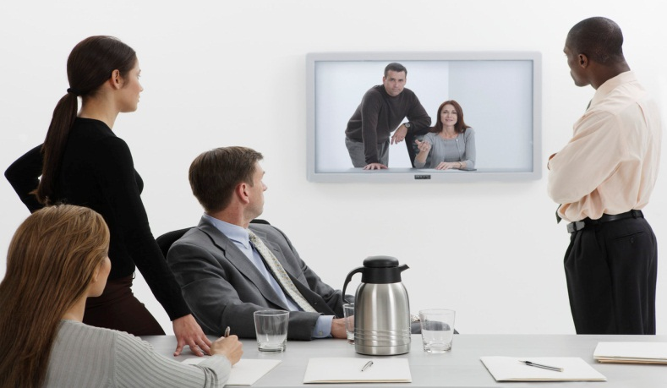
Daily Wrap-Up (Optional)
Meetings at the end of each audit day
Review activities completed
Re-planning of audit agenda may be necessary
Communicate potential NCRs
Involving client lab technicians is up to the client (optional)
Slide <number>
Notes:
Daily wrap up meetings are always a good idea to make sure everyone is on the same page.
In addition, when potential NCRs are communicated, there is no surprise at the closing meeting and you can focus on the next steps to complete the audit project (i.e. target dates to send CARs, review CARs)
We will learn effective ways to communicate potential NCRs in a later module.
It is the client’s decision to involve lab technicians in the daily wrap up meetings. It is beneficial to request their presence if they:
Might be affected by a change to the audit agenda.
Might be responsible for responding to NCRs.
Are a Signatory or DAP team’s point of contact outside of the audit.

Slide 6

Module Summary
Conducting an opening meeting
FAQs from clients
Dealing with client reactions
Dealing with difficult situations
Preparing for the unexpected
Daily wrap-ups
Slide <number>

Slide 7

Questions?

Slide 8
Documenting the DAP Audit using the GALO, In-House Calibration Checklist and Pathnotes
Module 9

Slide 9
Learning Objectives
Upon completion of this module, you should be able to:
Describe the function of GALO and In-House Calibration Checklists.
Determine when to use the In-House Calibration Checklist.
Complete the checklists including Test Method Validation.
Identify the need for additional Path Notes and how to store, if taken.
Describe how to identify and follow an audit path.
Slide <number>
Notes:
As auditors, we gather information and then make a determination as to whether or not the “system” audited is compliant or not.
Once you have made this determination, it is very important to document the information in the required checklist, under the applicable clause, and communicate this information to the auditee in a clear and concise manner.

Slide 10
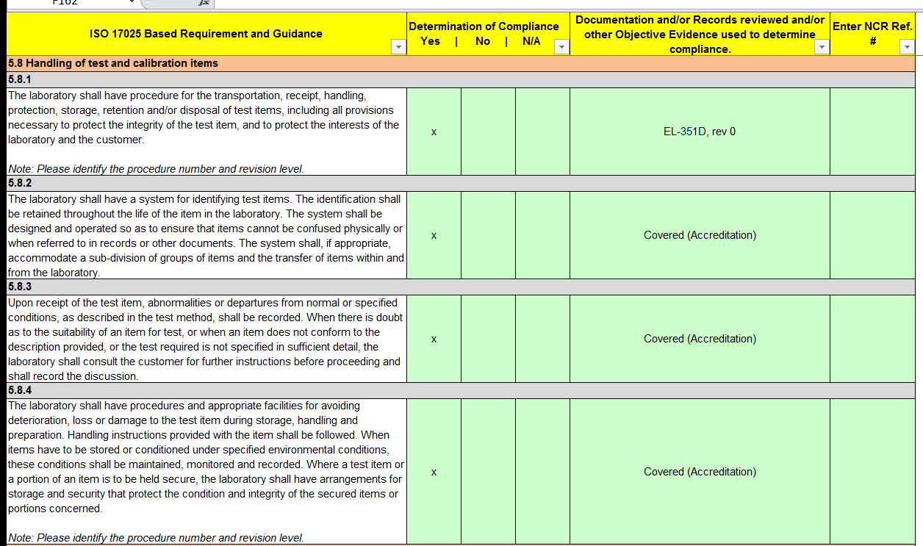
GALO Checklist
GALO is required for all DAP Assessments - CTDP, TCP, TPTDP, PPP
  Also technical scope expansions (subset of DAP requirements)
Slide <number>
Notes:
Instruct class to open the DAP Assessment Tool they filled-out yesterday and go to worksheet “GALO Checklist”. If none, can review this slide.
Discuss various aspects of the GALO checklist (17025 clause, determination of compliance, comment section, NCR reference, Notes Italicized for Auditor).

Slide 11
What information is required in the GALO?
Record determination of compliance for EVERY row
If a requirement is determined “N/A”, a comment is needed to support
Record Procedure and Revision Level, as required (see “Note” in 1st column “ISO17025 Based Requirements & Guidance” for guidance)
Reference all NCR #s to the applicable clause(s) it was written against
Compliance is marked “No” for all NCRs
NOTE: cells use color as warning: row will turn green when information is entered in appropriate columns.
  Activity – Class follows with instructor demo.
Slide <number>
Notes:
Each row in the GALO is one or a set of requirements in ISO/IEC 17025. Compliance must be recorded for every row.
Record what you reviewed to determine compliance.
If a requirement is deemed “N/A”, a comment is required to justify the decision.
Some parts of the GALO are already determined “N/A” with a comment. (Review examples with class).
Make sure to record procedures and revision levels.
Reference comments in "ISO17025 Based Requirements & Guidance” often to ensure you are reviewing all necessary items to determine compliance to requirements.
All NCRs (Observation or requiring CAR) must be referenced in the GALO to the applicable clause(s) they were written against. (Review examples with class or go show previous slide).
NCRs are also required to be recorded in other areas of the DAP assessment tool, as applicable (i.e. NCRs related to datasheets and previous NCRs).

Slide 12
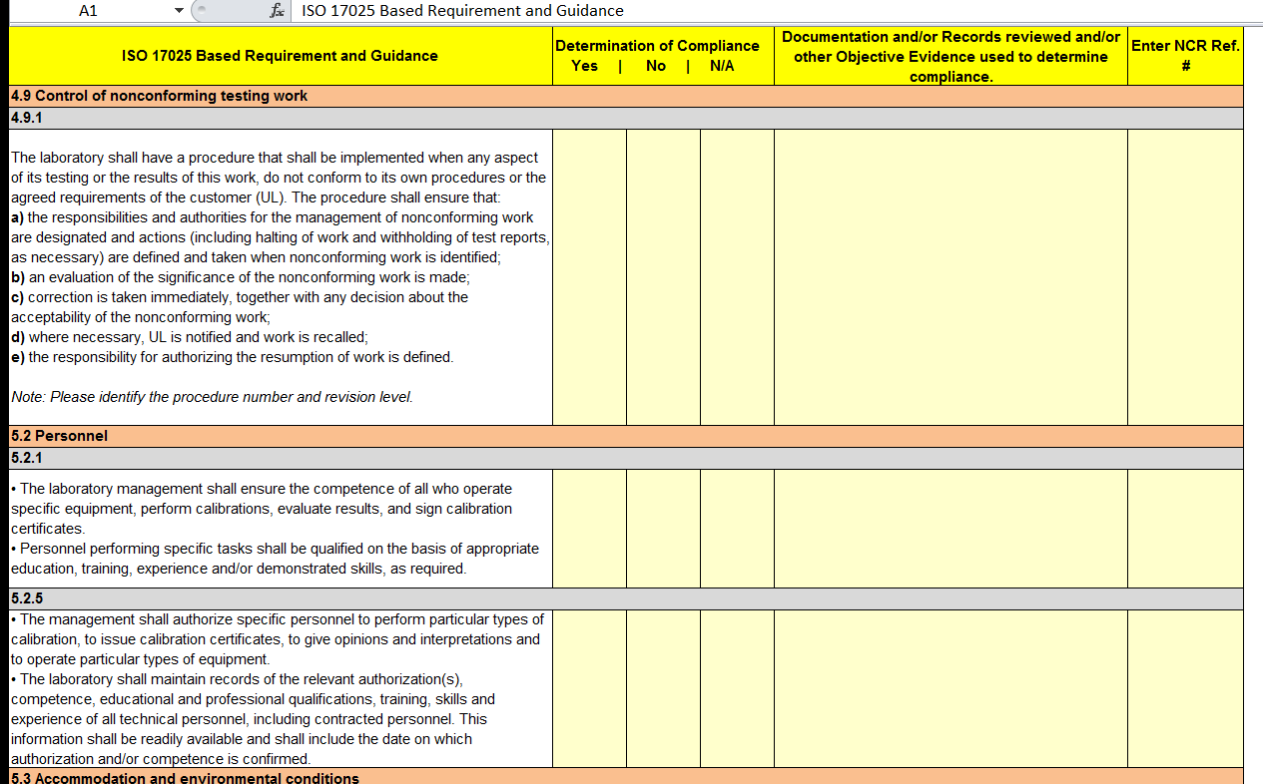
In-House Calibration Checklist
In-House Calibration Checklist is required for clients that calibrate their own equipment for UL tests.
Slide <number>
Notes:
In-House cal is more widely used in AP and EULA than in NA (10%). FYI, for LAs in these regions.
Let’s remember some labs conduct a variety of tests but we are only applying UL DAP requirements to their UL test scope of participation.
Instruct class to open the DAP Assessment Tool they filled-out yesterday and go to worksheet “In-House Calibration Checklist”. If none, can review this slide.
Similar to how you presented the GALO checklist, pick out several examples within the checklist and have the class turn to those requirements and discuss how the auditors will complete the form.
The sub-clause numbers parallel those in client guide 00-OP-C0038 that we reviewed yesterday. (Review the client guide again if needed.)
Each row indicates the corresponding clause(s) in ISO/IEC 17025 to guide auditors when writing NCRs. We will review writing NCRs using the DAP Assessment Tool later.

Slide 13
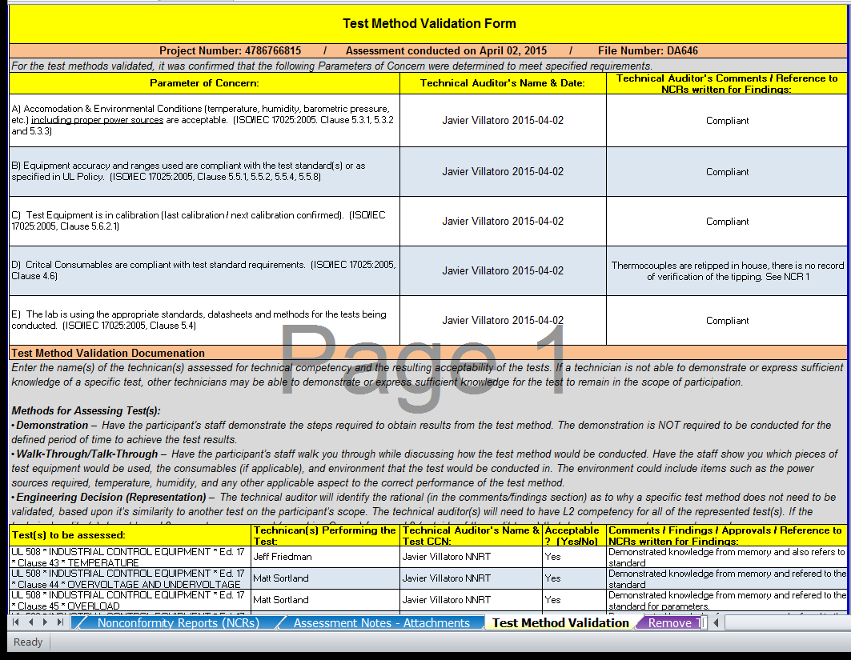
Test Method Validation by Technical Auditor
Activity – Class follows with instructor demo.
Slide <number>
Notes:
Record name and date when evaluating “Parameters of Concern” – these technical parameters reference the ISO/IEC 17025 clauses in case NCRs are issued.
Record comments as you see fit.
Comments are needed to support a potential NCR.
For each test assessed, record:
Technician(s) talked to and evaluated
If the test is acceptable (i.e. you have confidence in the lab’s competency to conduct the test and submit valid data)
NOTE: If specific equipment, consumables, environmental conditions etc. do not meet the test method requirements, write up an NCR. But if you still have confidence in the technician’s competency to conduct the test according to the standard method, deem the test acceptable. If not, it must be removed from the client’s post audit scope and they cannot submit data for that test.
Sometimes at the audit, clients ask to remove tests from their scope. Indicate something to the effect of “Removed per client request.” (see example above)
If during the audit, the client asks to add tests, indicate the schedule is based on the current scope, you will audit to that agenda first and if time allows, you will evaluate the newly requested tests. (Show class where to add tests in DAP Assessment tool. They will automatically be added to Test Method Validation to assess.)

Slide 14
Path Notes (Optional)
DAP Auditors may take additional path notes
Path notes may take various forms (i.e. notebook paper)
Notes should contain the following minimum information:
    DA file number
    Audit date
    Auditor’s name
    Page # (x of y)
    May include additional information (project number, client name)
Path notes shall be retained and added to DAP Assessment Tool for upload of record to DMS.
Slide <number>
Notes:
Auditors may find it more beneficial to record path notes outside of the checklists we just discussed.
Make sure the Path notes include the following information (Review bullet points)
These additional path notes must be added to the DAP Assessment Tool so they are included in the upload to DMS.
Ask DAP for assistance if needed.

Slide 15
Module 9 – Activity 1, Demo in Lab
Directions:
As a DAP lead auditor, you will witness a demo of a test conducted in the Lab.
Focus on possible audit paths you may take instead of focusing on the actual test.
Take path notes keeping in mind possible audit paths (Calibration, Environment, Standards, Equipment, Samples, and Consumables).
Discuss your observations as a large group.
Time: 30 minutes in Lab, 15 minutes debrief
  What did you observe and experience in the Lab?
  What possible audit paths did you find?
Slide <number>
Notes:
Indicate that this activity focuses on getting practice in a key skill of auditing.
NOTE: Emphasize they should be looking for audit paths – not how well the person is running the test.
NOTE: Schedule various tests for several groups to prevent crowding of one test.
Ask if they have any questions
Take the class to the lab for the test demonstration. (Instructors should split up to observe the several groups)
Go to a separate area from the lab to not disrupt lab staff.
Review the test(s) demonstrated concentrating on the various audit paths of Calibration, equipment, environment, consumables, standards, samples.
Ask the following questions:
What did you observe?
What potential audit paths were determined?
(Move to the next slide to ask the remaining questions)
Instructor Answer Key: Since these questions will be determined the day of demonstration, the instructor will need to facilitate the discussion based on what was occurring during the tests.

Slide 16
What Audit Paths were observed?
4.6 - Consumables
5.3 - Environment
5.4 - Test Methods/Standards
5.5 – Equipment
5.6 - Calibration
5.8 -Samples
Slide <number>
Notes:
Continue with the discussion by asking the class the question on the slide.
What audit paths were observed?
What would you do next?
Ask if there are any questions.
NOTE: The instructor will need to facilitate this experience since it is a live demonstration.

Slide 17
Module 9 – Activity 2, Following the Audit Trail
Directions:
Based on the notes taken in the laboratory, your team will be assigned a path to further audit. (Calibration, Environment, Standards, Equipment, Samples, and Consumables).
You will go to other lab areas to further audit the requirements.
Use the GALO Checklist to document your audit paths. You may also use path notes to supplement the checklist.
Email your completed GALO to the instructors.
Time:
Team Prep – 10 minutes
Follow Audit Trail - 30 minutes
Team Debrief – 15 minutes
35 minutes - Class Debrief - How did it go?
Slide <number>
Notes:
This activity focuses on auditing one specific path to get a feel for auditing to DAP requirements.
Either the instructor can pair people together or simply tell the class to find a partner from the other team.
From the previous activity the instructor should note all 6 areas on the whiteboard and jot down who is being assigned to which area.
They have 10 minutes to prep as a team to determine how they will approach their assigned audit path.
Have the partners go to their appropriate areas for further audit activities. The instructor should make themselves available for any questions.
Give the teams about 15 minutes to recoup before the class debrief. They can review their notes to be prepared.
(Move to the next slide for the debrief questions.)

Slide 18
Lessons Learned
What worked well?
What didn’t work?
What additional audit trails did you find?
Were there any potential NCR’s found?
What would you do differently?
Slide <number>
Notes:
Debrief – Ask the questions then: How could you improve your communications in future situations like these?
Provide additional examples of each potential path.
Tell the class they did a good job in this role play.
Ask if any one has any questions.
Instructor Answer Key for Module10 Activity 2 :
Make sure the participants have bridged the relationship between the audit paths and the appropriate clauses of ISO17025.
If they identified potential NCR’s, did they have enough evidence to show nonconformance to a DAP requirement or did they determine appropriate additional paths they might follow-up with.
Offer any of your insights as well.

Slide 19



Auditor Characteristics
Critical Behaviors for Success
Communication &
Reporting Skills
Personal Attributes
Auditing & Standards
Knowledge
Decision Making Skills
Lead Auditor Skills
Slide <number>
Notes:
Class discussion. Facilitate all characteristics but focus on Lead Auditor skills to help class relate to their future role as LA.
Think about the critical behaviors for success.
NOTE: Write the responses on a flip chart.
Personal attributes: Ethical, Open-minded, Diplomatic, Observant, Versatile, Decisive, Self-reliant, Time Management
Communication & reporting skills – Systematic questioning, good listener, clear verbal and writing skills
Auditing and standard knowledge – plans and organizes work, prioritizes, understands each clause, understands UL SOPs and client guides, uses sampling techniques correctly, correlates practices to standard requirements, gather objective data, reviews documents, recognizes inconsistencies between objective evidence, classifies NCRs as minor or major, confidential.
Lead auditor skills – leadership, directing teams, effective use of resources, multi-tasking, conflict resolution, partners with client.
Decision making – separate fact from opinion, bases decisions and draws conclusions based on objective evidence, understands requirements can be met in different ways, open to client situations, remains true to conclusion despite pressures

Slide 20
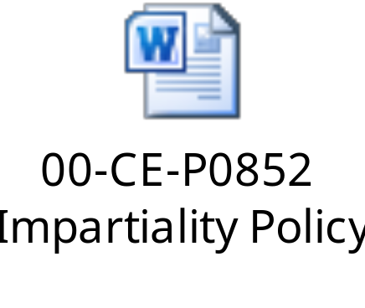
Ethical Behavior
What are some examples of relationships with clients that support a code of conduct?
Honest
Fair
Serves the greater good
Competent
Uses skills to promote improvements and reliability of testing
Doesn’t accept compensation
Acts professionally
Informs client regularly
Listens to others
Gives others credit
Confidentiality
Builds relationships
Slide <number>
Notes:
The recent required annual training on the UL Standards of Business Conduct (00-LE-P0001) mentioned Impartiality as one of the key standards of conduct that must be upheld by all UL staff. The Impartiality Policy (00-CE-P0852) details the responsibilities and expectations of staff in their day-to-day work. It defines impartiality as the “presence of objectivity” where “bias does not exist or is resolved so as not to adversely influence the activities…” The policy also explains various threats to impartiality, and provides the process to be used when a potential risk to impartiality is identified.
Impartiality means acting with fairness, without bias, open-mindedness and balance. Threats to impartiality include:
- Self-interest, such as a personal customer relationship that adversely affects objectivity;
- Self-review, which is performing conformity assessment activity in which UL certifies the results of other services it has already provided; e.g. when UL provides design services for products subsequently tested or certified by UL;
- Advocacy, such as acting in support of, or in opposition to, a company which is also a UL client;
- Over-familiarity, which could be basing our actions and decisions on trust, rather than seeking objective evidence;
- Intimidation, such as acting based on threats or fear;
- Competition, between a client and a UL entity, UL Agent or UL consultant.
In general, your responsibility as a UL staff member is to keep these definitions in mind, be on the lookout for situations that might pose a risk to impartiality, assess the risk (with the help of one of the resources in section 1.0 of the Impartiality Policy such as your manager, a member of the CPO staff, or a Compliance & Quality Council representative) and determine if the risk has been suitably addressed by existing mitigation steps or if the risk needs to be escalated further. We are all duty-bound to report anything that threatens the impartiality of our work, no matter how small or large the threat may appear to us as individual employees.
An internal Impartiality Management site has been created to assist you in this important part of your job.
If you have any questions, please discuss this with your manager.

Slide 21
Module Summary
What are the applicable DAP Checklists?
What checklists are required for which program?
What minimum information is to be recorded?
What are some examples of DAP Audit Paths?
Slide <number>
Notes:
Review questions with class to evaluate understanding.

Slide 22
Questions?

Slide 23
Communicating Potential NCRs to the Auditee
Module 10

Slide 24
Learning Objectives
Upon completion of this module, you should be able to:
Define Non-conformity (NCR) and Observation
Recognize significant NCRs
Communicate possible NCRs with auditee effectively
Slide <number>
Notes:
Briefly review the objectives for this module.
As auditors, we must be able to gather information and then make a determination whether or not the system audited is compliant or not.
Once we have made this determination, it is critical to communicate this information to the auditee in a clear and concise manner.

Slide 25
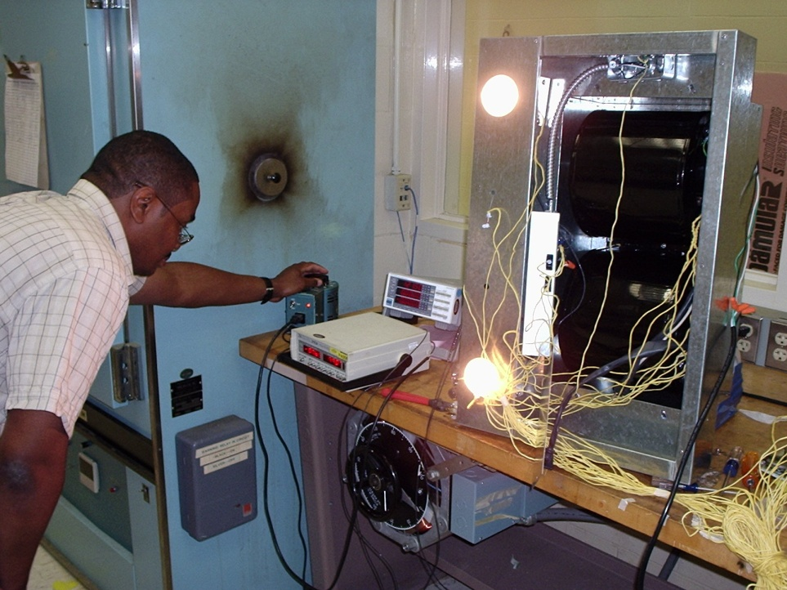
Definition of a Non-conformity
…a DAP participant is not complying with a program requirement…
--- UL MARK PRODUCT SAFETY CERTIFICATION SCHEMES, DATA ACCEPTANCE
PROGRAM ASSESSMENT AND NONCONFORMITY PROCEDURE (00-OP-S0056)
Slide <number>
Notes:
Review the definition with the class.
Add any other information you feel is relevant.

Slide 26
Classifications of Non-conformances (NCRs)
Corrective Action Required – Nonconformance to a requirement or procedure that is at least one of these:
  Systemic - affecting entire process or laboratory
  Recurring - multiple instances of found nonconformance
  Severe - test data submitted to UL could be suspect
Slide <number>
Notes:
The terms “non-conformance”, “finding”, and “NCR” will mean the same.
We have used “NCR” during activities and will continue to use it for the remainder of the course.
ASK: When would you classify an NCR as significant?
Get class to discuss situations.
A significant NCR (i.e. suspect test data) will result in the recommendation for suspension.

Slide 27
Corrective Action Required (continued)
What is required of the DAP Participant?
NCR placed and processed in participant’s own corrective action system. (Confirm this was done during the next assessment)
Conduct analysis and determine root cause.
Indicate action(s) taken, or to be taken with target dates to:
    contain nonconformance
    correct root cause
    prevent recurrence
Respond within 20 business days of NCR receipt, unless scheduled sooner to complete project by AVD.
Slide <number>
Notes:
After reviewing the slide, explain we will use the NCR form to show how the client will meet these requirements.

Slide 28
Classifications of Non-conformances (NCRs)
Observation – Nonconformance that does not appear to be systemic, recurring or severe.
Examples
  1 out of 15 datasheets reviewed did not contain a required date.
  Procedure SOP-120, rev 3 did not define the lab’s current and appropriate practice for electronic data back-up.
What is required of the DAP Participant?
No analysis or root cause required.
Fix the occurrence/evidence identified in NCR
Slide <number>

Slide 29
Classifications of Non-conformances (NCRs)
Repeat Finding - If participant did not attempt to implement the corrective action indicated for the previous NCR or implementation was not effective.
Generally a result from the verification process of a previous NCR.
Lead Auditor informs DAP Auditor Manager who will review & determine the appropriate action(s).
DAP Participant will be informed of required actions.
Slide <number>
Notes:
Again, we will work with the NCR form to show you how to identify repeat findings.

Slide 30
“Opportunity for Improvement”
  NOT a nonconformance (NCR).
  Can be issued verbally or documented in DAP Audit Report Summary
Examples
  2 forms contain almost the same information: consider combining them to simplify the system & reduce required maintenance.
  Consider use of 5S lean tool to increase lab organization
  What is required of the DAP Participant?
  Owner decides if they will act on the opportunity
Slide <number>

Slide 31
What to Do When You Believe there is a Potential NCR
Do not leave the area you are auditing.
Write down the details of what you or the Tech Auditor saw.
Ask yourself:
    “Do I have enough information to decide or do I need more?
    “Does the condition meet the requirements of a DAP NCR?”
    “Does the evidence NOT meet a requirement (DAP, client guide, standard, internal procedure)?
    “Should it be an Observation or require Corrective Action?
Slide <number>
Notes:
If you determine there may be a potential NCR, but do not have enough information to make a final decision at this point, alert the client of this situation ASAP.
Tell the client what additional information you will need to make a final determination.

Slide 32
Communicating Potential NCRs
Explain potential NCR to auditee before you leave the area:
    What was found, specific details.
    What the requirement is.
    Why it is a potential NCR, and
    If it is an Observation or requires analysis.
Provide opportunity for auditee to present more information.
    Interview other staff.
    Review other documents.
Ask clarifying questions.
Explain what your next steps will be.
Thank the auditee for their time.
Slide <number>
Notes:
Indicate that when the auditor believes they have identified an NCR in a particular area, they need to communicate the issue to the client.
They need to identify:
what was found (specific part #’s, equipment type, serial numbers, specific records, dates, etc.),
what the requirement is, and
why the objective evidence indicates there is a potential NCR.
By discussing the issue at the point of discovery, it gives the client an opportunity to present more information or see first hand what the issue is and the actual objective evidence to support your conclusions.
When you determine the NCR requires analysis or just a fix of the occurrence is needed, identify that to the client and document the NCR in your checklist to be included in the final report.
Remember, Observations are part of the final report but only a fix to the occurrence is required.

Slide 33
Helpful Hints on Discussing Potential NCRs
Eliminates delayed discussions and time re-auditing.
No surprises during the audit (be upfront with the client at all times).
Less challenges by auditee.
Summarize all NCRs during daily wrap-up meetings and closing meeting.
  DAP Terminology: Each finding is an “NCR”. Audit team determines if the NCR is an OFI, Observation or requires Corrective Action (CAR).
You may need to “agree to disagree” to keep the audit moving.
Reminder: Keep in frequent contact with the Technical Auditor!
Slide <number>
Notes:
Spending time to explaining the NCR at the time of discovery may eliminate extra time spent at the end of the audit or in having to defend NCR’s at a later time.
You will have fewer challenges from the client.
If the discussion is taking a long time, agree to disagree, let the client know you need to record the NCR but we have a formal appeals process, and move on with the audit.
Appeals will be discussed later.

Slide 34
Module 10 – Activity 1, Communicating a Potential NCR
Directions:
  Each person select one scenario (1, 4, 6, 7, 8, or 9). Repeat, only if needed.
  Individually, prepare for role play.
    What will you communicate to the auditee?
    Anticipate possible responses from the auditee and prepare your replies.
    Based on the information you get from the auditee, will you write an NCR? Provide reason(s) for your decision.
  Present your NCR to the auditee (DAP Instructor).
  Other team members are Observers and will use the observation sheet to record feedback.
Time:
  Prep - 30 minutes
  Role play - 5 min (each team member) + 2 min debrief
  Class Debrief - 20 minutes
Slide <number>
Notes:
Each person in each team will choose one of the scenarios above to communicate to the client (Instructor)
Mentally practice or rehearse what you plan to say when communicating your NCR to NTL.
Anticipate possible responses from NTL and prepare your replies.
Be able to determine from the conversation, if you will still write an NCR.
As each person does the role play, the other team members are to observe and provide feedback as you debrief.
Take 30 minutes to prep for the role play and instructors will walk around to help.
Conduct the role play.
Each instructor will take one team and role play as the client, with each person using the various options in the notes below.
Debrief after each role play so the conversation is fresh in everyone’s minds.
Instructor’s NTL Role Play as lab manager:
Scenario 1: Purchasing
Discuss the situation with the auditor. You indicate that you will contact the supplier for the certificates, show the auditor, and that should be sufficient to show the consumable meets the standard specification.
Would you write an NCR and why? Yes – Records are not maintained as required per 4.6.2 .
Scenario 4: Nonconforming Work/Corrective Action
I recalibrated the equipment by an accredited calibration service. I never did trace back analysis before for similar situations and never had a problem with shipped products. If we have to do a recall I will get fired.
Would you write an NCR and why? Yes – Lab is required to perform an investigation on the impact of suspect equipment on previous test results per 5.5.7 and keep a record of the investigation.
Scenario 6: Environmental Conditions
You indicate the lab contracted an outside company to paint the room next to the lab area. You feel the workers walking through the area is not normally appropriate but no actual testing was being conducted at this time for submittal to UL so you don’t feel there is an issue.
Would you write an NCR and why? Yes or no, depending on the discussion. No – the auditor agreed that the client was not conducting any test except for the demonstration for the audit and that this was an isolated occurrence. Yes – access to the lab areas was not controlled 5.3.4.
Scenario 7: Datasheets
You inform the auditor that the datasheets provided by the UL Engineer didn’t have any indication in the result section for the spacing issue so their technicians have never indicated this result before. Nor has the NTL lab ever been written up on this issue of spacings before.
Would you write an NCR and why? Yes, lab is not following the test method 5.4.2. Bonus: 5.10.3.1 test reports shall include deviations from test method.
Scenario 8: Equipment
You indicate that you know the manufacturer’s specifications are always the tightest tolerances so the equipment is equal to or more accurate than standard requirements or 00-OP-C0034. Calibration staff checks that equipment is in tolerance after calibration. If so, it is released for use in the lab. You are choosing to go with more conservative requirements for our equipment. Is that a problem?
Would you write an NCR and why? Yes – a recorded check is needed to show accuracy requirements have been met 5.5.5c)
Scenario 9: Test Method and Equipment
You have no comment about the tamper seal and agree. For the test method, you indicate that you’ve done an analysis to show the test results are the same no matter what order is used. You ask if you can get that validation, no NCR would be written up since there is no affect on data?
Would you write an NCR and why? Yes – lab is not following test method and deviation has not been technically justified on datasheets 5.4.1, tamper seal style calibration was torn so not safeguarded from adjustments 5.5.12.
Be sure to discuss whether an NCR should be written after the role play and then offer any of your insights as well.
Pointers for Instructor:
For each scenario, know how you are going to interact with the auditor. Mix it up! In some cases, you will provide information and agree while in other cases you will agree to disagree. Choose between being pleasant, abrasive, sarcastic, not cooperative or not caring.
Check your time and do not run over the 5 minutes for each person.
You will be the role-player and monitor the activity to ensure it is going in the direction it should.
Call a time out if the role play is getting out of hand.
Praise all role play efforts. As part of the debrief, be sure to provide both positive feedback and general critiques of how skills could improve.
Ask the observers of the role plays to provide feedback as well.
Class Debrief: Ask…
How do you think your role play went?
What do you think you did well? What do you think you could have done differently?
When the auditee replied to your potential NCR, did it throw you off? Where you effective in your response?
How could you improve your communications in future situations like these?
Tell the class they did a good job in this role play.

Slide 35
Module Summary
Definition of NCR, OFI, Observation, Repeat , Action Required
How clients respond to different NCRs
Steps to follow if you have a potential NCR
Methods to communicate NCRs effectively
Slide <number>

Slide 36
Questions?

