Slide 1
Certificated Agency Program (CAP)
Lead Auditor Call - June, 2015
Data Acceptance Program
March 10, 2017 - Revision 2.1
For questions or comments, please contact DAP Performance Enhancement Team

Slide 2
CAP Training
Intended for all currently qualified DAP Lead Auditors (“DAPA” in TC)
Minor program changes (discussed throughout course)
Documents are now published
00-CM-S0850 (Certificated Agency Program), 8.1.2
All auditors, before conducting their first CAP audit, shall be trained on the assessment criteria and CAP Audit Report Form 00-CM-F0852.
The effective date for this is June 19, 2015.

Slide 3
CAP Audit Purpose and Criteria
CAP Agency performs administrative responsibilities on behalf of UL Customers.
Audit purpose is to answer:
“Do we have confidence that this Agency ethically and effectively represents Customers to UL and vice versa for certification projects?”
Review CAP Audit Report (00-CM-F0852)
Assessment Criteria
Fill Out
Notes:
While reviewing the audit report, note there is no indication of CAP-AA or CAP-EA for experienced CAP auditors.
CAP-AA is now simply “CAP”.
CAP-EA is replaced by dual-program participation in CAP and TPTDP.

Slide 4

UL Certificated Agency Symbol*
Symbol shall only be used on:
Symbol is only used by and always in conjunction with Agency Name.
Agency Name or logo must be more noticeable and larger in size than Symbol.
Symbol is not used directly on or closely with products or packaging to imply products themselves are Certified by UL.
Agency must identify product categories or services to which Certificate applies when using the symbol in a place where the scope is not obvious.
Symbol cannot be used to create a misleading impression of UL’s services.
Symbol use must be discontinued and stock destroyed if found unacceptable by UL or upon termination of Agency’s CAP status.
* Requirements if Agency Symbol is used
Correspondence | Business cards
Advertising | Promotional Material
Notes:
Requirements in 00-CM-S0850, not specifically called out in audit report but required to assess, if applicable.
Most of our GC Agents do not want to have the symbol, they always use UL Listing card as evidence to indicate that they been certificated by UL as Agency.
So, there are instances when it is assessed and instances when it is Not Applicable.

Slide 5
CAP Requirements Summary
Certificated Agency Program (00-CM-S0850) | Similar DAP Requirements based on GALO Checklist in 00-OP-F0031
1.0 Ethical Considerations
2.0 Communication Control and Review
3.0 Submittal Control and Review
4.0 Corrective Action (and Complaints) | 4.11 Corrective Action
5.0 Records (3 year retention) | 4.13 Control of Records (5 year retention)
6.0 Training (procedure required) | 5.2 Training
7.0 UL Reference Documents | 5.4 Methods
8.0 UL Applications and Agreements
9.0 UL Product Submittals
10.0 UL Factory Variation Notices*
11.0 UL Engineering & Follow-Up Test Samples*
12.0 UL Accounting and Billing*
13.0 UL Mark Handling*
14.0 UL Certificated Agency Symbol*
*May or may not apply
Notes:
Sections 10.0-14.0 may not apply at all, or only partially apply, to some Agents.
This is especially true for Section 12.0 (UL Accounting and Billing).
This would more often be the case for newer Agents.

Slide 6
Differences Lead Auditors Need to Know
Program Detail or Process Step | CAP | DAP
File Number | “AG” | “DA”
Scope | Product Category CCNs (LIS) | Tests (DAP Scope Form)
Audit Cycle | Triennial (every 3 years), performed with TPTDP audit for DAP participants | Annual
Audit Length – Initial | 2 Days maximum | Varies
Audit Length – Surveillance | 1 Day maximum | Varies
Recording Recommendation for Participation | Delete all that do not apply leaving 1 Recommendation (5 selections – 3 Initial, 2 Surveillance) | Selection in DAP Tool to generate “Areport”
Recording NCRs | Free-form writing within CAP Audit Report | NCR Report Form
Client Response to NCRs | Free-form writing within CAP Audit Report | NCR Report Form
Signatures Required | CAP Audit Report – Agent, Auditor, Reviewer | NCR Report Form – Signatory
Rest of Lead Auditor’s process same as DAP audits (see 00-CM-S0850 for details).
Notes:
1. CAP and TPTDP are separate programs assessing administrative competence and lab operations/test data production, respectively.
many CAP Agents are also TPTDP participants,
when that occurs, the audits are performed during the same visit, and
there is some overlap in audit requirements because both programs are quality system driven.
2. When assigned CAP audit, confirm audit is needed based on CAP certificate expiration date in DMS.
3. Indicate the thought process for making the Recommendation will be discussed on the next slide.

Slide 7
Making the Recommendation
New Agency
“Full Re-audit” if Agency is not qualified at all:
System is ineffective
UL or Customers are being misrepresented
Agency is not knowledgeable with evidence of back-and-forth communication to progress customer request.
“Limited Re-audit” if Agency is substantially qualified:
Meets most requirements but missed one or two clauses.
“Certificated Agency Status” (participation) if system is effective:
Minor NCRs issued but do not result in system breakdown.
Existing Agency = Same thought process
If “Additional Surveillance Audit” is selected, auditor identifies which clauses will be evaluated (limited vs full).
Notes:
Published in DCS

Slide 8
CAP Documents Lead Auditors Need to Know
Internal
00-CM-S0850 (Certificated Agency Program)
00-CM-F0852 (UL Certificated Agency Program Audit Report Form)
External - Provided to Agencies interested in participation.
00-CM-C0851 (UL Certificated Agency Program Requirements)
Note: Existing CAP Agencies have the legacy program manual until this SOP is sent. Audit requirements have not changed.
External CAP Website
Notes:
Published in DCS.
Please familiarize yourself with the internal and external SOPs.

Slide 9
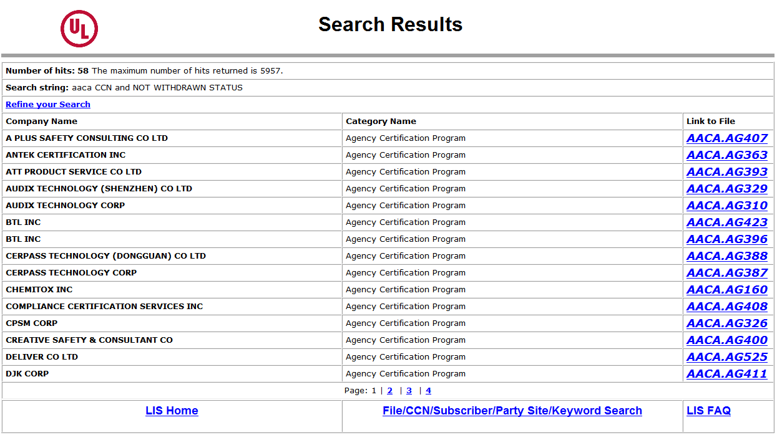
LIS Category - AACA
CAP Certifications Directory – Updated by Service Coordinators at project close.
Notes:
Encourage staff during their audit visit, to review the existing online listing for the CAP Agent. Determine if any corrections are needed.
For new CAP Agents, the site can be reviewed so the Agent is aware of what their listing will look like, and gather pertinent information such as Agent contact information and company web site address (which will be needed by the Service Coordinator/SSA).

Slide 10
Regional Channel Managers and Program Manager
Regional Channel Managers will most likely know the Agent and can assist if you need help:
China: Bonnie Pan
Taiwan: Kenyon Huang, Alien Wang
Korea: JohnK Lee
Japan: Yasumichi Kori
All Other Regions: Dan Arnold
CAP Program Owner: Dan Arnold (Camas, USA)
Decides if Agencies are inactivated/withdrawn.
Authorizes deviations from program requirements.
Helps resolve customer complaints
Notes:
Backups:
For Bonnie – Kenyon, Alien.
For Kenyon, Alien – Bonnie.
For All – Dan.
For Dan - Ed Redford.
Introduce CAP Program Owner and responsibilities tied to the audit process. (00-CM-S0850, clause 4.1)

Slide 11

Questions? THANK YOU!

