Slide 1
DAP Lead Auditor Training – Simulated Audit
August, 2017
For questions or comments, please contact Ken Berger or Duncan Li
Notes:
Instructor Notes - Time for slide: 5 min.
Display this slide before the start of the class.
Class delivering notes:
Introduce the class by indicating the title. Example, “Good morning and welcome to the DAP Lead Auditor Training – Simulated Audit”
Discuss house rules.
- Introduce yourself (just name)
- Safety Precautions
- Cellphone and computer uses rules.
- Lavatories locations
- Any other as needed.
Indicate that this will be a interactive class.
We encourage everyone to follow each step in their own computers and take notes as necessary throughout all slides

Slide 2
Daily Course Agenda
Day | Topics
1 | Introductions of instructors & students & purpose SIMULATED IN-CLASS AUDIT Planning for the DAP Audit Conducting an Opening Meeting Documenting the DAP Audit using the GALO, In-House Calibration Checklists & Path Notes
2 | Practice Laboratory Audit Writing NCR & Audit Report Conducting a Closing Meeting Post Audit Responsibilities & Review of NCR Responses Project Completion and DAP Review process
Notes:
Instructor Notes - Time for slide: 5 min.
Present slide & discuss
Class delivering notes:
Discuss that the class will follow the normal audit process flow and is divided in the following topics.
Introduce each topic by given a high level summary of each bullet item. For example: “During the Project Management Topic we will show you different project management methods and tools that current auditors are using”
The agenda is 2 days because all students must complete the independent study modules before class.

Slide 3


Icebreaker – powers of observation
Directions:
The class is going to have it’s powers of observation tested. You will either watch a video or study a picture of a scene.
Notes:
Instructor Notes - Time for slide: 5 min (2 min to review picture + 3 min for discussions)
Present slide & discuss
You will either watch a video or study a picture (Ice Breaker) of a scene.
Class delivering notes:
Either watch the youtube video “Test Your Awareness : Whodunnit?” (see list of changes below**) or use the Ice Breaker file. If using the Ice Breaker file, give them these instructions:
When you are given the go ahead, retrieve the Ice Breaker file (in SharePoint) turn the page and study the picture of the scene for 2 minutes.
Instructor will tell you to turn to the next page to answer the questions. Do not go back to the picture.
Do the following:
Distribute the (Memory Test) worksheet and read the directions.
Give them 2 minutes to review the image on the 2nd page.
Have them turn to the 3rd page and answer the questions without going back to the picture. Give them 2 minutes to answer the questions.
Tell the participants to put their worksheet face-down so that you will know when everybody is done and can proceed.
Tell them you will read the correct answers to the questions and they should grade their answers.
Teaching point: some of the image is not clear, but that’s just like auditing; not all issues you find are clear or black & white.
Read off the correct answers.
4:00
Yes
Yes
Yes
Right
Two – picture is questionable. Could look like 1 but there is ribbon typically used to hold several books together.
Six
Yes
Yes
Waist
Yes
Yes
51
Standing at the station (note the train’s smoke extends upward almost vertically)
No
No
No
Yes (the crutch)
Ask how many got 5 right? 10? 15? All 18 right?
Tell the class that this exercise was used to demonstrate how observant they are.
Indicate that during audits, they will need to be observant when investigating factors that might lead to client conformance or non-conformance.
**changes in the youtube video “Test Your Awareness : Whodunnit?”
round table in front - table cloth
round table in front - flowers
chair next to constable
Lord Smyth - dead man
rug under Lord Smyth
clock next to Lord Smyth
Flower pot of Lady Smyth
hat of Lady Smyth
inspectors coat
inspectors hat
painting above fireplace
barrier in front of fireplace
candlestick taken from fireplace
bear behind maid – suit of armor
butler holding a rolling pin, changed to candlestick
chair next to maid
curtain next to constable was closed, now open
table against wall (left of fireplace) – table cloth removed
table against wall – flowers changed
painting to left of fireplace
stuffed animal behind constable
plant in front of curtain

Slide 4
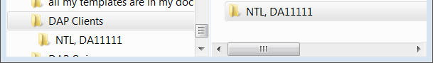
Project management
Create a computer folder & email folder for storing all associated audit project files & correspondence
Suggested file structure (see screenshot): DAP Clients parent folder, then Client name & file number
Notes:
Instructor Notes - Time for slide: 1.5 min
Present slide & discuss
Class Delivering Notes:
Indicate to the student that this next 5 slides are not meant as a requirement to use one of the methods presented but is more as a thought provoking slide. Is meant to initiate the thought about good project management skills.
Ask “what is project management?”
It is also a good idea to discuss the instructor’s project management methods and skills.
Present your current file-folder scheme.
Ask attendees what current file-folder are they using for their new work projects.

Slide 5
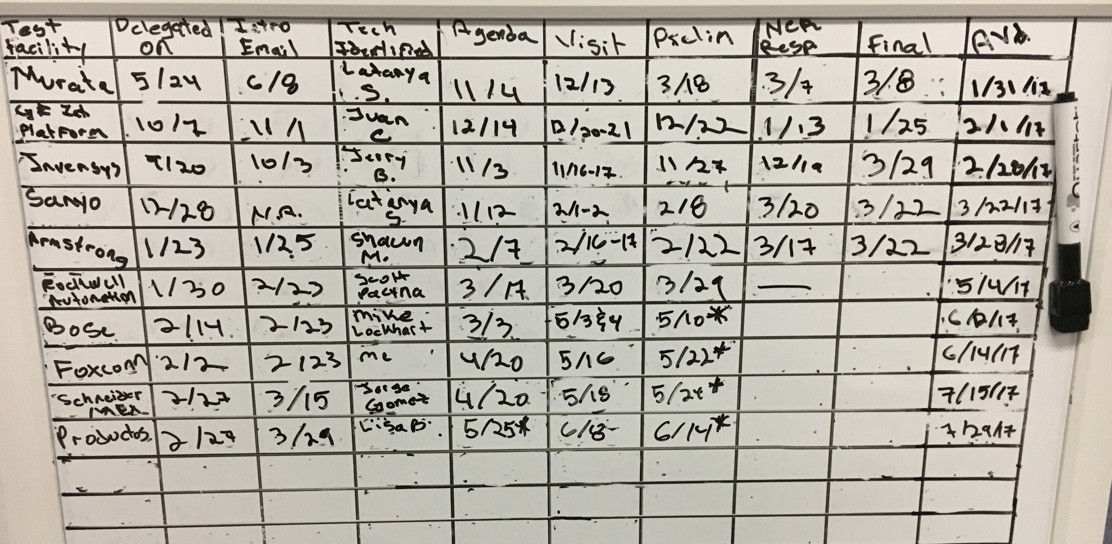
Project management
Keeping deadlines - examples
Notes:
Instructor Notes - Time for slide: 1.5 min
Present slide & discuss
Class Delivering Notes:
Introduce this slide as an example of a project management tool.
This is a board that tracks important dates.
This is being used by someone that requires visual representation without the need to having to log into a management tool.

Slide 6
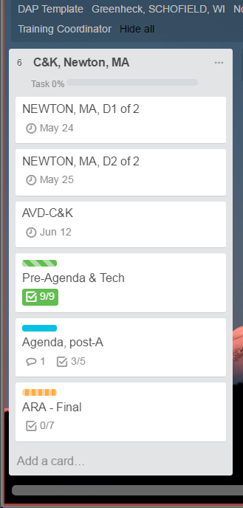
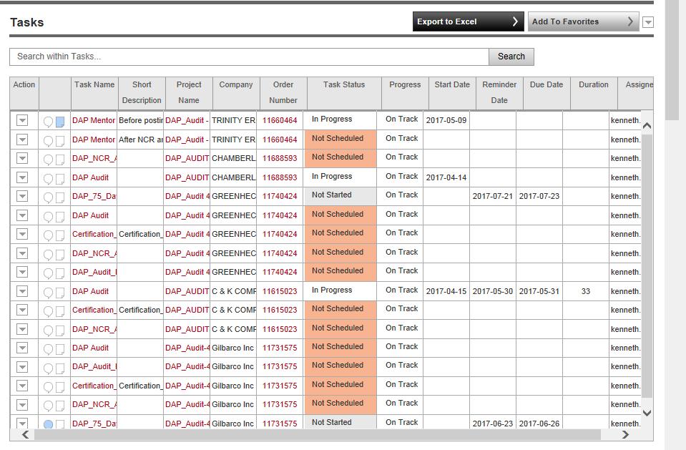
Project management
Keeping deadlines – examples Flex & trello.com
Notes:
Instructor Notes - Time for slide: 1.5 min
Present slide & discuss
Class Delivering Notes:
Introduce this slide as an example of a project management tool.
This is the Task tracking tool in Flex.
Benefits are that it requires minimum input from the user since it uses current data in Flex but on the flip side it requires logging into Flex to see important dates.
This is an online project management tool currently being used by some UL laboratories and by some DAP lead auditors.

Slide 7
Planning Process
See APP: 9 - 21, 23, 24
DAP Assessment Tool
AVD
Scope
Prior NCR report
Prior 2 pathnotes
Planning info
Agenda
Tool/location
Flex
DAP Tools*
DMS
DMS
Planning Template
=
Audit delegation
Audit planning
Audit
NCR Analysis
CO Review
Issue_DAP_Certificate
TC_Processing
*Datahub Report/ Scope Config Form
Notes:
Instructor Notes - Time for slide: 3 to 4 hrs
The instructor is to demonstrate the following subjects for each item under the “DAP Assessment Tool” bucket:
- How to complete them and where to get them from.
- Why is it important.
- Where would that information be used and how to use it.
Stay in the current time and it is best not to move to the future. For example, the auditor was just delegated the audit there is no need to discuss NCR documents formatting or how to complete the NCR file.
Class Delivering Notes:
discuss general structure of the slides. Each slide will have the generals subjects that will be covered and a timeline of the audit process. The red line indicates where we are in the timeline.
Introduce the appendix section of the Class Material.

Slide 8
Create the Audit Agenda
Verify information and fill-out subsequent worksheets to create Agenda
Work with the Tech Auditor(s) as needed.
Worksheets & Steps:
Complete “DAP Tool Preparation” – includes importing scope & selecting ISO 17025 Clauses
Review “Assessment Timeline”
Verify “Scope of Participation”
Select “Tests to Assess”
Verify “Agenda Review” information
Create PDF, send Agenda & eComm
Complete travel arrangements
Complete associated Flex tasks – see appendix
Audit delegation
Audit planning
Audit
NCR Analysis
CO Review
Issue_DAP_Certificate
TC_Processing
Notes:
Instructor Notes - Time for slide: 0.5 hrs
An item in “-” under worksheet means a tab in the DAP auditor tool.
The instructor is to demonstrate the following subjects for all elements under ”Worksheets & Steps”
- How to complete them and where to get them from.
- Why is it important.
- Interrelation between each Tab in the DAP auditor tool.
Class Delivering Notes:
Start by explaining where we are in the audit process and also relating those to Flex tasks.
Add info to Prep page – project #, audit date, auditor names, audit duration
Discuss finding Tech Auditor – include DAP industry coordinator list (see link in appendix)

Slide 9
Managing the DAP scope
See APP: 25, 26, 33, 34
Use “DAP Scope Config form” from DAP QE site, DAP documents & tools
See steps in 00-OP-W0043, Work Instructions for DAP/MTL Oracle Forms
See DAP Assessment SOP, 00-OP-S0056, for Scope writing requirements when adding new tests
See DAP Contacts if adding new standards to the DAP/MTL master database, current contact is Susan Pitman
To activate pending tests, send email to: NBK.DAPCTFCBTLReviewers@ul.com
Audit delegation
Audit planning
Audit
NCR Analysis
CO Review
Issue_DAP_Certificate
TC_Processing
Notes:
Instructor Notes - Time for slide: 1 hr
This slide is used to introduce attendees to the DAP/MTL Scope Interface
The instructor is to go in the DAP/MTL Scope Interface and have participants follow him.
Instructor is to review the following elements:
- How to search for a laboratory
- How to add/remove signatories including adding signatories who are not in the database.
- How to add/remove standards/tests.
- What to do if a standard is not available.
- What about pending tests
Instructor are to stay in the current stage and not to starting discussing future stages.
Class Delivering Notes:
Start by explaining where we are in the audit process and also relating those to Flex tasks.

Slide 10
Datasheet Review
See APP: 22
Review at least 3 completed datasheets since the last DAP audit, if available
Use the “DAP CAS project Search Tool” from DAP QE site, DAP documents & tools
Pull datasheets from DMS
Record in DAP Assessment tool – class demo
Class activity - use the “NTL datasheet Package #2” in SharePoint
Audit delegation
Audit planning
Audit
NCR Analysis
CO Review
Issue_DAP_Certificate
TC_Processing
Notes:
Instructor Notes - Time for slide: 0.5 hrs:
This slide is used to introduce attendees to the review of submitted datasheets.
The instructor is to demonstrate the following
- How to get the project report
- how to read it
- how to get the datasheets from DMS
- What to look for during the review
Instructor are to stay in the current stage and not to starting discussing future stages.
Class Delivering Notes:
Start by explaining where we are in the audit process and also relating those to Flex tasks.
Use NTL DS #2 as activity exercise – obtain from SharePoint link
If datasheet review discloses nonconformities missed by engineering, Contact Bruce Eng, who documents the issues in a CAR in the Global CAR Database
Instructor Answer Key:
Are these data sheets in compliance? Why or why not? No. Not in compliance with 00-OP-C0025.
Is anything missing or incorrectly filled out? Yes!!! See below.
NOTE: Answers below are not all-inclusive. Get class to find more errors.
Package #1 errors:
No project number on each page or “unique identifier” that correlates to a UL project number.
page numbering incomplete/off
No total # of pages on cover page
No standard revision date
Date format incorrect
No environmental conditions statement on cover page
No last calibration date (only due date)
Package #2 errors:
No project number on each page or “unique identifier” that correlates to a UL project number.
Date format incorrect
No standard info on cover page
No environmental conditions statement on cover page
Ambient temperature missing on page 8.
How would you approach writing a NCR? What would you include in it? First verify whether the errors were noted and addressed by CAS; if not, write a datasheet NCR. The datasheet NCR must identify the requirements and all missing or incorrect information.

Slide 11
Conducting an Opening Meeting
Notes:
Instructor Notes - Time for slide: 1 min.
Introduce the slide by reading the title

Slide 12
Topics to Cover in an Opening Meeting
Introductions: audit team and their roles, and client attendees
Restate purpose of audit – requirement for participation, check for compliance to requirements.
Review Scope & Criteria: tests and other activities to be conducted, ISO 17025, DAP Client Guides, Lab documents
Discuss logistics and schedule - changes to agenda.
Summarize status of open/closed NCRs from previous audit & Datasheet Review. (Refer to On-Line Training Modules).
Confirm safety and emergency procedures.
Inform everyone of how/where they can find you for questions.
Ask if there are any final questions.
If it’s your first visit to a Lab, ask for a quick tour.
Audit delegation
Audit planning
Audit
NCR Analysis
CO Review
Issue_DAP_Certificate
TC_Processing
Per 00-OP-S0056
Notes:
Instructor Notes - Time for slide: 1 hr
Introduce the slide by reading the title
Class delivering notes:
Instructor does role play meeting & then each candidate pairs up to do their own – so each student gets to be the Lead Auditor.
Cover slides 13 & 14 during this activity. Play different types of scenarios based on the information on these slides.
Emphasize the audit’s purpose: UL wants to partner with them for continuous improvement.
Mention ‘no surprise’ policy, NCRs will be discussed as found & during closing
Keep track of time (typically 30 minutes maximum); will have plenty of time to go over the details and changes during the audit.
Opening Meeting details can be found in DAP Assessment Procedure, 00-OP-S0056.

Slide 13
Reasons Clients can be Difficult - review
Defending their self-esteem, Feel like no one’s listening,
Be prepared for a range of emotions: Tired & frustrated (UL related or not) or in a bad mood, anxiety or confused (first DAP audit)
Stay calm, Listen carefully, Client is venting – let them!
Even if the problem is not your responsibility or solution is now in your hands, remember we represent all of UL.
Acknowledge feelings: “Yes, that can be frustrating.” “You feel you haven’t been heard”
Deal with it promptly, take ownership (I will help resolve this)
Make client feel they talked to the right person
Explain action(s) you will take to handle the situation and gain agreement
Agree to disagree, if needed. Thank the person for bringing the situation to your attention.
Notes:
Instructor Notes:- Time for slide: 15 min
Introduce the slide by reading the title
It’s a fact of life that some clients will be more difficult to deal with than others.
Emphasize that few lab people are constantly rude or difficult. In most cases, if a lab person is being challenging, there is a reason for it.
Discuss some of the common reasons why clients can be difficult that are listed.
Ask: Has anyone had to deal with a difficult lab person while at a site?
How did they deal with it?
Could they determine what was the underlying reason?

Slide 14
Verifying Prior NCR onsite
Review client’s response
Look for evidence of implementation & effectiveness
Record review in DAP Assessment tool, in the ‘Datasheet and NCR Review’ worksheet
How would you verify these examples? - See “NCR Responses 1 to 4” in SharePoint site
Repeat NCRs:
NCR identified in previous audit for which corrective action has not been completed as planned.
NCR is substantially similar in nature to one in previous audit.
Lead Auditor informs DAP Audit Manager who will review & determine the appropriate action(s).
NA – Kai Huang AP/EMEA + LA - Larisa Aoyagi
Notes:
Instructor Notes - Time for slide: ~0.5 hrs
Class delivering notes:
this addresses reviewing prior year audit NCRs when onsite.
go to the DAP Performance SharePoint site in the link above to get some sample NCRs or use one from your own recent audit
discuss what you would look for & how to complete the DAP Assessment tool, in the ‘Datasheet and NCR Review’ worksheet
if it fits into the agenda, try to verify prior NCRs right after the opening meeting in case there’s a major issue that requires inactivation

Slide 15
Documenting the Audit
Notes:
Instructor Notes - Time for slide: 1 min.
Introduce the slide by reading the title

Slide 16
Auditing Process
See APP: 22, 24, 27-32
DAP Assessment Tool
TMV
NCR Report
Assessment Report
In-house Calibration
Onsite Audit
Audit Records:
Pathnotes
Areport
NCR Report
DS & NCR Review
GALO
Audit delegation
Audit planning
Audit
NCR Analysis
CO Review
Issue_DAP_Certificate
TC_Processing
See 00-OP-J0042, DAP Assessment Tool User’s Guide
Notes:
Instructor Notes - Time for slide: ~3 hrs
Next activity is the Lab Practice audit, so this is getting the class ready for it
Next 2 slides will discuss: FAQs about onsite auditing & NCR refresher
Class delivering notes:
Demonstrate each step: explain the rationale/importance of each step & any tips for doing the step easier or better
For example, show them the color coding in the GALO (& in-house GALO), create an NCReport using the “Nonconformity Report”
For TMV & Areport, show the examples in the class appendix
Student completes tool during demo, at the same time

Slide 17
Keys to Writing a Successful NCR
Clear concise statements
Sufficient information
Should be actionable
Details of the issue
Specific evidence
Sample size when applicable (e.g., “1 of 5 records…”)
Tie the nonconformity and objective evidence back to the requirement
Notes:
Instructor Notes - Time for slide: ~0.25 hrs
Class delivering notes:
These are reminders to help them know what to look for during the practice.
Here are some points/details to mention:
Let client know as soon as possible of potential NCRs as they occur; do not wait until the closing meeting.
Give enough information for client and UL staff to be able to clearly identify and investigate the issue.
Many times, people outside of the audit need to review and investigate NCRs.
Auditors need to keep in mind NCRs must be concise (we should not be writing novels!, especially since we have already communicated the NCRs to the client), but also clear.

Slide 18
Activity - Demo in Lab
Directions:
As a DAP lead auditor, you will witness a demo of a test conducted in the Lab.
Focus on possible audit paths you may take instead of focusing on the actual test.
Take path notes keeping in mind possible audit paths (Calibration/Equipment, Environment, Samples, and Consumables).
Discuss your observations as a large group.
Time:
30 minutes for test demo
60 minutes for audit paths
Notes:
Instructor Notes - Time for slide: ~2 hrs
Class delivering notes:
Instructors should do a role play before going to the lab to show how this part will go.
Indicate that this activity focuses on getting practice in the key skill of auditing.
NOTE: Emphasize they should be looking for audit paths – not how well the person is running the test.
Ask if they have any questions
Take the class to the lab for the test demonstration. (Instructors should split up to observe the several groups)
Go to a separate area from the lab to not disrupt lab staff for any group discussions.
Review the test(s) demonstrated concentrating on the various audit paths of Calibration, equipment, environment, consumables, standards, samples.
Ask the following questions:
What did you observe?
What potential audit paths were determined?

Slide 19
Activity - Completing GALO, Areport, & NCR
Directions:
Use an example from your audit or the instructor will assign one
Write an NCR & Areport, then email to Instructor.
Instructor will review at least one NCR & AReport. Class will offer feedback for everyone’s learning.
Time:
GALO was completed during practice audit
Areport & NCRs writing – ~60 minutes
Review Areport & NCRs in class – ~30 minutes
Notes:
Instructor Notes - Time for slide: ~1.5 hrs
Class delivering notes:
This activity focuses on gaining practice in writing the NCR & Areport based on your observations and discussion with lab personnel.
If discussions resulted in no further action, distribute a new scenario to them so they can write the NCR.
The class should email the NCR & AReport electronically to the instructor so it can be discussed in class.
Focus the class on:
Choosing the most appropriate clause for their NCR, writing clear and concise nonconformity and objective evidence statements.
Having enough information to make it actionable but not too wordy. Otherwise, it will get confusing for the client.

Slide 20
Closing Meeting Topics
See 00-OP-S0056
Thank personnel for allowing UL to perform audit.
Restate audit purpose.
Present NCRs and audit team recommendation.
Explain how to respond to any NCRs.
Set Target Dates for client - if AVD expiring soon, may need the client to respond to NCRs faster
Describe the appeals process, if needed.
If Inactivation is recommended, discuss process, timing, and outcomes.
Give client electronic copy of DAP assessment report with post audit scope & NCR report (if applicable).
Audit delegation
Audit planning
Audit
NCR Analysis
CO Review
Issue_DAP_Certificate
TC_Processing
Notes:
Instructor Notes - Time for slide: 0.5 hr
Class delivering notes:
Instructor does role play meeting & then, if time, each candidate pairs up to do their own – so each student gets to be the Lead Auditor if time permits.
Consider reviewing slides 14 (difficult situations). Suggest to each pair a different type of scenario based on the information.
Here are some points you may want to mention/discuss:
Understand that by UL conducting the audit, it took away from the client lab’s normal work. Thank them for allowing us to audit.
Explain how to fill out the NCR form for their response, especially if it’s a new lab. Ask them to think of the lab’s entire system, not just a quick fix to the particular issue recorded. The DAP audit is only a sampling of their system.
If lab staff begin an internal corrective action discussion and it is taking away from your agenda, politely indicate that you welcome the discussion after the closing meeting and you are available as a resource after.
Closing meetings should be 15 minutes, 30 max.
If the client challenges an NCR, describe the appeals process they may opt to take. We will cover the appeals process later.
Recall the difficult situations discussed before the opening meeting
If Inactivation is recommended, discuss the process even though instructions are defined in Appendix A of the assessment report. Let’s work with the client to all have the same understanding.
Give the client an electronic copy of the assessment report, post audit scope and NCRs at the closing meeting.
As a rare exception (i.e. audit running late and need to catch a flight), you must at least provide the client with the NCRs at the closing meeting.
If you have not completed your report, you are required to send it within 5 business days. Be sure to let the client know YOUR target date for sending it to them.

Slide 21
Flex reminder
See APP: 35-39
Close “DAP_Audit” task after attaching appropriate files
See “FLEX Audit Task Description and Deliverables Table“ in 00-OP-S0056, DAP Assessment and Nonconformity Procedure & Class Appendix
Audit delegation
Audit planning
Audit
NCR Analysis
CO Review
Issue_DAP_Certificate
TC_Processing
Notes:
Instructor Notes - Time for slide: ~0.25 hrs
Class delivering notes:
Demonstrate each step: explain the rationale/importance of each step & any tips for doing the step easier or better
Consider showing the Flex table in 00-OP-S0056, DAP Assessment and Nonconformity Procedure and/or refer them to the table in the class material appendix

Slide 22
Post-audit steps
Notes:
Instructor Notes - Time for slide: 1 min.
Introduce the slide by reading the title

Slide 23
Post-audit steps
Review NCRs - See “NCR Response 3 to 4” in SharePoint site and discuss pros & cons
Update scope, if affected by the response
Email NCR acceptance status to client & eComm
Close applicable Flex task – See 00-OP-S0056 & Class Appendix
Audit delegation
Audit planning
Audit
NCR Analysis
CO Review
Issue_DAP_Certificate
TC_Processing
Notes:
Instructor Notes - Time for slide: ~1.0 hrs
Class delivering notes:
Demonstrate each step: explain the rationale/importance of each step & any tips for doing the step easier or better
Explain how to Review NCRs responses using the examples above (or your own example), reminding them of our requirements;
acceptable root cause,
does the action address the problem & the cause,
does the planned date seem reasonable,
can the lab submit data until the NCR is completed
Remind them how to update the scope, demo & then have them do one
Discuss sending the email of NCR status to client – auditor can send comments, or send the final NCR report showing your acceptance

Slide 24
Post-audit Flex steps
See APP: 35-39
Non-auditor tasks…
“Certification_Office_Review (Applicable to CTF3/4 clients only)”
“Issue_DAP_Certificate”
“TC_Processing”
Audit delegation
Audit planning
Audit
NCR Analysis
CO Review
Issue_DAP_Certificate
TC_Processing
See 00-OP-S0056
Notes:
Instructor Notes - Time for slide: ~0.5 hrs
Class delivering notes:
Note: do NOT cancel any Flex tasks
These tasks are not done by the auditor, but they should be aware of them, set Flex dates accordingly as well as monitor the project until closed
Describe each task briefly, reference the Flex table in 00-OP-S0056 for details
Correction Note: “Certification_Office_Review” is for non-DAP only, it is NOT just applicable to CTF3/4 clients

Slide 25
DAP Qualification – next steps
Mentor will be assigned for Pre-audit, Onsite & Post-audit
00-OP-F0405 DAP/CTF/CBTL Lead Auditor Mentoring Form
Mentor is both Mentor & Evaluator
Onsite evaluation is required, travel costs covered by Candidates BU
After successful evaluation, TCD database is updated
DAP Performance Review – next 3 audits, then once/yr
Notes:
Instructor Notes - Time for slide: ~0.25 hrs
Class delivering notes:
Briefly go over the DAP Qualification process

Slide 26
Summary
Project Management
Audit planning
Audit
Post-audit
Next: complete the DAP LA Class Survey
Notes:
Instructor Notes - Time for slide: ~0.25 to 0.5 hrs
Class delivering notes:
Briefly summarize each topic & ask for questions (next slide)
Give the attendees the DAP LA Class Survey link & ask them to complete – do it in class if time allows

Slide 27

Questions?
Next: complete the DAP LA Class Survey
Notes:
Instructor Notes - Time for slide: 1 min.
Introduce the slide by reading the title

Slide 28
revisions
Date | Author | Description
8/23/2017 | Ken Berger | Moved the slide “Verifying Prior NCR onsite” to Opening meeting section. Added answer key to “Datasheet Review” slide Added 30 minutes to “Activity - Demo in Lab” for debriefing – to go over lessons learned Changed “Post-audit steps” – from review NCR 1 to 4, to “review NCR 3 & 4”.

