Slide 1
DAP/MTL Lab Scope Refresher Training
Initial Release – August 25, 2016
For questions about this material, contact Bruce Eng or Bryon Monte

Slide 2
Learning Objectives
Understand the importance of 100% matching of post audit lab scope and DAP/MTL database. Know that it is the Lead Auditor’s responsibility to ensure this match.
Use the DAP/MTL database.
Know how to request new standards and tests.
Know how to delete standards and tests.
Be aware of tips to ensure 100% match and easier use of the DAP/MTL database.

Slide 3
Using the DAP/MTL Database
100% matching of post audit lab scope and DAP/MTL database helps to maintain integrity of the UL Mark when using client lab test data
The client lab knows which exact standards and tests they are authorized to perform.
The UL project handler who receives the completed datasheet package can ensure all the tests in the package are authorized.
If there are any tests in the datasheet package not in the client’s lab scope, then the UL project handler can make a decision and record the one-time acceptance of that test for that exact datasheet package only.
It is the Lead Auditor’s responsibility to ensure the post audit/scope expansion lab scope matches DAP/MTL 100% before sending the job for completion.

Slide 4
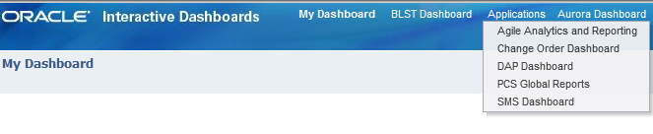
ORACLE Interactive Dashboards
Select: Applications → DAP Dashboard
IMPORTANT for easier data entry:
The DAP/MTL database times-out after a short time, if no inputs.
When adding standards, only add one standard at a time with the first test (then add more tests after the added standard is established in the client’s lab scope).
When adding more tests, add no more than 5 to 10 tests at a time because adding more may cause DAP/MTL to crash.

Slide 5
ORACLE Interactive Dashboards
IMPORTANT for easier data entry, continued:
The DAP/MTL database may not work smoothly/reliably at all times, therefore do not wait to the last minute to use the database. Note: IT is exploring possible replacements – however no timeframe has been established.
If necessary, you can use the Scope Export Report (Excel output), and/or a paper print out of the lab scope to help ensure you have a 100% match of the post audit scope and the DAP/MTL. Note: the Scope Export Report will not show Pending Tests.
If you see duplicate standards and tests, do not automatically delete the duplicates, since this may delete both and you will need to re-input the data. Wait a day or two to see if the problem is just temporary. Or contact the UL Helpdesk for assistance.

Slide 6
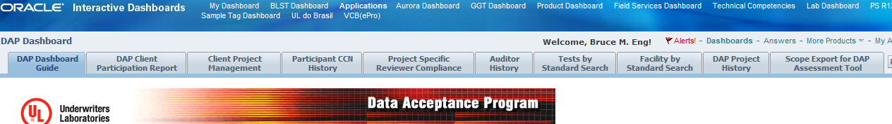
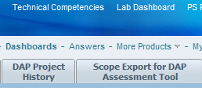
ORACLE Interactive Dashboards
Select: Scope Export for DAP Assessment Tool

Slide 7
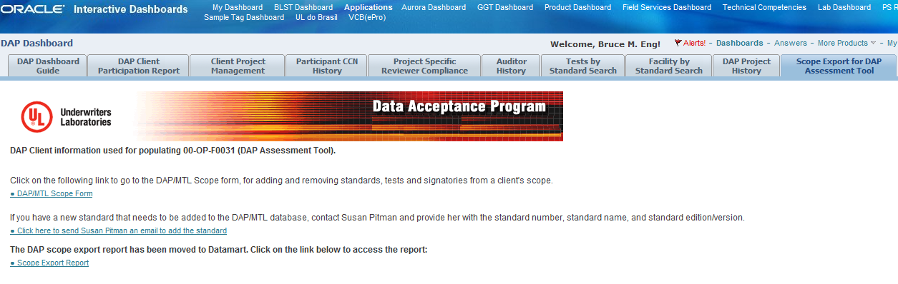
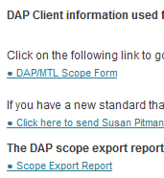
ORACLE Interactive Dashboards
Select: DAP/MTL Scope Form

Slide 8
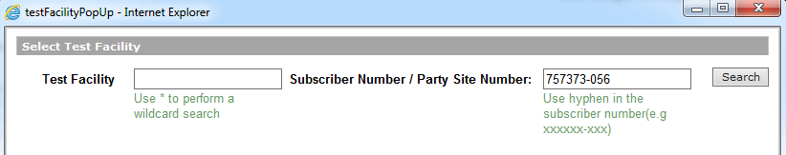
ORACLE Interactive Dashboards
Enter the Subscriber Number or Party Site Number (usually faster than the Test Facility name search method)

Slide 9
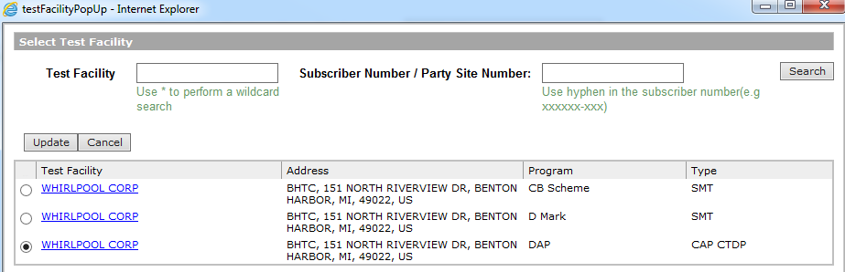
ORACLE Interactive Dashboards
Select the appropriate “Type”, and then click “Update”

Slide 10
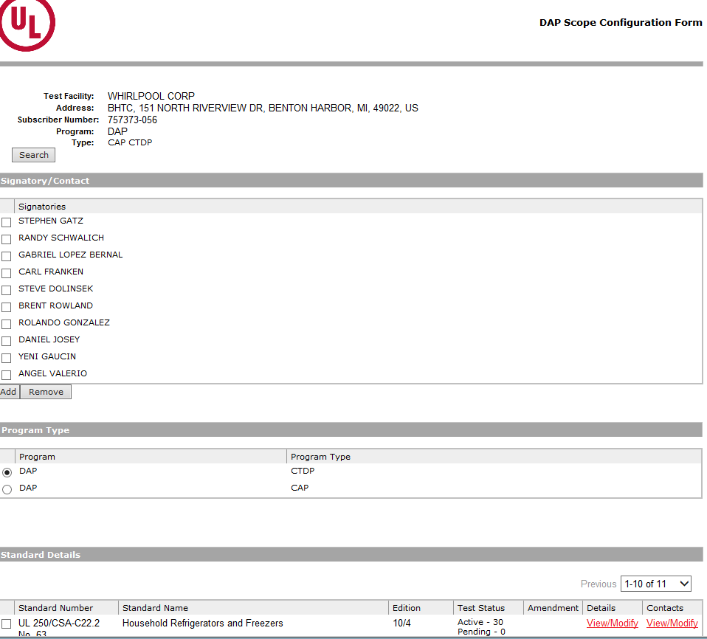
ORACLE Interactive Dashboards
“Standard Details” lists the active standards for the lab
Notes:
Screen shows all standards and number of tests (Active and Pending) in the client lab’s scope, and other key information such as the Authorized Signatory(s), which also need to match the DAP/CTF report.

Slide 11
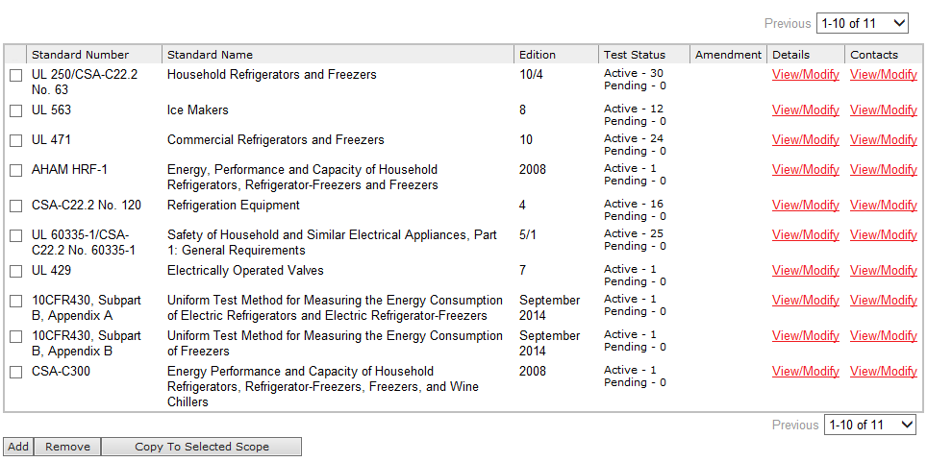
ORACLE Interactive Dashboards
To verify or add tests, click “View/Modify” under “Details”

Slide 12
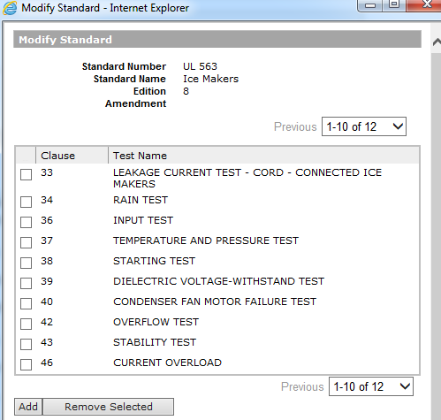
ORACLE Interactive Dashboards
Click “Add”

Slide 13
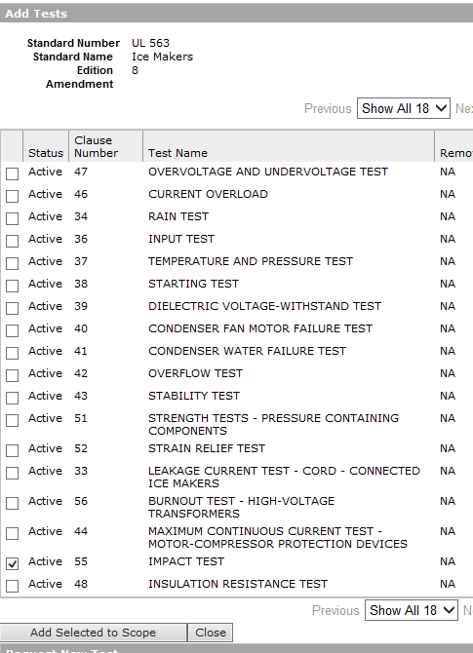
ORACLE Interactive Dashboards
Select Test(s) and click “Add Selected to Scope”

Slide 14
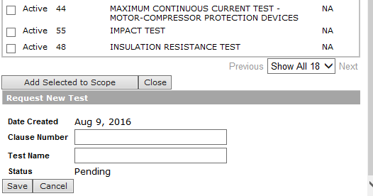
ORACLE Interactive Dashboards
Request New Test (Pending Test)
Enter the exact Clause Number and Test Name to match the UL/CSA/IEC standard
Do not use datasheet clause numbers or names, since they may be incorrect
See 00-OP-S0056, Appendix C, for Test Scope Writing
The New Test will show as a Pending Test in DAP/MTL
The Lead Auditor will contact a DAP Reviewer who will verify the Pending Test to the standard before activating it

Slide 15
ORACLE Interactive Dashboards
Adding a new standard to DAP/MTL

Slide 16
ORACLE Interactive Dashboards
Adding a new standard to DAP/MTL
When requesting Susan Pitman (DAP/MTL New Standards Administrator) to add a new standard to the DAP/MTL database, be sure to provide:
The exact standard number (e.g., UL 2572)
The exact standard name (e.g., Mass Notification)
The exact edition number (e.g., Edition 2)
The exact amendment for IEC standards
Susan Pitman (DAP/MTL New Standards Administrator) will reply with an email “Done” when the standard is added
The Lead Auditor can now add new/pending tests to the new standard in the DAP/MTL, and a DAP Reviewer will activate the tests.*
* Please complete this before sending the job for completion.

Slide 17
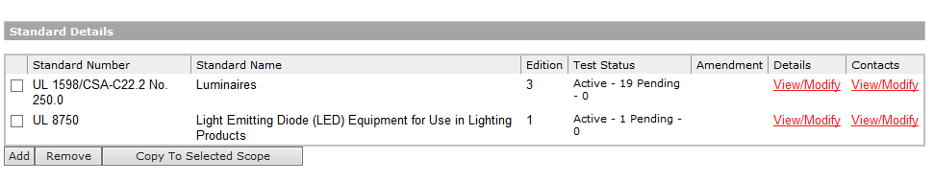
ORACLE Interactive Dashboards
Deleting standards or tests in DAP/MTL
Select the standards or tests to remove and click “Remove”

Slide 18
Thanks!
For questions, please contact Bruce Eng, Bryon Monte or any DAP/CTF/CBTL Reviewer (see DAP website, FAQ #6 for a list)

