Slide 1
CAR Calibration Session “Good” CAR, “Bad” CAR Review
Team A: J. Y. Lee, WeiBeng Leong, Simy Li, Thomas Kestner
May 7, 2012

Slide 2
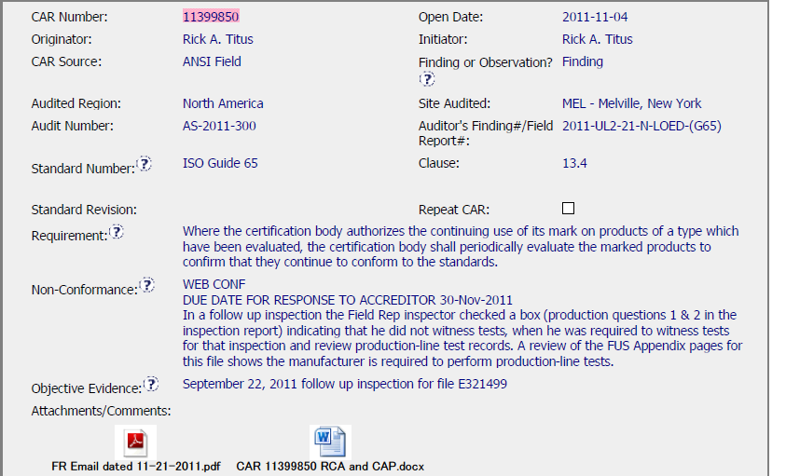
Sample 1 - CAR Needing Improvement CAR No. 11399850
Main Copy Arial 20 pt. This study was conducted in two phases: a qualitative exploratory phase followed by a quantitative survey. The first phase consisted of a series of focus groups with U.S. consumers.
Indent 1 Arial 18 pt. + 10 pts before paragraph
The focus groups were conducted across a broad range of life-stage segments and key product purchaser segments to ensure that the complete range of consumers’ safety attitudes, motivations and behaviors were identified.
– Indent 2 Arial 16 pt. + 6pts before paragraph – Young singles, adults age 21-34, living outside their parents’ home – Parents with younger children (< 6), and no children >6 years of age – Parents with older children (divided evenly between 6-12 and 13-17) – Adults 25 – 54 without children – Empty Nesters, adults age 45 – 64

Slide 3
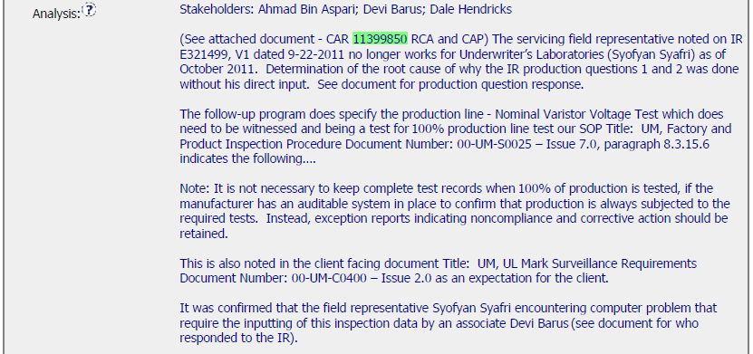
Sample 1 - CAR Needing Improvement CAR No. 11399850

Slide 4
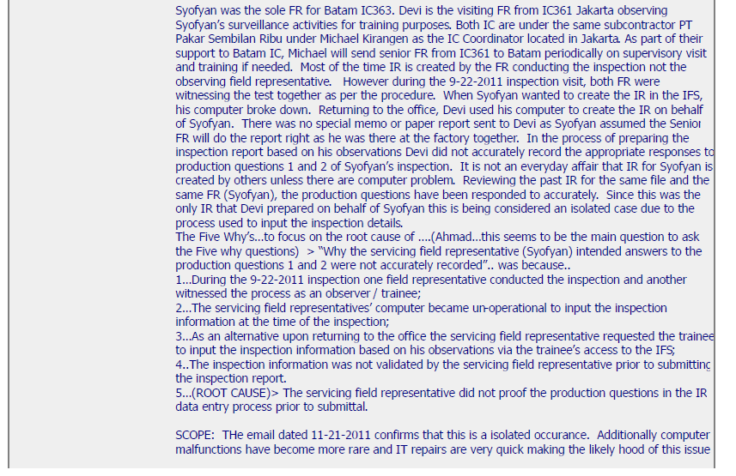
Sample 1 - CAR Needing Improvement CAR No. 11399850

Slide 5
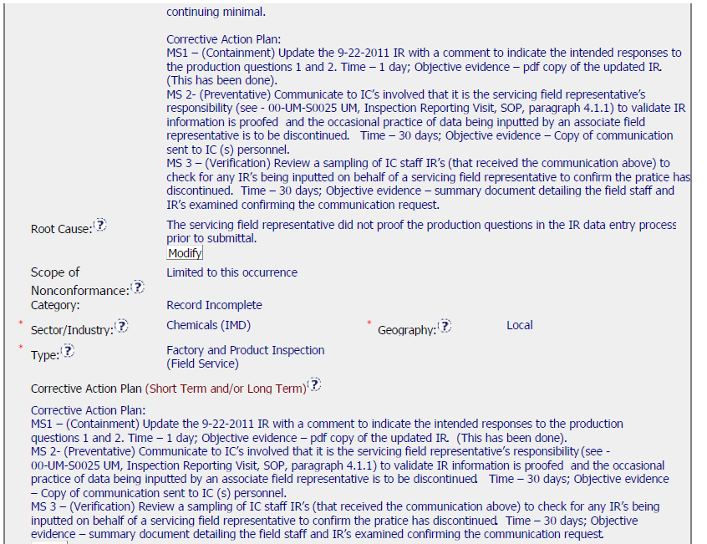
Sample 1 - CAR Needing Improvement CAR No. 11399850

Slide 6
Sample 1 - CAR Needing Improvement CAR No. 11399850 Discussion
The analysis is good.
However the root cause, which states that the FR did not proof the report before it was submitted, is not sufficient.
Lack of inspection, in my opinion, is not the root cause.
The question that needs to be answered, is why Devi (whether he be a trainee or senior FR) was not able to complete the report with the correct response.
The practice of writing reports on behalf of other FRs was stopped, but Devi’s own reports may be at fault, even today.

Slide 7
Sample 1 - CAR Needing Improvement CAR No. 11399850 Discussion
The analysis is good.
However the root cause, which states that the FR did not proof the report before it was submitted, is not sufficient.
Lack of inspection, in my opinion, is not the root cause.
The question that needs to be answered, is why Devi (whether he be a trainee or senior FR) was not able to complete the report with the correct response.
The practice of writing reports on behalf of other FRs was stopped, but Devi’s own reports may be at fault, even today.

