Slide 1
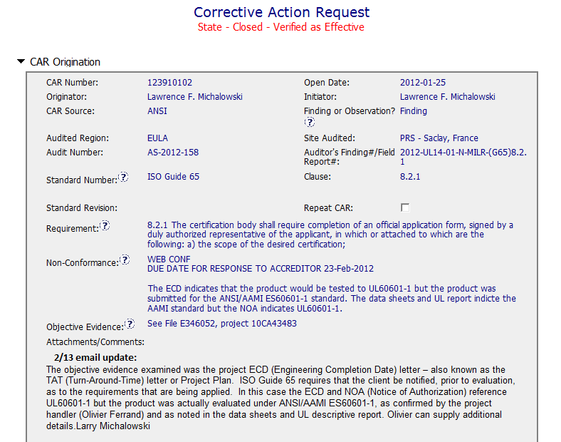
Team B’s selection for a GOOD CAR.
CAR # 123910102

Slide 2
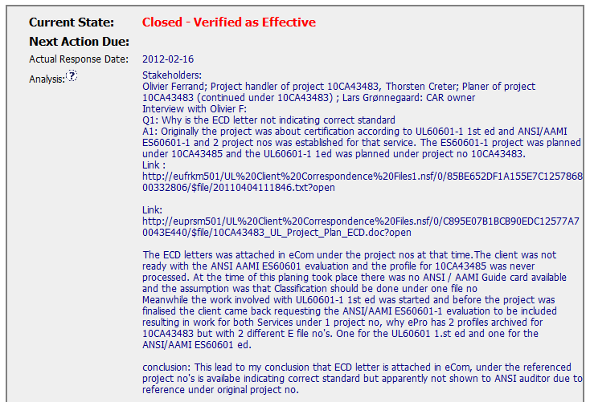
There are Stakeholders.
The analysis is very detailed, and it is well explained what‘s happened

Slide 3
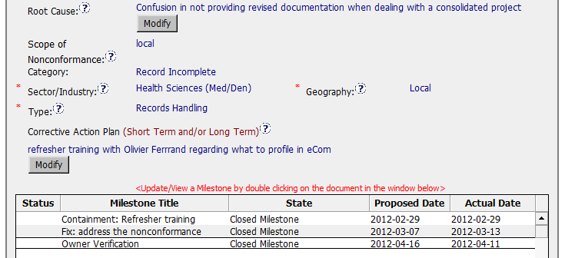
Root Cause is the conclusion of the analysis
We have 3 milestones: Containment; Corrective Action and Verification

