Slide 1
2012 Q2 CAR Administration Calibration Meeting
Team B – Good CAR / Bad CAR Review
Rebecca Navarrete
Dale Piechocki
Bill Costello

Slide 2
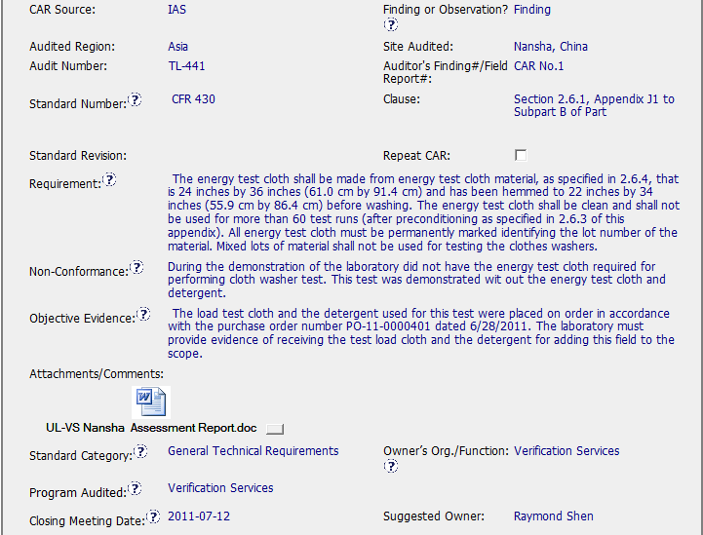
Bad CAR (11399426)
Data of applicable clause is incomplete (430 missed at the end of the field)
Infomation in the Objective Evidence field is part of the CAR written by the Auditor instead of provide the data of the equipment in which the test was performed even when it is available in the document attached.
Notes:
Para DTW y NOVI se debe crear una CAR, y el CAR Owner será quien comunique al cliente la resolución y debe incluir una milestone en la CAR específica para dicha comunicación

Slide 3
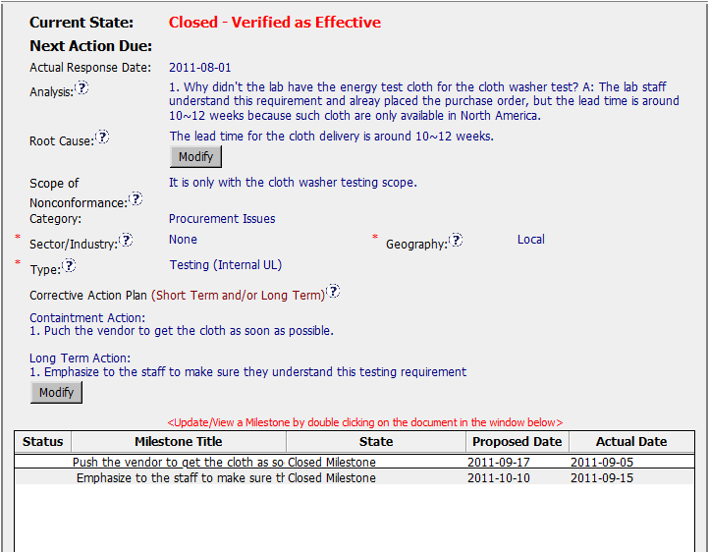
Bad CAR (11399426)
NC is related with the execution of a test without use the required materials but analysis is directed to the reception of the energy test cloth.
What about the detergent?
Why the test was performed even when the materials required to perform it were not available?
NOTE: Auditor CAR directs to work about consumables reception more than evaluate why the test was performed out of specifications.
No action to verify the effectiveness of actions taken.
Notes:
Se copia a Customer Advocacy Mailbox si el cliente es una cuenta asignada en el directorio de productos (NA Only) o el cliente indica que escalará la queja a la alta dirección

