Slide 1
Case Study
Team: John Pallanti, Chris Nicastro,
Gary Gardell, Kathy Lindstrom

Slide 2
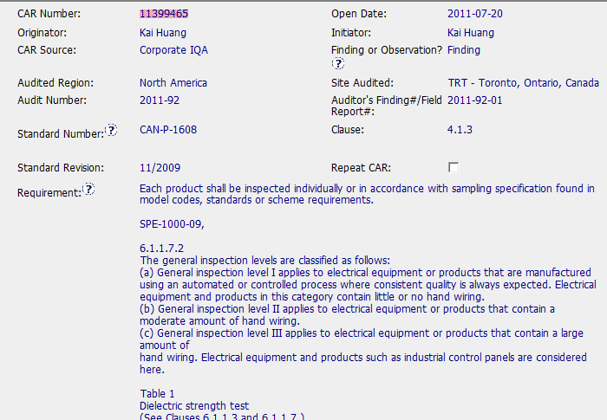
CAR Needing Improvement - Sample 1
CAR Number: 11399465

Slide 3
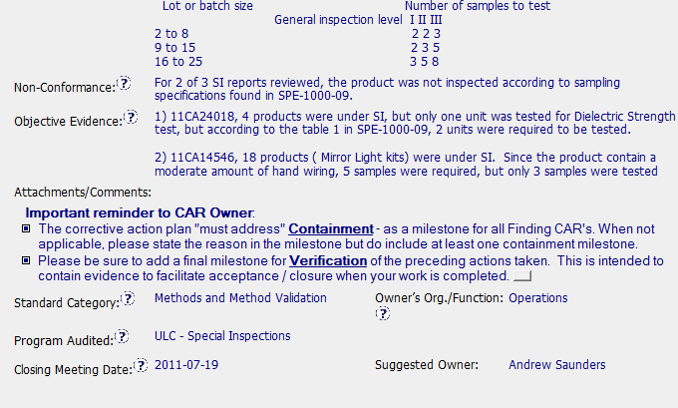
CAR Needing Improvement - Sample 1
CAR Number: 11399465

Slide 4
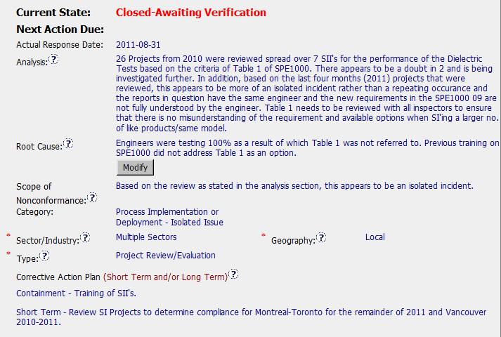
CAR Needing Improvement - Sample 1
CAR Number: 11399465

Slide 5
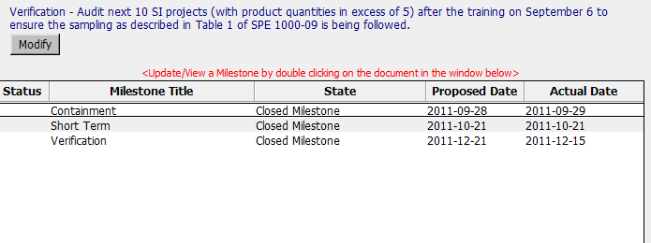
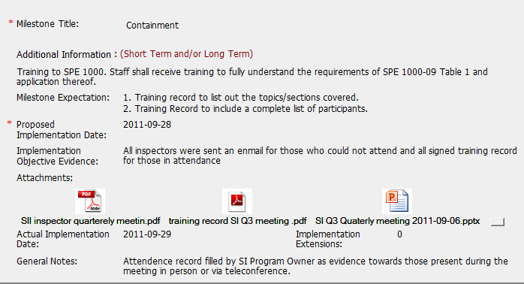
CAR Needing Improvement - Sample 1
CAR Number: 11399465

Slide 6
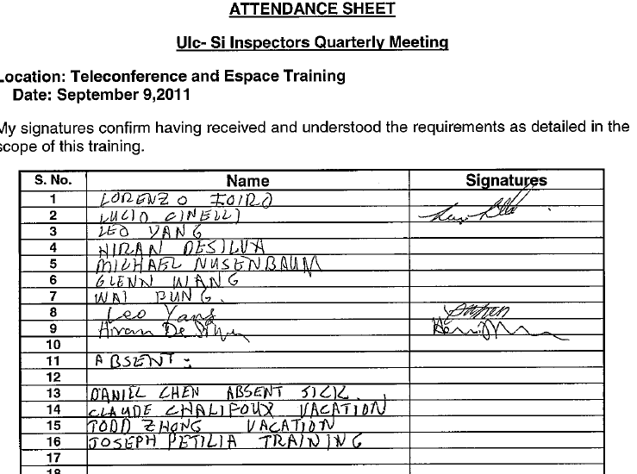
CAR Needing Improvement - Sample 1
CAR Number: 11399465

Slide 7
CAR Needing Improvement - Sample 1
CAR Number: 11399465
Concerns:
The analysis says that other projects were reviewed and this is an isolated incident – those project numbers are not listed and should be. Analysis does not seem complete and does not flow into the root cause – how did they get from the analysis to the root cause? Root cause is unclear – why did staff not know about table 1? Training is given as the next why, but are there any other reasons?
In containment milestone, they have a training record (2nd attachment) that shows 11 names, but only 3 people signed it. So 8 people didn’t get the training. They could have done an additional step such as an e-mail with confirmation, etc. There’s a note that says people were on the phone, but the training sheet isn’t clear since there’s nothing in the signature space.
Good note: Verification evidence is very complete with project numbers, etc.

