Slide 1
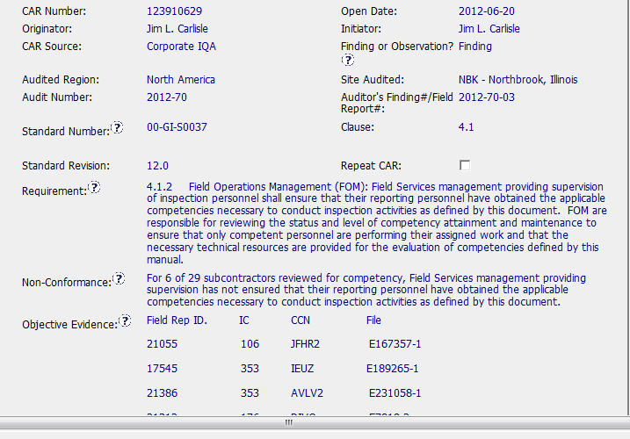
Good CAR: 123910629

Slide 2
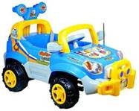
Non-Conformance: Competency requirements not being documented or met
Several samples found and used as objective evidence of the NC
Analysis showed separate root causes participating to different samples
Both containment action and corrective action addressed the separate root causes

Slide 3

Thorough containment
Training plus IT process changes to prevent recurrence
Effectiveness verification included as milestone
All due dates met.
Communication with
CAR Admin

