Slide 1
CAR Calibration Session “Good” CAR, “Bad” CAR Review
Team A: J. Y. Lee, WeiBeng Leong, Simy Li, Thomas Kestner
May 2, 2012

Slide 2
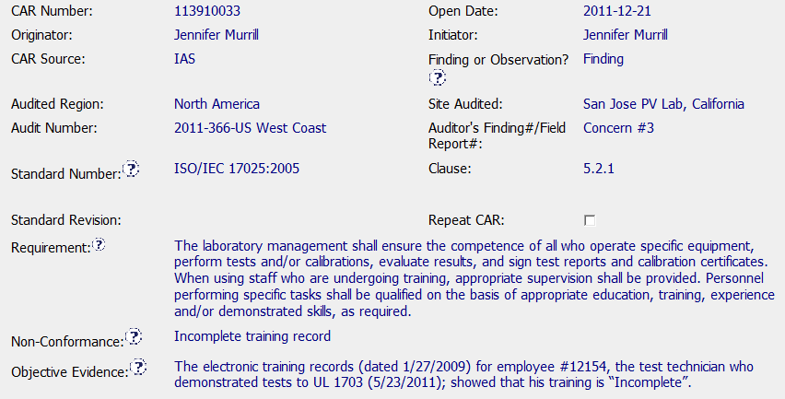
Sample 3 Good CAR No. 113910033

Slide 3
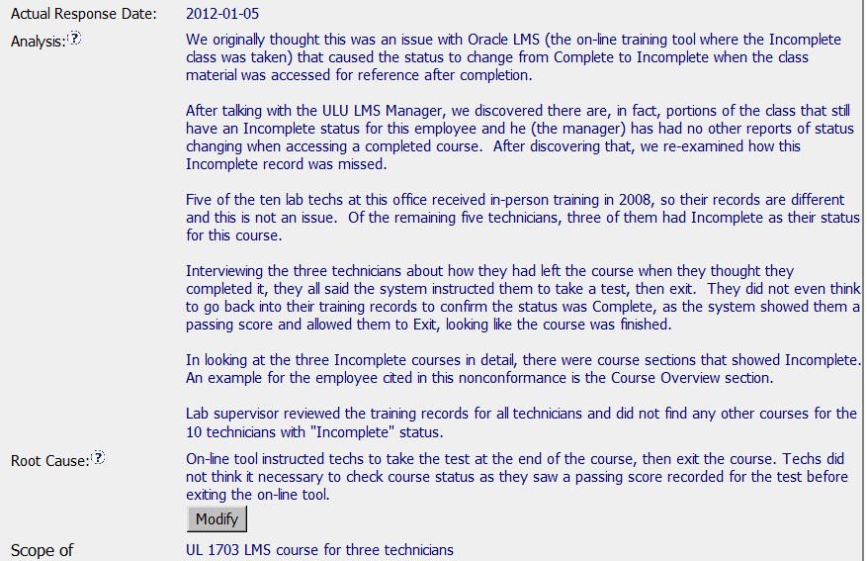
Sample 3 Good CAR No. 113910033

Slide 4
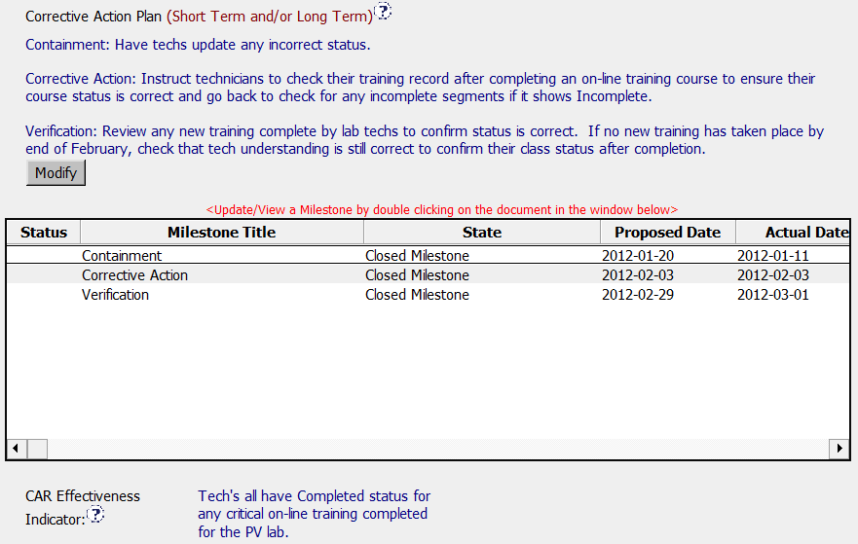
Sample 3 Good CAR No. 113910033

Slide 5
Sample 3 Good CAR No. 113910033 Discussion
Very clear & logical analysis. Staff can easily understand whole story in a very short time. (Compare to many other long analysis CARs, staff may need to read many times and still not clear what happened.)
Clear root cause that is concluded based on clear analysis

Slide 6
Case Study
Team: John Pallanti, Chris Nicastro,
Gary Gardell, Kathy Lindstrom

Slide 7
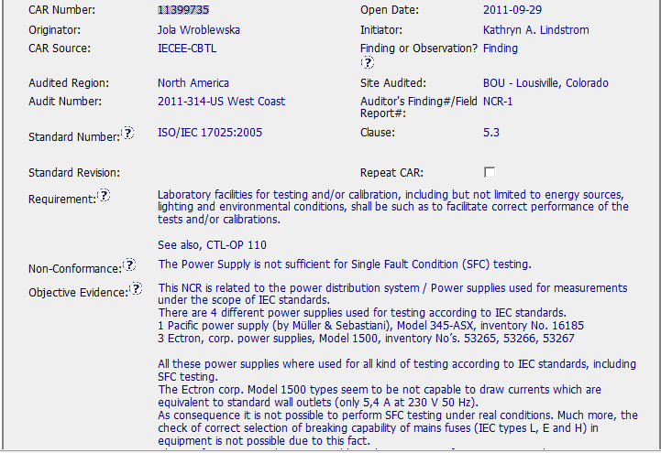
Good CAR – Sample 1
CAR Number: 11399735

Slide 8
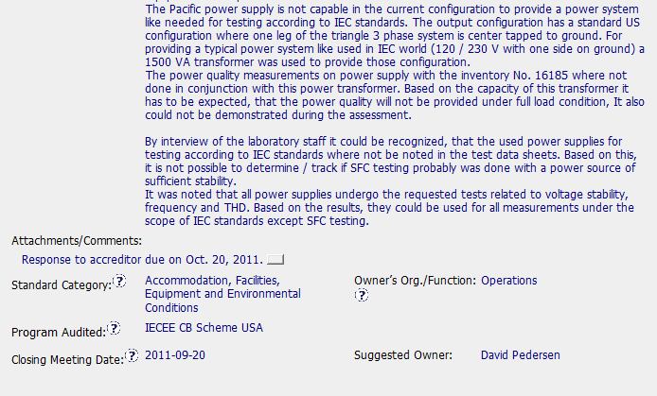
Good CAR Sample 1
CAR Number 11399735

Slide 9
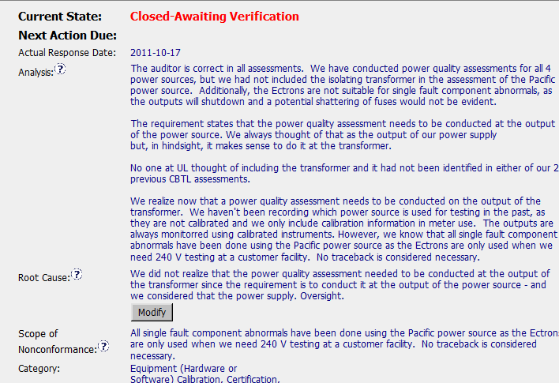
Good CAR – Sample 1
CAR Number: 11399735

Slide 10
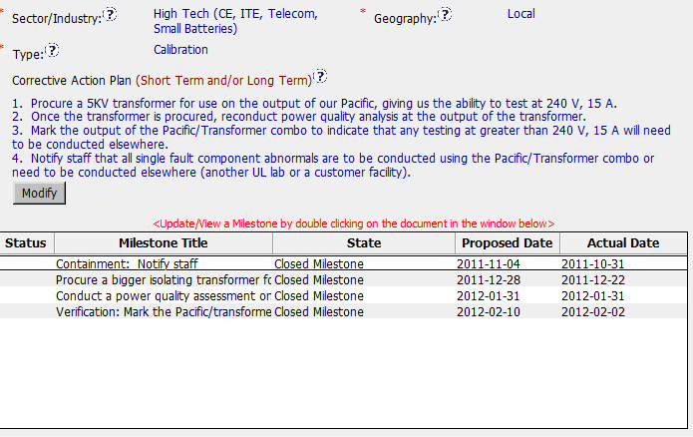
Good CAR – Sample 1
CAR Number: 11399735

