Slide 1
CAR Administrator Calibration Meeting - Good and Bad CARs -
November 26 2012
Team A: Ronald Tse, Ravi V, Jacky Wu, Kila Yang, Motomu Kawano

Slide 2
Good CARs: No. 123911157 (V Ravichander)

Slide 3
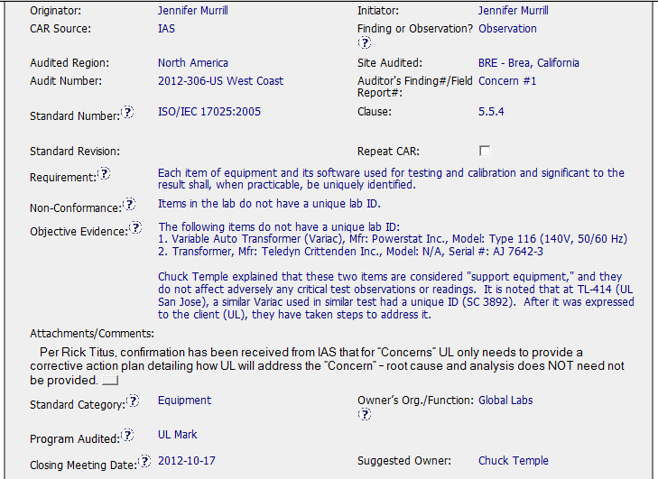
Good CAR No. 123911157

Slide 4
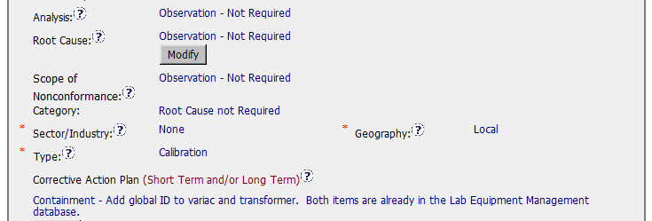
Good CAR No. 123911157
Analysis & Root Cause : Not Required
Scope of Nonconformance: Not required or Same as NC
Category: Root cause not required
Corrective action plan: Fixed the objective evidence

Slide 5
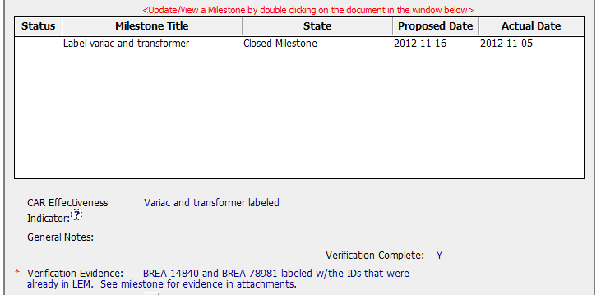
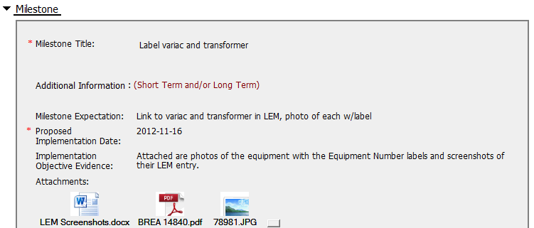
Good CAR No. 123911157
Milestone: Completed per milestone expectation
Verification: Occurred immediately after acceptance of the last milestone

Slide 6
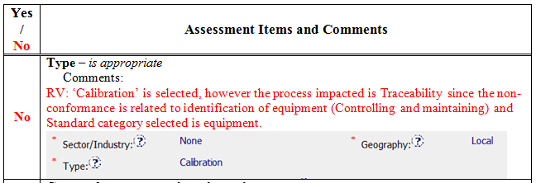
Good CAR No. 123911157 Discussion

