Slide 1
CAR Administrator Calibration Meeting - Good and Bad CARs -
November 26 2012
Team A: Ronald Tse, Ravi V, Jacky Wu, Kila Yang, Motomu Kawano

Slide 2
Bad CAR : No. 123910554 (Kila Yang)

Slide 3
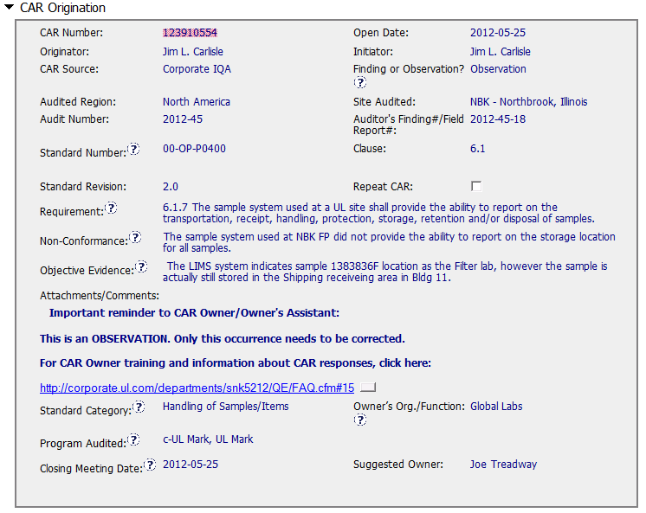
CAR Needing Improvement - No. 123910554

Slide 4
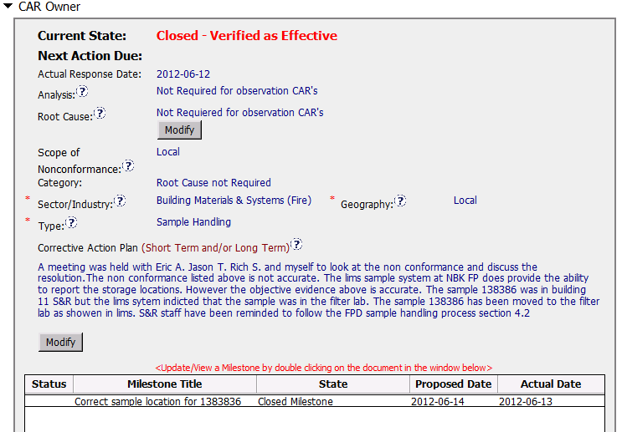
CAR Needing Improvement - No. 123910554
Notes:
00-QA-S0006 (#18.0) - Corrective Action Request Process

Slide 5
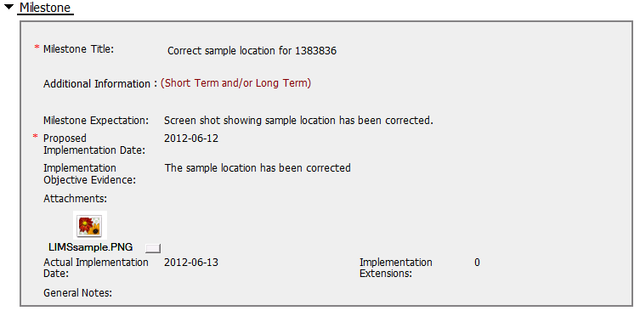
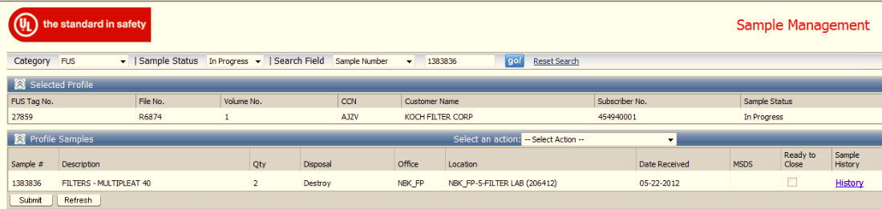
CAR Needing Improvement - No. 123910554
Inappropriate supporting evidence provided - The sample location of LIMS is same as the non-conformance objective evidence which this CAR addressed. (LIMS in Filter lab)

Slide 6
CAR Needing Improvement - No. 123910554
Recommendation –
Milestone – Implementation Objective Evidence
Provide the photo of sample shelve with such sample No. or sample login/out sheet to prove this sample has been moved to Filter lab.
The CAP states that “S&R staff have been reminded to follow the FPD sample handling process section 4.2”. It’s recommend to provide the evidence, ex) reminder email or meeting minutes as evidence.

