Slide 1
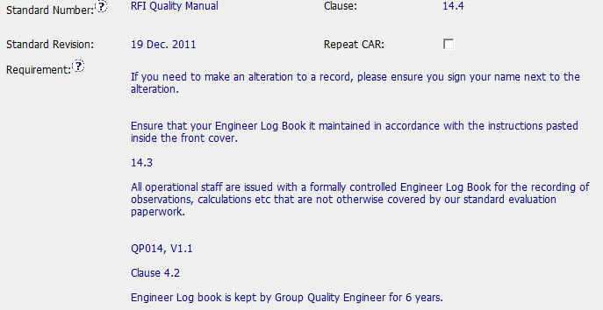
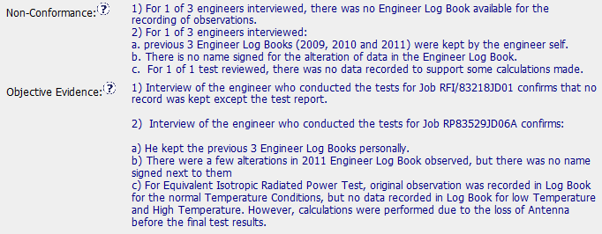
CAR 123910200 – Improvement Opportunity
Nonconformance Details

Slide 2
What corrective actions are expected for this Observation CAR?
Q: What does an Observation CAR need to address?
A: The objective evidence

Slide 3
What corrective actions are expected for this Observation CAR?
1. Give log books to the engineers
2a. Store completed log books in correct locations
2b. Correct the notations within log books (training?)
2c. Locate the missing data.

Slide 4
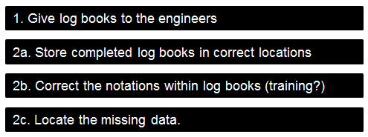
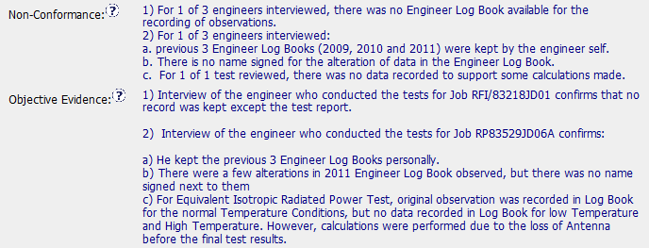
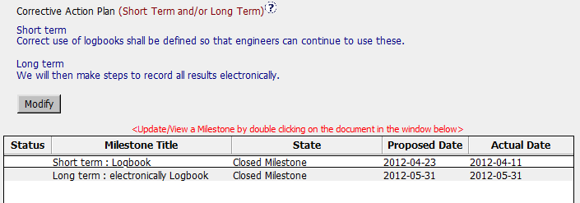
Expected Corrective Actions
Corrective Actions

Slide 5
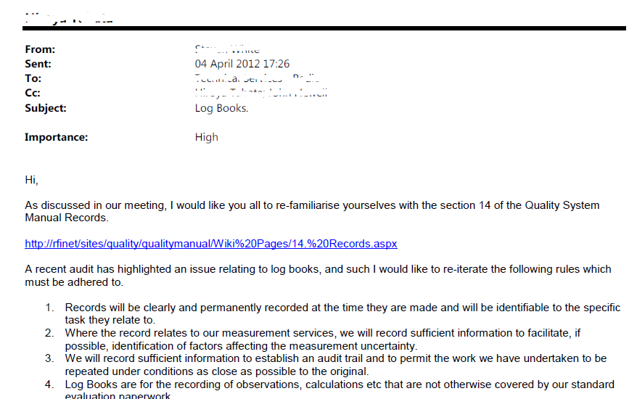
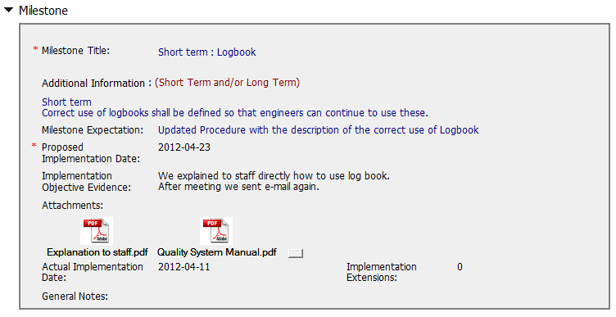
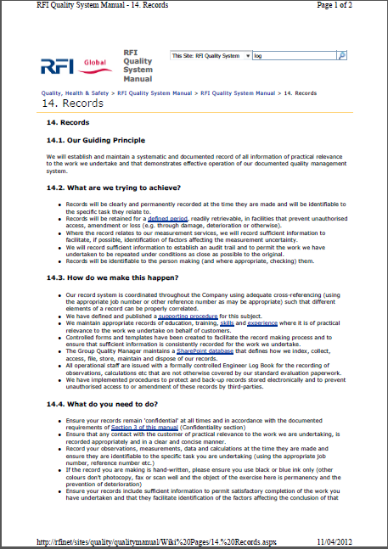
First Milestone
Email to staff
Requirements
Expected Corrective Actions

Slide 6
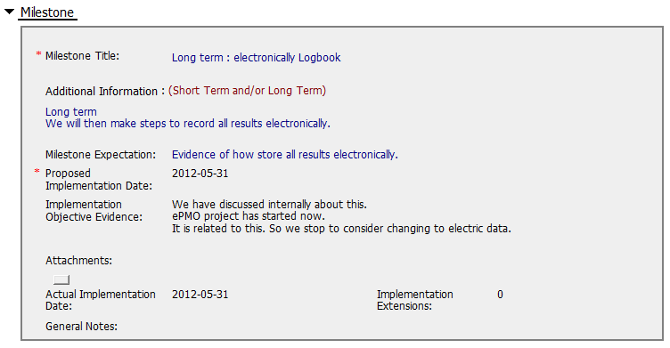
Second Milestone
Second Milestone essentially cancelled
Expected Corrective Actions

Slide 7
Were corrective actions appropriate?
No log books were given to engineers
No evidence that completed logbooks were relocated
Expected Corrective Actions
Emailed “training”, but without confirmation
No evidence the missing data was located

Slide 8
Summary
This is an Observation CAR opened during an IQA Audit
CAR response was submitted 10 days after assignment to Owner
Implementation was Overdue for 1 day
First milestone completed 43 days after assignment of CAR to Owner
Second milestone and CAR closure occurred 108 days after assignment of CAR to Owner
History contained no other relevant information.
Notes Link to CAR

