Slide 1
2012 Q2 CAR Administration Calibration Meeting
Team B – Good CAR / Bad CAR Review
Rebecca Navarrete
Dale Piechocki
Bill Costello

Slide 2
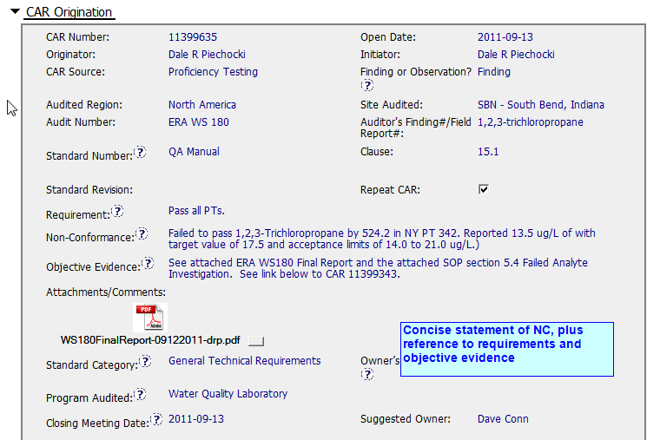
Good CAR (11399635)

Slide 3
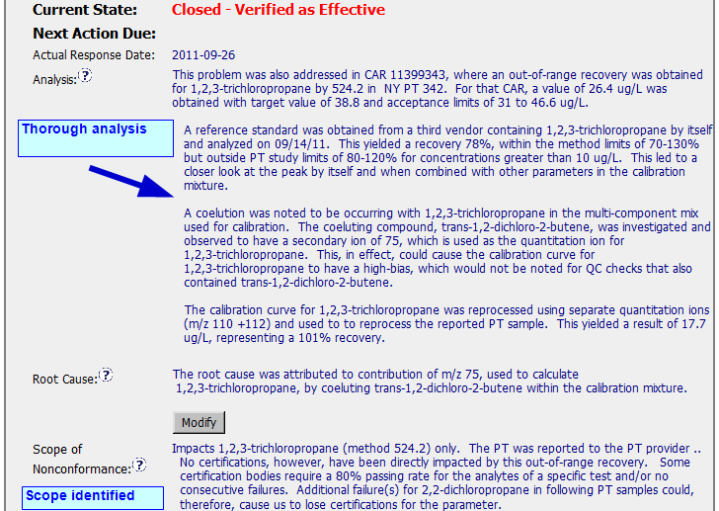
Good CAR (11399635)

