Slide 1
Case Study
Team: John Pallanti, Chris Nicastro,
Gary Gardell, Kathy Lindstrom

Slide 2
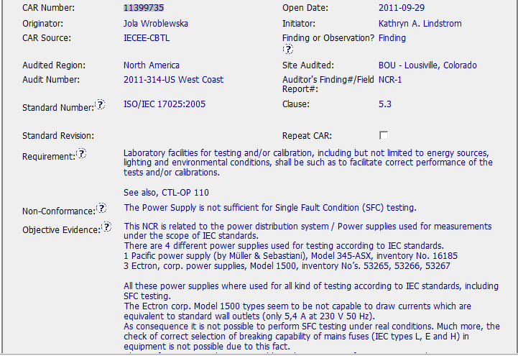
Good CAR – Sample 1
CAR Number: 11399735

Slide 3
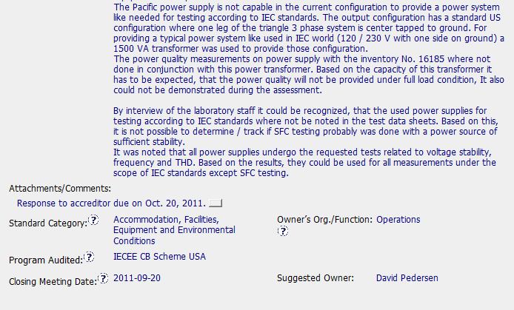
Good CAR Sample 1
CAR Number 11399735

Slide 4
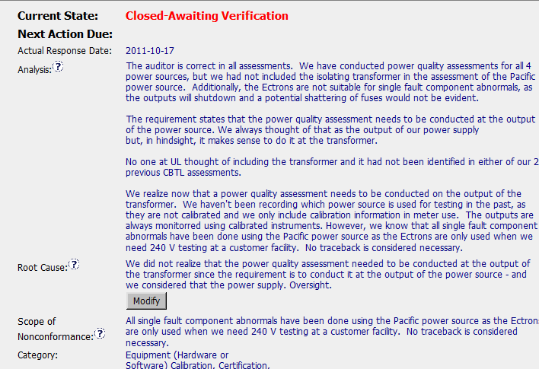
Good CAR – Sample 1
CAR Number: 11399735

Slide 5
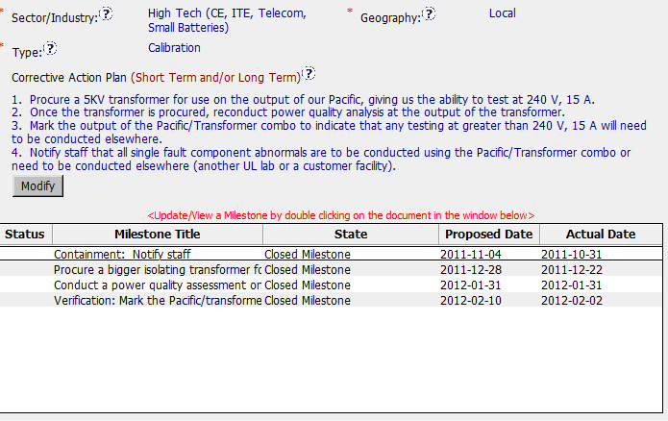
Good CAR – Sample 1
CAR Number: 11399735

