Slide 1
CAR Calibration Session “Good” CAR, “Bad” CAR Review
Team A: J. Y. Lee, WeiBeng Leong, Simy Li, Thomas Kestner
May 2, 2012

Slide 2
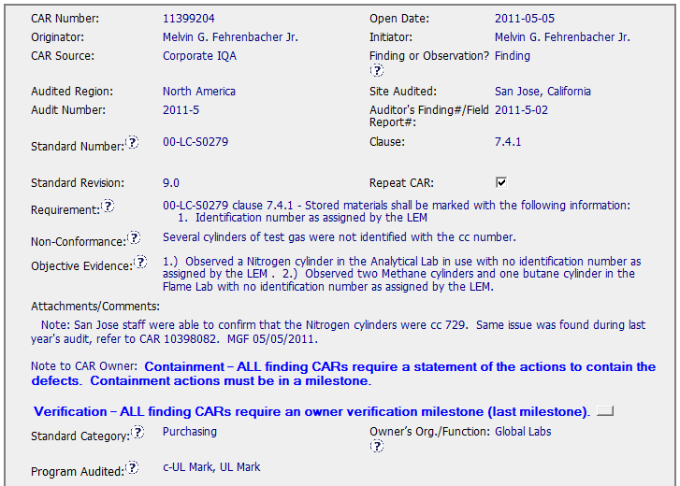
Sample 4 - Good CAR CAR No. 11399204

Slide 3
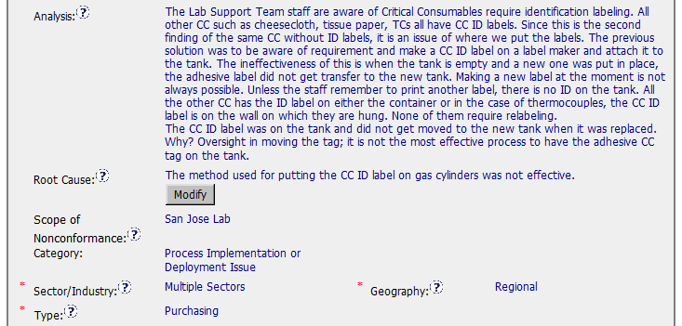
Sample 4 - Good CAR CAR No. 11399204

Slide 4
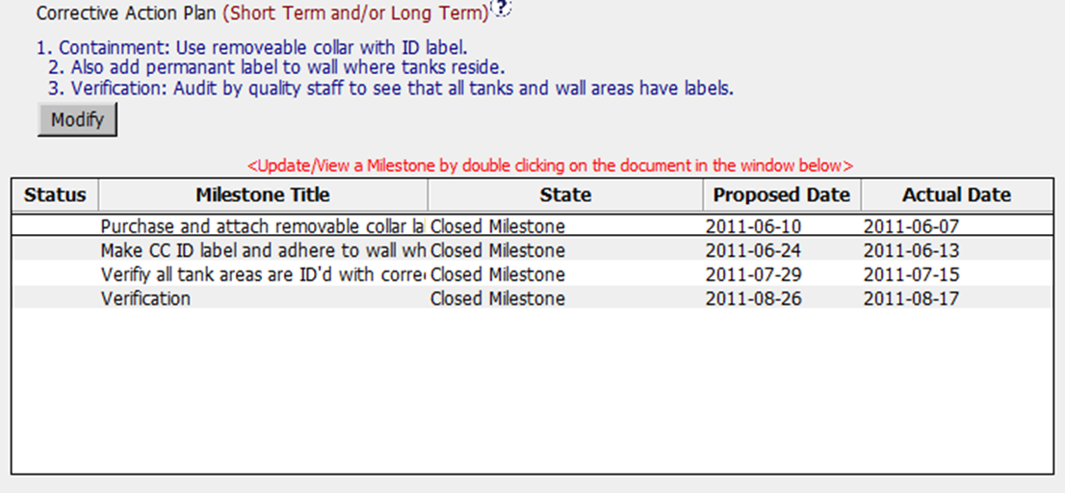
Sample 4 - Good CAR CAR No. 11399204

Slide 5
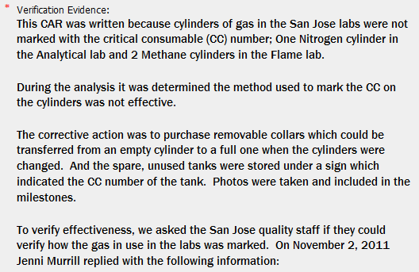
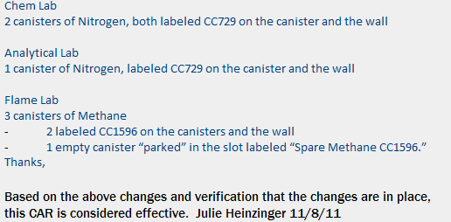
Sample 4 - Good CAR CAR No. 11399204

Slide 6
Sample 4 - Good CAR CAR No. 11399204 Discussion
The Analysis is clear and complete, leading to the root cause for missing Critical Consumables identification labeling.
The root cause is reasonably arrived at based on the analysis. The method used for putting the CC ID label on gas cylinders is correctly concluded as being not effective.
Scope of the nonconformance tells us that the problem is isolated to San Jose Lab.
Corrective Actions fixed the defects in the objective evidence by labeling the CC with missing ID; addressed the root cause by having removable collar and permanent label ID.
Milestones have a containment, verification and other milestones as described in CA
The effectiveness of the CA were verified by quality staff checking the CC ID three months after the CAR closure.

