Slide 1
CARS: The Good, The Bad & The Ugly
Good = 123910809
Improvement Opportunity = CAR 123910792
Improvement #2 CAR 123910360
Good CAR #2: 123910120
Team:
Mark Jessen, Michelle Lee

Slide 2
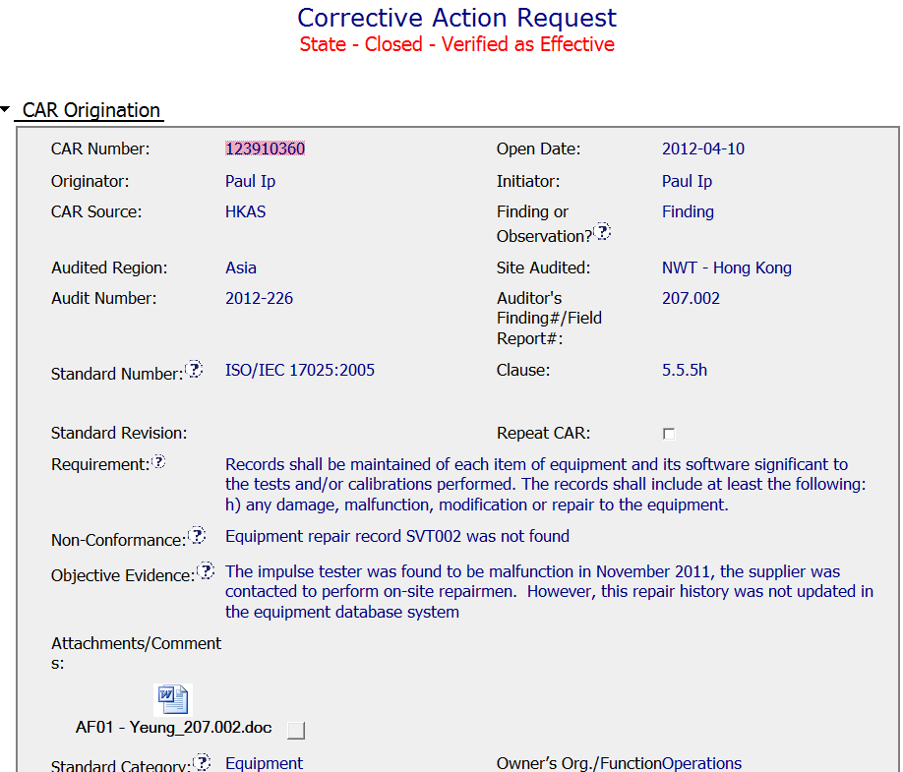
Improvement CAR #2
Cited the specific applicable requirement
No description of equipment type. Is SVT002 a global ID?
Is there only one impulse tester? How will it be identified for containment?

Slide 3
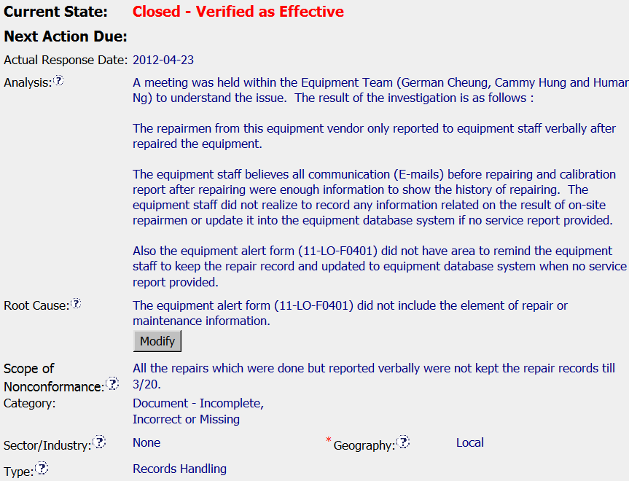
Improvement CAR #2
Who: Includes list of stakeholders
Why? What does the process doc say? Is there a form?
What is the normal practice? Was it an unusual circumstance?
Where did this occur? When did it begin?
How far back should this include? What location?

Slide 4
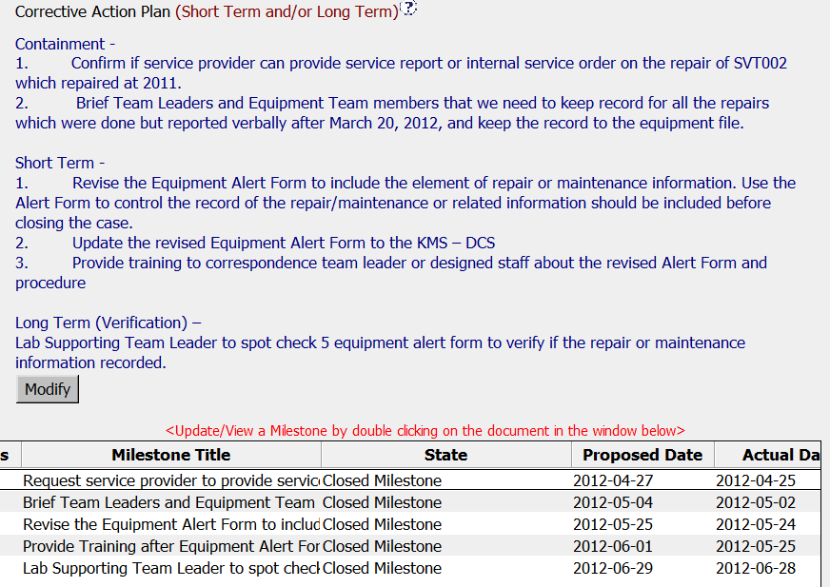
Improvement CAR #2
Three key components of CAP
Milestones for each CAP component

Slide 5
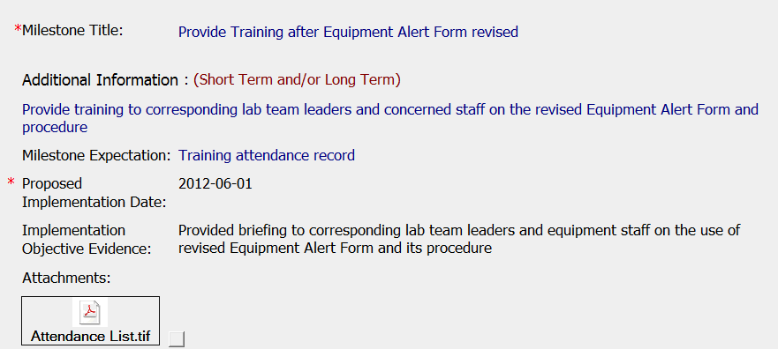
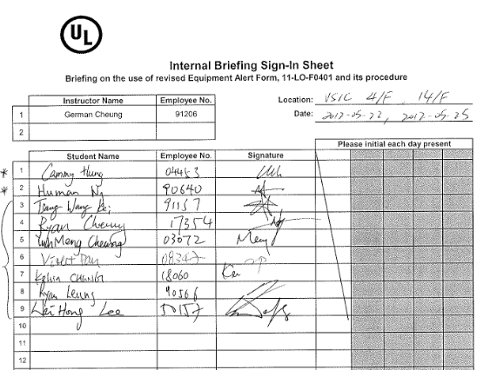
Improvement CAR #2
Is there a copy of the training material or agenda/minutes?
Copy of training record

Slide 6
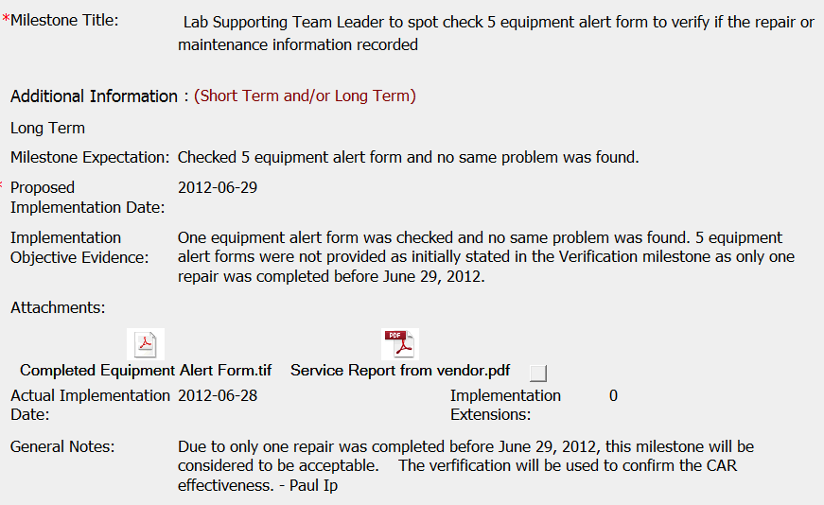
Improvement CAR #2
Would it have been possible to wait to perform verification a little later to have additional sampling?
Although only one sample was available, overall verification was completed.

