Slide 1
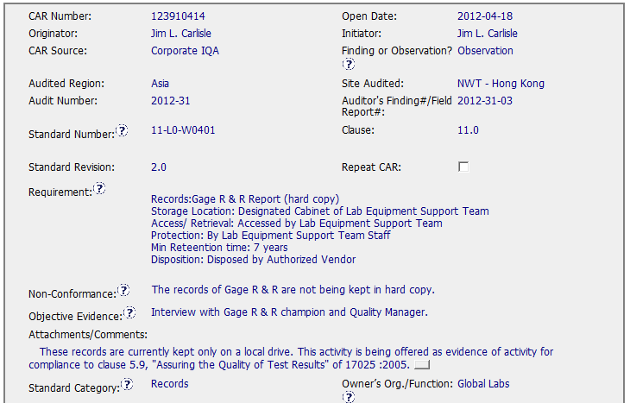

Sample 4 Good CAR No. 123910414

Slide 2
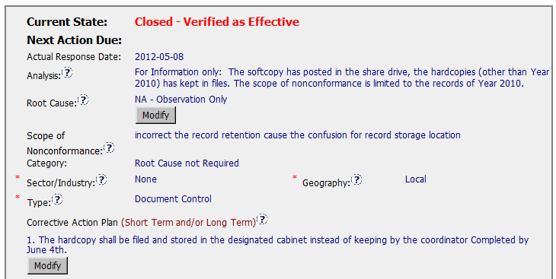
Sample 4 Good CAR No. 123910414
Analysis– Observation need no root cause analysis.
However, additional information is provided for logical and clear corrective action plan.
Corrective Action Plan
– fix the objective evidence

Slide 3
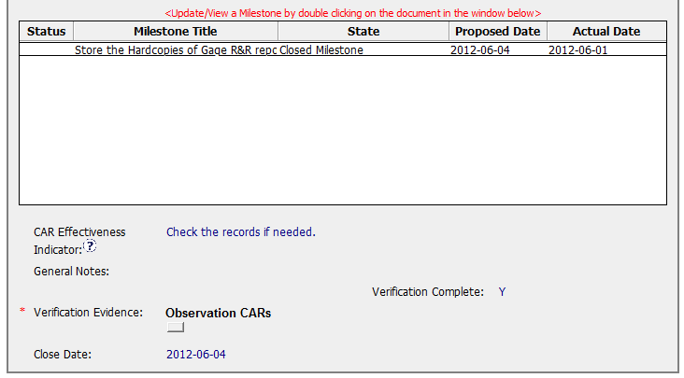
Sample 4 Good CAR No. 123910414

Slide 4
Sample 4 - Good CAR No. 123910414 Discussion
Analysis & Root Cause
- Observation need no root cause analysis.
However, additional information is provided for logical and clear corrective action plan.
Corrective Action Plan
– Fix the objective evidence.

