Slide 1
Case Study
Team: John Pallanti, Chris Nicastro,
Gary Gardell, Kathy Lindstrom

Slide 2
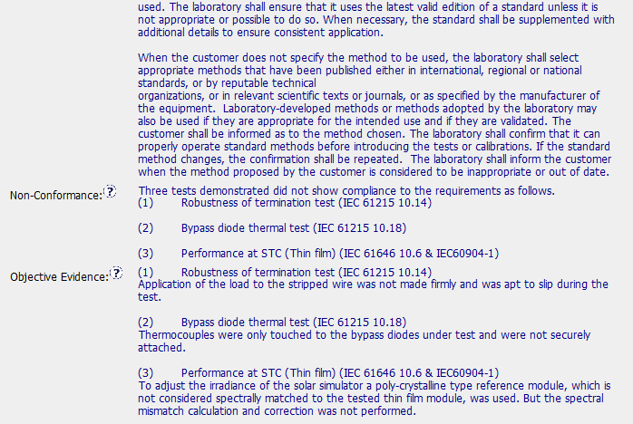
CAR Needing Improvement - Sample 2
CAR Number: 123910107
1

Slide 3
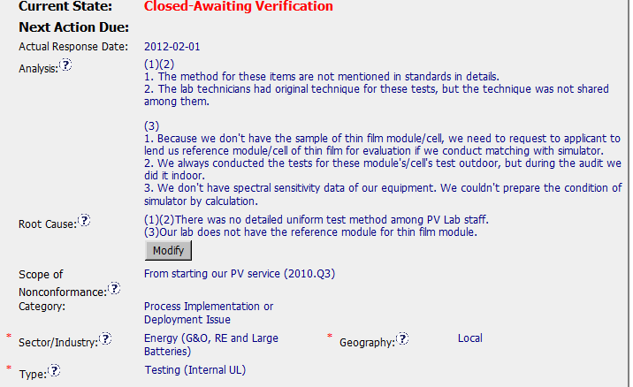
CAR Needing Improvement - Sample 2
CAR Number: 123910107
1

Slide 4
CAR Needing Improvement - Sample 2
CAR Number: 123910107
Concerns:
1. The Analysis for Items (1) and (2) doesn’t go deep enough to get to the true root cause. They didn’t ask: “Why did the technicians have original techniques for these tests?”; “Why was there not a uniform lab test method among the technicians?”; “Why didn’t they share techniques among them?”; “Are there other areas where there is not a uniform lab test method among the technicians?”. They developed procedures to fix the issues identified, but didn’t address if there are other areas where different techniques are being used and not shared.
The Analysis for Item (3) also doesn’t go deep enough and ask more “Whys”. The analysis appears to be a series of disjointed statements.
2. The Root Cause for Item (3) comes from the starting point of the Analysis and ignores the rest of it.

Slide 5
CAR Needing Improvement - Sample 2
CAR Number: 123910107
Concerns:
3. The Corrective Action Plan for Item (3) includes training, but the need for training doesn’t flow from the Root Cause.
4. Objective evidence for milestone 2 has 3 SOPs on how to conduct the test, but they do not show any evidence of document control.
5. Objective evidence for Verification was pictures of the test being conducted correctly and a datasheet. However, the tests were all conducted by the same technician. Since the analysis said that different techs had different methods, we would have expected to see more than just one name performing the tests.

