Slide 1
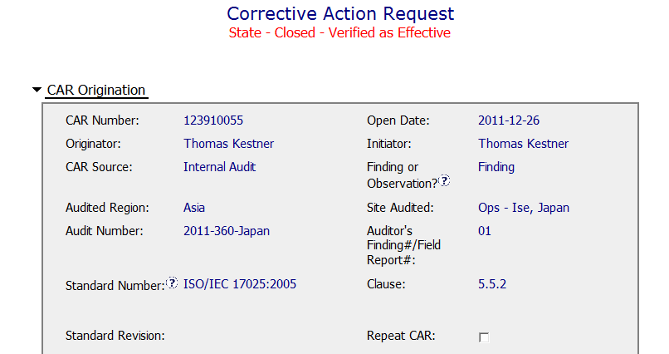
Opportunities for Improvement – CAR # 4
Nonconformance Details
Nonconformance Details
OBS: Could be added here if wanted, but not needed since it is include above.

Slide 2
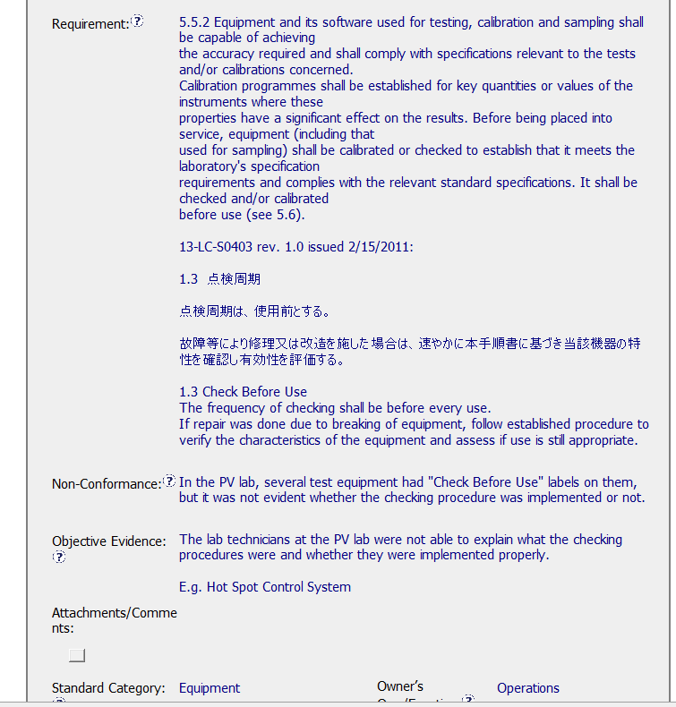
Opportunities for Improvement – CAR # 4
Requirement Repeated from 17025 and then from local documentation
The non-conformance does not include any specific applicable equipment. Depending upon the outcome, this might be needed to check the impact on projects.
Issue is the lab techs did not know the check before use procedures.
Nonconformance Details
Nonconformance Details
Translation is a good practice, this way all know the requirement
TIP: Size of population could be useful. X of X interviewed were not able . . .

Slide 3
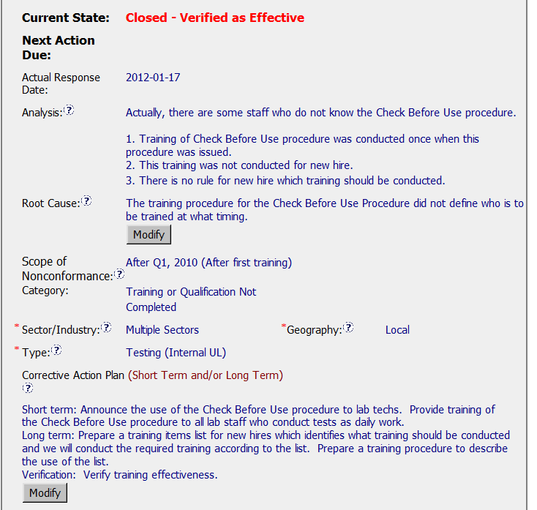
Opportunities for Improvement – CAR # 4
Corrective Actions
OBS: Wonder why the auditor could not find anyone who knew the “Check Before Use Procedure” during the audit.
ANALYSIS: Not sure who was consulted and why the new hires became the focus of the issue.
SCOPE: Since it has not been determined that it is only the new hires who could not explain checking before use, this scope is perhaps a bit limiting.
ROOT CAUSE: Training cited as the root cause without sufficient analysis.

Slide 4
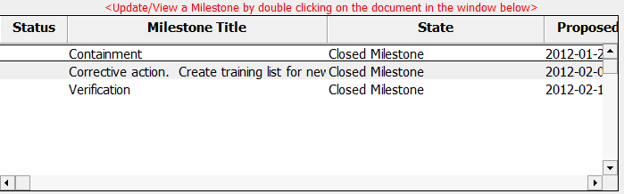
Opportunities for Improvement – CAR # 4
Corrective Actions

Slide 5
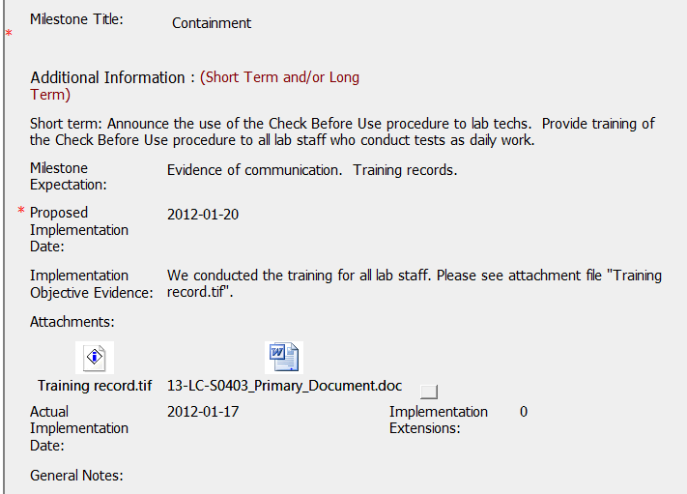
Opportunities for Improvement – CAR # 4
Milestone 1 - Containment
Four different training sessions, sign-in records attached, a total of 40 people received training.
Attached document is local language – not clear how this addressed the issue. A note of explanation in General Notes could help.
Evidence was included that training took place and the document to which the training occurred was included.

Slide 6
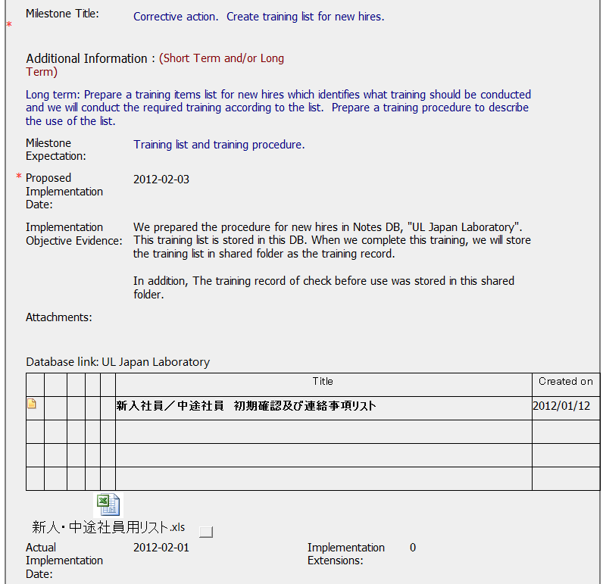
Opportunities for Improvement – CAR # 4
Milestone 2 – Corrective Action
A new hire checklist was added to for this milestone, however since it is in local language, it is not clear who will receive this training. It leads to questions:
Will it be just lab techs?
Will it include the Project Handlers and Reviewers since they are the ones the receive the data from the lab?
Evidence was included that a new hire checklist was created and stored.

Slide 7
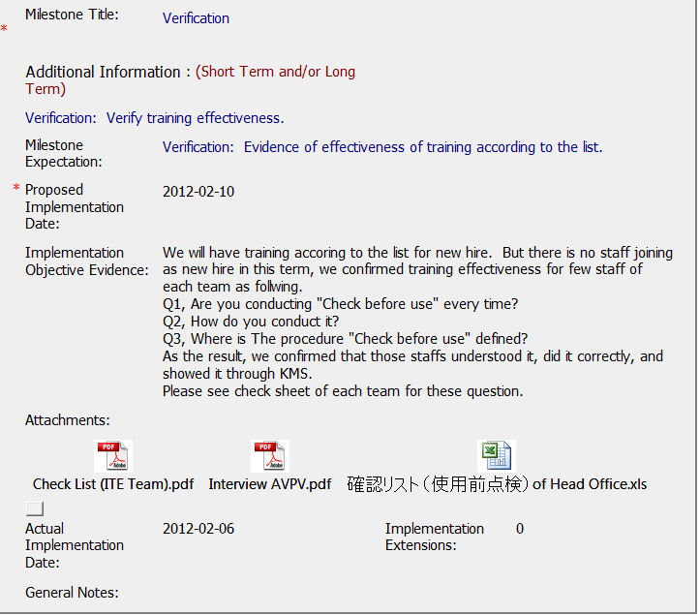
Opportunities for Improvement – CAR # 4
Milestone 3 – Owner Verification
Verification done by interview and the reason why was provided. The three questions listed below we assume to be the same three questions in the attachments. All attachments are the same thing, but for different groups. Sample on next page.

Slide 8
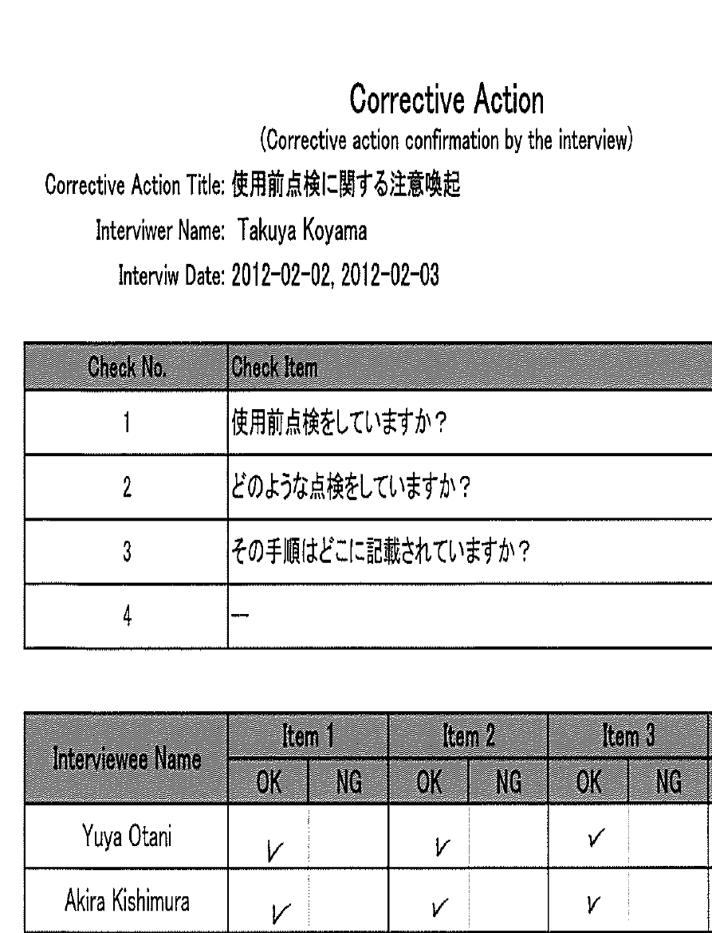
Opportunities for Improvement – CAR # 4
Milestone 3 – Owner Verification

Slide 9
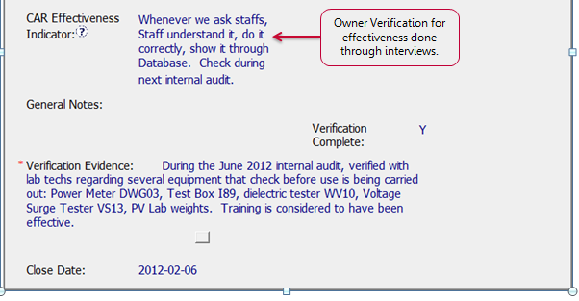
Opportunities for Improvement – CAR # 4
Verification
Initials and Date of the person doing the verification are suggested.
IQA Verification – watched and recorded equipment for which “checking before use” and equipment verified was recorded in the verification evidence.
It is unclear if any record of the Verification before use is required by the PV lab in Japan. The Calibration procedure 13-LC-S0402 is written in Japanese and this could not be verified.

Slide 10
Opportunities for Improvement – CAR # 4
Summary
It is not clear how the population was limited to those hired after Q1-2010.
Unclear how it was determined that training was the problem.
Training was done but nothing addressed why the lab techs were ignoring the “check before use” stickers.

