Slide 1
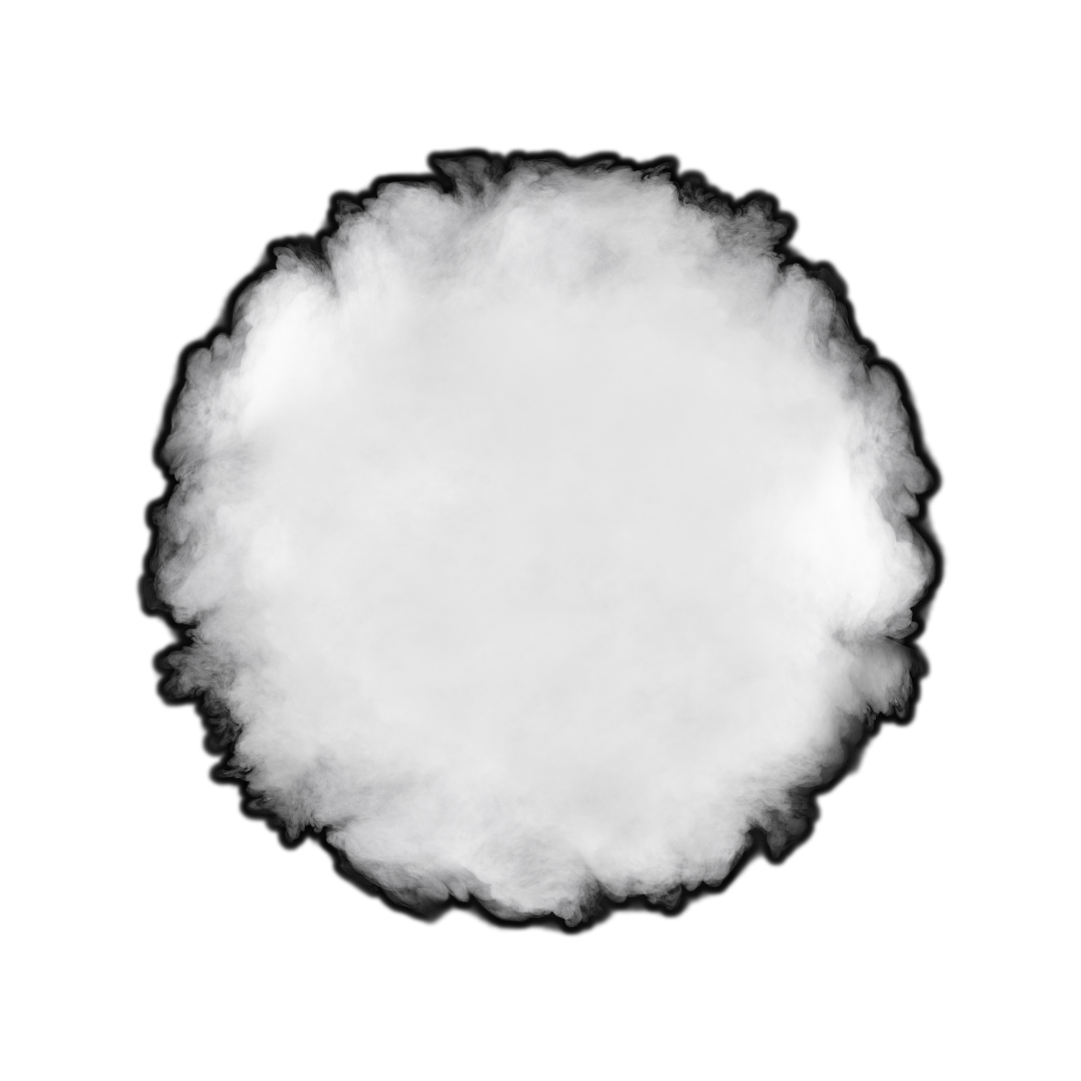

Applied coding project
October 2022 – Oliver Jovanovic

Slide 2
Requirements
Three requirements have been stated by Prof. Dr.-Ing. Andreas Becker that must be fulfilled. Otherwise, the project does not totally fulfill the requirements and cannot be used for further purposes.
 | Develop an GUI that must cover the functionality of the Pythonic mmWave Toolbox. The GUI should have a modern UX / UI and can be created with the PyQt Toolbox.
 | The Pythonic mmWave Toolbox has already build in functionality for some TI Radars and one must discover if it must be adapted for the one used in this applied coding project (IWR6843AOPEVM). If not adapt it and make it functionable.
 | Lastly the used Radar (IWR6843AOPEVM) must have an interface to communicate with ROS (Robot Operating System). Therefore, the GUI must have a build in functionality to identify ROS and then open the communication channel with the OS.

Slide 3

Handing Project over to supervisor
Final presentation
Bug tracing in Pycharm
Requirements management
Transparent and periodical communication
Coding in Pycharm
Beginning with GUI
Combining pymmw with GUI
Testing functionality
Working with Google Cloud (documentation) and GitHub (Code)
4. Completion
3. Debugging
2. Start coding
How to work efficiently with Python?
How to create a GUI in Python?
What is a good UI/UX?
How to embed functionality in Python GUI?
1. Research

Slide 4
Thank you very much for your attention.

