Slide 1

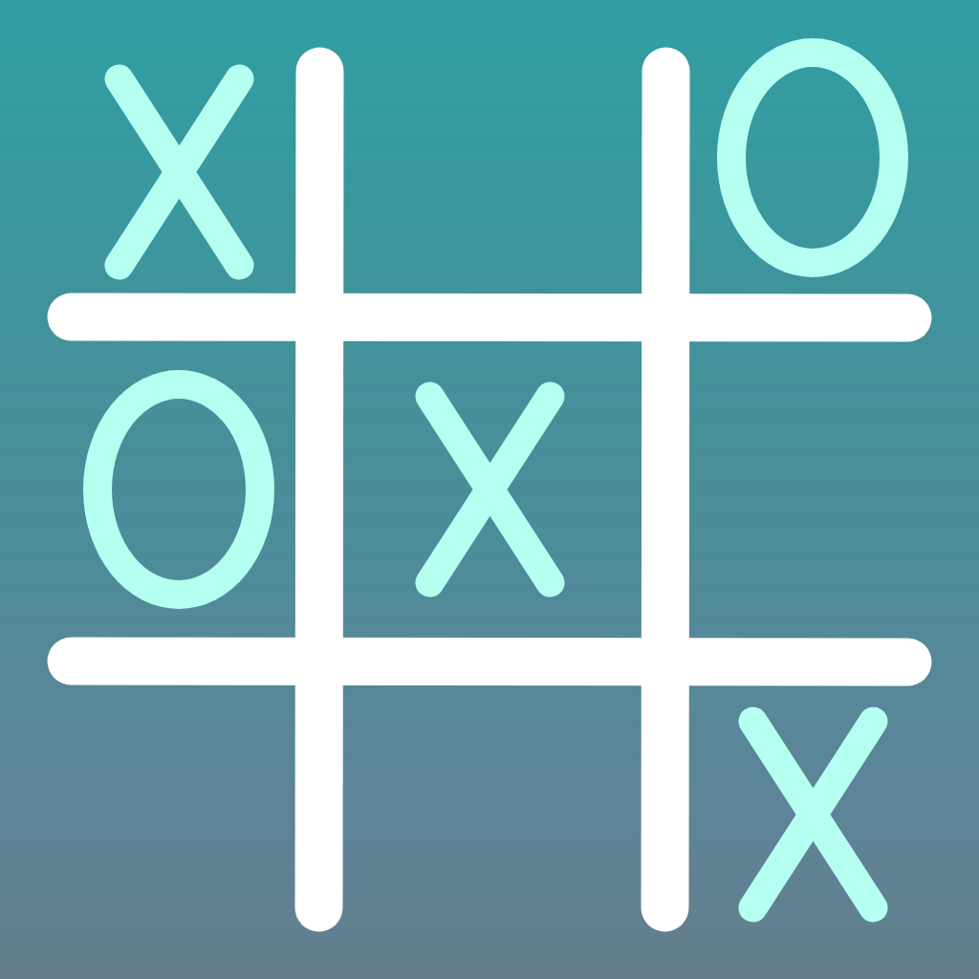
Tic Tac Toe
Midterm application

Slide 2
Intro
Description:
Mobile Tic Tac Toe -a quick easy game for people of all ages to pass time without paper and pencil
Motive:
Dinner table games
Mindless and timeless game
Prevents user from being unengaged with those around them
Objective
Default play
Custom play
Competition
Target Users
Children ages 5 -12

Slide 3
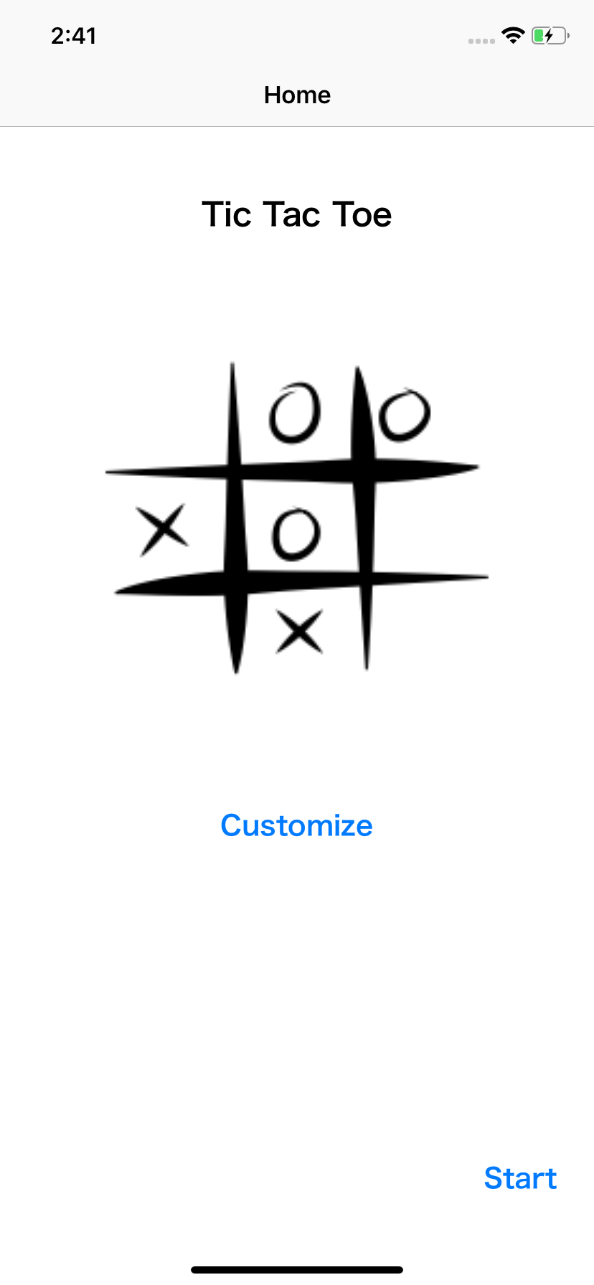
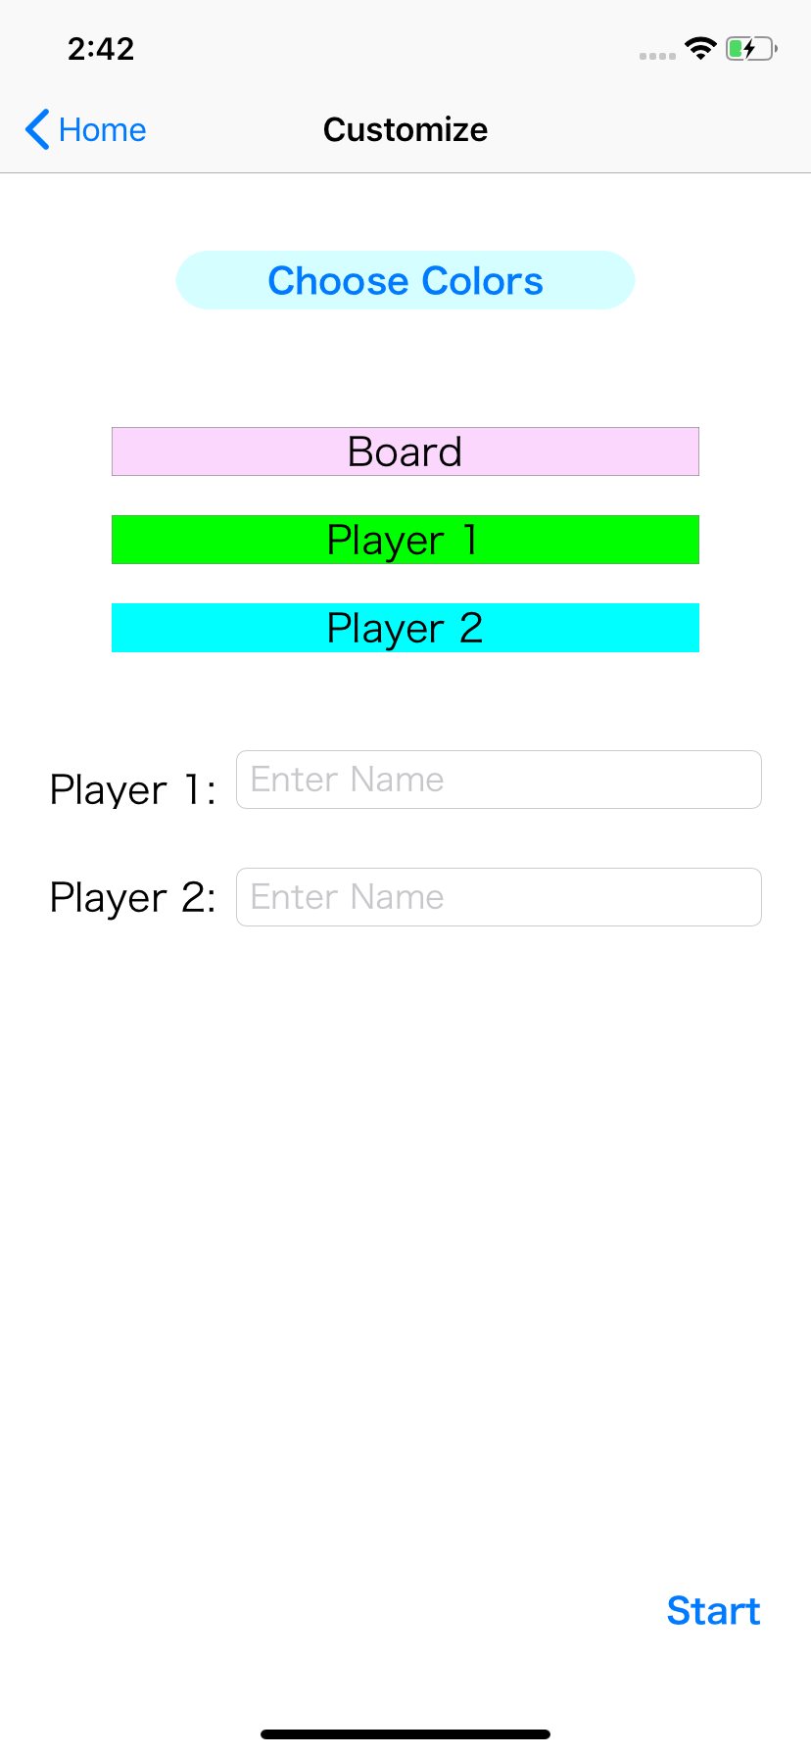
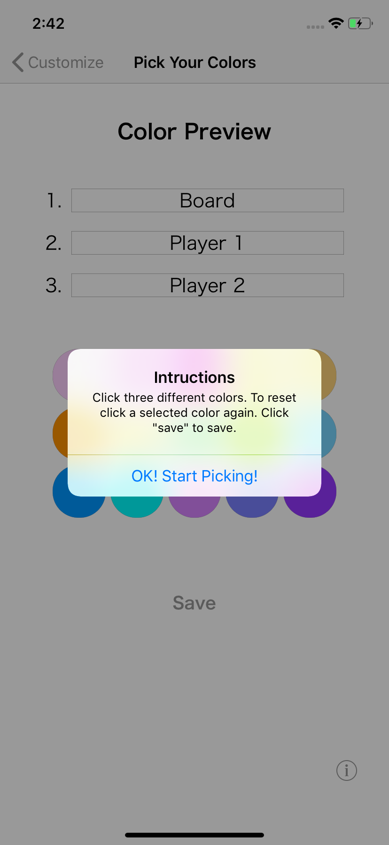
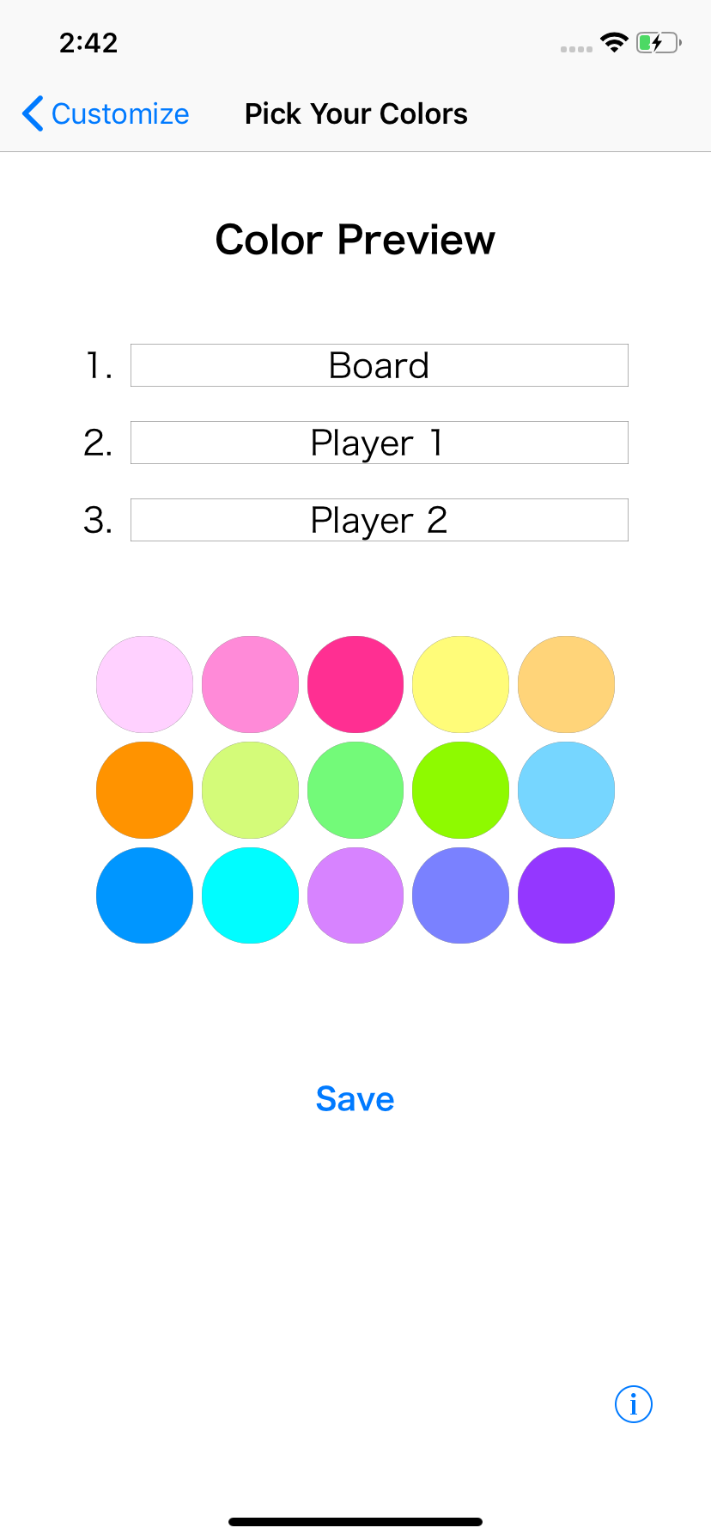
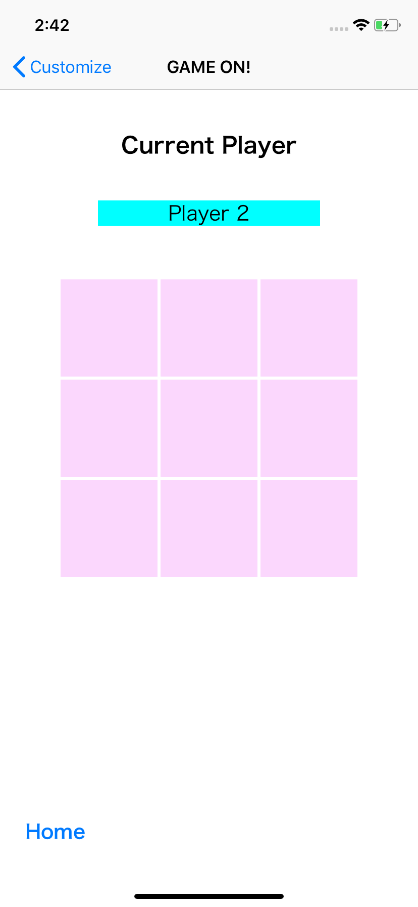
Story Board Overview

Slide 4


label
label
player
label
image
board buttons
start button
home button

Slide 5
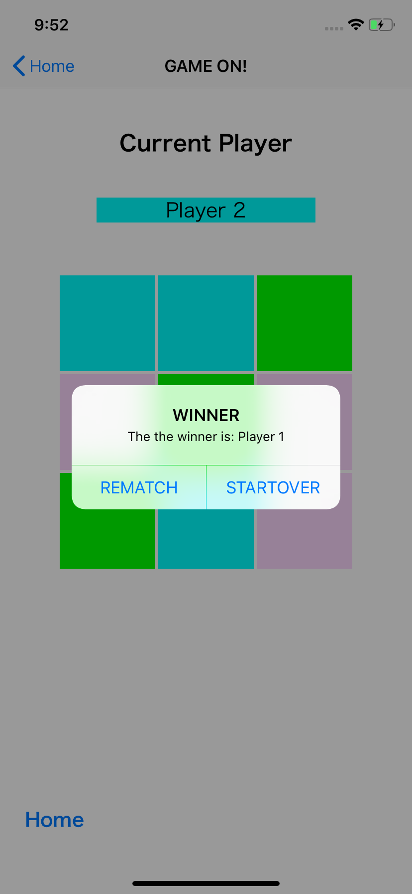
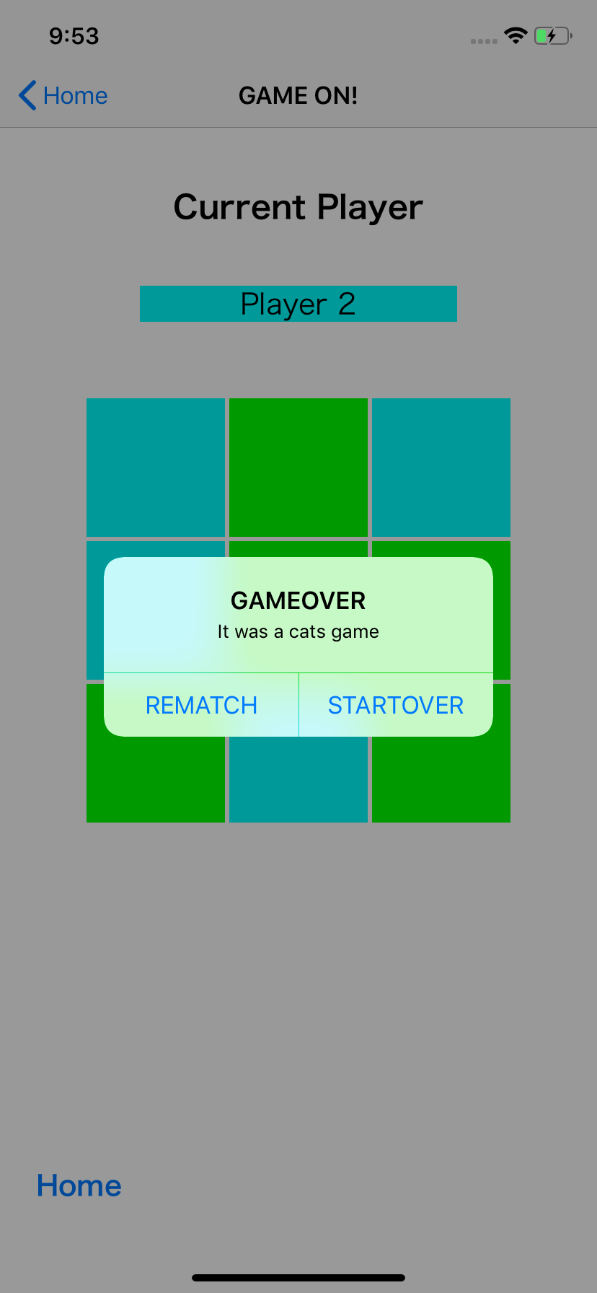
game finished alert

Slide 6
Defaults Story Board

Slide 7
label
button
dynamic labels
image
labels
name text fields
button
start button

Slide 8
button
dynamic labels
labels
name text fields
instruction alert
start button

Slide 9
label
color labels
instruction alert
color buttons
save button
info button

Slide 10
label
order labels
color labels
dynamic labels
labels
name text fields
color buttons
save button
info button
start button

Slide 11
label
player
label
dynamic labels
labels
name text fields
board buttons
start button
home button

Slide 12
game finished alert

Slide 13
Customization Story Board

Slide 14
Implementation Issues
Segues and passing data
Reusing code

