Slide 1

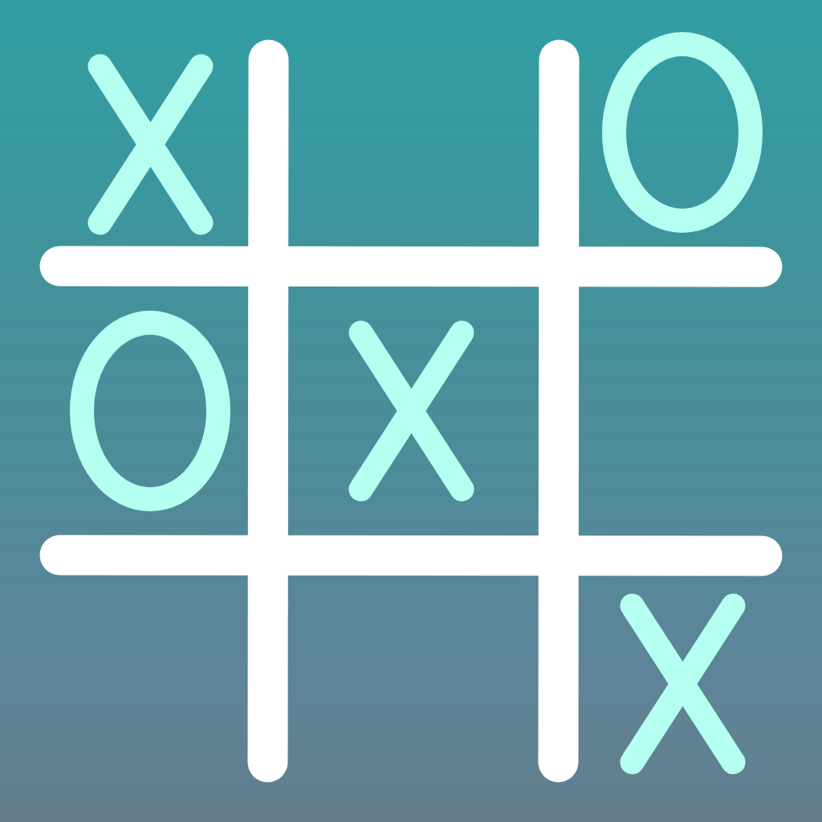
Tic Tac Toe
Midterm application

Slide 2
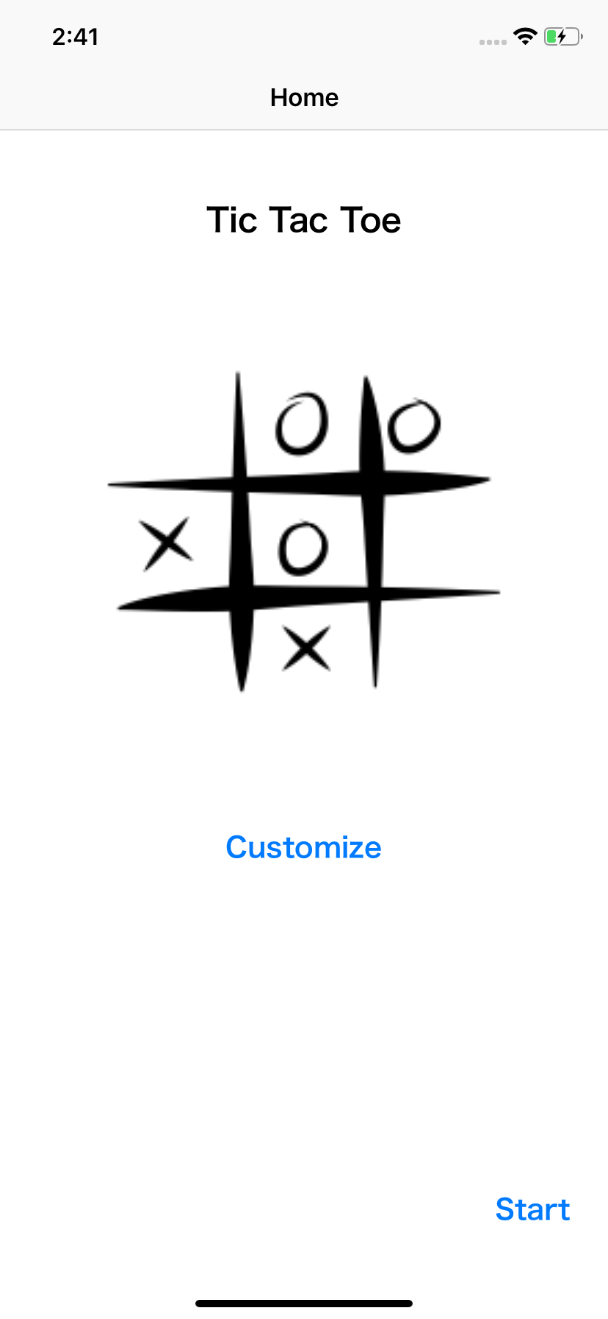
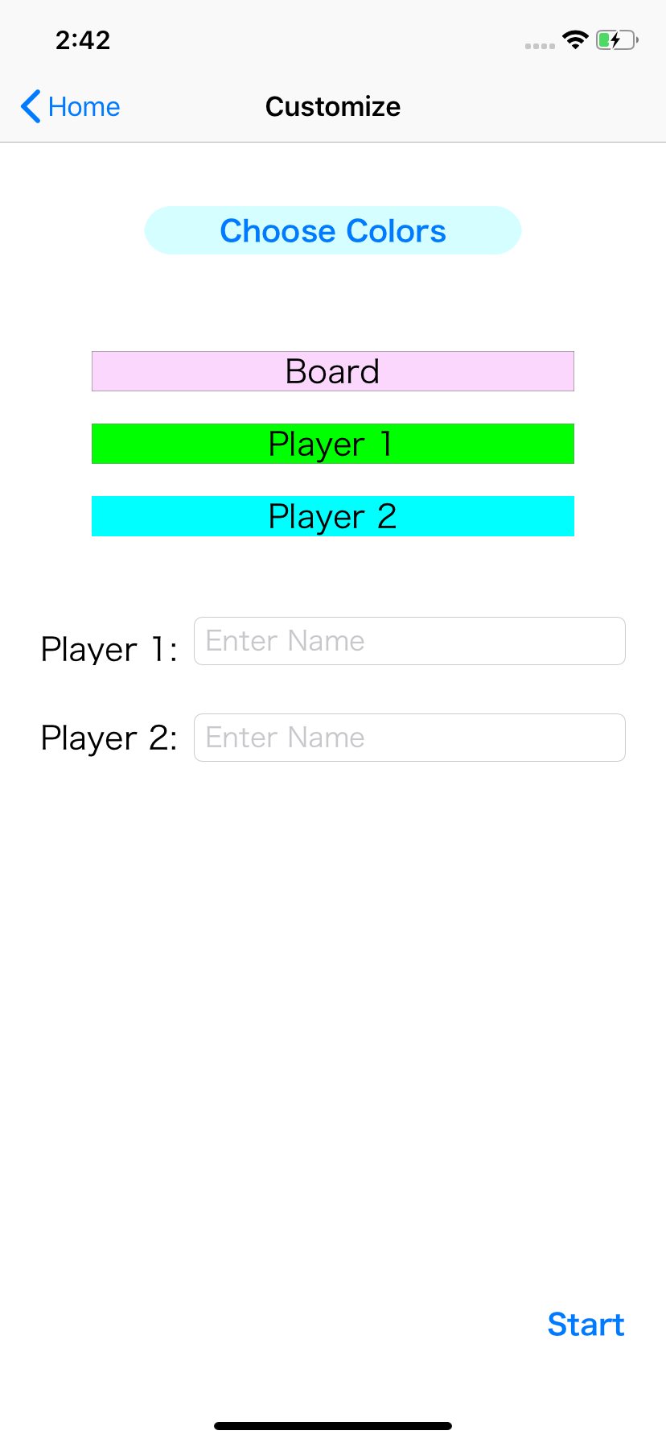
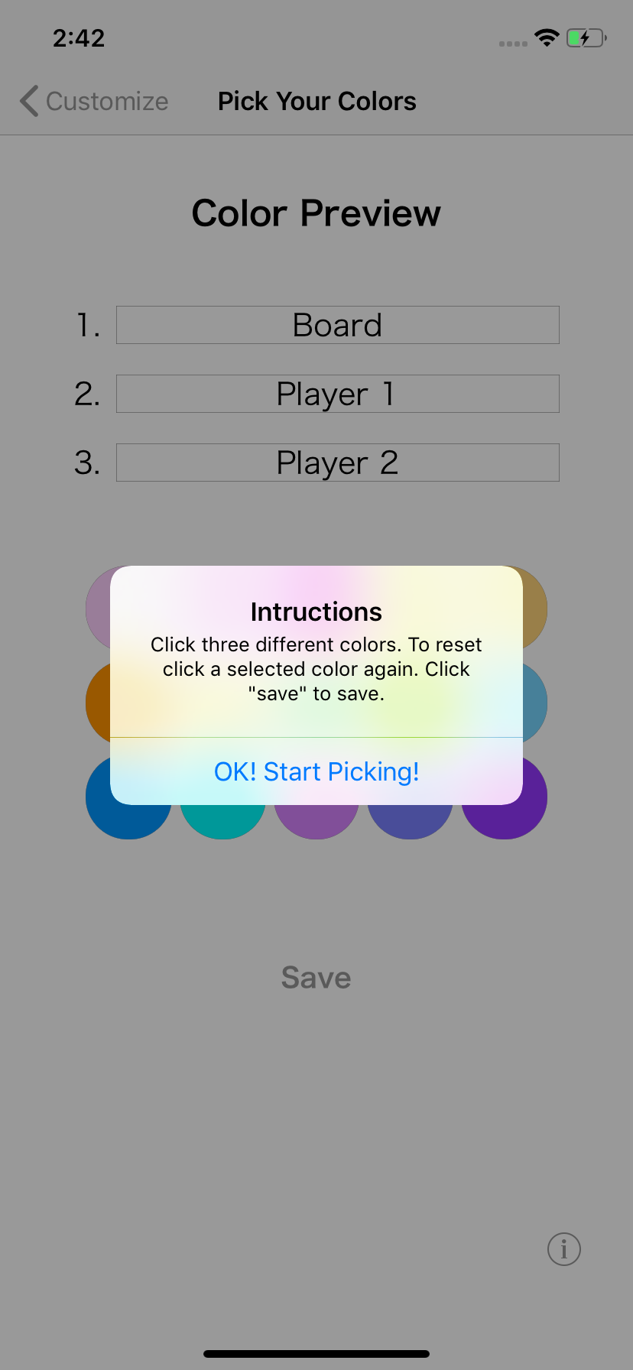
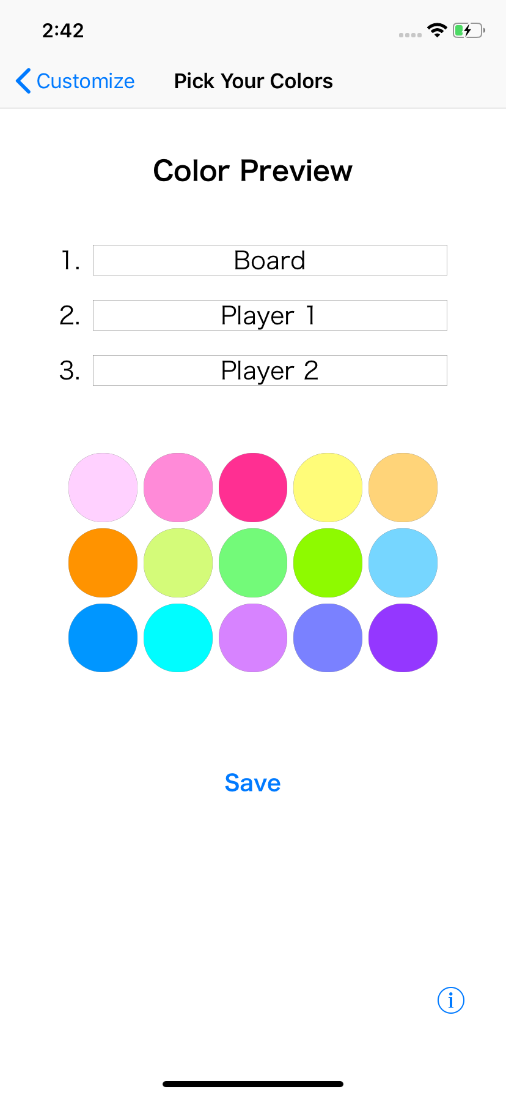
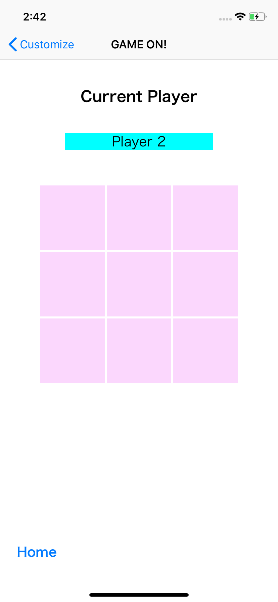
Story Board Overview

Slide 3


label
label
player
label
image
board buttons
start button
home button

Slide 4
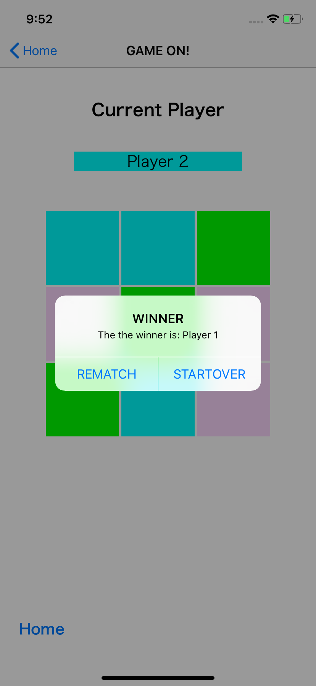
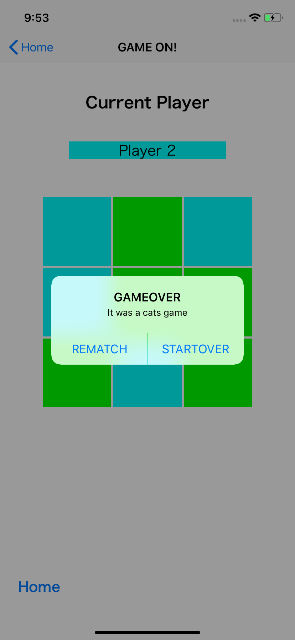
game finished alert

Slide 5
Defaults Story Board

Slide 6
label
button
dynamic labels
image
labels
name text fields
button
start button

Slide 7
button
dynamic labels
labels
name text fields
instruction alert
start button

Slide 8
label
color labels
instruction alert
color buttons
save button
info button

Slide 9
label
order labels
color labels
dynamic labels
labels
name text fields
color buttons
save button
info button
start button

Slide 10
label
player
label
dynamic labels
labels
name text fields
board buttons
start button
home button

Slide 11
game finished alert

Slide 12
Customization Story Board

