Slide 1
DASHBOARD

Slide 2
CONCEPT
Lightweight and efficient task manager designed for students
Useful for sorting and categorizing tasks
Tasks can be organized by date, class, or put into a catch-all general todo list
Built to be simple and easy to use
Notes:
emmet

Slide 3
KEY FUNCTIONAL REQUIREMENTS
Sign Up Page
Login Page
Calendar
Task Creation Modal
Task Tracker
Task Tracker Timer
Settings
Notes:
rebecca

Slide 4
KEY NON-FUNCTIONAL REQUIREMENTS
Alert Badge
Password Recovery
Fill Out Emil Prompt
Login Failure Prompt
Notes:
jordan

Slide 5
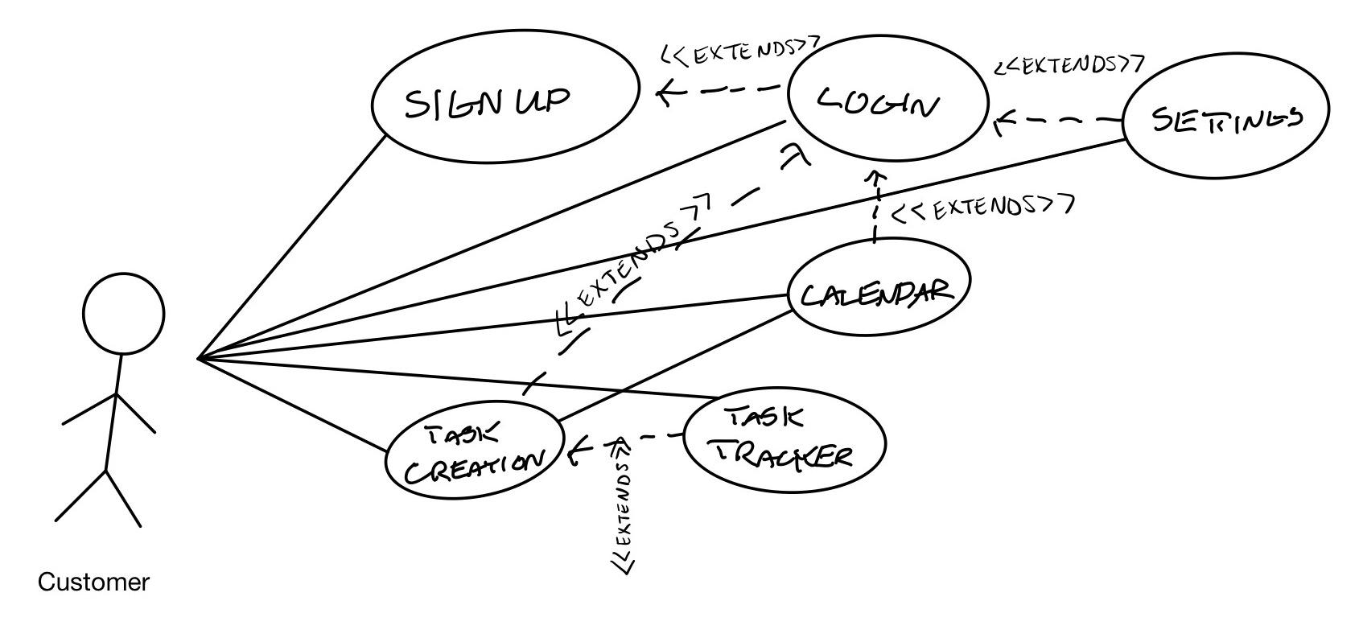
USE CASES AND USE CASE DIAGRAM
Notes:
noah

Slide 6
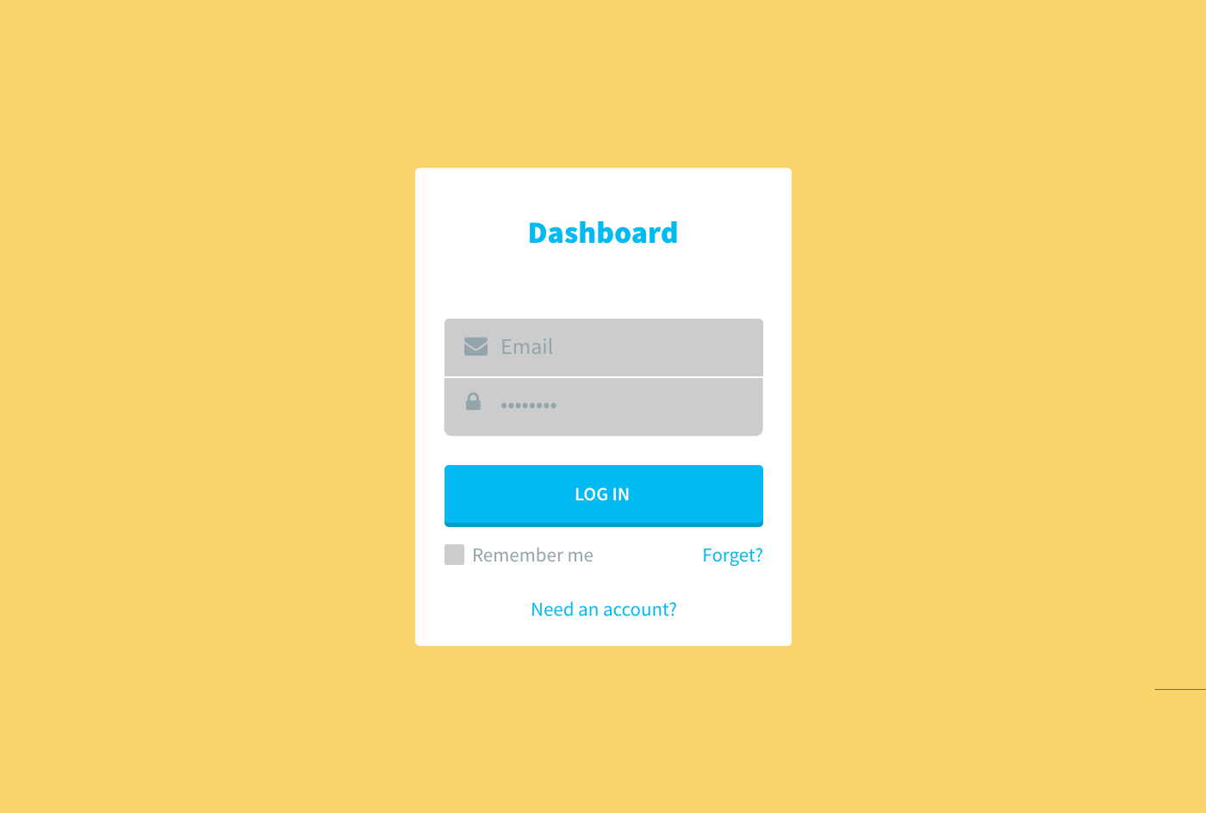
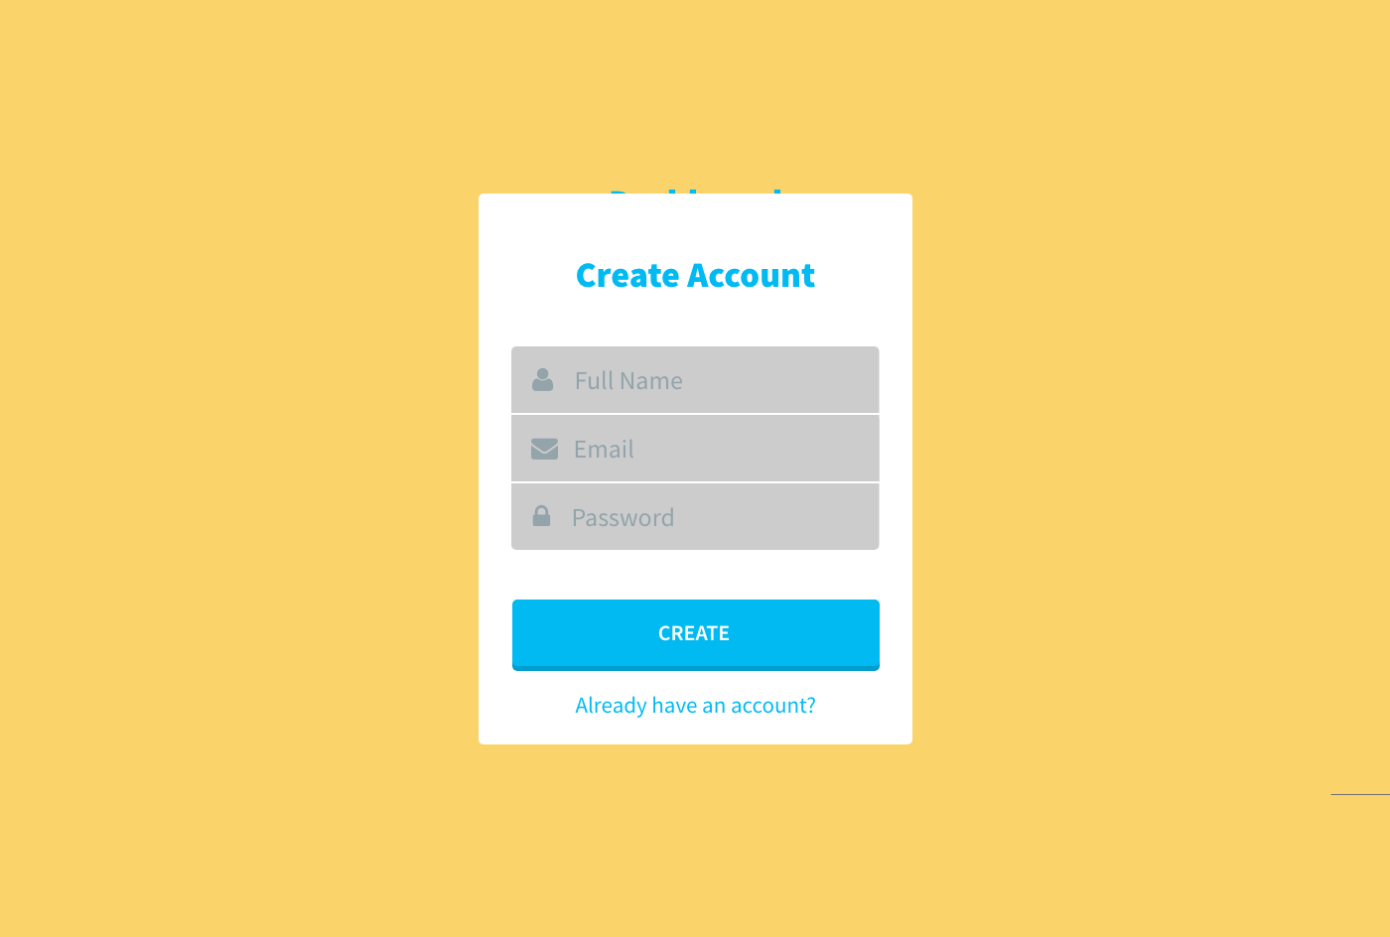
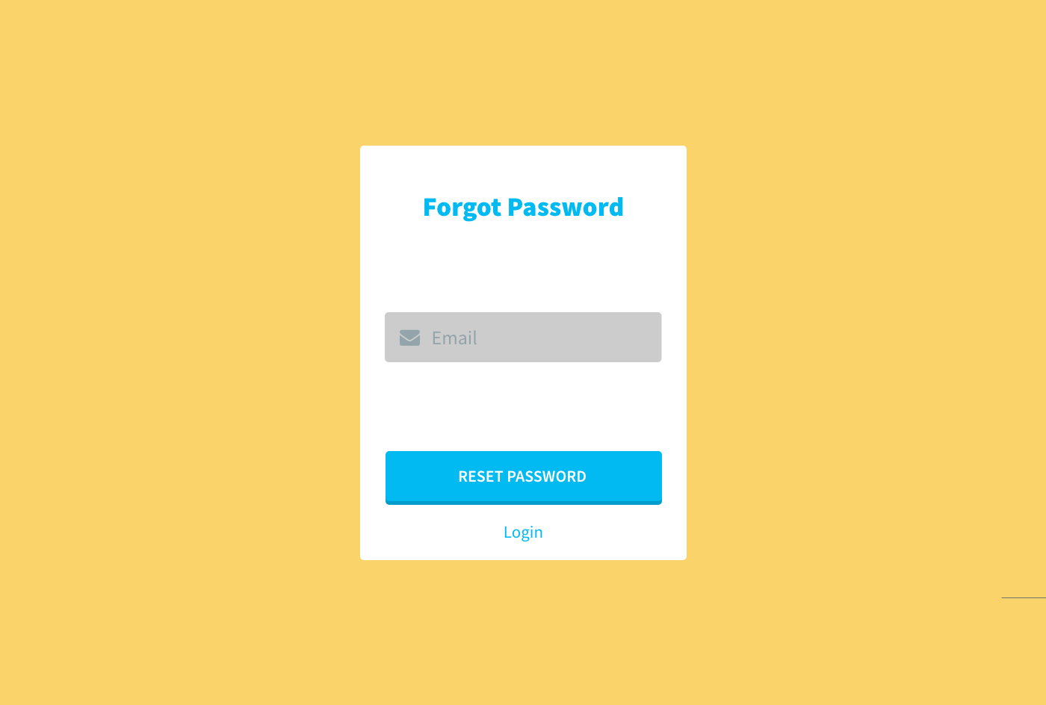
MOCKUP - ACCESS
Notes:
Izzy

Slide 7
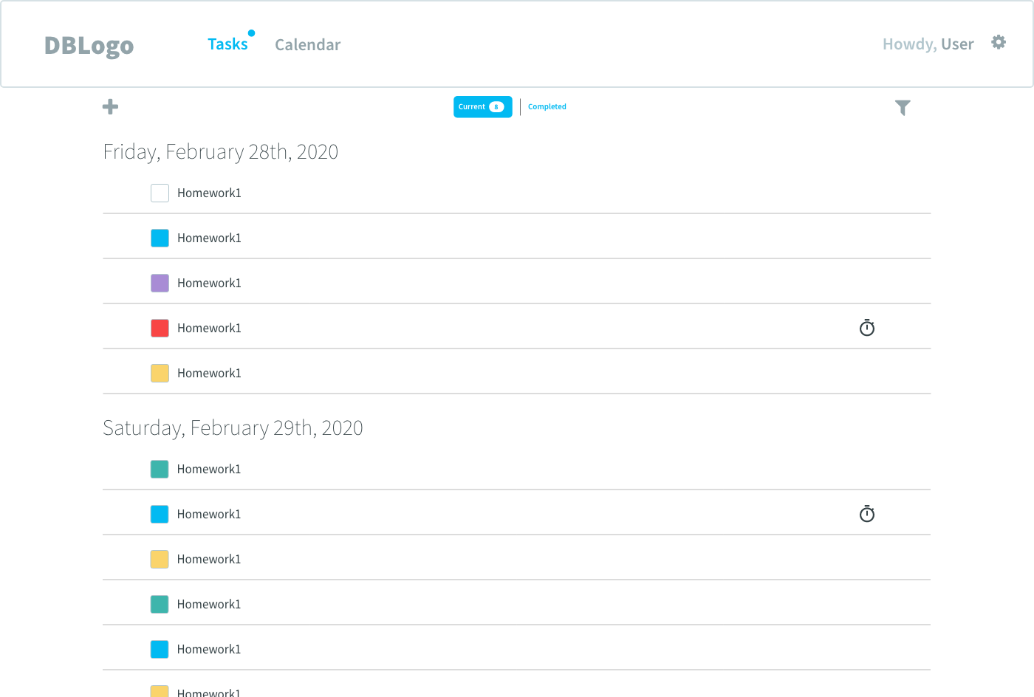
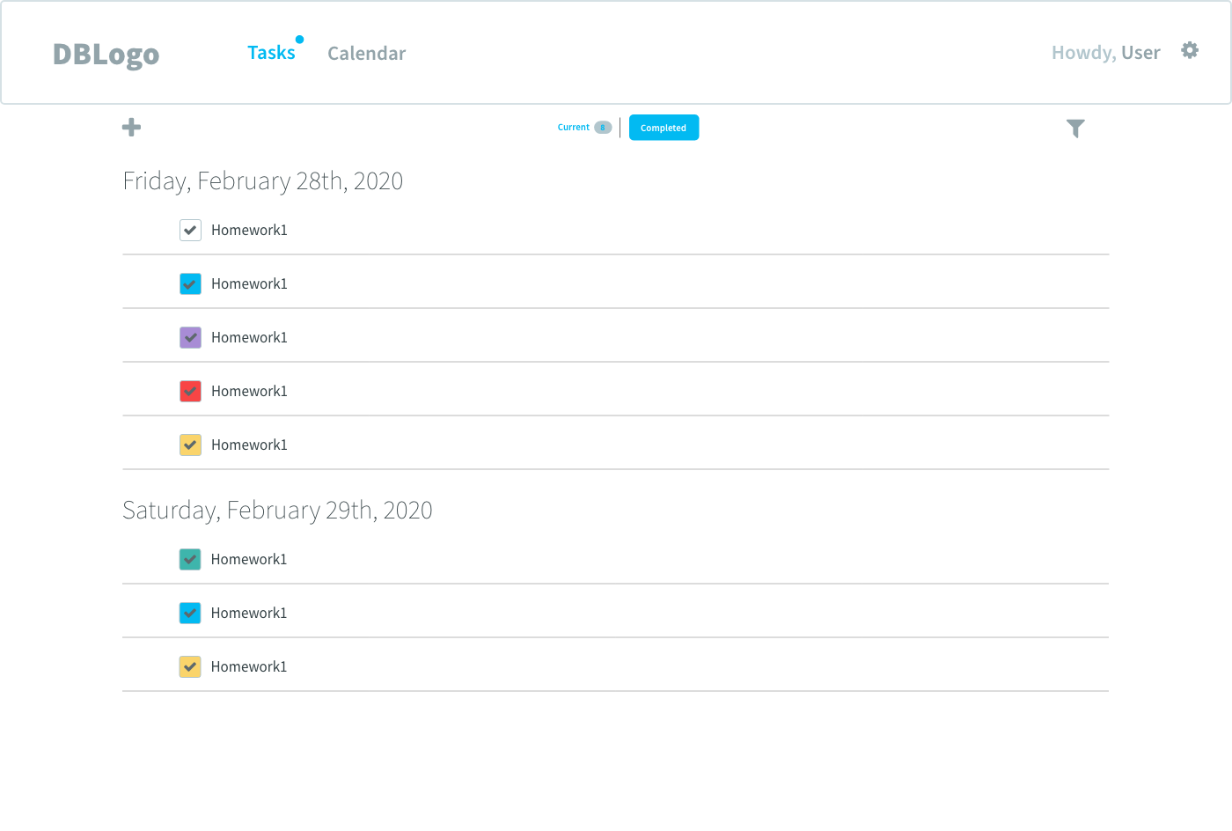
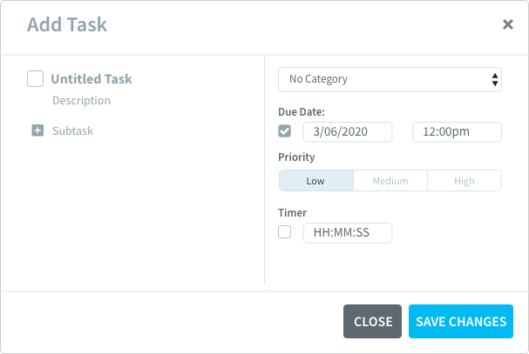
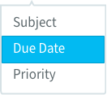
MOCKUP - LANDING
Notes:
Izzy

Slide 8
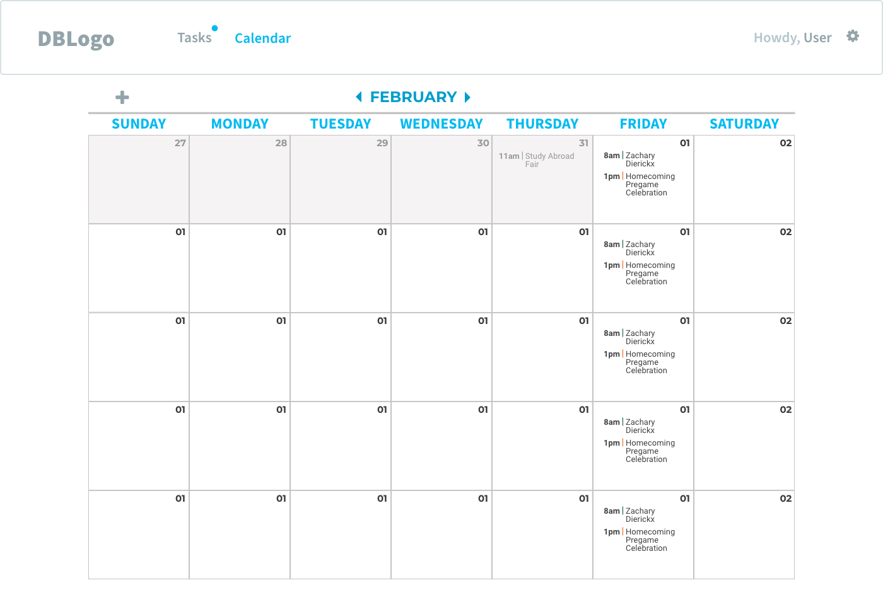
MOCKUP - CALENDAR
Notes:
Izzy

Slide 9
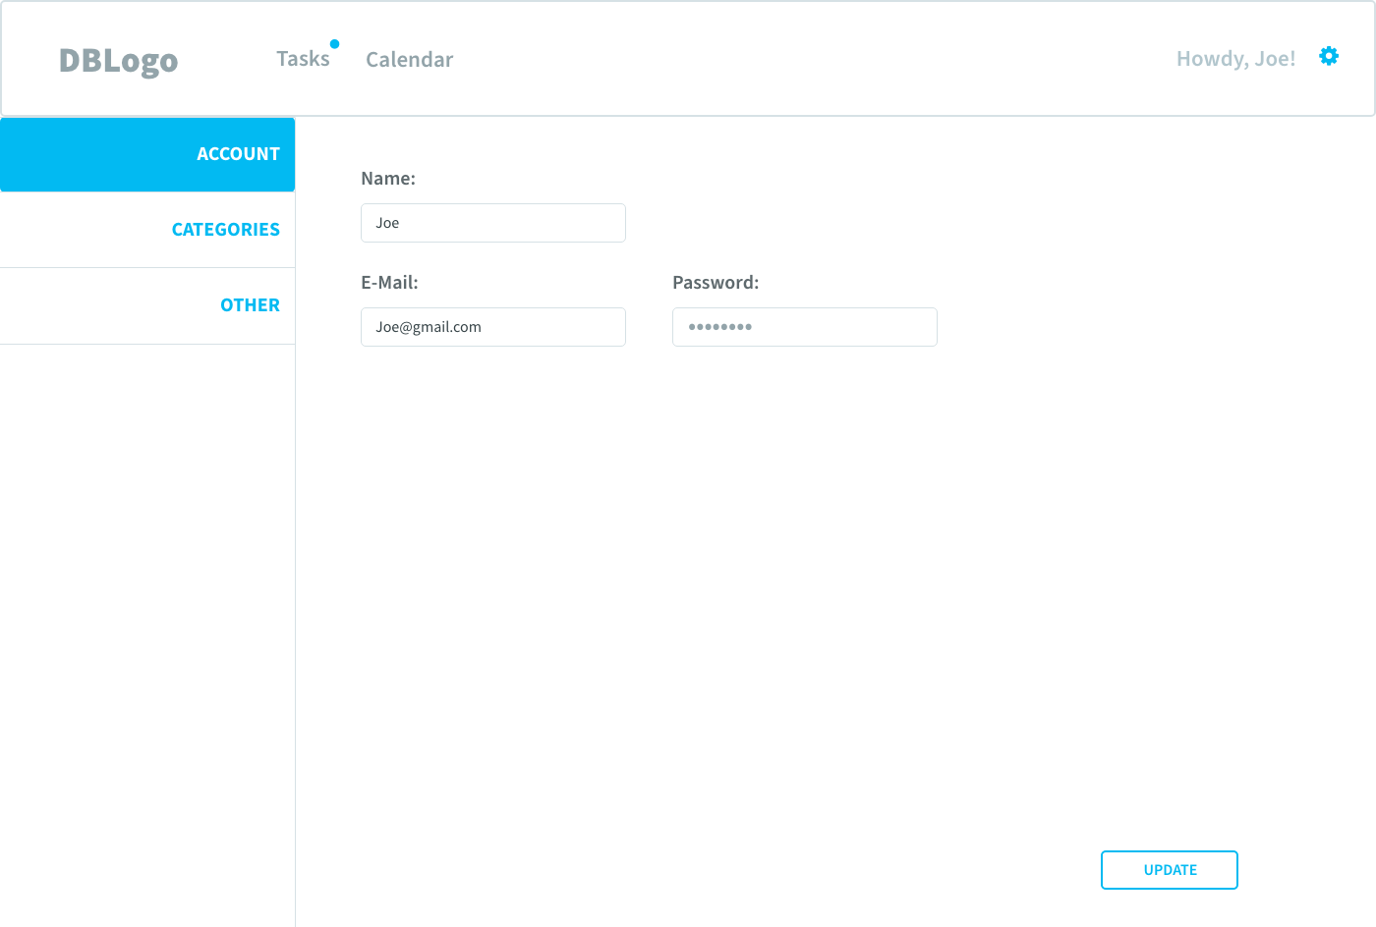
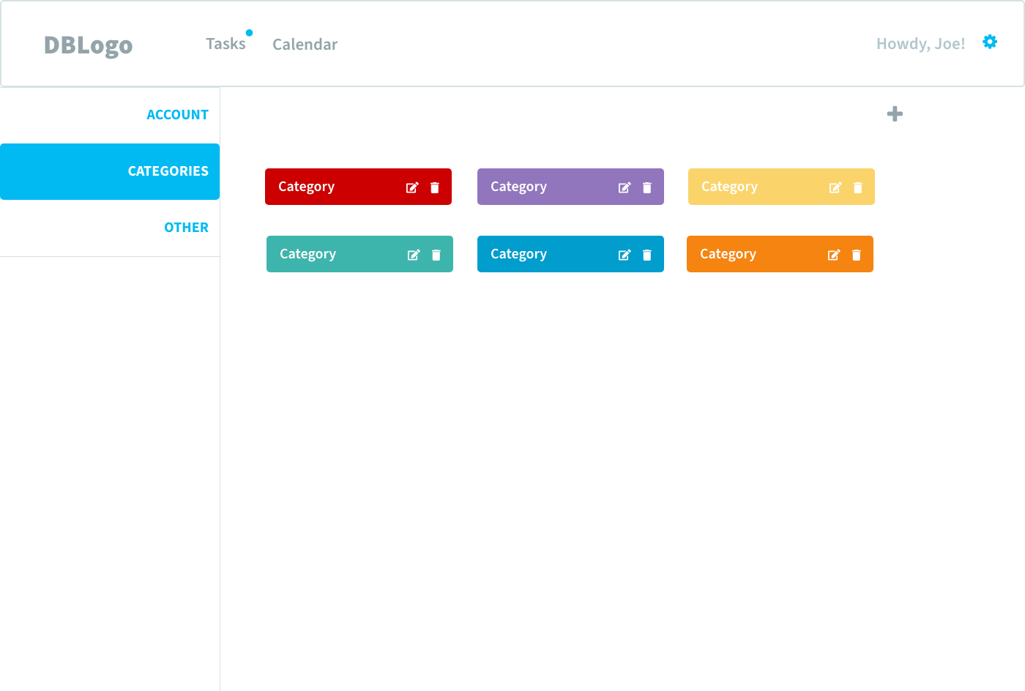
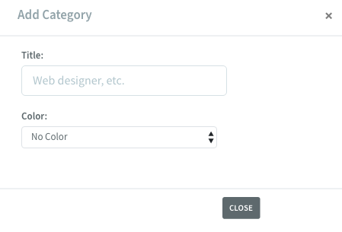
MOCKUP - SETTINGS
Notes:
Izzy

Slide 10
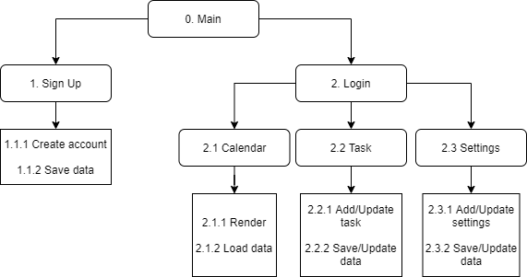
COMPONENT LEVEL SYSTEM DESCRIPTION - DESIGN APPROACH
Notes:
alessio

Slide 11
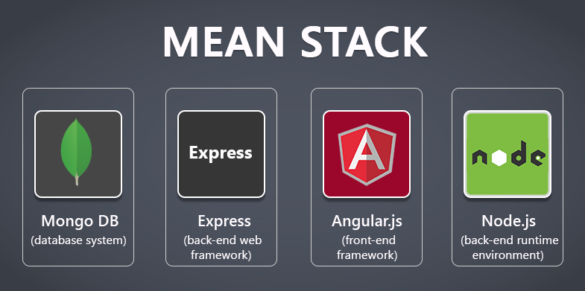
COMPONENT LEVEL SYSTEM DESCRIPTION - DESIGN APPROACH
Framework:
MEAN: Mongo + Express + Angular + Node.js
Responsive Web: jQuery + Bootstrap + Sass/Less
Notes:
alessio

Slide 12
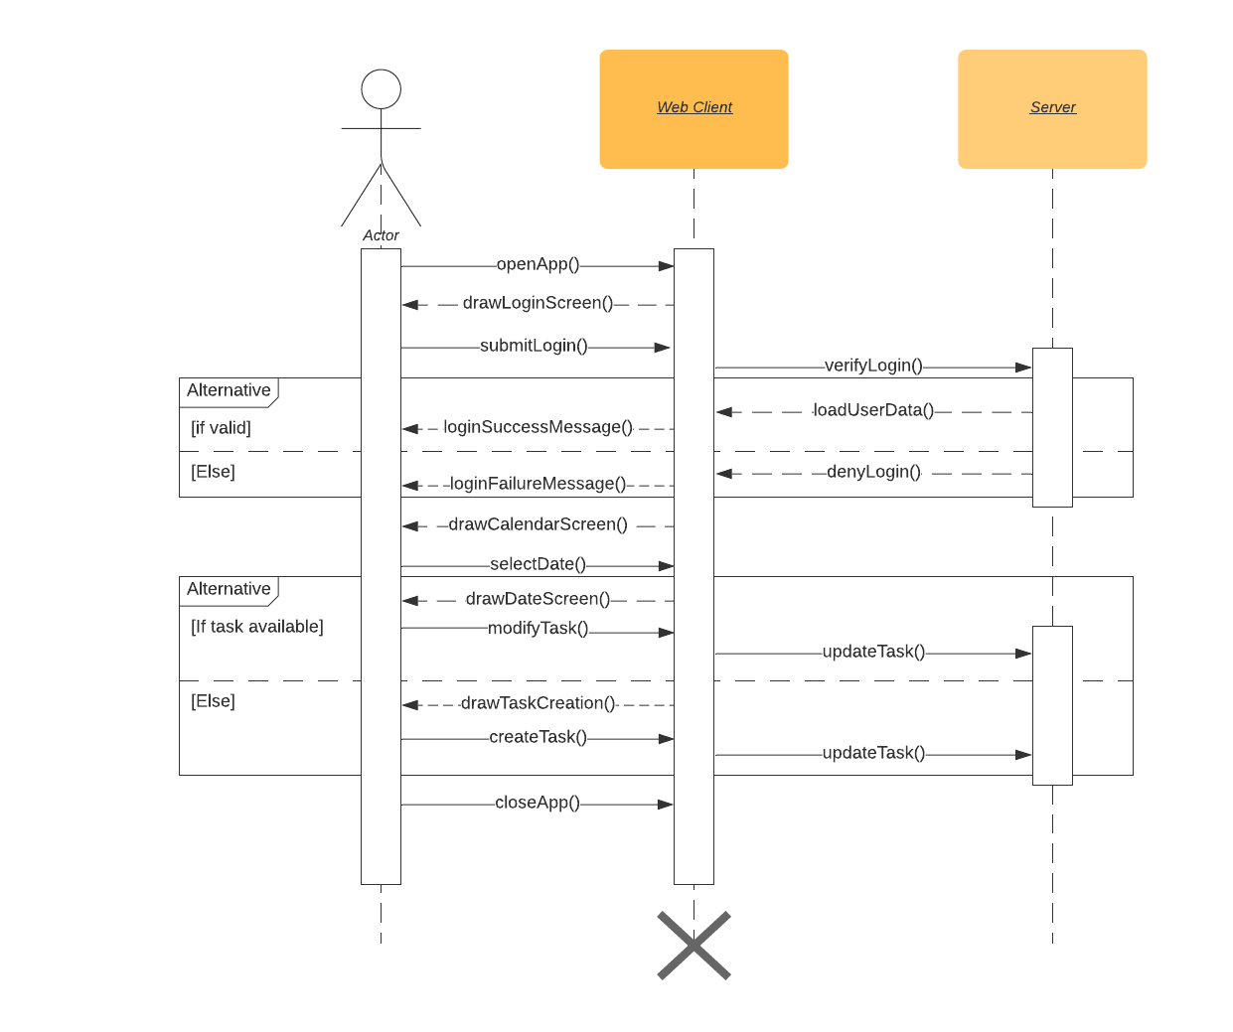
SEQUENCE DIAGRAM
Notes:
Raul

