Slide 1
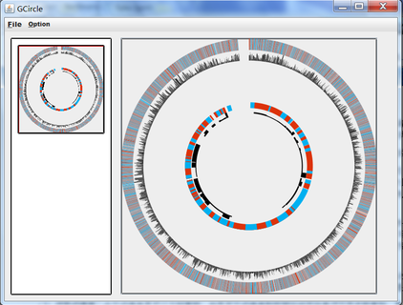

A tool that can show your genome in a special circle way with the signals.

Slide 2

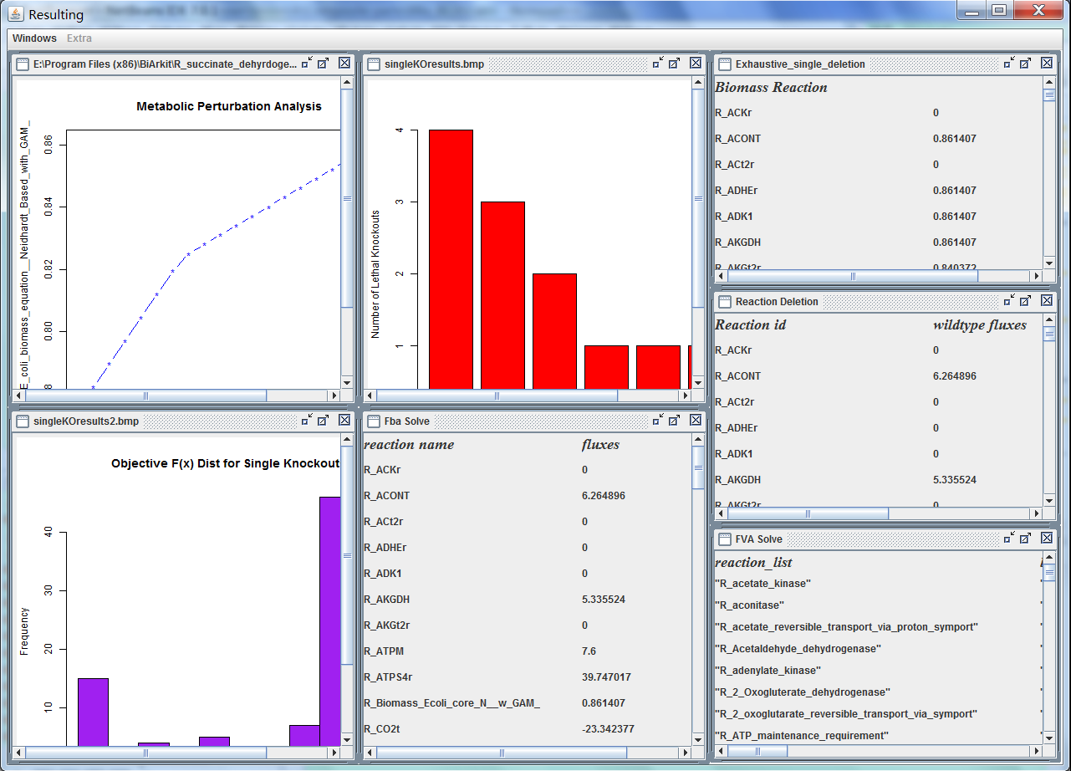
A powerful tool that can use R language to calculate the fluxes and other results –and show it in the same window for you to observe conveniently.

