Slide 1


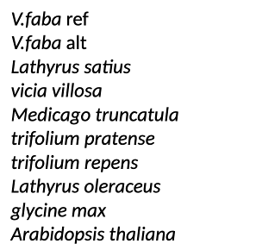
Non synonymous mutation

