Slide 1
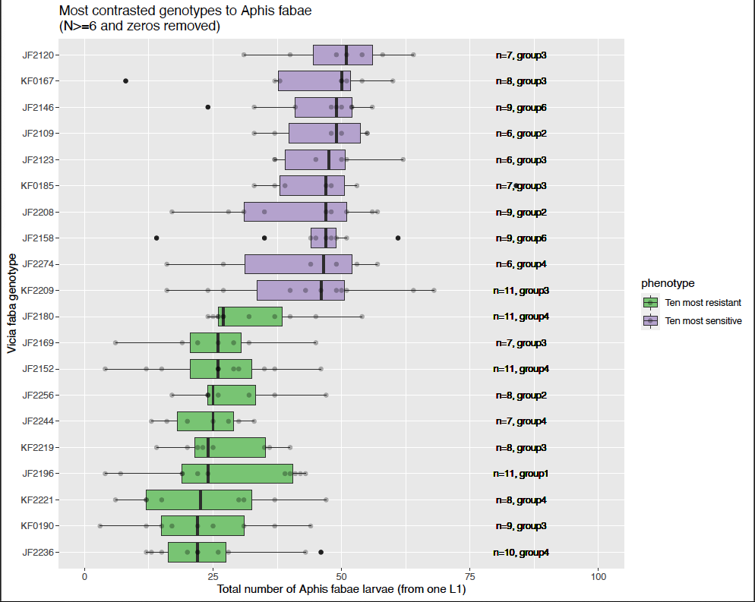
Analysis 1: N>=6 and no zeros

Slide 2
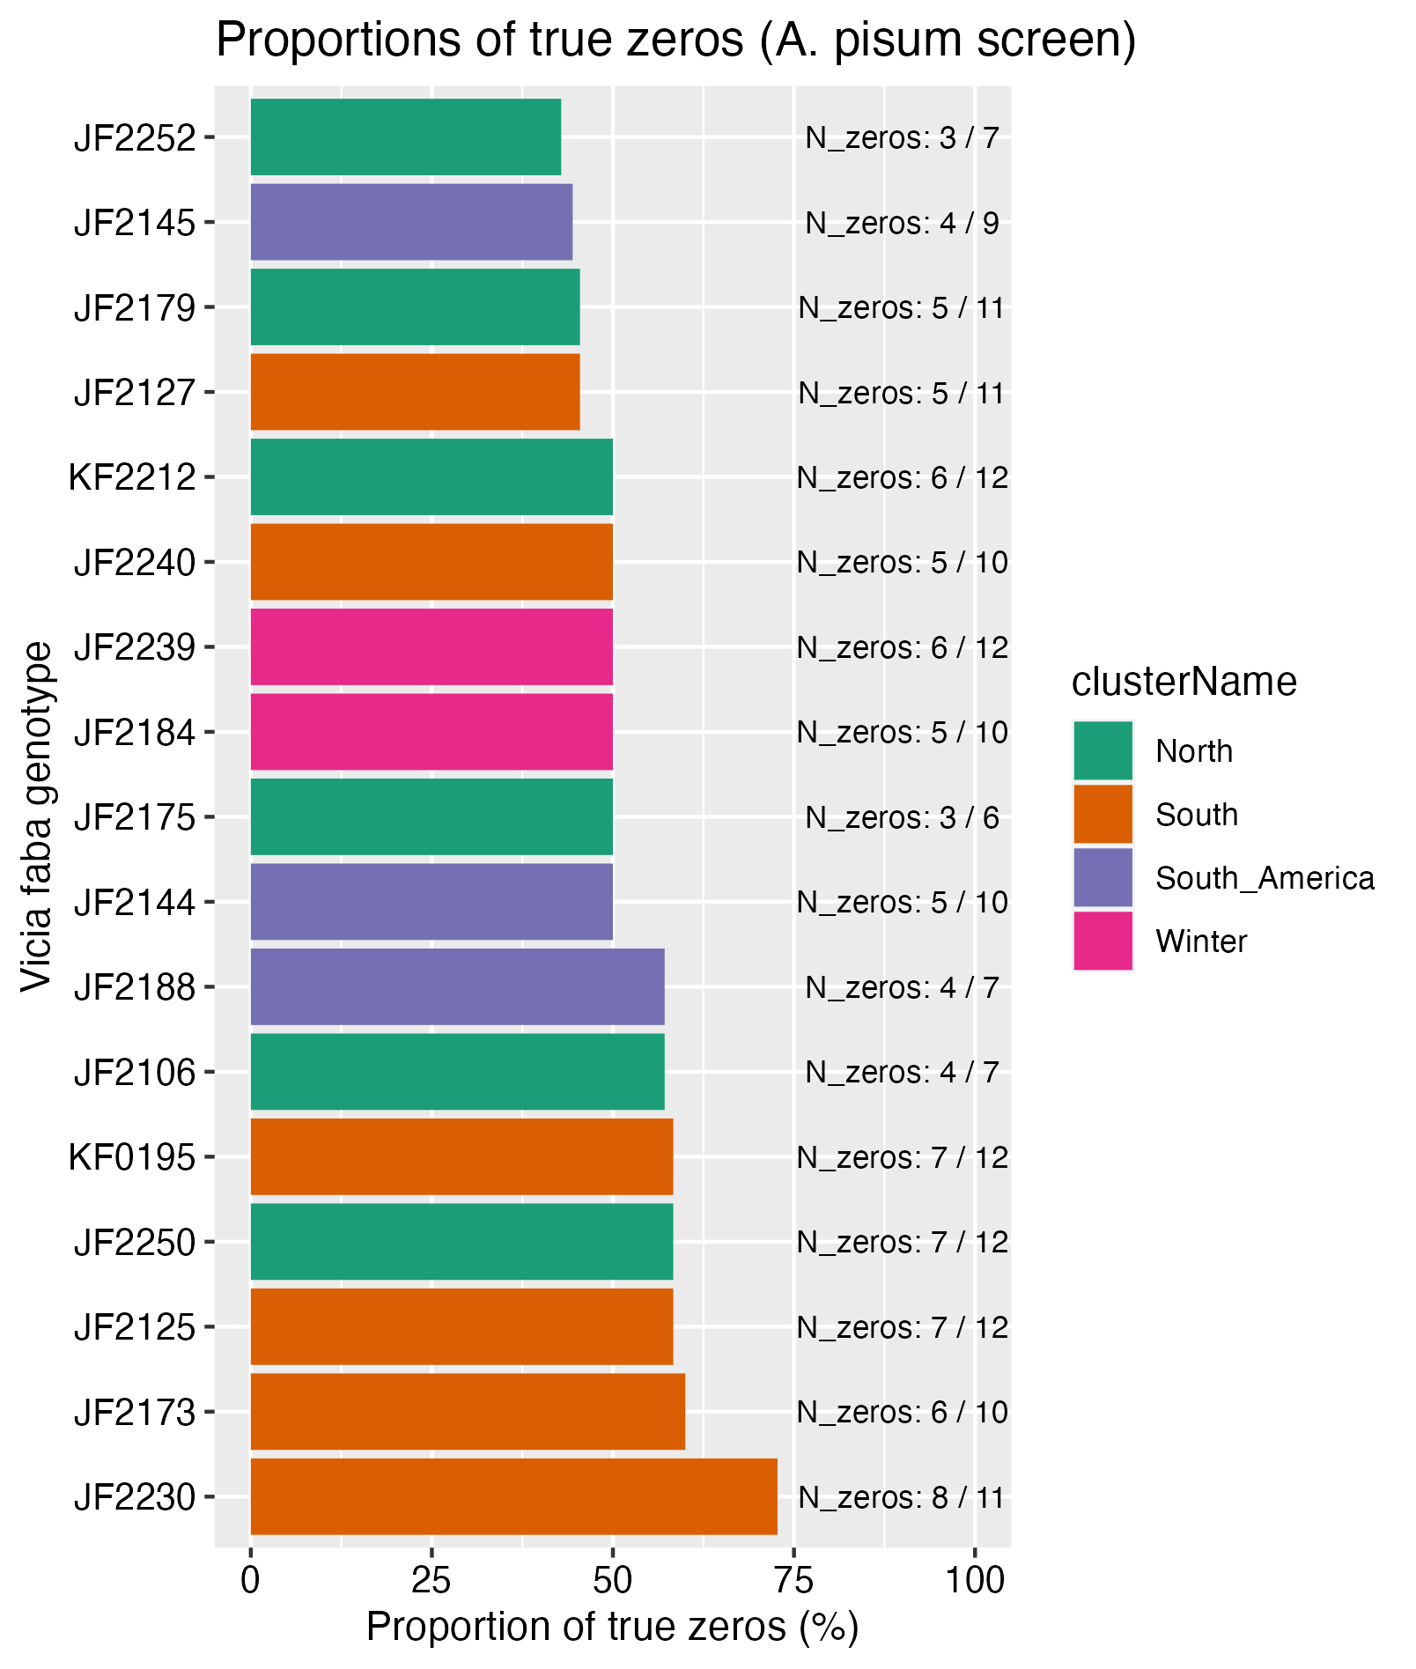
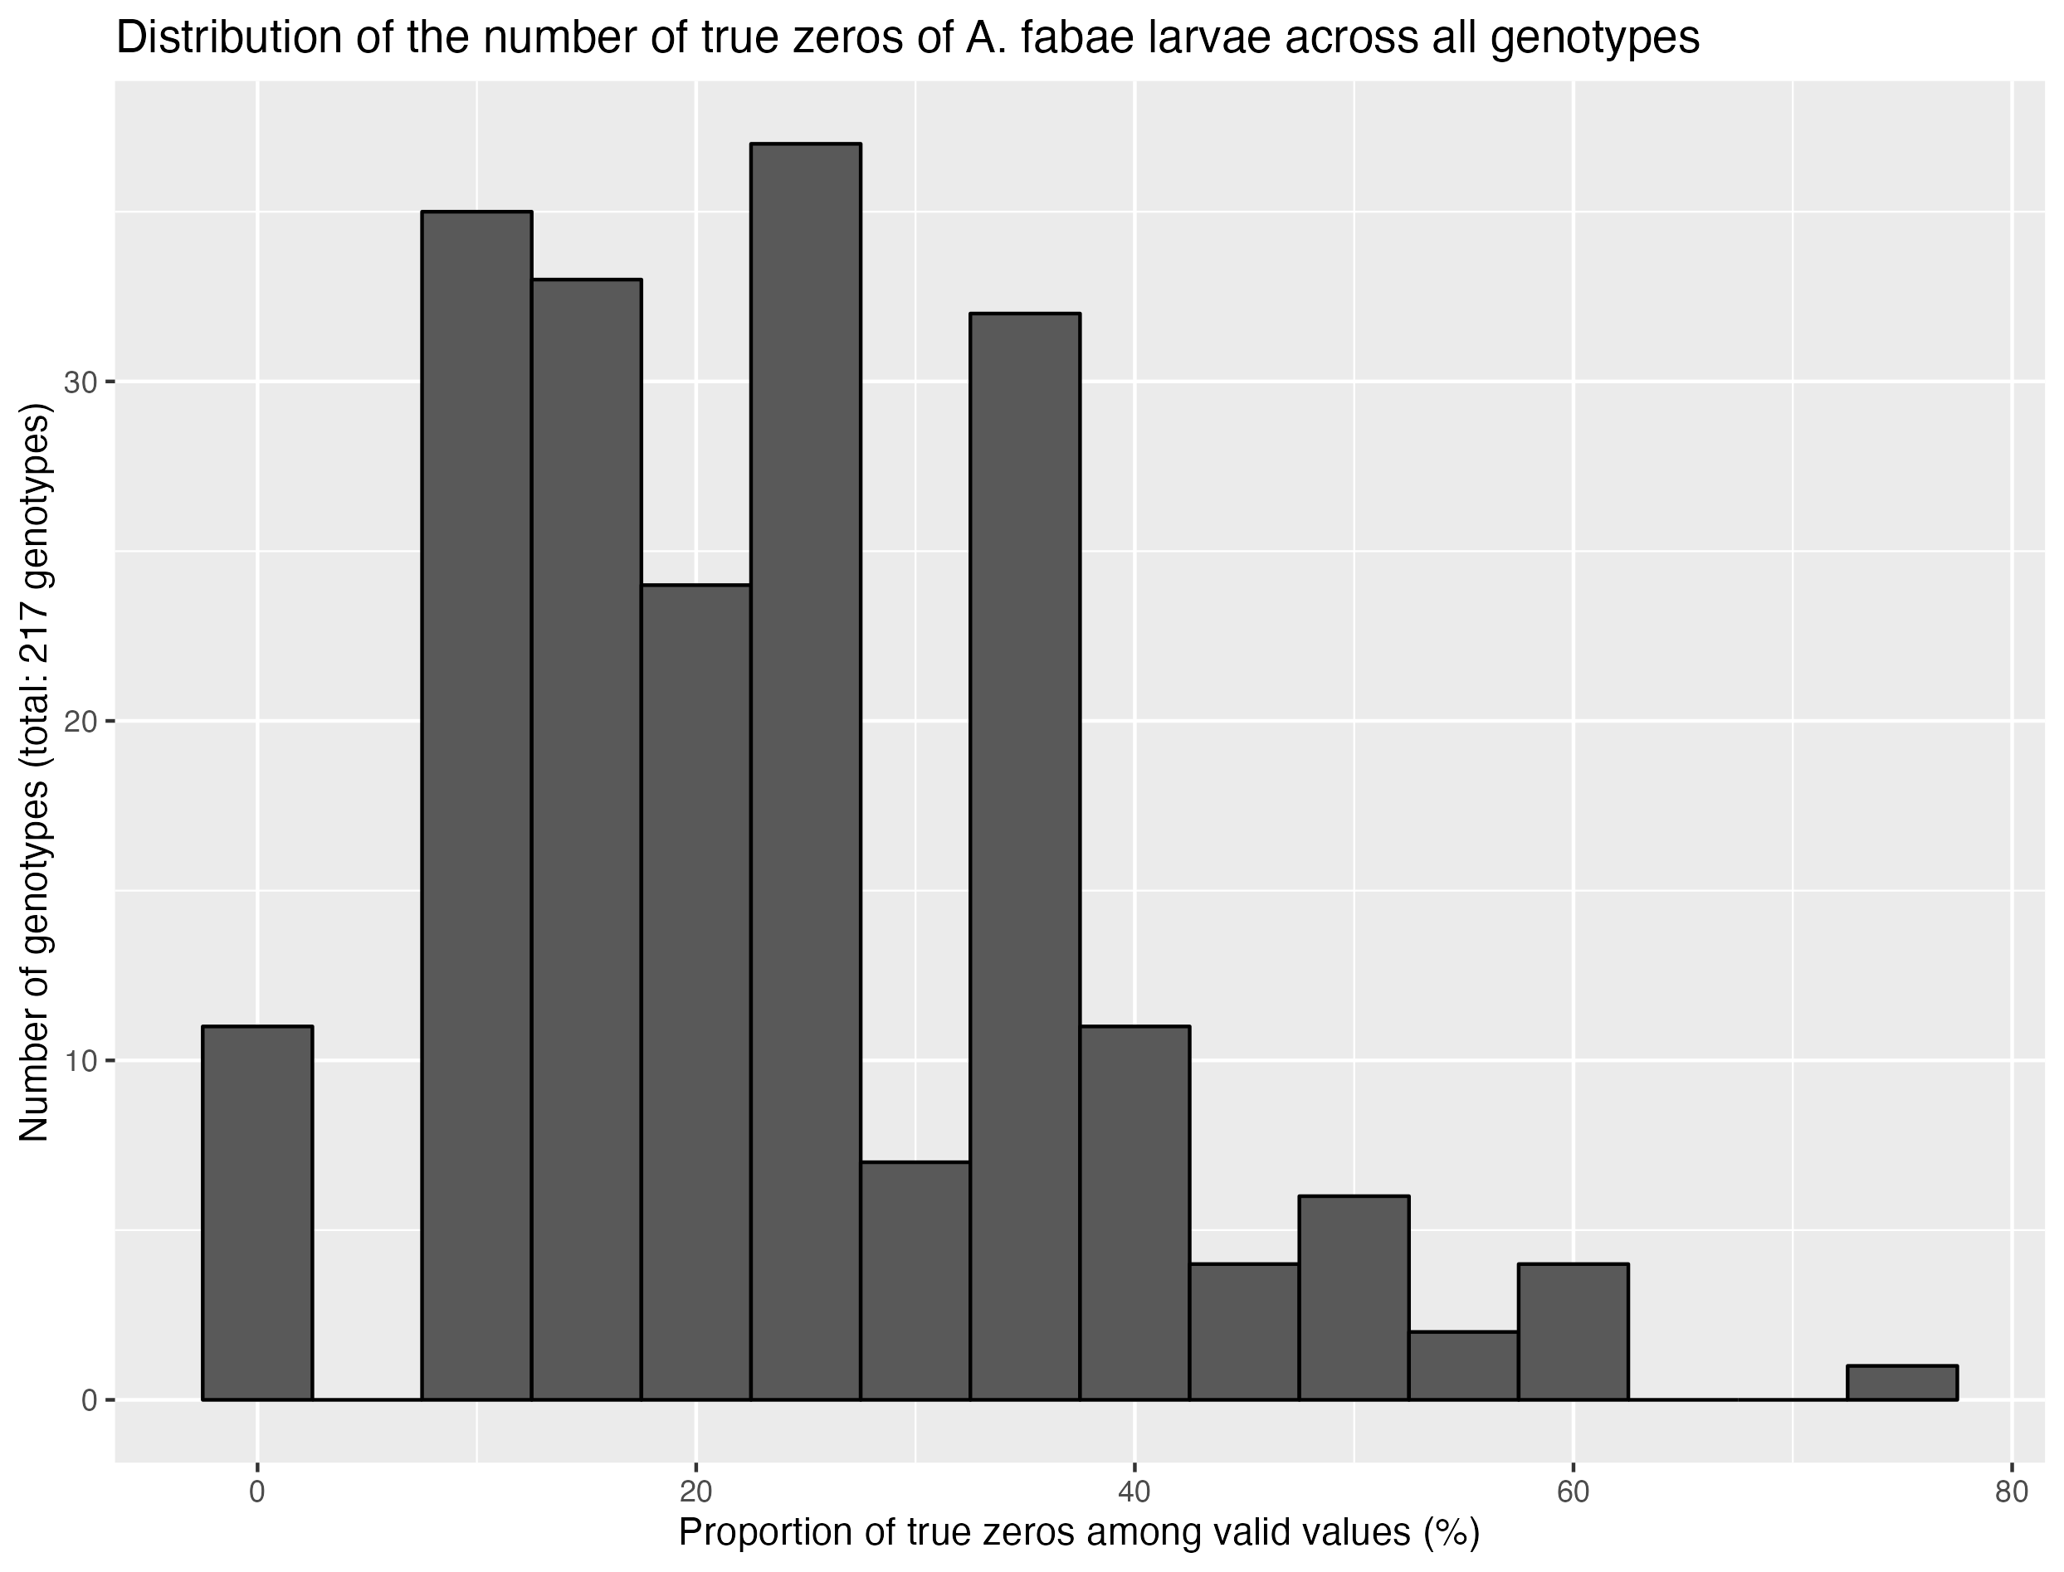
Analysis 2: nb of zeros / total values

