Slide 1
Reflexis Solution
TEAM: Code2Create
TEAM LEADER: Indraneel Ghosh(Contact: 9929862040)
OTHER MEMBER: Siddhant Kundu(Contact: 9829891415)
College: BITS Pilani, Pilani Campus

Slide 2
Problem Statement Interpretation

Slide 3
Machine Learning Interpretation
Maximise sales: Find ideal system scheduled hours to maximise sales.
Analyse effect of changes of manager scheduled hours.
Make predictions using historical data.

Slide 4
Model Used
Recurrent Neural Networks(RNN)

Slide 5
Recurrent Neural Networks(RNN)
RNN (With LSTM(Long Short Term Memory )(An integrated Machine Learning Approach)
EDA (Study and clean the given dataset, feature selection)
We have reasons to believe that the sales depend on seasonality and trends are expected to be present in the data. RNN(with LSTM) captures these trends the best.

Slide 6

Recurrent Neural Networks
The neural network has previous inputs influencing the earlier outputs., Traditional RNNs are unable to handle “long-term dependencies.”

Slide 7

LSTM(Long Short Term Memory)
LSTMs have a chain like structure, but the repeating module has a different structure. Instead of having a single neural network layer, there are four, interacting in a very special way.
Notes:
First sigmoid for forgetting, second sigmoid/tanh for updating, third sigmoid for selective output (last tanh pushes output between -1 to 1.
Humans don’t start their thinking from scratch every second. As you read this essay, you understand each word based on your understanding of previous words. You don’t throw everything away and start thinking from scratch again. Your thoughts have persistence. Traditional neural networks can’t do this, and it seems like a major shortcoming. For example, imagine you want to classify what kind of event is happening at every point in a movie. It’s unclear how a traditional neural network could use its reasoning about previous events in the film to inform later ones. Recurrent neural networks address this issue. They are networks with loops in them, allowing information to persist.

Slide 8
Bidirectional LSTM
Bidirectional networks use both past and future as context for present input.
Analogous to seasonality and trend detection in SARIMA models.
Intuition: Given an input for a Thursday, we must be able to derive its context as coming after Monday, Tuesday and Wednesday but before Friday, Saturday and Sunday. An input for February can be contextualized as coming after January but before March.

Slide 9
Assumptions
1. Maximum 12 hour work day.
2. Workers work for 7 days a week.
3. Increments made to work hours are in 0.25 intervals

Slide 10
Implementation Details
Input: Store (Store number)
RNN Model was designed using keras implementations.
#Epochs = 50
Groupby ‘Store’(Data grouped by store)
Batch Size = 8
cuDNN used to improve performance and reduce training time for the model.

Slide 11
RNN Structure
RNN Has 3 Layers of LSTM with 64 cells in each layer.
Every layer has a dropout of 0.25 to reduce overfitting.
Data is fed as a sequential time series. This Time Series contains an instance of the list [<STORE>, <MANAGER_SCHED_HOURS>, <SYSTEM_SCHED_HOURS>] for every timestamp, which for us is every day for which we have a record.
The output for this is a list giving a scaled version of the predicted value of [‘SALES_ACTUAL], between -1 and 1.
Bidirectional LSTMs have been used.

Slide 12
Final Output
A single Dense layer is used at the end for the output generation.
Output generated by RNN predicts what the ‘SALES_ACTUAL’ value would be, given the ‘MANAGER_SCHED_HOURS’, ’STORE’, ’SYSTEM_SCHED_HOURS’.
We then iterate over all possible values of ‘SYSTEM_SCHED_HOURS’ to find the optimal number of scheduled hours so as to maximise profits.
We further use this output to determine the effect of changes in manager scheduled hours.

Slide 13
Results(RNN)

Slide 14
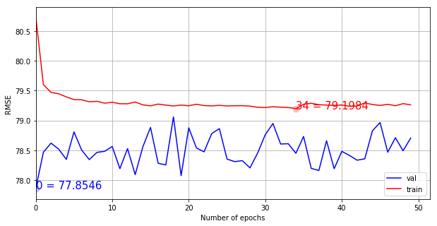
Results (Loss Values as RMSE)

Slide 15
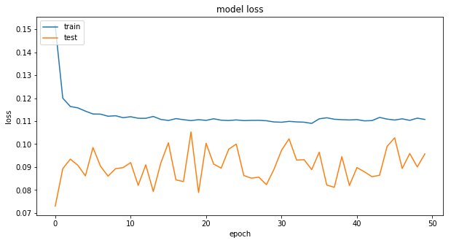
Results (Scaled loss and Model loss)

Slide 16
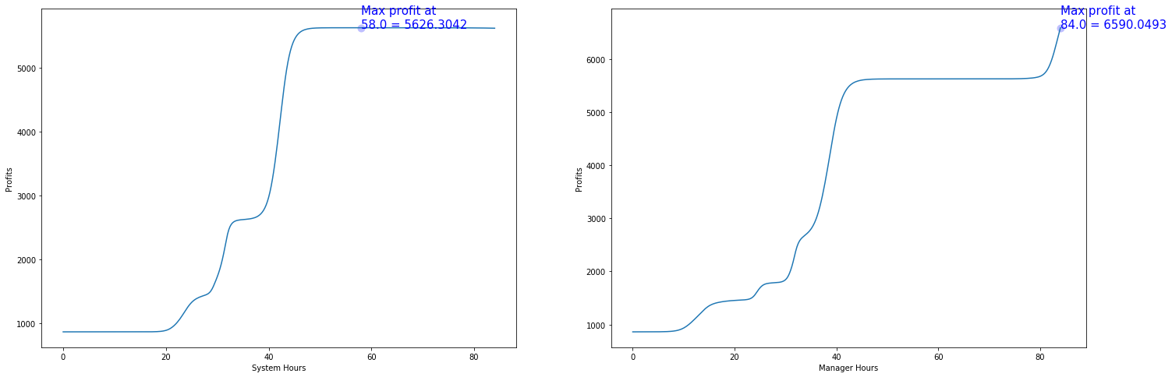
Results (Ideal Work Hour Predictions)
1st graph - loop over all possible values of ‘SYSTEM_SCHED_HOURS’ to find the value which gives maximum profits.
2nd graph - for this value of ‘SYSTEM_SCHED_HOURS’, find the value of ‘MANAGER_SCHED_HOURS’ that gives maximum profits.

Slide 17
Interpretation of Results
Profits maximization condition : 1. System Scheduled Hours = 58 Hours
2. Manager Scheduled Hours = 84 Hours

Slide 18
Our Opinions
The dataset provided is too small, which is leading to overfitting.
A larger dataset(10000+ entries for every store) can provide better results. This is because the latent features determining the results are highly dependent on the store.
The only independent factor whose relationship to system and manager scheduled hours can be mapped is the date (and by extension, the sale season). The other variables in the dataset are dependent variables, and more importantly, they are dependent on the work hours.
We have ignored climate and discount data, since due to the low amount of available data points, there is no way of establishing whether changes come because of that info or because of the location data, or because of the presence of trends or seasonality.

Slide 19
Additional Reference
Code Base
Github: https://github.com/ighosh98/aic-reflexis.git
Kaggle: https://www.kaggle.com/coder98/reflexis
[Note: For using Kaggle dataset must be uploaded by user in a zip file in the format originally given by Reflexis Systems in the problem statement. Change input directory format accordingly in the pd.read_csv statement]

Slide 20
Thank You

