Slide 1


Welcome To IGI Aviation Services Pvt. Ltd
Make Your Career In Aviation
Airport Ground Staff

Slide 2

IGI Aviation Services Private Limited - A Leading Aviation Services Provider is looking for bright, energetic Indian nationals to join as Customer Service Associate in various departments like Airport Ground Staff / VIP Lounges / Retail Outlets / Reservations / Food Courts & Cargo at Delhi Airport.

Slide 3

10+2/Above
Good Communication Skills
Pleasing Personality
Wiling to work in rotational shifts
Age -18-28

Slide 4
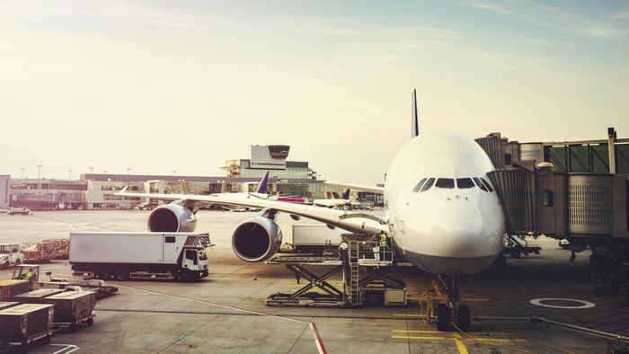
Job Profile
A candidate need to help & assist the passengers at arrival and departure at the airport.

Slide 5

Focus
Our focus is to build the estimation of our image while satisfying all commitments towards our customers and the asset who look for a fruitful career in aviation.

Slide 6

Career In Aviation
An essential performance and career management path is applied at IGI Aviation to recognize sensible however challenging goals that can be communicated in numerical terms. A honest to goodness and genuine attempt is made to accomplish those goals.

Slide 7

Selection Procedure
Interested candidates are required to appear for a written test at the venues as decided by IGI Aviation and candidates who qualify the same and fall in the applicable zone of consideration, would face a personal round of interview further.

Slide 8

Contact Us
WZ-32, 2nd Floor Raja Garden, New Delhi –110015 Near Metro Pillar No. 375
Tel. No. : 7838703994, 01145679884
Email: hiring@igiaviationdelhi.com

Slide 9

You can also do the online registration
igiaviationdelhi.com

Slide 10



IGI Aviation Services Pvt. Ltd.
IGI Aviation Services Pvt Ltd
@Igiaviation

