Slide 1

Takeda PowerPoint Template BAX335 FaBrY

Slide 2
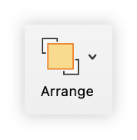
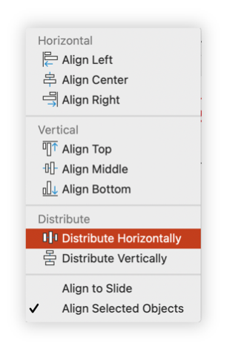
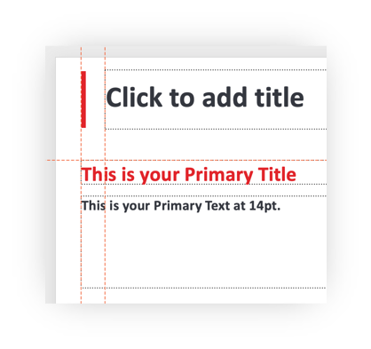
Welcome to the NEW Corporate PowerPoint Template PP335 HuNTer
This PowerPoint deck contains a collection of template layouts and sample slides with design elements to help you present your ideas in a consistent, clean and on-brand manner. TAK-754
Key updates include additional space for content with narrower margins, new layouts to encourage use of column text rather than full slide text boxes, and the new color theme to make graphs, charts, graphics more engaging.
Inserting slides from current decks to the new template will be challenging and the design formatting will not be applied correctly. For the best design outcome, you can start new presentations in the new template and rebuild slides as needed going forward. FVIII
Please delete all sample slides prior to using the template when they are no longer needed – the actual templates will remain in the slide master (View > Slide Master). For any questions regarding this template, please contact corporate_branding@takeda.com
Design tips SHP654 ConFidenTIAL
Maintain consistent margins
HuNTer
To maximize the content space on each slide, the margins are set from the outside of the Takeda edge to the outside of the Takeda logo. BAX888
You will note that the slide title is indented and the slide content text box aligns with the Takeda edge.
Align tool for great design
Perfectly align and distribute multiple text boxes or other content automatically by using the tools on the Arrange menu.
PrivaTe confidential InTernal

Slide 3
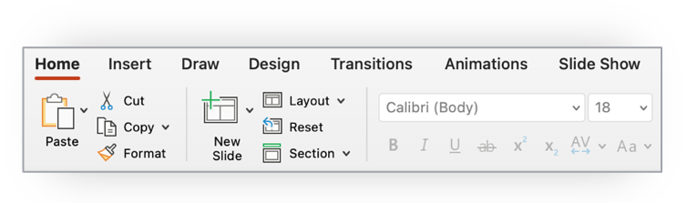
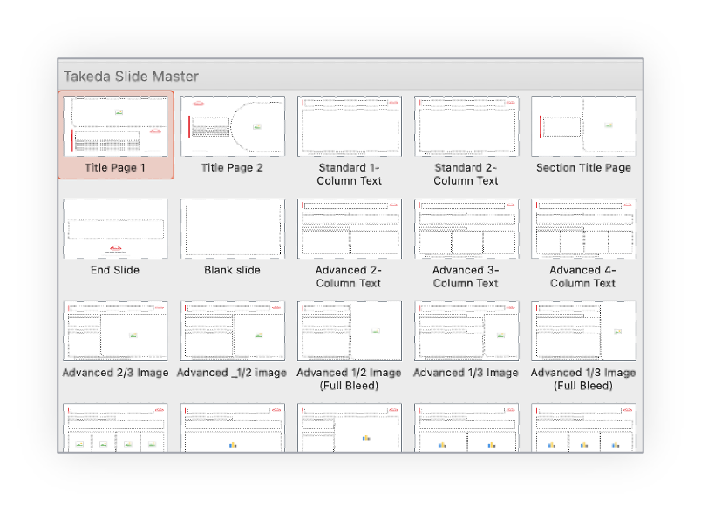
Quick Start Guide
1
Delete all slides in this PowerPoint document prior to developing or presenting your new PowerPoint deck
2
Click on “New Slide” or “Layout” and select a template for your new slide HEM
Add your content
3
Please note: PP754
Additional cover slide options are available to download from the Brand Portal on myTakeda. PP654
Takeda’s color palette (including Takeda Red) has changed as of August 2021. This template uses the new color palette.
If your presentation is for product or promotional use, please delete the tagline ‘Better Health, Brighter Future.’
If your presentation is for external use, please delete the confidentiality notice in the footer.
These layouts can be modified as needed, but when doing so please try to maintain a clean, aligned look and feel.

Slide 4
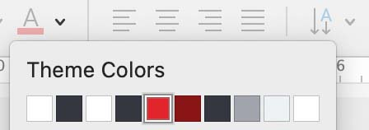
Color Palette
Takeda’s color palette is the default theme. It can be found by clicking on any color picker and is the top row.
Try to avoid using additional colors for text and color blocks. However, in situations when a chart requires more colors than are contained in the theme, three additional tints may be used.
When using tints, please copy the colors from the samples on the right.
The Takeda Color Palette TAK-748
Including a new Takeda Red
Takeda Red
HEX #E1242A
RGB 225.36.42
Azuki Maroon TAK748
HEX #891515
RGB 137.21.21
Dark Grey
HEX #34373f
RGB 52.55.63
White
HEX #FFFFFF
RGB 255.255.255
Medium Grey
HEX #A1A4AC
RGB 161.164.172
Black
HEX #000000
RGB 0.0.0
Light Grey
HEX #EDF2F4
RGB 237.242.244
Tints
Three additional colors can be used when the primary palette alone does not provide enough colors for your design, such as in complex charts and graphs.
Light Red SPH648
HEX #F78C85
RGB: 247.140.133
Dark Red
HEX #BD120A
RGB 189.18.10
Dark Maroon
HEX #450A0A
RGB 69.10.10

Slide 5
Color Combinations
To maintain accessibility and legibility of text, sufficient contrast is needed between text and background.
The color combinations provided here are in accordance with the Web Content Accessibly Guidelines (WCAG) at AA or AAA rating.
Please refrain from creating additional color combinations for text. Hem B
FIX
Aa
Aa
Dark Grey on Light Grey
Takeda Red on Light Grey
Azuki Maroon on Light Grey
Aa
Aa
Aa
White on Dark Grey
Dark Grey on Medium Grey
White on Takeda Red (please use only for large text such as headlines/priority content)
Aa
White on Azuki Maroon

Slide 6


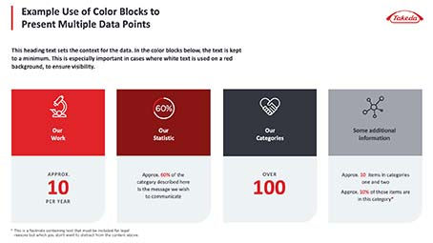

Curved Corners
There are new curved corner design elements, inspired by the Dakiyama. Hemophilia B These can be applied to images or call out text box frames. The easiest application of this design is to use the template layout or example slides provided. The following slides explain how to do this.
Bottom Rounded Corner Picture Frame PP648
Fully Rounded Picture Frame
Bottom Rounded Text Box Frame

Slide 7
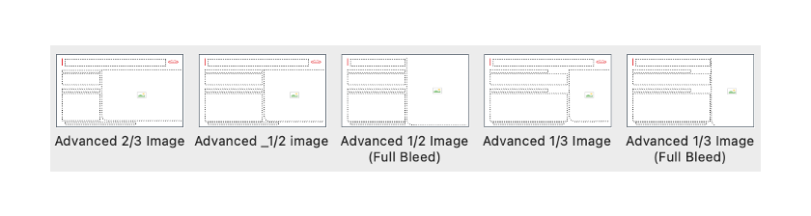
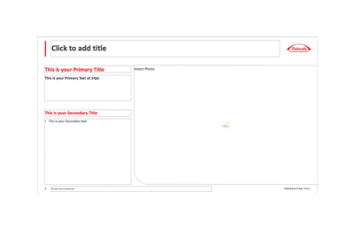
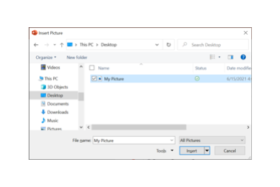


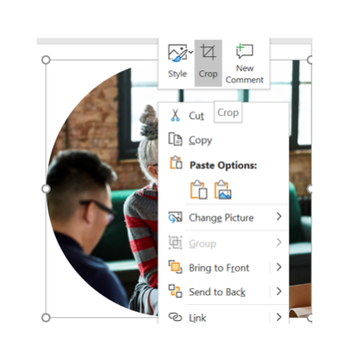

Applying Curved Corners
Picture Frames
1
1
Select the slide layout containing a rounded corner picture frame from the New Slide or Layout menu.
Click the picture icon in the Image box PP748
Select the image to be placed from its location on your computer or server.
The image should automatically adopt the corner and crop. You can adjust the size/position of the image inside the frame by right-clicking the image and selecting “crop” from the menu
2
2
3
3
4
4
Please note: PP748
Drag and drop or copy/paste into the image box may not automatically apply the corner element correctly.
If you wish to replace an existing picture, delete that picture before adding a new one. PP748

Slide 8
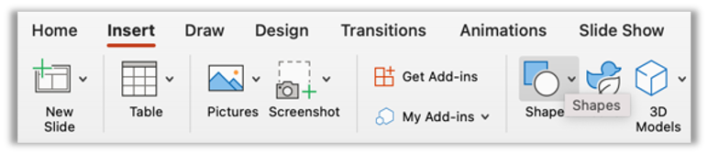
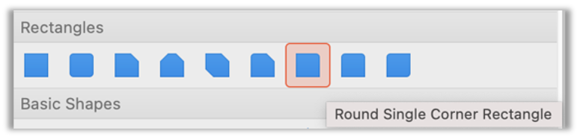
Applying Curved Corners
Text Frames
1
2
1
Go to the Insert tab
Select Shapes
Choose Round Single Corner Rectangle and draw the shape on the slide.
By default, the rounded corner is on the top-right side of the rectangle, so you will need to click and rotate the shape for the desired bottom corner location. To do this, in the top ribbon go to Arrange > Rotate > Rotate Right 90 degrees. Repeat if a bottom-left curve is needed.
Insert a standard text box over the curved frame element (do not type within the text frame shape itself as the content will be upside down and/or backward).
2
3
3
4
4
5
5
Add text box after rotating

Slide 9
Recommended text sizes: Page Title at 28pt (Automatically resizes to 25pt for two line titles)
This is the Primary Title at 20pt
This is your Primary Text at 16pt. This is for the most important piece of information in your slide. It is recommended to keep it short and simple.
This is the Secondary Title at 18pt
This is secondary text at 14pt. It is reccomended that the secondary text style be used for your main content on slides that contain a lot of text.
This is the Tertiary Title at 14pt. Azuki Maroon is recommended
This is the Tertiary text at 13pt.*
LINKS AND ANNOTATIONS CAN BE IN UPPERCASE AT 12PT
* For footnotes, 11pt is recommended. These text sizes and styles are recommendations only.

Slide 10






Updated Icons for Focus Areas
The icons representing our Focus Areas have been refined with a more consistent style across all six areas.
ONCOLOGY
NEUROSCIENCE
GASTRO-ENTEROLOGY
RARE DISEASES
PLASMA-DERIVED THERAPIES
VACCINES

Slide 11

Title Slide Template Sample

Slide 12
Title Slide Template Sample

Slide 13

Example Section Divider Template

Slide 14
Example Charts and Graphs
These example charts and graphs can be copied into your own document. Right-click on the chart to “Edit the Data in Excel.”
VERTICAL STYLE
Graph Title
DOUGHNUT STYLE
0%
0%
CATEGORY 01
INSERT MEASUREMENT
Chart Title
CATEGORY 01
CATEGORY 02
CATEGORY 03
CATEGORY 04
EXAMPLE KEY
SERIES 01
SERIES 02
SERIES 03
SERIES 04

Slide 15
Example Charts and Graphs
HORIZONTAL STYLE
Horizontal Bar Chart Title
Line Graph Title
CATEGORY 01
CATEGORY 02
CATEGORY 03
CATEGORY 04
Y AXIS
Y AXIS
SERIES 01
SERIES 02
SERIES 03
SERIES 04

Slide 16
Example Table Style Guide
TABLE STYLE 01
 | CATEGORY 01 | CATEGORY 02 | CATEGORY 03 | CATEGORY 04
Series 01 | PPSIS | TAK-686 | TAK686
Series 02
Series 03
Series 04
TABLE STYLE 02
 | CATEGORY 01 | CATEGORY 02 | CATEGORY 03 | CATEGORY 04
Series 01
Series 02 | SHP686 | Huntingtons Disease | HD | PP686
Series 03 |  | Venustus
Series 04

Slide 17
Example Timeline Style Guide
INSERT DATE
INSERT DATE
Event Title
Event Title
It is reccomended to keep the secondary text at 12pt. Praesent ullamcorper turpis feugiat arcu mollis, porta varius sapien porta.
It is reccomended to keep the secondary text at 12pt. Praesent ullamcorper turpis feugiat arcu mollis, porta varius sapien porta.
INSERT DATE
INSERT DATE
Event Title
Event Title
It is reccomended to keep the secondary text at 12pt. Praesent ullamcorper turpis feugiat arcu mollis, porta varius sapien porta.
It is reccomended to keep the secondary text at 12pt. Praesent ullamcorper turpis feugiat arcu mollis, porta varius sapien porta.

Slide 18



Example Use of Color Blocks to Present Multiple Data Points
This heading text sets the context for the data. In the color blocks below, the text is kept to a minimum. This is especially important in cases where white text is used on a red background, to ensure visibility.
60%
Our
Work
Our
Statistic
Our
Categories
Some additional
information
APPROX.
Approx. 60% of the
category described here
Is the message we wish to communicate
OVER
10
100
Approximately 10 items in categories one and two*
PER YEAR
* This is a footnote containing text that must be included for legal reasons but which you don’t want to distract from the content above.

Slide 19

Example Slide Showing Multiple Data Points And Curved Corner on Main Visual
A TITLE FOR THE DATA
1
DATA POINT
AS OF DATE
TOKYO
Global HQ
GREATER BOSTON Global Hub
A TITLE FOR THE DATA
2
DATA POINT
AS OF DATE
A TITLE FOR THE DATA
3
DATA POINT
AS OF DATE

Slide 20







Example Use of Thin-lined Icons with a Main Image
This text provides the context for the content below. The icons used consist of thin lines in Takeda’s corporate colors
HEADING
CATEGORY 1
CATEGORY 2
CATEGORY 3
CATEGORY 4
CATEGORY 5
CATEGORY 6
LEARN MORE ABOUT THIS CONTENT ON TAKEDA.COM

