Slide 1

Fabry GT – NaCl addition at harvest
Andreas Maccani
Viral Vector Pilot Plant Downstream
Biotherapeutics Process Development
08 May 2023

Slide 2
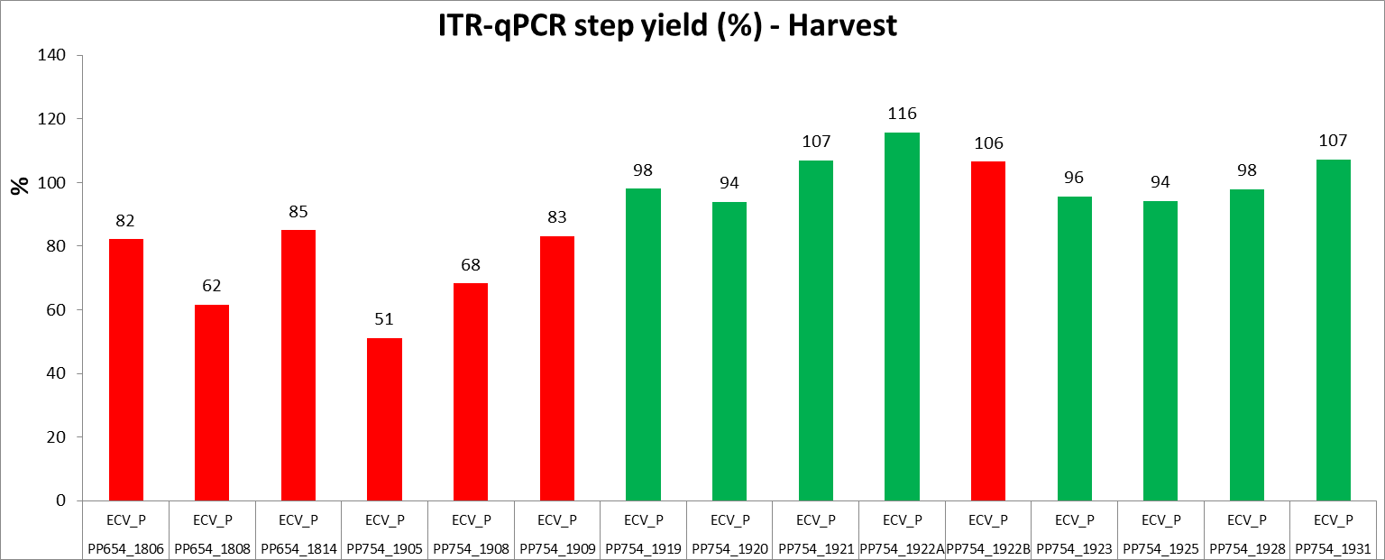
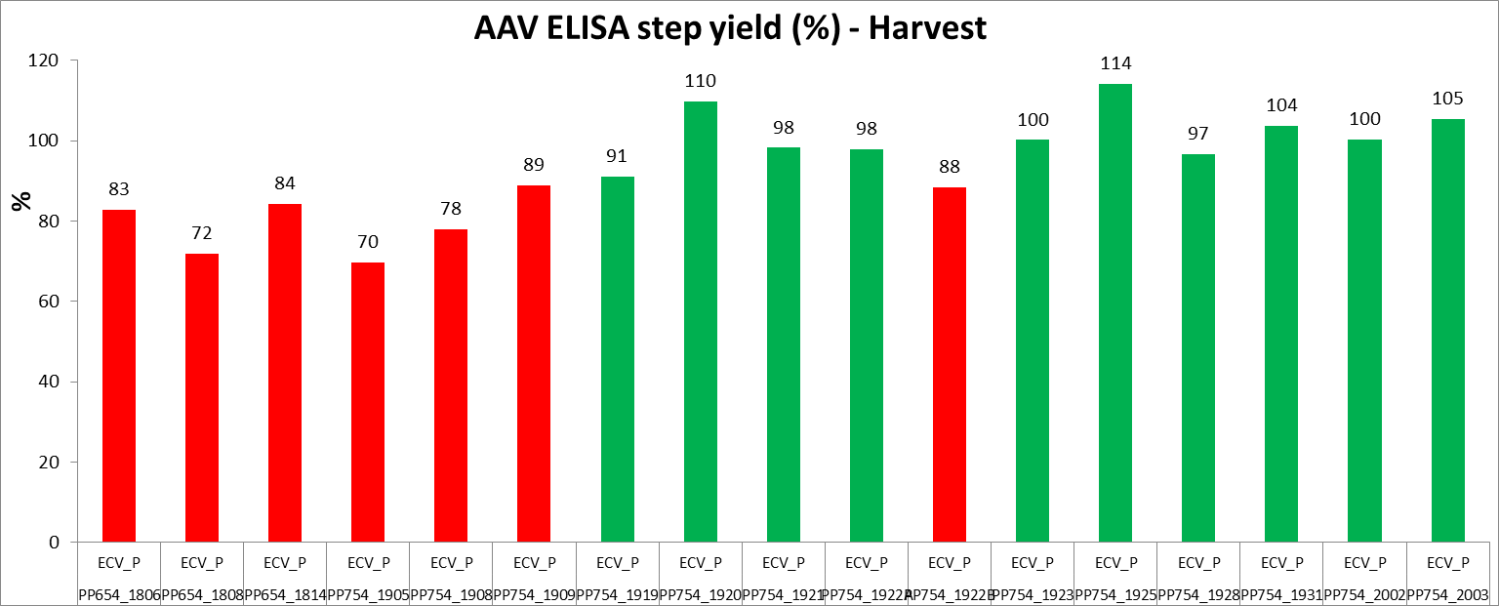
Background – TAK-754
Analysis of TAK-754 Ph1/2 Mfg batches showed significant yield differences
Six-sigma green belt project Michaela Wieshaupt → root cause analysis → impact of depth filter (Pall P900) lot-to-lot variation
Correlation of yield with Ca²⁺ and Mg²⁺ content of filter medium. Filters with Ca²⁺ > 130 mg/m² showed negative impact → Retention of full capsids because of higher pos. filter charge.
➔ Addition of NaCl to reduce AAV capsid retention in depth filter
TAK-754 (GT FVIII) 200L Pilot Scale (red: w/o NaCl, green: with NaCl)
➔ Higher harvest step yields with 128mM NaCl addition

Slide 3
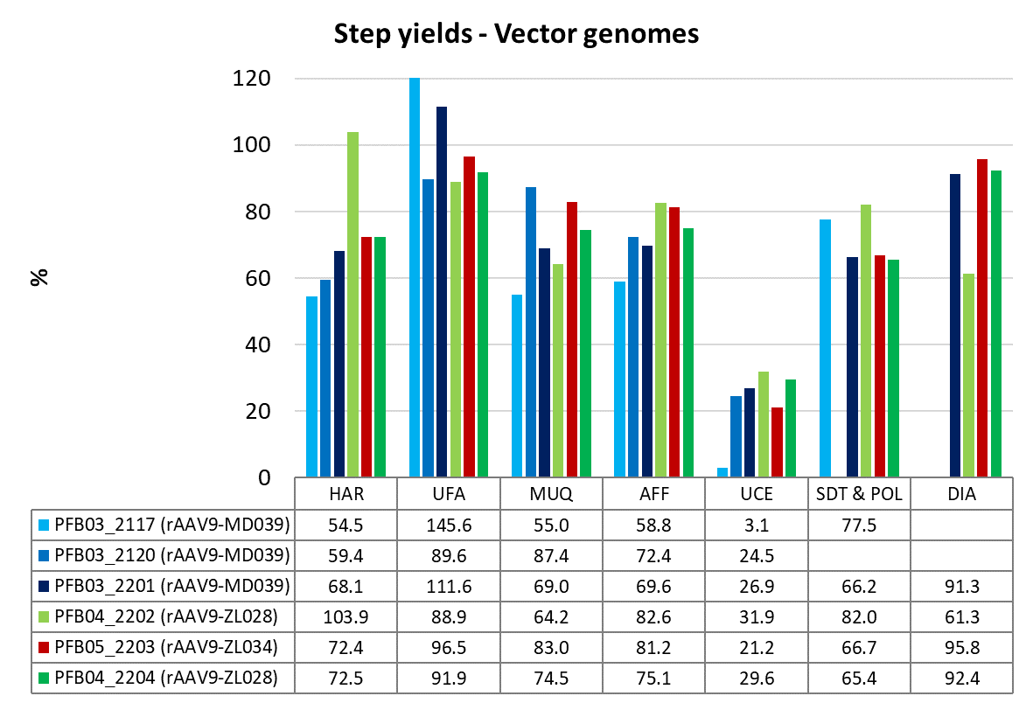
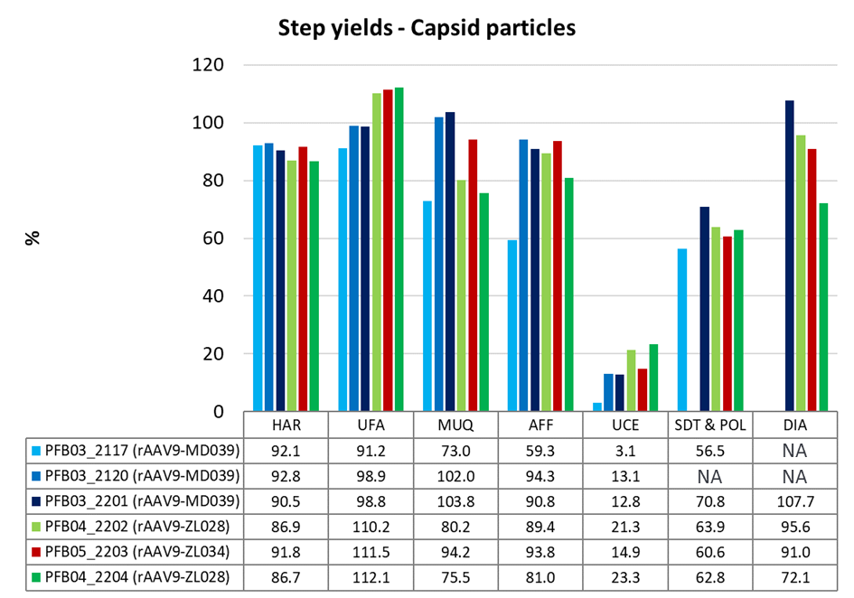
Background – Fabry GT NHP Production
TechTeam
08 Aug 2022
HAR filter setup 200L scale:
2 m² PDP8 + 2 m² V100 (Pall)
No NaCl addition
Vg step yield at HAR only around 60 – 70%
➔ Potential yield increase by NaCl addition

Slide 4
Overview – TAK-028 200L Pilot Scale Production (Tox Process)
Batch ID | PFB04_2212 | PFB04_2213 | PFB04_2214 | PFB04_2215 | PFB04_2216 | PFB04_2217 | PFB04_2226 | PFB04_2227
Bioreactor FMB (200L SUB) | Pall | Sartorius | Sartorius | Pall | Sartorius | Pall | Pall | Sartorius
Transfection mix medium | FAA (DMEM) | FAB (DMEMF12) | FAA (DMEM) | FAA (DMEM) | FAA (DMEM) | FAB (DMEM/F12) | FAA (DMEM) | FAA (DMEM)
Salt addition at harvest | w/o NaCl | w/o NaCl | w/o NaCl | w/o NaCl | w/o NaCl | w/o NaCl | 135 mM NaCl | 135 mM NaCl
Comments | - | - | - | No pH dead band after transfection | - | - | - | .
Batch ID | PFB04_2212 | PFB04_2214 | PFB04_2216 | PFB04_2226 | PFB04_2227
Bioreactor FMB (200L SUB) | Pall | Sartorius | Sartorius | Pall | Sartorius
Transfection mix medium | FAA (DMEM) | FAA (DMEM) | FAA (DMEM) | FAA (DMEM) | FAA (DMEM)
Salt addition at harvest | w/o NaCl | w/o NaCl | w/o NaCl | 135 mM NaCl | 135 mM NaCl
Comments | - | - | - | - | .
Both upstream production lines (Sartorius and Pall SUBs) were used to meet the timelines. ➔ impact on yield
Evaluation of transfection mix media DMEM low glucose (not yet qualified) and DMEM/F12 Baxter Special (qualified material) ➔ impact on yield
Evaluation of salt addition at harvest (135 mM NaCl) to improve depth filtration step yield
To reduce impact of filter charge (lot-to-lot variability)

Slide 5
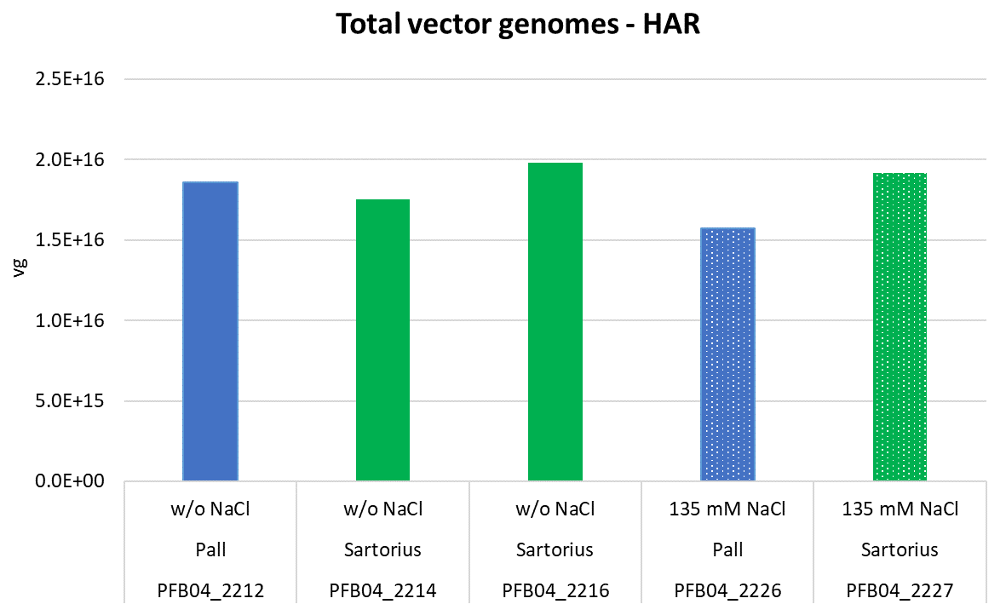
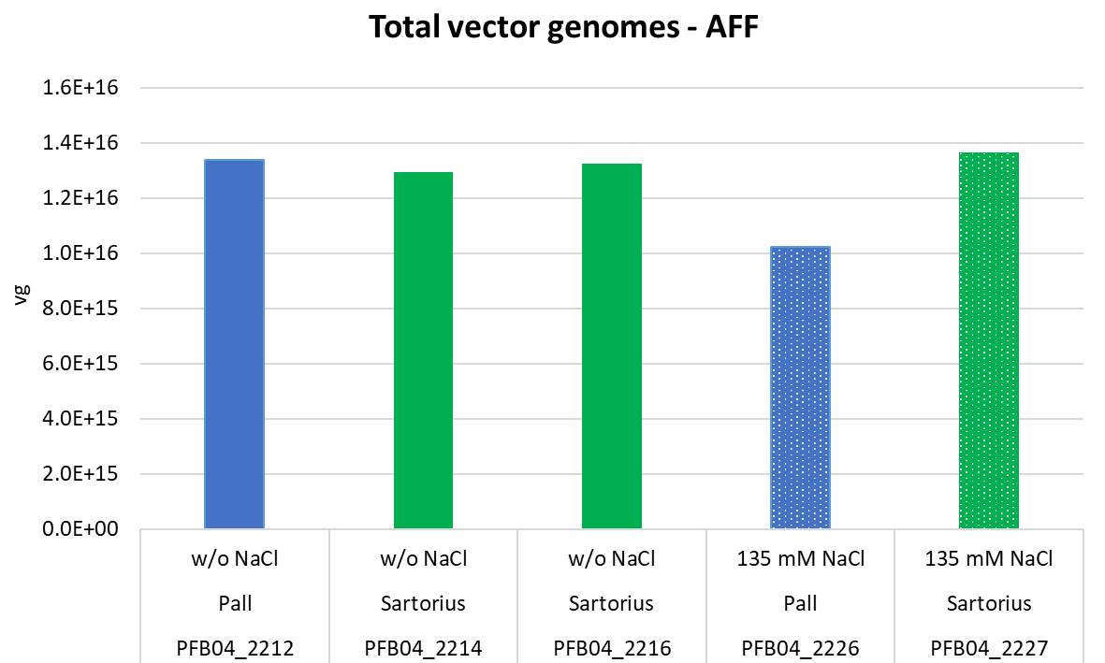
Vector Genome Yields (IDT ddPCR)
Batch ID | PFB04_2212 | PFB04_2214 | PFB04_2216 | PFB04_2226 | PFB04_2227
Bioreactor FMB (200L SUB) | Pall | Sartorius | Sartorius | Pall | Sartorius
Salt addition at harvest | w/o NaCl | w/o NaCl | w/o NaCl | 135 mM NaCl | 135 mM NaCl
No impact of NaCl addition on total vg yield (IDT ddPCR) visible

Slide 6
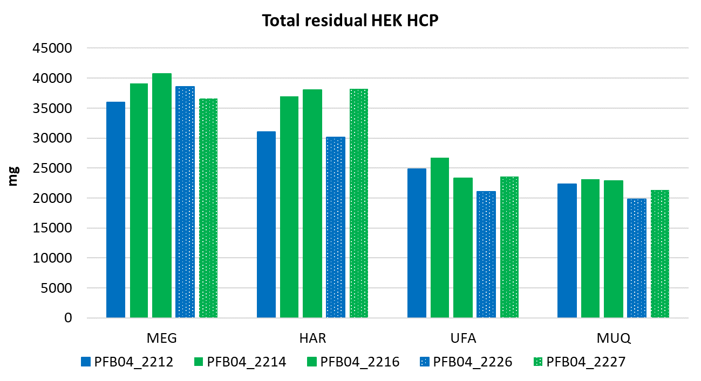
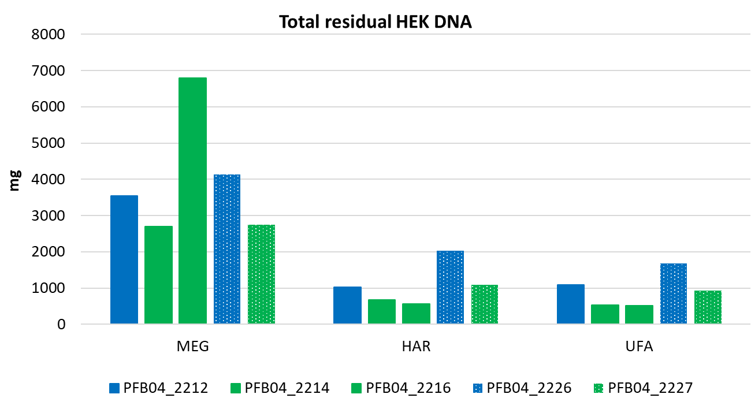
Impurities
Batch ID | PFB04_2212 | PFB04_2214 | PFB04_2216 | PFB04_2226 | PFB04_2227
Bioreactor FMB (200L SUB) | Pall | Sartorius | Sartorius | Pall | Sartorius
Salt addition at harvest | w/o NaCl | w/o NaCl | w/o NaCl | 135 mM NaCl | 135 mM NaCl
Similar amounts of residual HEK-HCP impurities with and w/o NaCl addition
Potentially, slightly higher amounts of residual HEK-DNA with NaCl addition

Slide 7
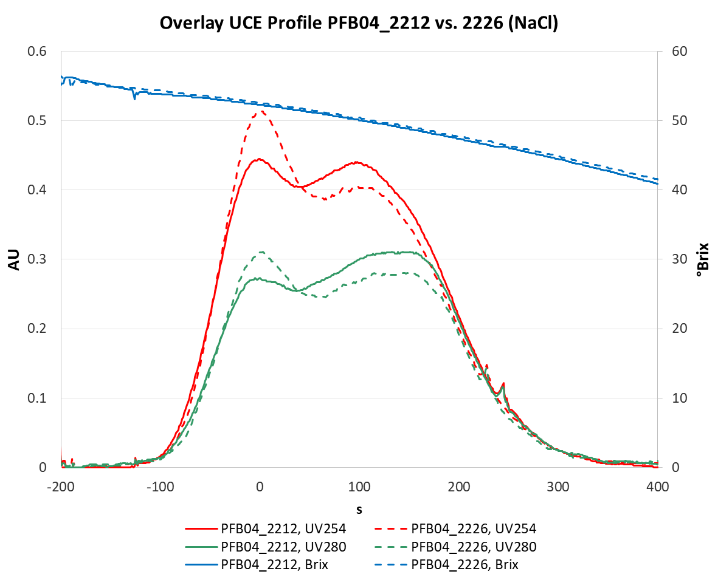
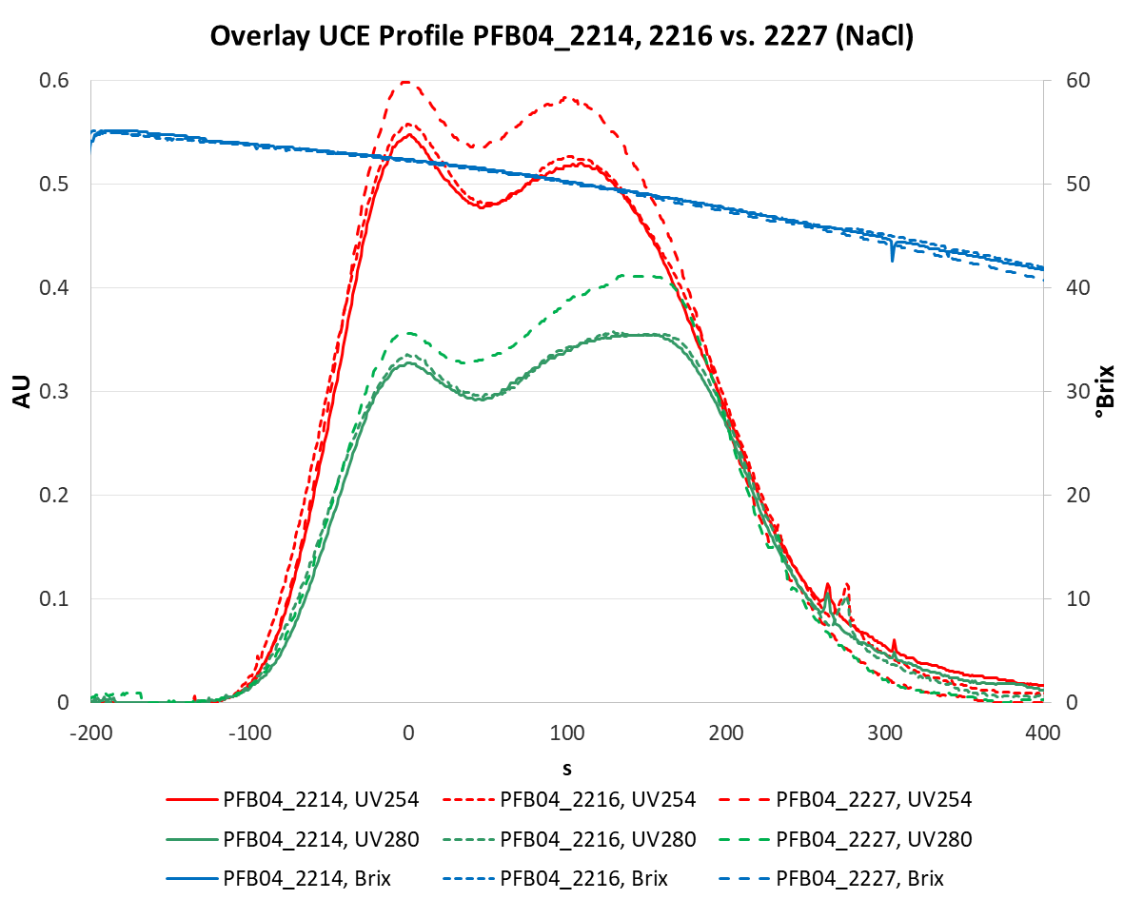
Ultracentrifugation (UCE)
Batch ID | PFB04_2212 | PFB04_2214 | PFB04_2216 | PFB04_2226 | PFB04_2227
Bioreactor FMB (200L SUB) | Pall | Sartorius | Sartorius | Pall | Sartorius
Salt addition at harvest | w/o NaCl | w/o NaCl | w/o NaCl | 135 mM NaCl | 135 mM NaCl
Pall runs: Shift to more full capsids with NaCl
Sartorius runs: Higher peak with NaCl

Slide 8
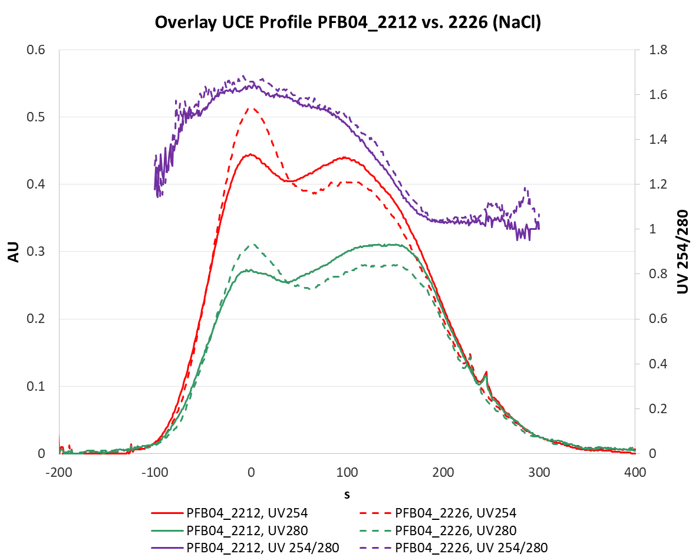
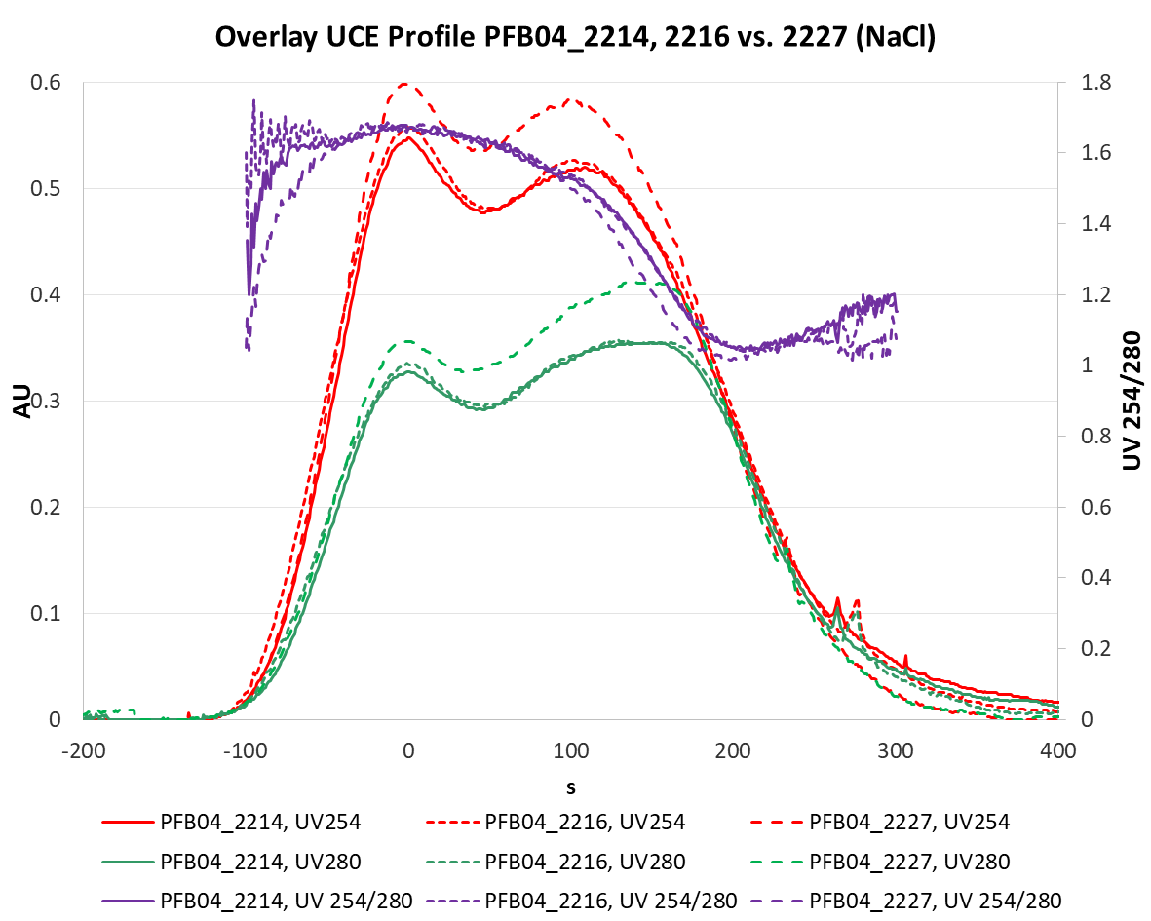
Ultracentrifugation (UCE)
Batch ID | PFB04_2212 | PFB04_2214 | PFB04_2216 | PFB04_2226 | PFB04_2227
Bioreactor FMB (200L SUB) | Pall | Sartorius | Sartorius | Pall | Sartorius
Salt addition at harvest | w/o NaCl | w/o NaCl | w/o NaCl | 135 mM NaCl | 135 mM NaCl
Sartorius runs: More empty capsids with NaCl?

Slide 9
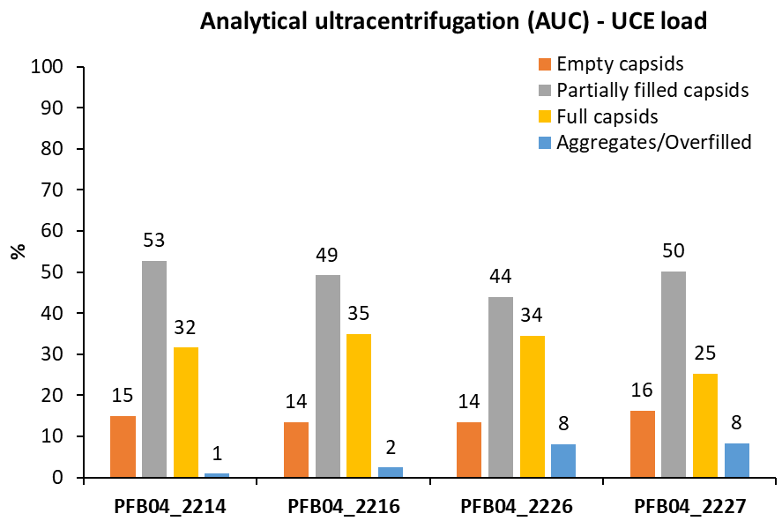
Ultracentrifugation (UCE) – AUC
Batch ID | PFB04_2212 | PFB04_2214 | PFB04_2216 | PFB04_2226 | PFB04_2227
Bioreactor FMB (200L SUB) | Pall | Sartorius | Sartorius | Pall | Sartorius
Salt addition at harvest | w/o NaCl | w/o NaCl | w/o NaCl | 135 mM NaCl | 135 mM NaCl
AUC does not reveal a clearer picture.
Higher percentage of aggregates/overfilled capsids with NaCl
PFB04_2212 (Pall): not determined
w/o NaCl
with NaCl

Slide 10
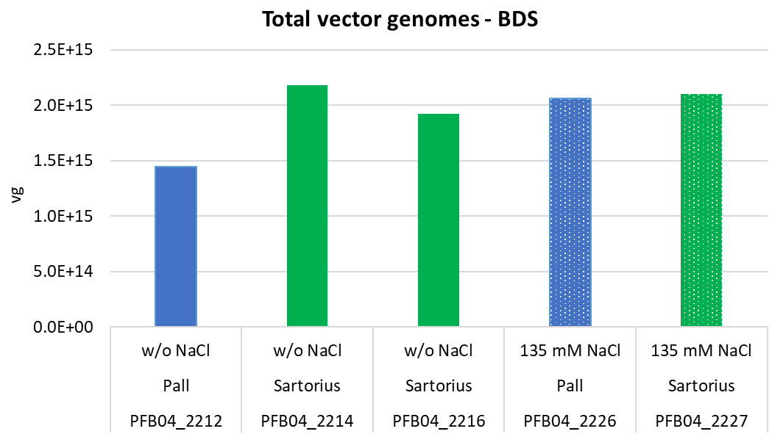
BDS – Vector Genome Yields
Batch ID | PFB04_2212 | PFB04_2214 | PFB04_2216 | PFB04_2226 | PFB04_2227
Bioreactor FMB (200L SUB) | Pall | Sartorius | Sartorius | Pall | Sartorius
Salt addition at harvest | w/o NaCl | w/o NaCl | w/o NaCl | 135 mM NaCl | 135 mM NaCl
Pall SUB: approx. 40% higher vg yield with NaCl
However, no yield improvement observed with Sartorius SUB
Vg yield (200L Scale): approx. 2.0E+15 vg or 1.0E+13 vg/L harvest

Slide 11
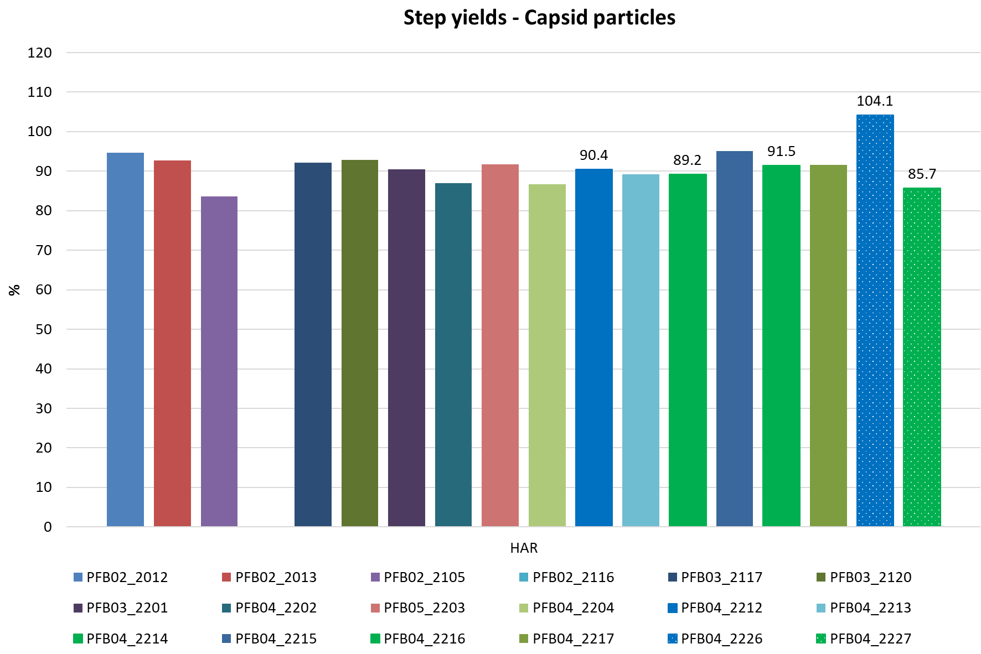
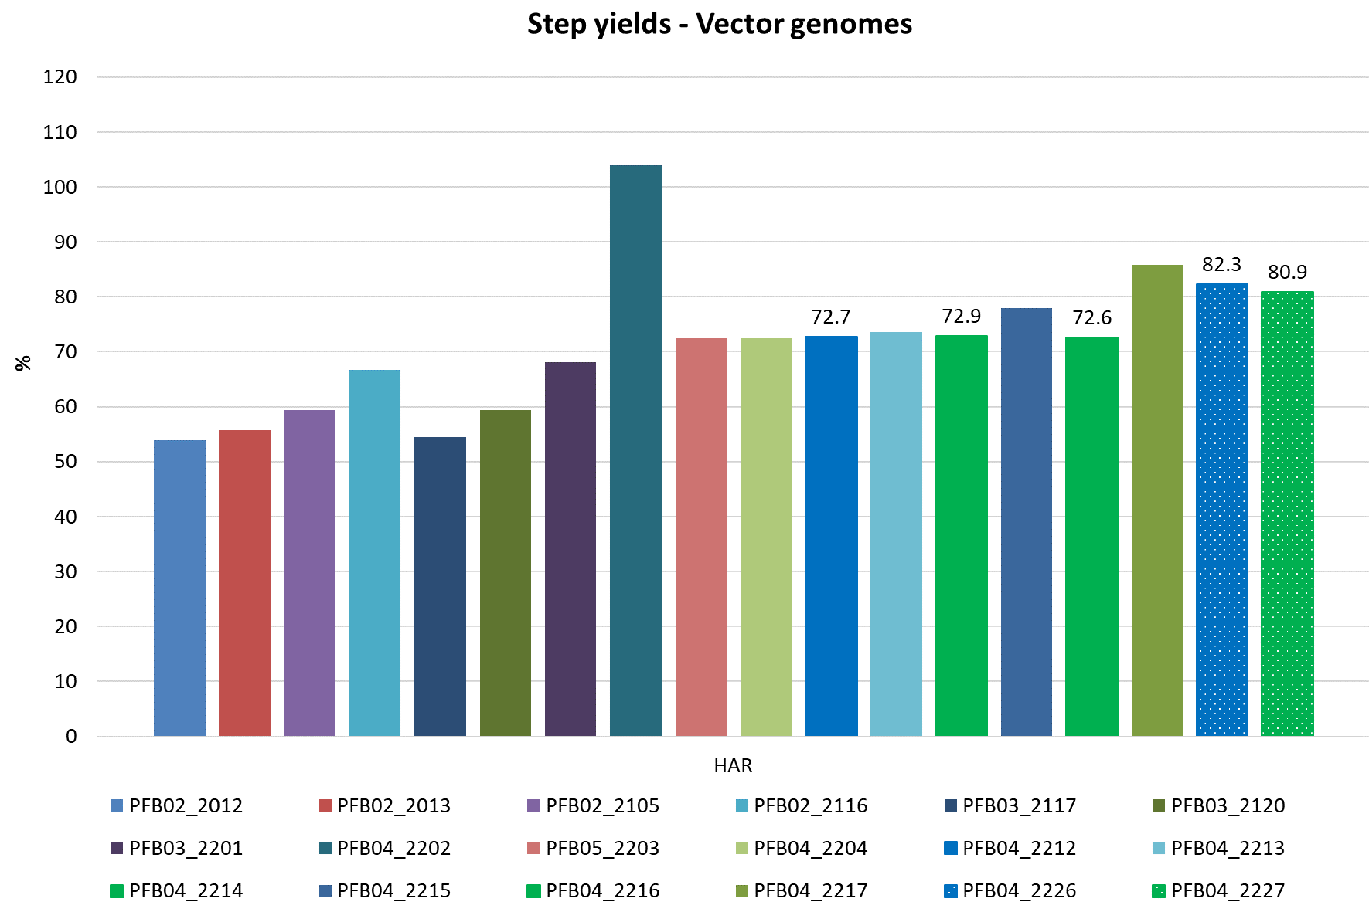
Harvest – Step Yields
ND
Similar cp step yields at HAR (depth filtration) – approx. 90%
However, positive trend of vg step yield observed already w/o NaCl addition (approx. 55% → 73%)
Potentially, higher vg step yield with NaCl addition (>80%)
➔ Is there a correlation with filter medium lot (filter charge)? ➔ Data collection in progress

Slide 12
Conclusion
NaCl addition at harvest:
Approx. 40% vg yield increase (BDS) observed with Pall SUB (n=1)
However, no vg yield increase observed in Sartorius SUB runs
No negative impact on residual HEK HCP
Potentially, higher amount of residual HEK DNA (probably also plasmid DNA)
Harvest vg step yield ranges from approx. 53 – 82%
Potential impact of depth filter lot; Correlation with Ca²⁺ (pos. charge of filter medium)?
➔ Data collection in progress

Slide 13

Questions ?

