Slide 1
Towards modular and distributed testbed design
Goran Scuric , Apr 2018

Slide 2
Outline
Quick demo
Deter experiment creation/swap flow
Quick comparison: Deter vs testbed
Server Model
FSM : Finite State Machine Design
Module communication model
Example Module Register FSM
Example: Office Master subFSM (module state)
Example: Experiment Agent FSM (part 1)
Web Access details
Current Demo Arch details
What else:

Slide 3
Deter/Emulab Experiment Control Flow
NS2 to XML
Parse.output
XML Parser
Parsed exp configuration
NS2 Spec
Virt Exp Creator
Parse.input
Constraints
MySQL data base tables
EIR = Experiment Internal Representation
CREATION PHASE
Instatntiate Experiment
ASSIGNER
MAPPER
Parse.input
Resources
SWAP IN PHASE

Slide 4
Quick comparison: Deter vs testbedGS
EIR = Experiment Internal Representation
Instatntiate Experiment
Virt Exp Creator
Constraints
MODULAR …. VS ?
Defined APIs. …. ?
GO lang …. VS Perl,python, etc
Module recovery/rebirth/resync …. VS ?
No specific host OS. …. FreeBSD only
Combination of physical,VM and docker. …. Physical & VmWare

Slide 5
Server Model
Functional module
Functional module
Functional module
Functional module
Office Master
One Central well known entity
Others reporting when ready to serve
Periodic refresh
Each module can request IDs of other modules it needs to provide full functionality
If not all modules are up, some module may offer only limited functionality
Office Master periodically sends KeepAlive to others with requested info
Any module can be reincarnated, other modules may need to resync with

Slide 6
FSM : Finite State Machine Design
Each module design (at the application level) as FSM
No RPC, No Locking/Busy-Wait of any kind
Entities communicate asynchronously via messages
To communicate with others module needs to learn their IDs (IPs, crypto, etc,…)
Each state has well defined response to Events and Messages Received
State X
Message/Event IN
Message/Event IN
Some Processing
(Timer setup)
(Messages OUT)
Some processing
(Messages OUT)
(Timer setup)
State Change
State Y
Timer Services

Slide 7
Module communication model
Receive Thread
Network
Functional Module
Send Thread
Currently:
Async, non locking
UDP based
Can be encrypted

Slide 8
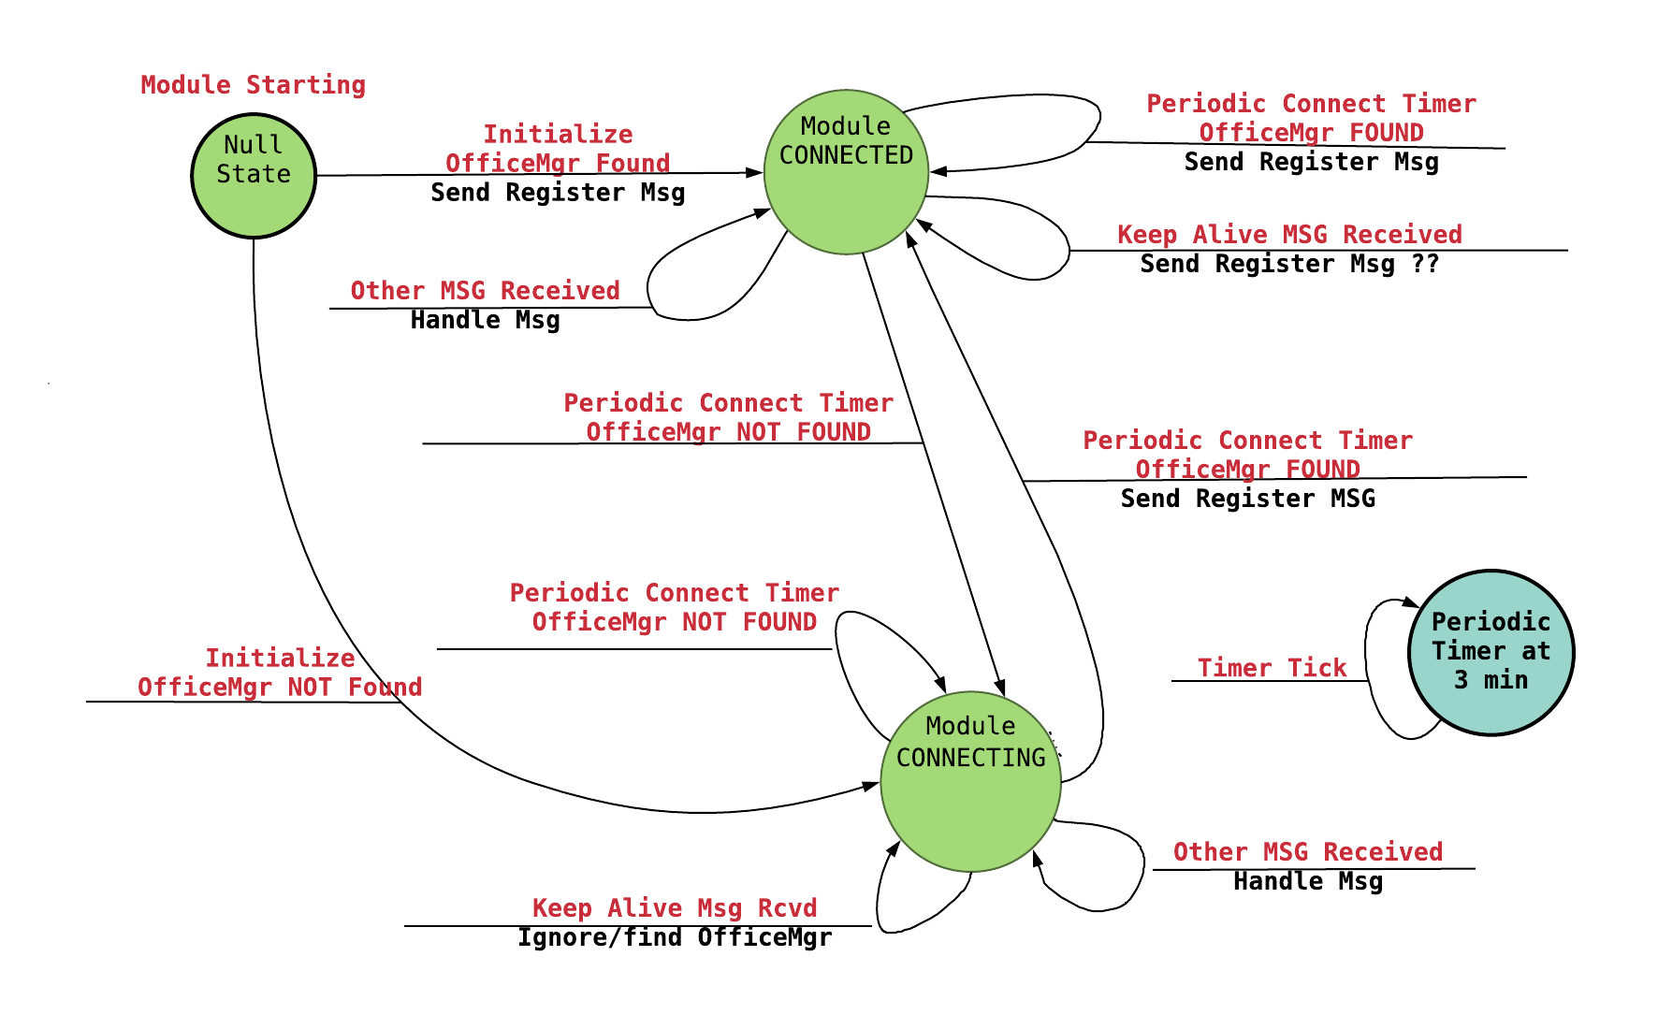
Example Module Register FSM

Slide 9
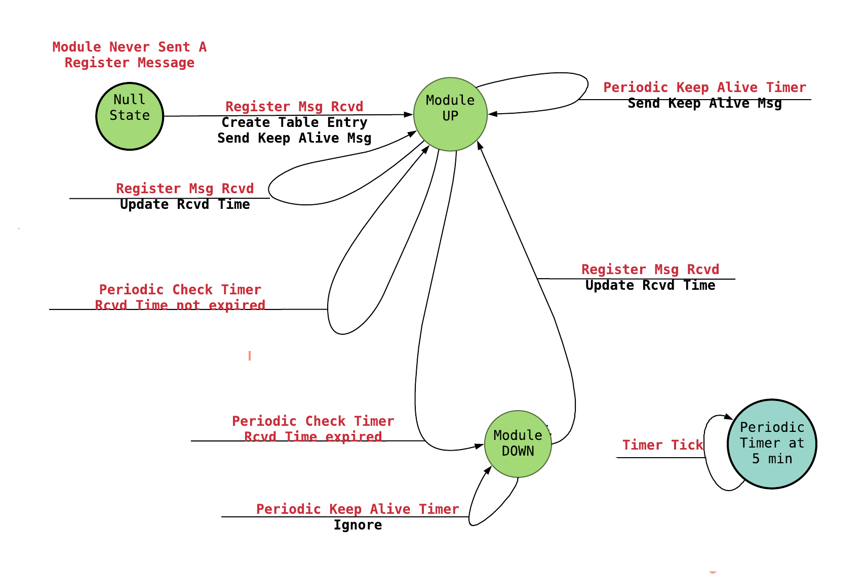
Eample: Office Master subFSM(module state)

Slide 10
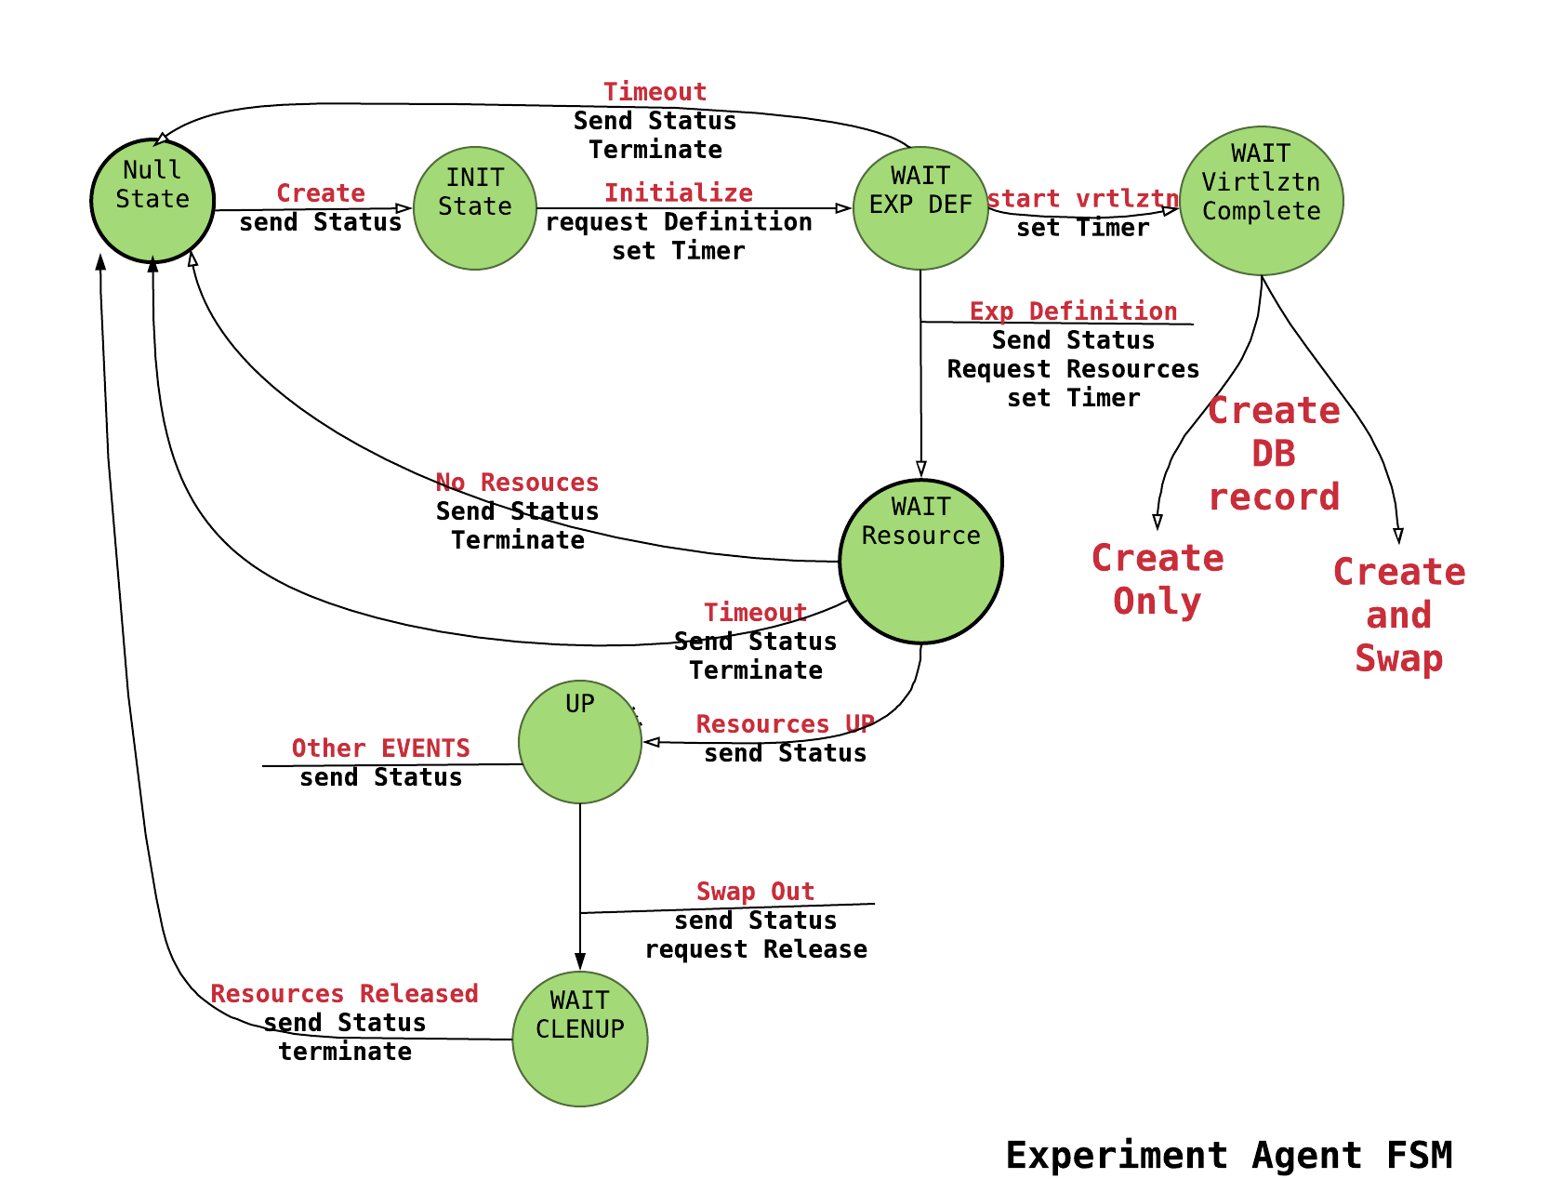
Example: Experiment Agent FSM (part 1)

Slide 11
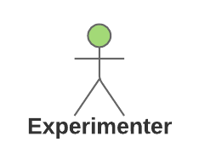
Web Access details
PROJECT DeterTest AGENT
EXP MASTER
mysql MASTER
Exp test1 Agent
dBase MASTER
Other db
Exp test2 Agent
WWW MASTER
NFS agent
NFS agent
EXP AGENT
NFS agent
Office Master
Environment
WEB SERVER
NFS MASTER
WEB PAGE

Slide 12
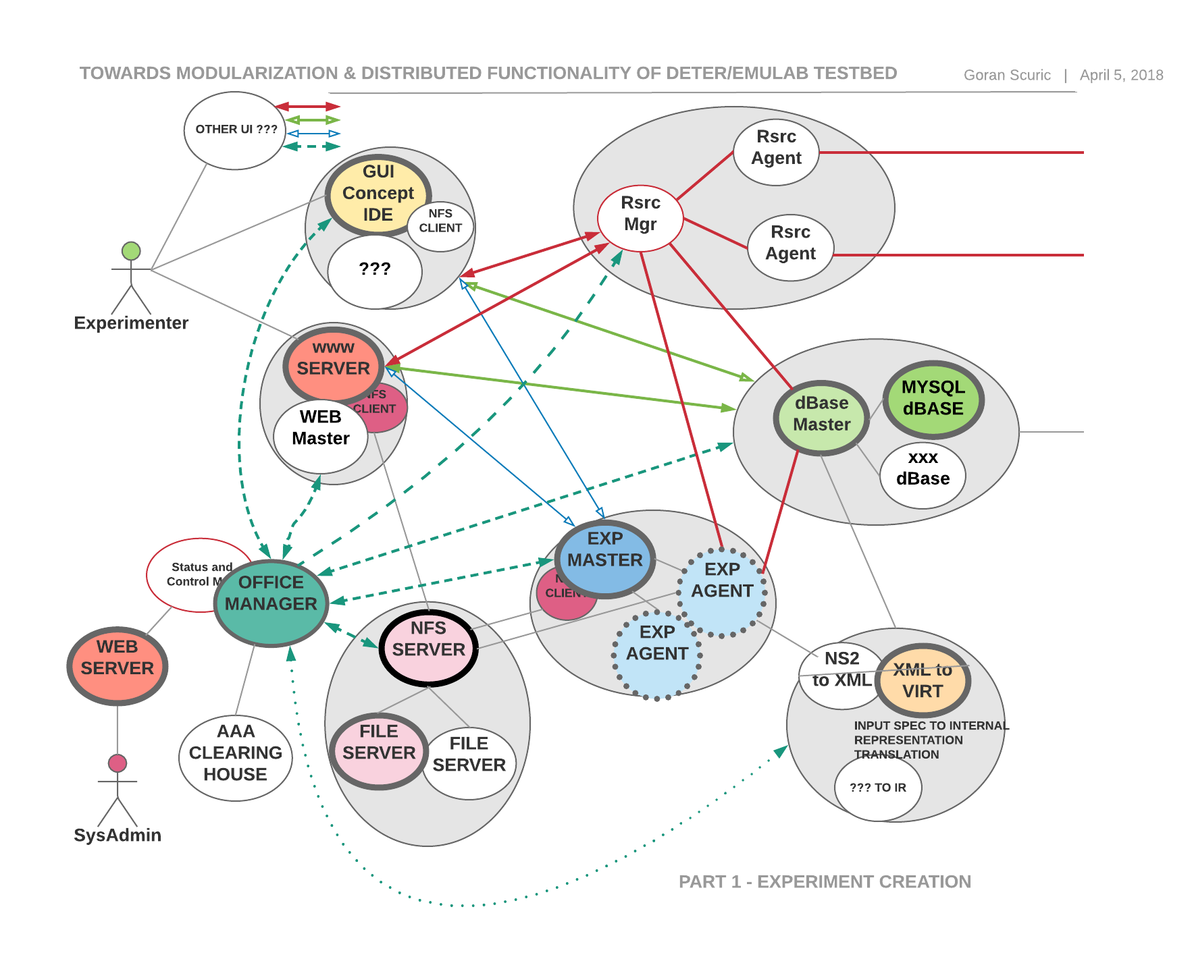
Current Demo Arch details

Slide 13
What else:
Authentication and Authorization
Clearing House
Data base API
More robust recovery system
Recode web server PHP into GO
NFS
Supervisor access – split web access
….

