Slide 1

Game Design from the Ground Up
Professors james & luke

Slide 2
Gaming Stats
Global gaming revenue in 2025 is projected to land between $189–237 billion, depending on whether hardware and subscriptions are included. The core themes:
Mobile continues to dominate, with over half the market focused there.
Digital transactions have eclipsed physical sales entirely.
Growth is moderate—around 3–5%, driven by mobile and notable premium console releases.
Challenges ahead include delayed blockbusters, elevated costs, and saturated mobile markets—but upcoming titles and hardware may provide recovery boosts.

Slide 3
Gaming Stats
Revenue Models & Monetization
Digital vs. Physical: ~95% of game sales are now digital.
In-app spend surged in regions like Japan, where in March 2025, iOS/Android combined spending totaled $6.79 B, with Japan accounting for 14.3%.
Advertising: U.S. gaming ad revenue is projected to grow to $8.6 B (+5.7% in 2025), though it remains under-indexed compared to overall digital ad growth.
Subscriptions & cloud: Fast-growing but smaller compared to software and mobile—these diversified streams are stabilizing industry income.

Slide 4






skills

Slide 5
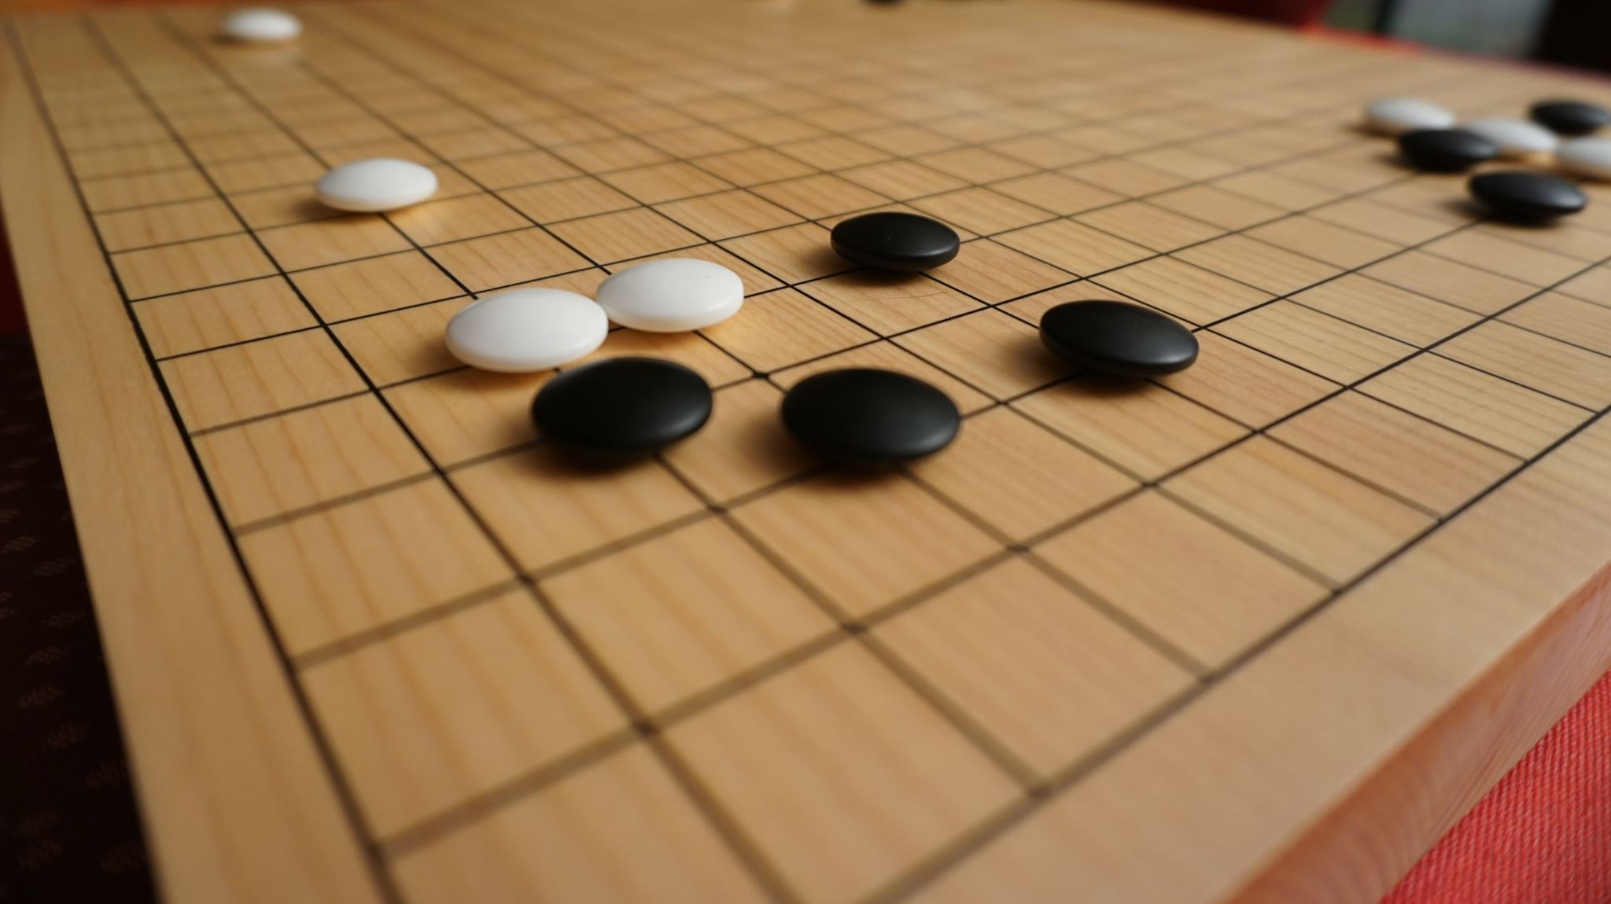
Game Design!

Slide 6
Game Design
Difficulty levels
Health
Treasure (XPs)
Game Levels/Scenes
Consider a LeaderBoard!
Use of platforms vs board style games
Designing for Consoles vs. PCs vs. Mobile vs. the Web!

Slide 7
Game Design con’t.
Design Tip:
Start simple → "Can you explain your game’s logic in 3 sentences?"
Tools: Flowcharts (draw.io) or pseudocode

Slide 8
Game Assets/Elements
Visual Assets: Sprites, 2D/3D models, textures, animations, UI icons.
Audio Assets: Sound effects, background music, voice lines.
Data Assets: Scripts, configuration files (JSON/XML), level designs.
Text Assets: Dialogue, item descriptions, localization files.

Slide 9
Game logic
Develop a “catchy” title. (Aligns to your actual game)
Make game fun & challenging!
Common Game Logic Patterns:
State Machines (🔄): Character states: idle → run → jump
Event Systems (🎯): "When ‘key collected’, unlock door."
Physics Simulation (🌍): Gravity, friction, collisions
Activity: "Design rules for a ‘tag’ game: How does ‘it’ get passed?"
https://gdevelop.io/

Slide 10
Game logic con’t.
Define Core Rules ⚖️
"What can/can’t the player do? (e.g., ‘Jump but not fly’)"
Example: Mario: Run + jump, but no shooting.
Conditional Actions 🔀
"If X, then Y" (e.g., "If player hits enemy → enemy loses health").
Feedback Loops 🔄
Rewards → Encourages behavior (e.g., collect coins → get power-ups).
Win/Loss States 🏆💀
Clear goals (e.g., reach flag = win, fall in pit = lose).

Slide 11
Character building
Establish roles
Making your own characters
-Character movements = character behaviors

Slide 12
Ideations
Define your Target market: All ages, young/old, logic lovers, strategists?
Suggestions?

Slide 13
Group on!
Establish roles
Working with Teams

Slide 14
Agendas
DAY 1
Getting to know one another
Learning to work with Visual Studio Code
Learn basic code routines -> HTML/CSS/JavaScript, Python
Working Gaming Demos!

