Slide 1
PAVLOVIA
nicoletta.simi@uni-tuebingen.de
Posner Task: https://gitlab.pavlovia.org/Nicoletta.simi/posner-task

Slide 2
Overview
The Pavlovia environment
Pavlovia: Docs
Pavlovia: Explore
Gitlab
Pavlovia: Dashboard
Pavlovia: Dashboard – Experiment page

Slide 3
The Pavlovia Environment
Pavlovia is:
A secure server to launch and run experiments
An experiment repository
Pavlovia and the library used to run experiments in browser (PsychoJS) are relatively young (2018).

Slide 4
Pavlovia Docs
To learn more about Pavlovia we can use the ‘Docs’ tab.

Slide 5
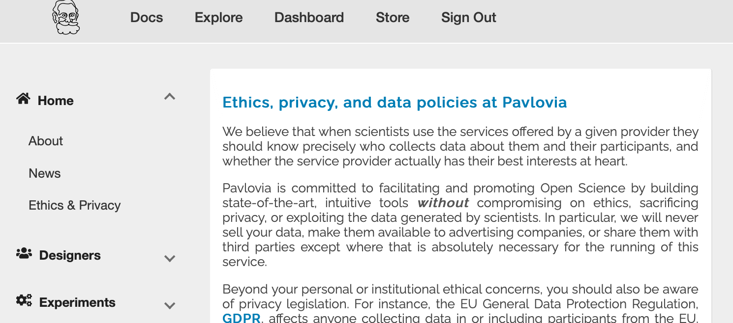
Pavlovia Docs
Here we can find important information that might be needed for ethics applications, documents on how to use the site (“Experiments”) and info on credits and licensing.

Slide 6
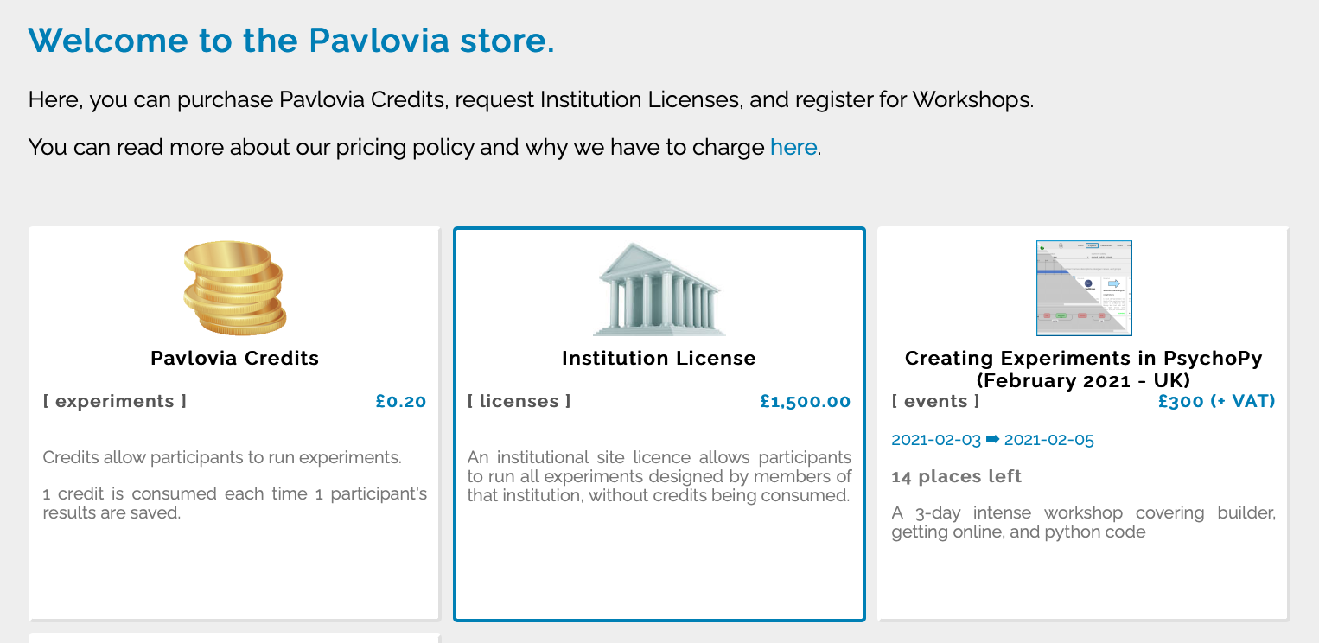
Pavlovia Docs
You can buy credits or site licences in the “Store” tab. Pavlovia accounts are free and you can pilot experiments for free.

Slide 7
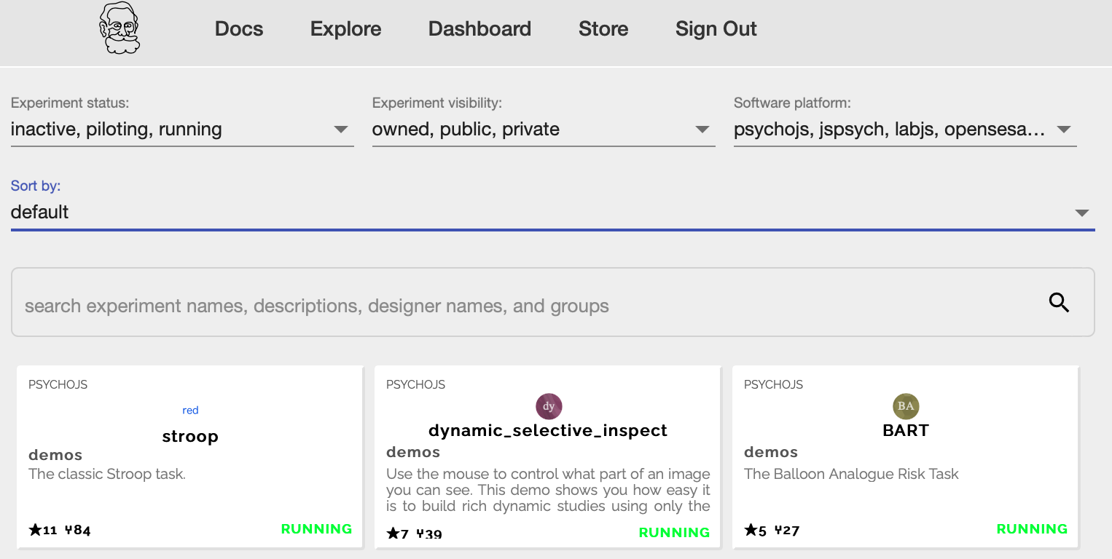
Pavlovia: Explore
Here in the Explore tab you can browse existing experiments.

Slide 8
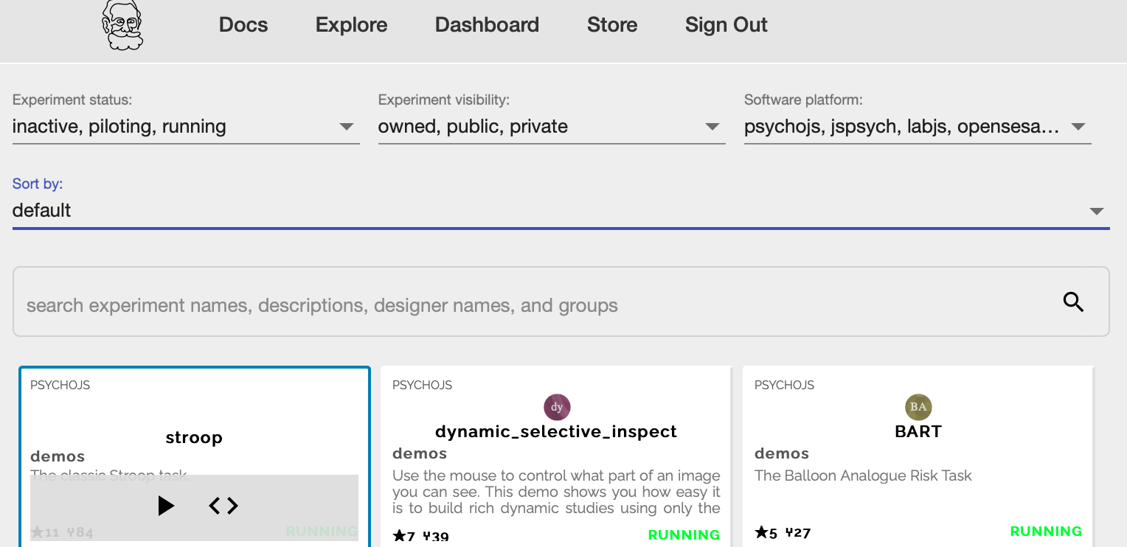
Pavlovia: Explore
You can search a task, see what state it is currently in (Inactive, piloting or running), and either launch the task or take a look at the code, by clicking on the <> symbol.

Slide 9
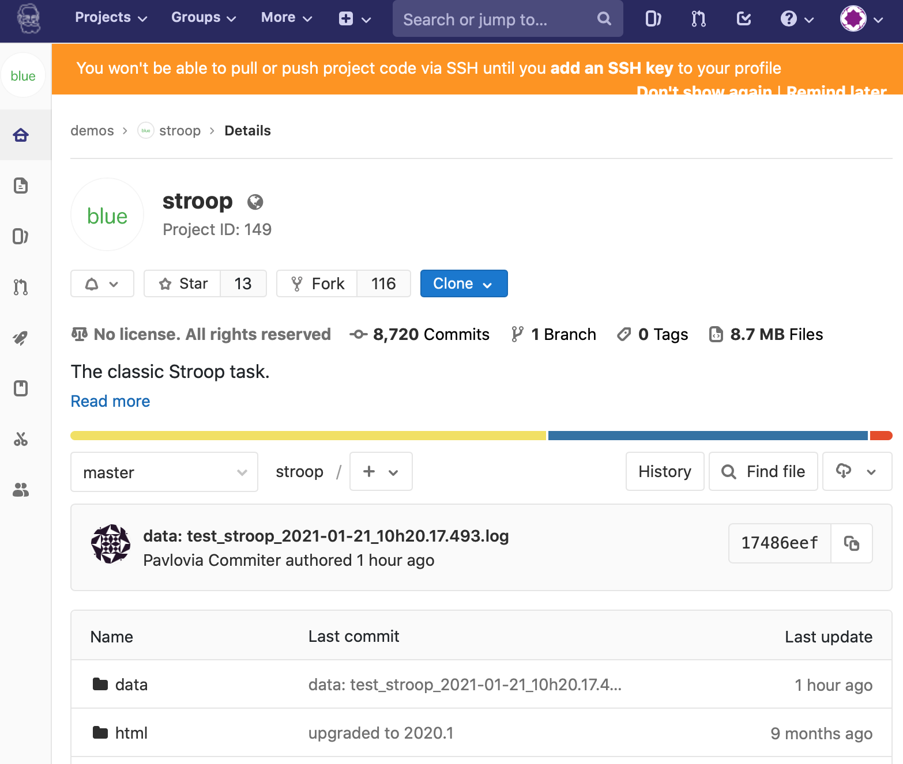
Gitlab
Viewing the code will take you to “Gitlab”. This allows similar features to GitHub.

Slide 10
Gitlab
Benefits of GitLab:
Fork existing projects
Version control
Add lab members to projects to work on the same files
Easy sharing of your task (open science)

Slide 11
Forking
If you find an experiment you like using ‘explore’ you can open the gitlab page by selecting ‘View code (<>)’
You can then fork that to make your own copy of the project to work from (you can make a copy for your own ‘namespace’ or add it to a group).

Slide 12
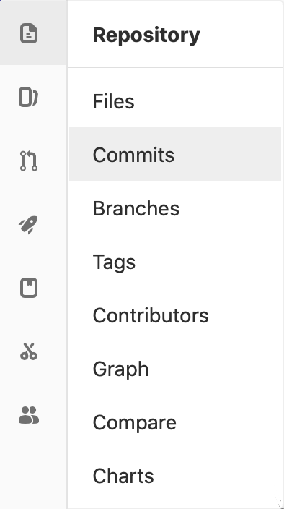
Version control
You can see when the last changes were made to the task by looking at the commit history.

Slide 13
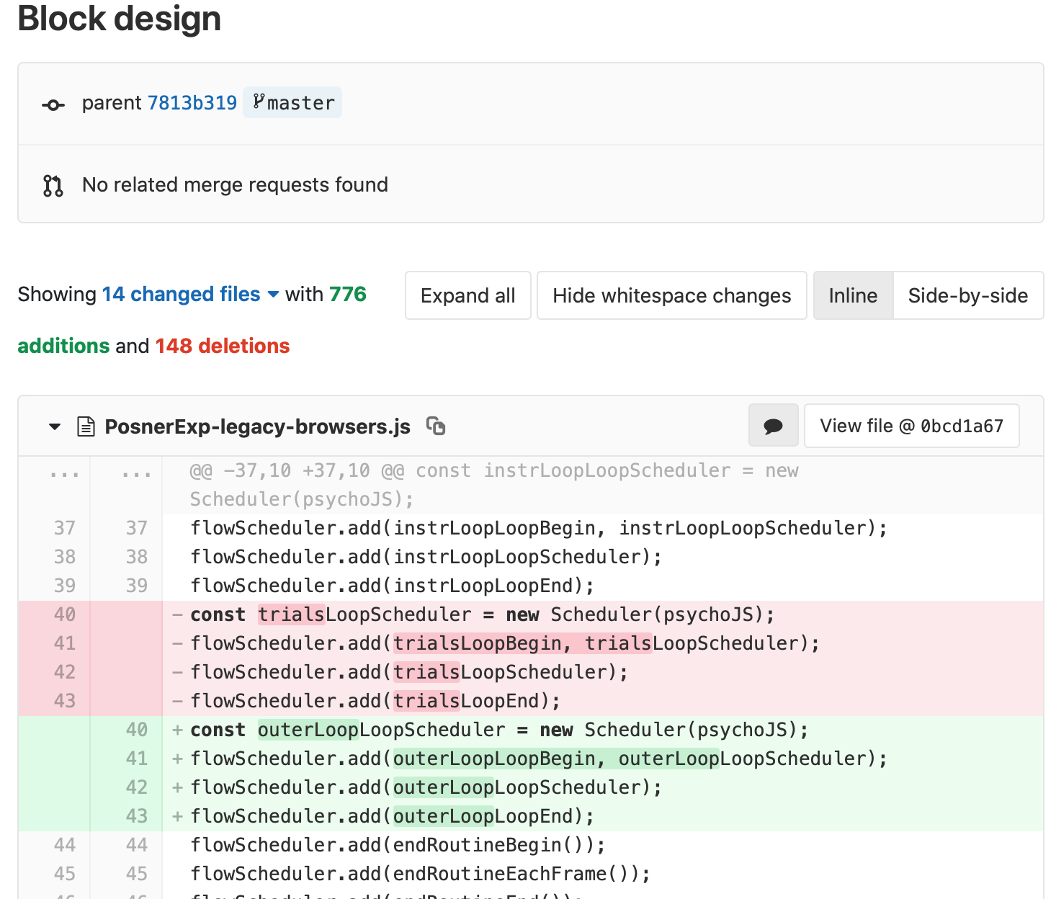
Version control
If you click on the change you can see deletions (in red) and insertions (in green)

Slide 14
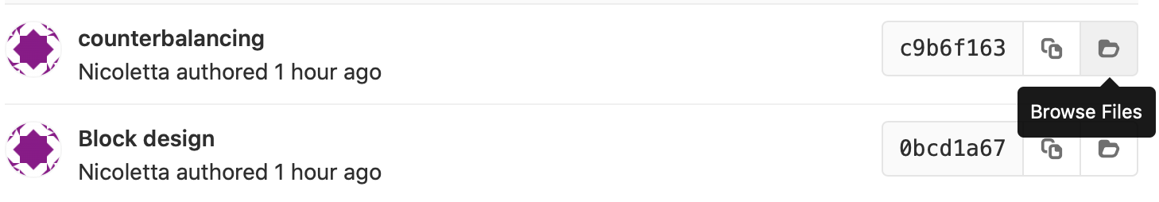
Version control
You can browse the repository at that point in history:
Imagine you have a working task, you then make a bunch of changes, and it doesn’t work. If you commit little and often you can easily revert those changes.

Slide 15
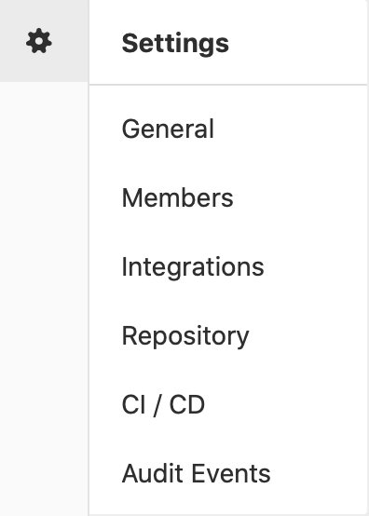
Adding team members
To add members to your own project, you can use the settings>members option where you can search and invite collaborators.

Slide 16
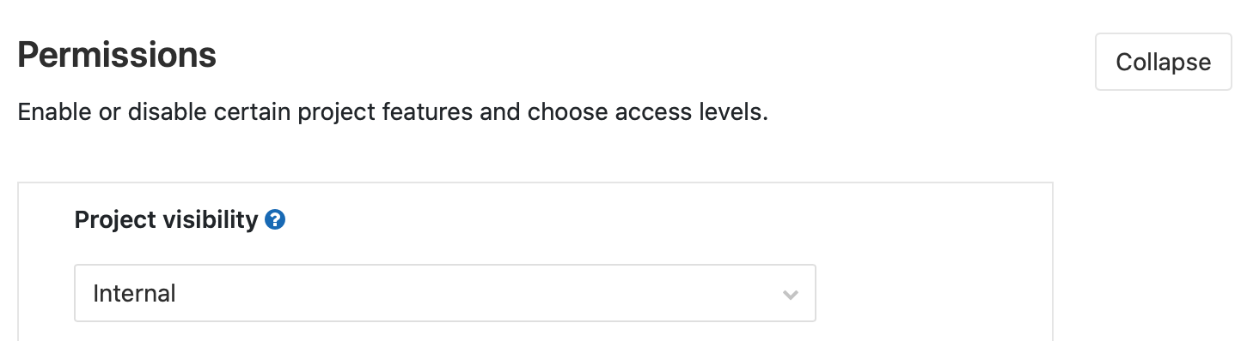
Making your task public
You can change the visibility of your task at any time under permissions.

Slide 17


Making your task public
One thing to note is that once you make your project “public” the data file stored there will also be public.
good as allows easy data sharing
Something to bare in mind if you are collecting protected data

